Slide 1
Understanding the Sensitivities of Cyclogenesis Using Adjoint Analysis Craig Oswald Dr. Michael Morgan University of Wisconsin – Madison Adjoint and Data Assimilation Workshop 2 July 2018

Slide 2
Motivation - How can an adjoint model and sensitivity analysis be applied in a study of explosive extratropical cyclogenesis? - Xynthia case study (Doyle et al., 2013) - Alpine lee cyclogenesis during ALPEX (Errico and Vukicevic, 1991)
Notes:
Xynthia, developed over the Atlantic. high impact event in Europe, flooding
Warm conveyer belt and atmospheric river
Alpine lee cyclogenesis in Alps, over Croatia
- Most sensitive to trough and ridge features

Slide 3
Goals and Methods - Understand how slight changes in certain dynamical variables, such as wind, temperature, or vorticity, have the ability to change a cyclogenesis event.

Slide 4
Goals and Methods - Understand how slight changes in certain dynamical variables, such as wind, temperature, or vorticity, have the ability to change a cyclogenesis event. - Complete a synoptic analysis of an explosive cyclogenesis event as simulated by the WRF model

Slide 5
Goals and Methods - Understand how slight changes in certain dynamical variables, such as wind, temperature, or vorticity, have the ability to change a cyclogenesis event. - Complete a synoptic analysis of an explosive cyclogenesis event as simulated by the WRF model - Use the WRF adjoint model to diagnose areas most sensitive to perturbations during development

Slide 6
Goals and Methods - Understand how slight changes in certain dynamical variables, such as wind, temperature, or vorticity, have the ability to change a cyclogenesis event. - Complete a synoptic analysis of an explosive cyclogenesis event as simulated by the WRF model - Use the WRF adjoint model to diagnose areas most sensitive to perturbations during development - Explore how a perturbed forecast deviates from the control simulation using synoptic diagnostics

Slide 7
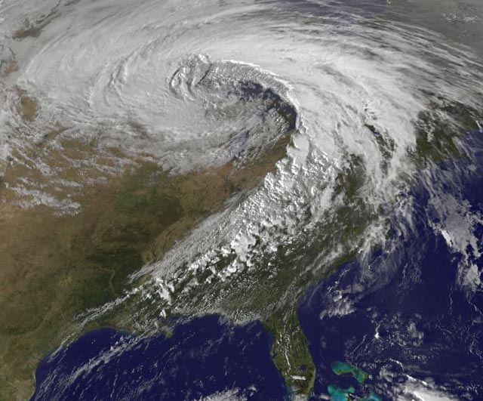
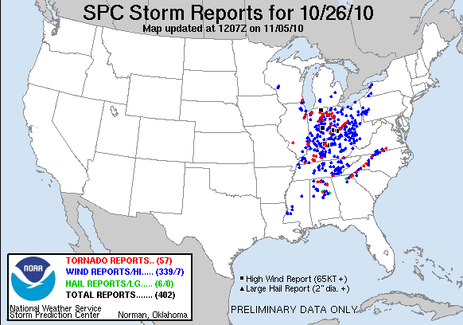
Case Study Background 24-26 October 2010 extratropical cyclone “Great Lakes Hurricane” - An observed low pressure of 955.2hPa through explosive cyclogenesis recorded in northern Minnesota at 2213UTC 26 Oct. - $18.5 million in damages - 80 tornadoes, 134 large hail, and 627 high wind reports over the three day period
Grumm, Richard H. “The Historic Storm of 24-26 October 2010”. NWS.
“SPC Storm Reports”. NOAA, 24-26 October 2010, http://www.spc.noaa.gov/climo/reports/101026_rpts.html. Accessed 23 May 2017.
Notes:
High wind: 65+ kts
Large hail: 2”+
$σ$ = standard deviations from normal. Anomalies calculated by $σ$ = (F-M)/$σ$(1)
F = value form the reanalysis data
M = mean for the specified date and time
$σ$(1) = value of 1 standard deviation
Jet feature perhaps related toTyphoon Megi present over west Pacific and
Stronger storm tracks across Great Lakes region in la nina. -1.7 nino index for (SON)

Slide 8
Case Study Background (Key Features of the Storm) During peak intensification: - Strong Pacific jet that was 4 to 5$σ$above normal - 500hPa height anomalies 2 to 3$σ$ below normal over western U.S. - Strong 850hPa southerly jet with winds 3 to 4$σ$ above normal ahead of the cold front - 1$σ$ warmer temperature anomaly throughout the warm sector
Grumm, Richard H. “The Historic Storm of 24-26 October 2010”. NWS.
Notes:
High wind: 65+ kts
Large hail: 2”+
$σ$ = standard deviations from normal. Anomalies calculated by $σ$ = (F-M)/$σ$(1)
F = value form the reanalysis data
M = mean for the specified date and time
$σ$(1) = value of 1 standard deviation
Jet feature perhaps related toTyphoon Megi present over west Pacific and
Stronger storm tracks across Great Lakes region in la nina. -1.7 nino index for (SON)

Slide 9
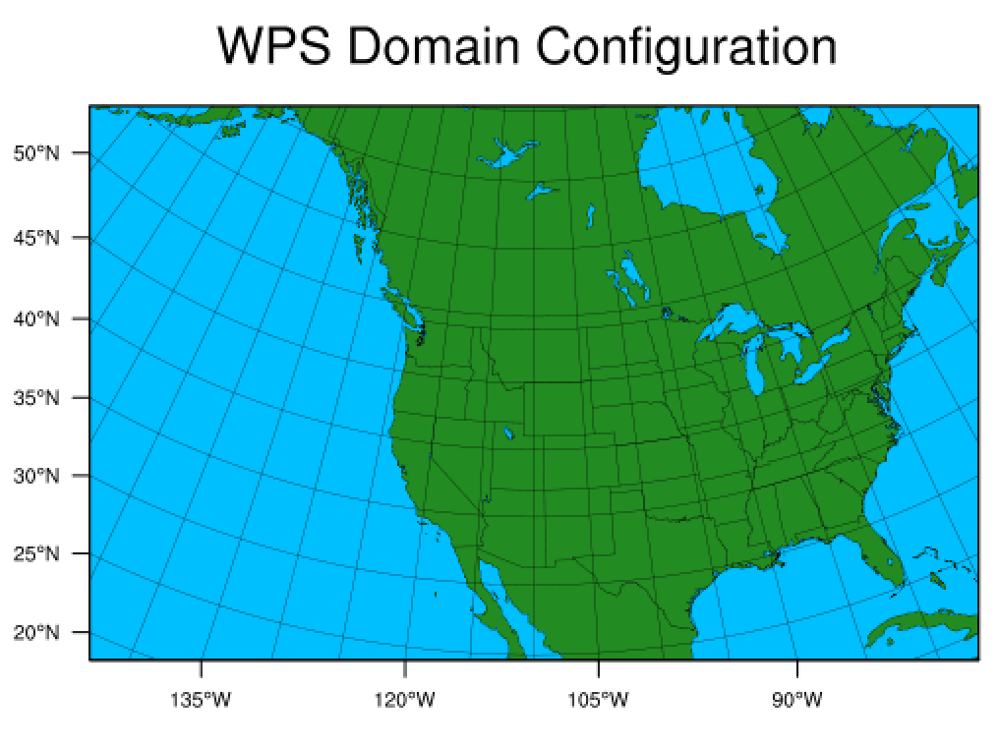
Synoptic Analysis (NWP Simulation)
48 hour WRF-ARW V3.8.1 simulation beginning 0000UTC 25 October 2010
1$°$ x 1$°$ grid resolution 6-hourly NCEP Operational Model Global Tropospheric Analysis Data
30 km model grid spacing
41 equally spaced vertical eta levels
Notes:
NCEP operational model global tropospheric analysis data is same as used to initialize GFS, but with more observations.

Slide 10
Synoptic Analysis (NWP Simulation) - SLP, 2m temp (C), 10m wind (kts)

Slide 11
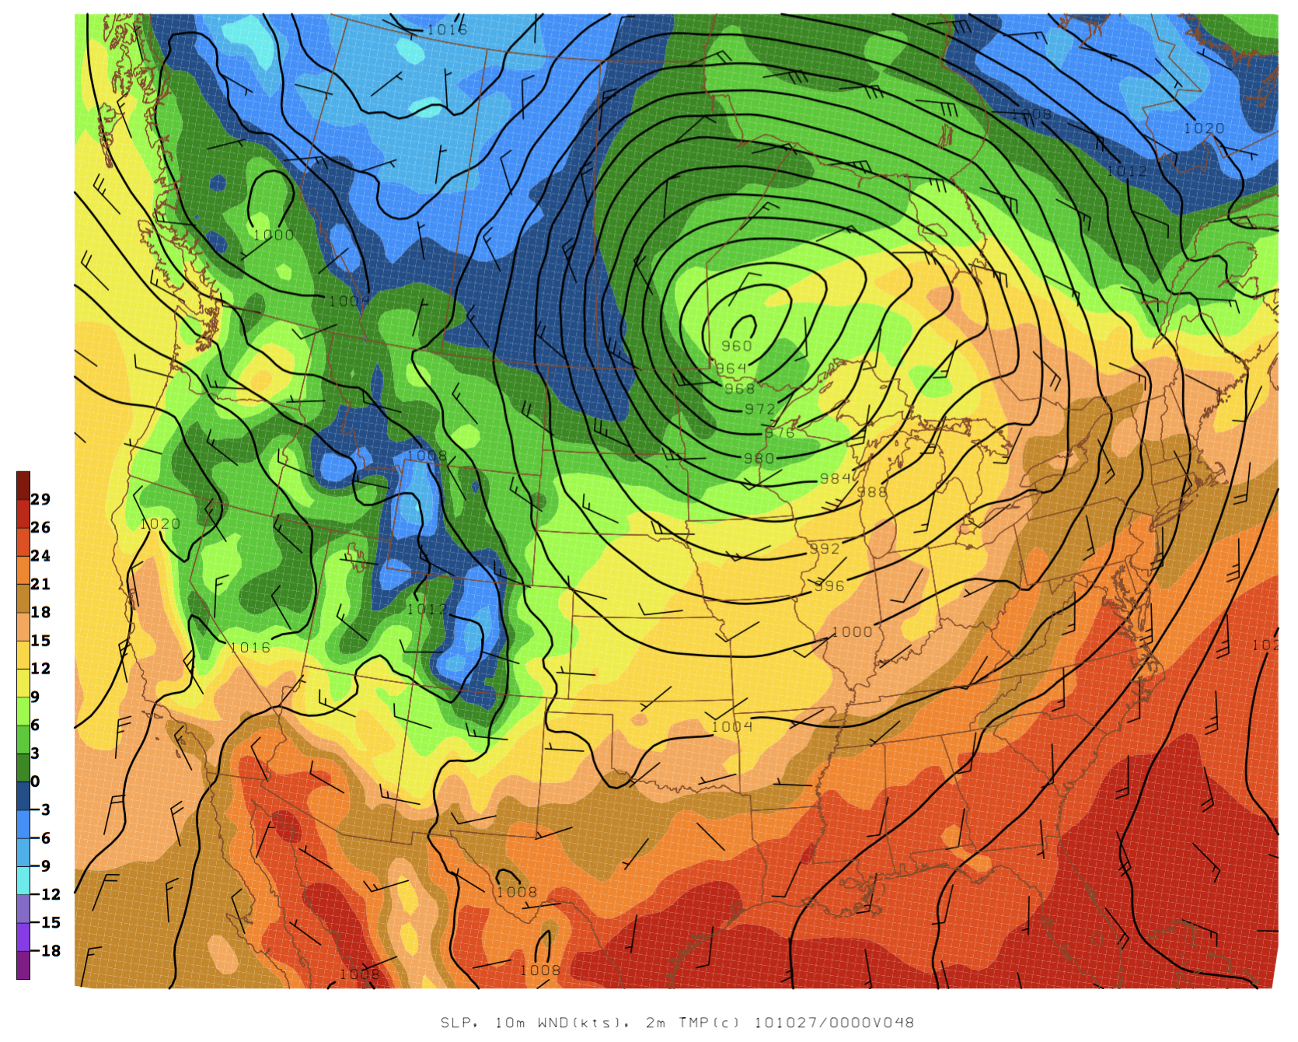
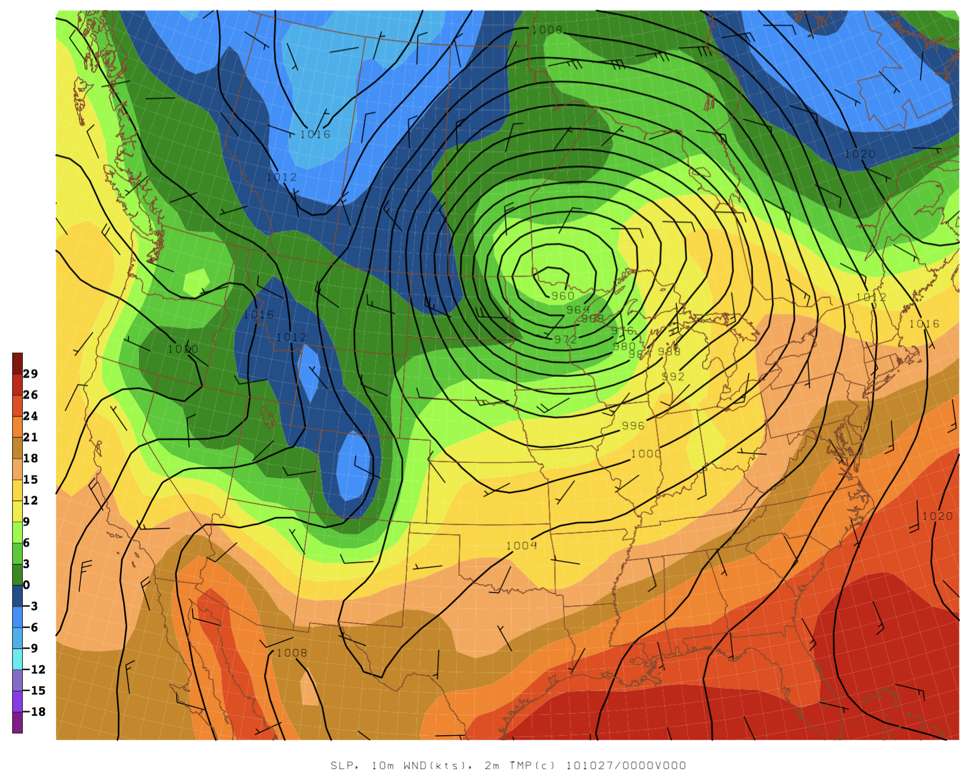
Synoptic Analysis (NWP Simulation) - SLP, 2m temp (C), 10m wind (kts) → 0000UTC 27 Oct./F48
WRF Simulation: 958.7hPa SLP minimum
NCEP Analysis Data: 957.7hPa SLP minimum
Notes:
960hPa low produced by WRF
955hPa low observed

Slide 12
Synoptic Analysis (NWP Simulation) - How is development of the cyclone sensitive to changes in the wind at the jet level? - How is development of the cyclone sensitive to changes in the wind and temperature at mid-levels?

Slide 13
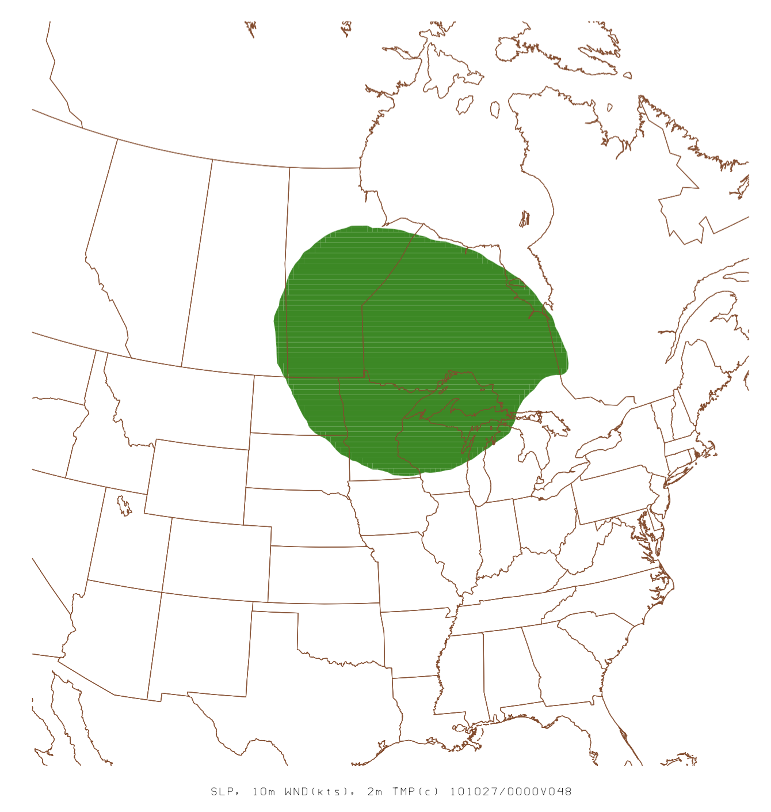
Adjoint Analysis (Response Function)
Define ‘R’ to be minus the dry air mass of a vertical column of the atmosphere, as measured at the surface
‘R’ is area enclosed within the 988hPa SLP contour at the final forecast time (F048)
Notes:
-MU = Pb-Pt (pressure at bottom of model space minus pressure at top of model space)
- Using F018 for adjoint analysis early time. That’s 5 hours before the 2nd surface cyclone (Kansas) develops.

Slide 14
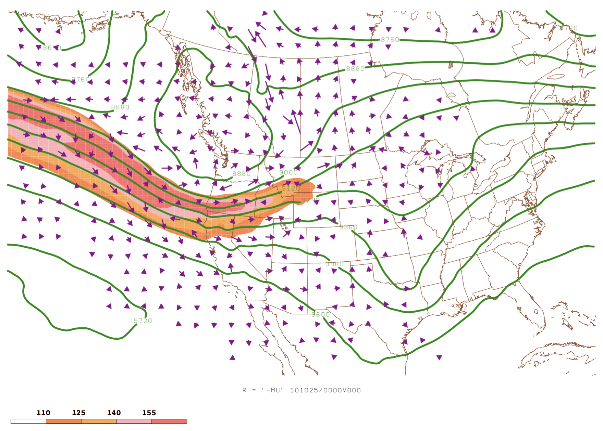
Adjoint Analysis (Sensitivity analysis) - Adjoint Simulation → 0000UTC 25 Oct./F00
300hPa height (m)
Wind (kts, peach fill)
Sensitivity to wind vectors

Slide 15
Adjoint Analysis (Sensitivity analysis) - Adjoint Simulation → 0000UTC 25 Oct./F00
300hPa height (m)
Wind (kts, peach fill)
Sensitivity to wind vectors

Slide 16
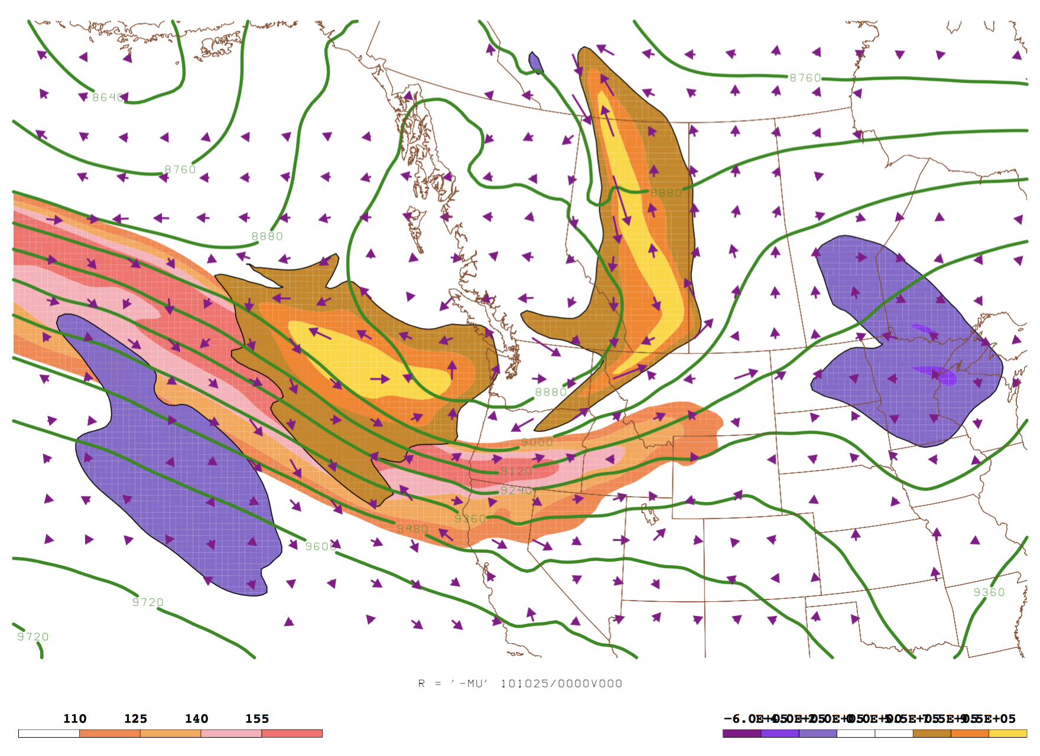
Adjoint Analysis (Sensitivity analysis) - Adjoint Simulation → 0000UTC 25 Oct./F00
- 300hPa height (m)
- Wind (kts, peach fill)
- Sensitivity to relative vorticity
- Sensitivity to wind vectors
$$(+)$$
$$(+)$$
$$\left(−\right)$$
$$\left(−\right)$$
-6 -4 -2 0 5.5 7.5 9.5
Notes:
Deepen trough
Increase ridge downstream.
- Shown by errico and vuckicevic that most sensitivity related to enhancement of trough ridge
Narrow and increase speed of jet
Focus on the jet region

Slide 17
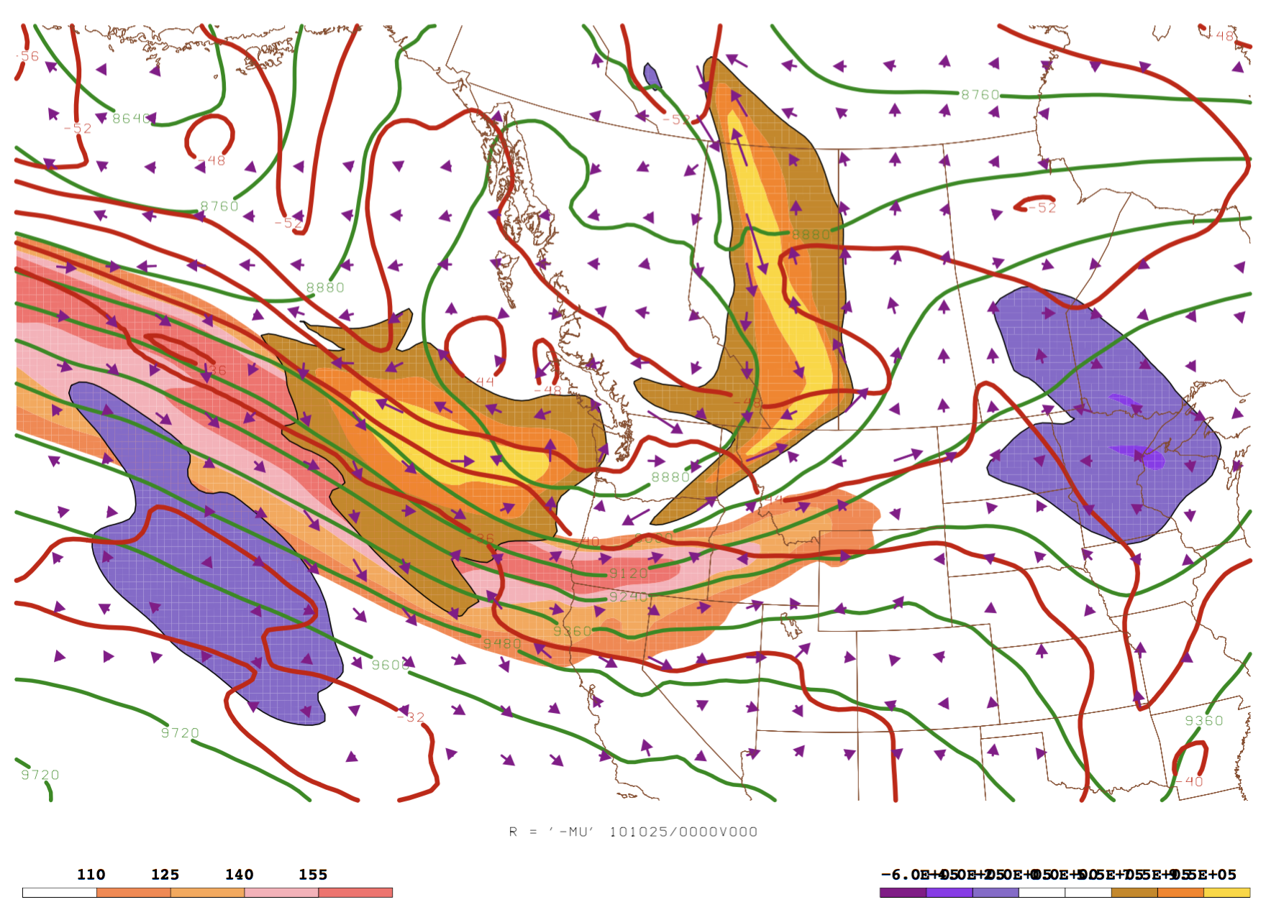
Adjoint Analysis (Sensitivity analysis) - Adjoint Simulation → 0000UTC 25 Oct./F00
- 300hPa height (m)
- Wind (kts, peach fill)
- Sensitivity to relative vorticity
- Sensitivity to wind vectors
- Temperature (C)
$$(+)$$
$$(+)$$
$$\left(−\right)$$
$$\left(−\right)$$
-6 -4 -2 0 5.5 7.5 9.5
Notes:
Going to examine what adjoint can tell us about PV perturbations

Slide 18
Adjoint Analysis (Sensitivity analysis) - Adjoint Simulation → 0000UTC 25 Oct./F00
- 300hPa height (m)
- Wind (kts, peach fill)
- Sensitivity to relative vorticity
- Sensitivity to wind vectors
- Resultant wind enhancement vectors
- Temperature (C)
$$(+)$$
$$(+)$$
$$\left(−\right)$$
$$\left(−\right)$$
-6 -4 -2 0 5.5 7.5 9.5
Notes:
1) Cold air advection into jet
2) Enhance subsidence of stratospheric high PV air into the jet and troposphere
3) Help increase the strength of the trough

Slide 19
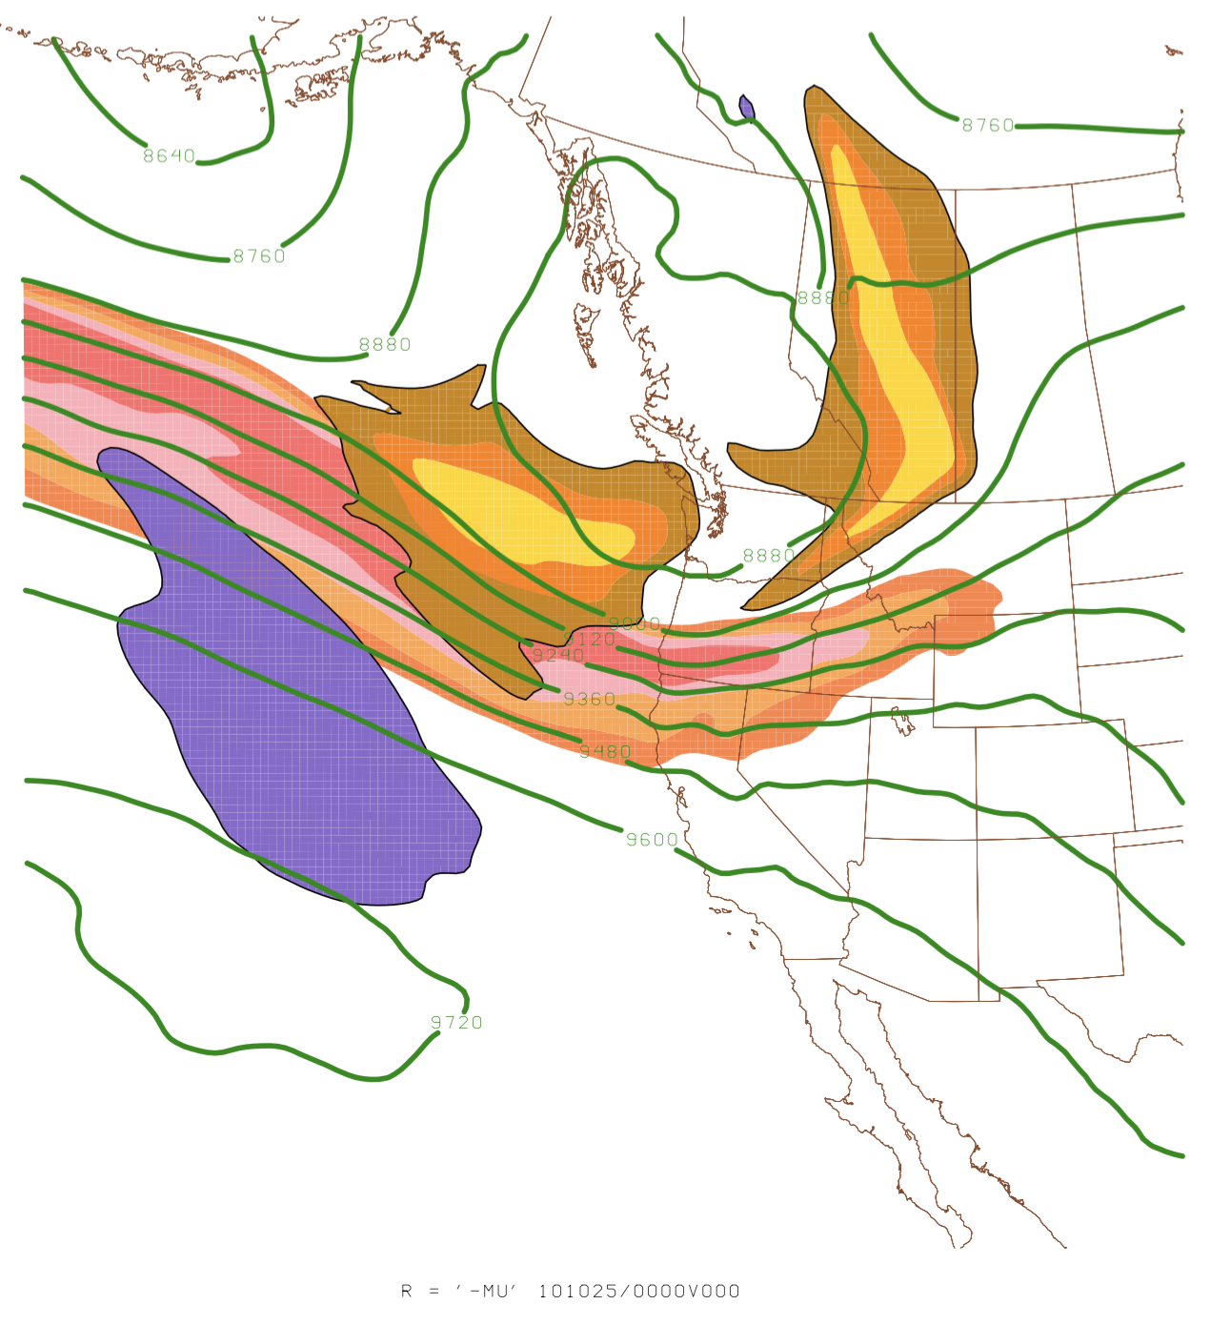
Adjoint Analysis (Sensitivity analysis) - Adjoint Simulation: Location of Cross Section→ 0000UTC 25 Oct./F00
A
B

Slide 20
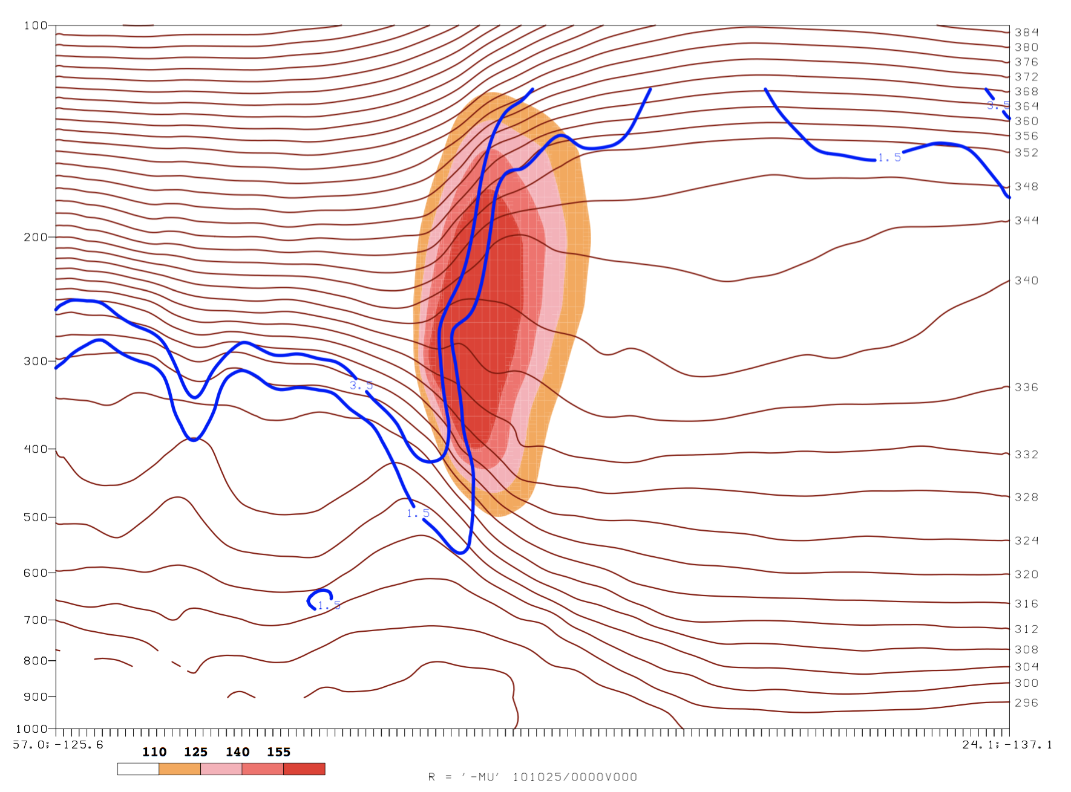
Adjoint Analysis (Sensitivity analysis) - Adjoint Simulation: Cross Section → 0000UTC 25 Oct./F00
Wind (kts, peach fill)
1.5 and 3.5 PVU surfaces
Potential temp
A
B

Slide 21
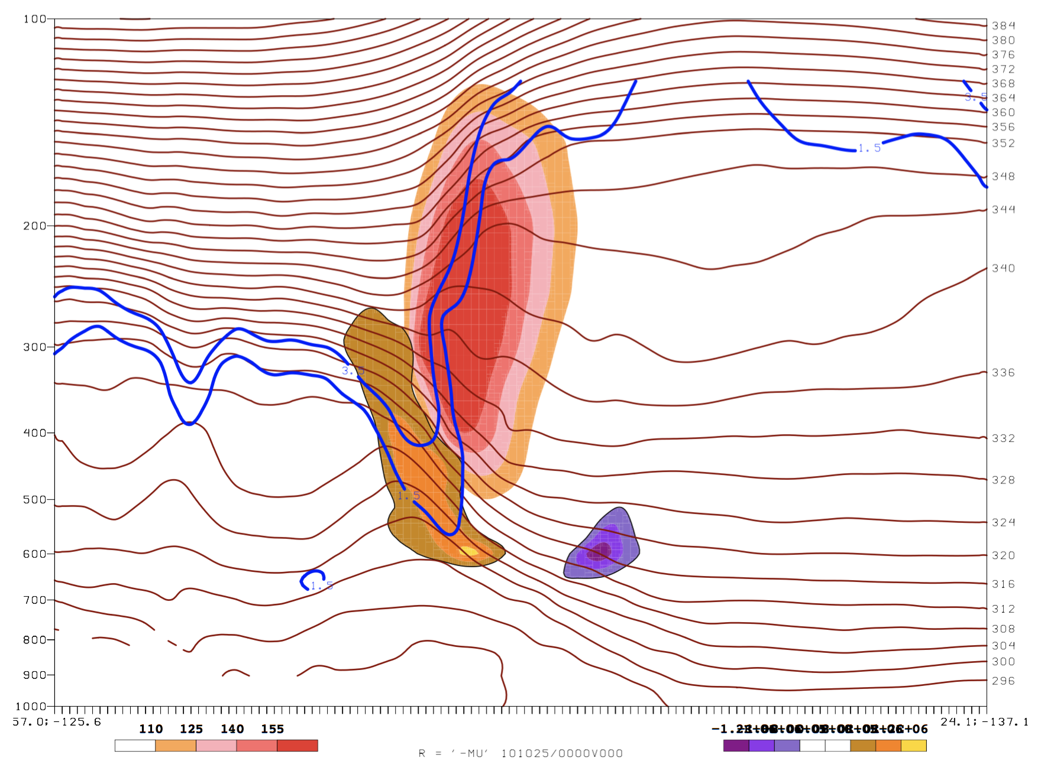
Adjoint Analysis (Sensitivity analysis) - Adjoint Simulation: Cross Section → 0000UTC 25 Oct./F00
Wind (kts, peach fill)
1.5 and 3.5 PVU surfaces
Potential temp
Sensitivity to vorticity (anticyclonic: purple fill, cyclonic: gold fill)
A
-12 -10 -8 0 8 10 12
B

Slide 22
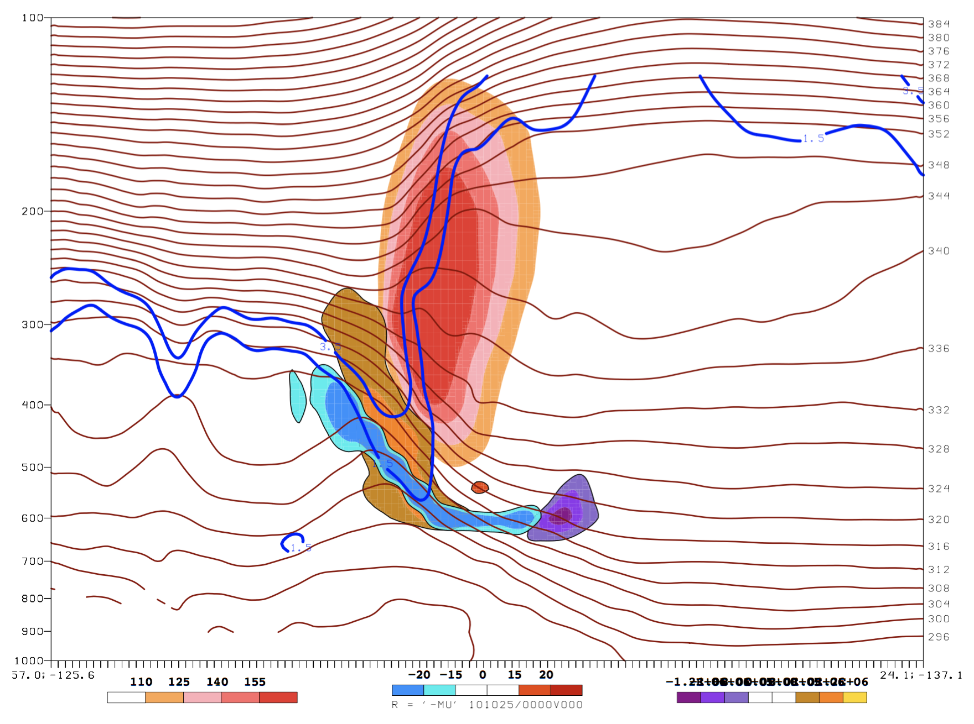
Adjoint Analysis (Sensitivity analysis) - Adjoint Simulation: Cross Section → 0000UTC 25 Oct./F00
Wind (kts, peach fill)
1.5 and 3.5 PVU surfaces
Potential temp
Sensitivity to vorticity (anticyclonic: purple fill, cyclonic: gold fill)
Sensitivity to temp. (cold: blue fill, warm: red fill)
A
-12 -10 -8 0 8 10 12
B

Slide 23
Adjoint Analysis (Sensitivity analysis) - Adjoint Simulation: Cross Section → 0000UTC 25 Oct./F00
Interpretation
Examine this in the context of Ertel’s PV equation
$$q=−g(ζ+f)∙\frac{∂θ}{∂p}$$
A
-12 -10 -8 0 8 10 12
B
Notes:
!) An enhancement of horizontal temperature gradient, as indicated by sensitivity to temperature below the jet
2) Can indicate an even stronger jet, and a resultant increase in cyclonic vorticity production along the cyclonic shear side of the jet
3) This is what produces the cyclonic vorticity to enhance PV perturbation.

Slide 24
Adjoint Analysis (Sensitivity analysis) - Adjoint Simulation: Cross Section → 0000UTC 25 Oct./F00
Interpretation
Patterns hint that an even stronger jet will further enhance development of the cyclone
Examine this in the context of Ertel’s PV equation
$$q=−g(ζ+f)∙\frac{∂θ}{∂p}$$
A
-12 -10 -8 0 8 10 12
B

Slide 25
Motivation
Let’s now calculate optimal perturbations to wind and temperature to decrease the simulated cyclone by 1hPa.
→ Max u-wind perturbation: 0.35m/s
→ Max v-wind perturbation: 0.44m/s
→ Max temperature perturbation: 0.37$°$C

Slide 26
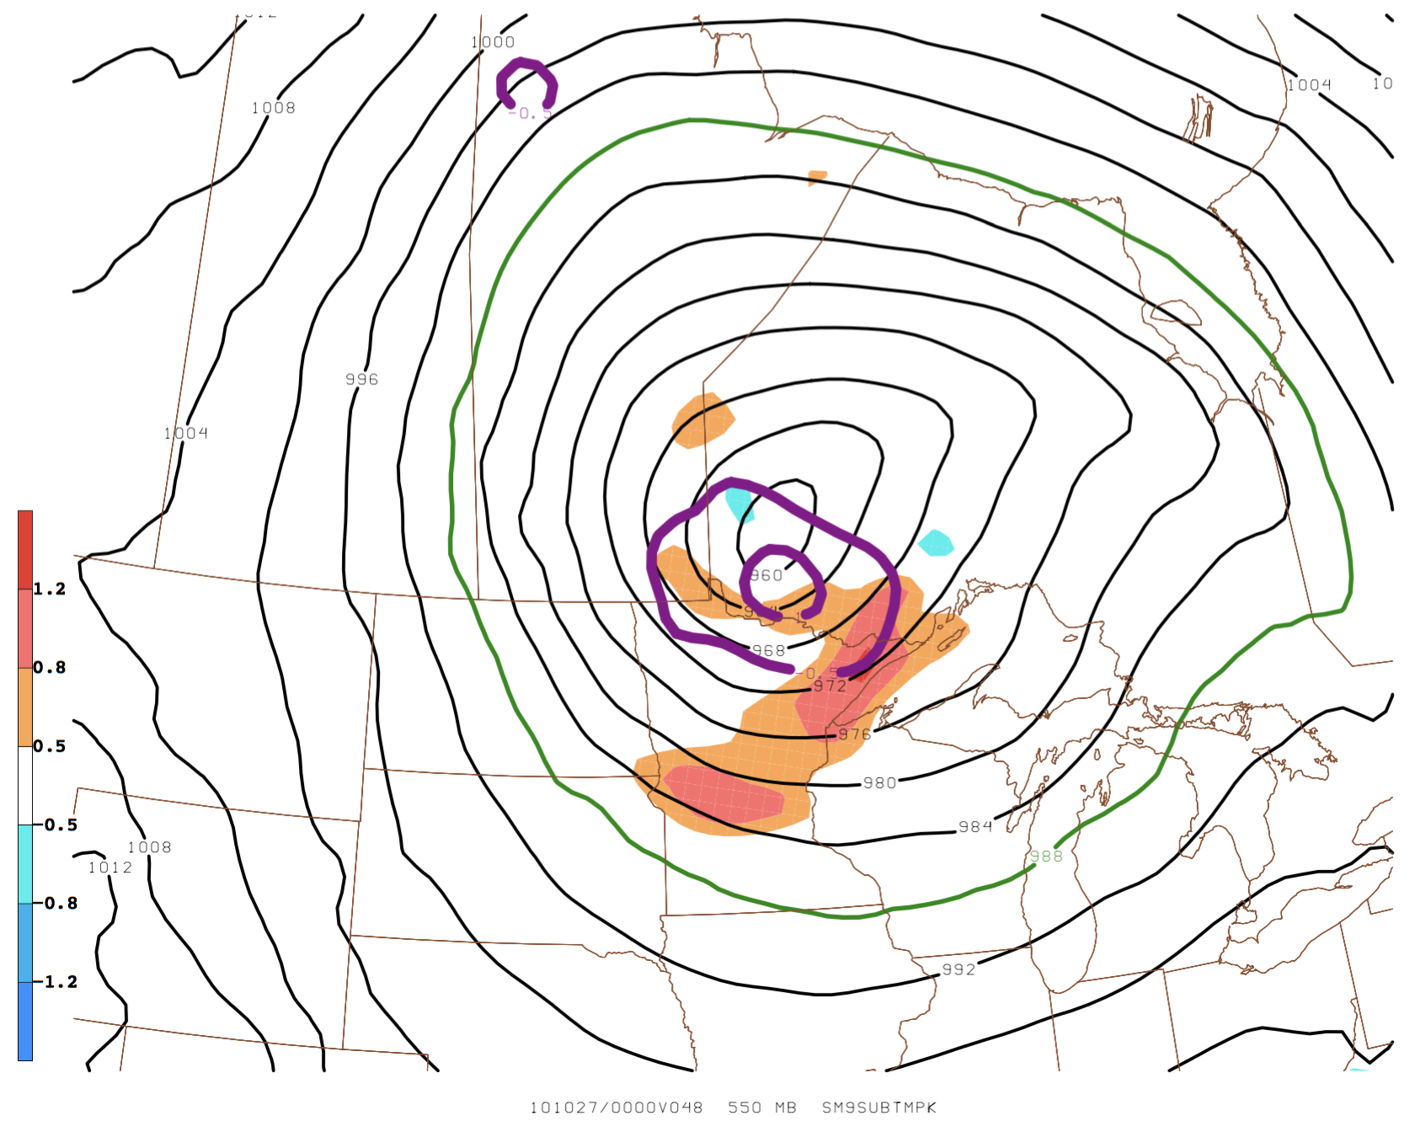
Perturbation Analysis (Perturbed NWP Simulation) - Perturbation SLP, 2m temp(C)→ 0000UTC 27 Oct./F48
→ 0.97hPa decrease in SLP and slight shift south, max decrease of 1.42hPa
→ 1.4$°$C warmer temperature perturbation near the cyclone center, indicating enhancement of warm seclusion (at 550hPa)

Slide 27
Motivation
Was there enhanced mid-level vorticity?
1) Increase of PV at the tropopause fold
2) Advection of PV enhances height falls at mid-levels
3) Enhancement of relative vorticity at mid-levels due to a deeper
trough

Slide 28
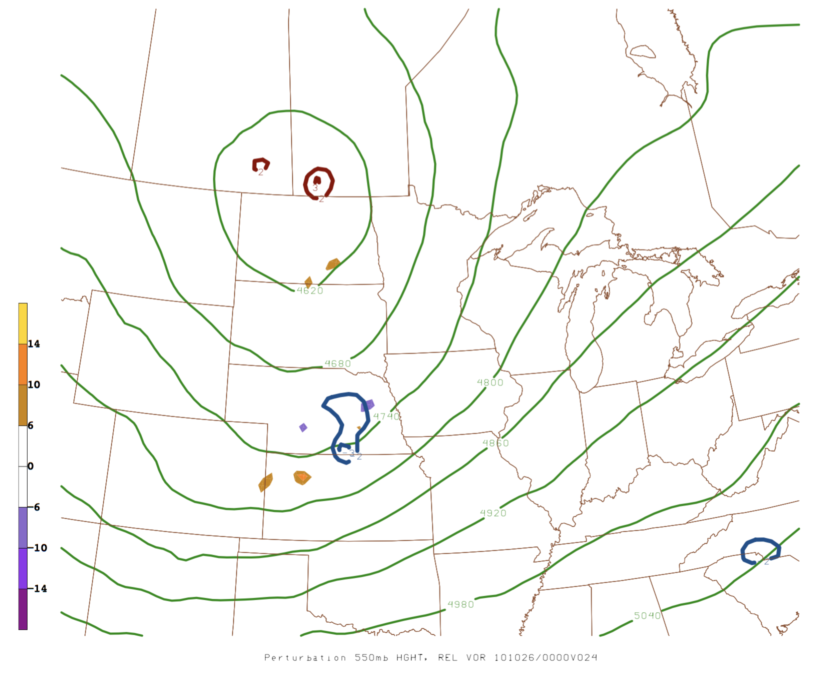
Perturbation Analysis - Perturbed NWP Simulation → 0000UTC 26 Oct./F24
- 550hPa relative vorticity perturbation (increased: yellow fill, decreased: purple fill)
- 550hPa height perturbations (lower: blue contours, higher: red contours)
- 550hPa height (control: green contours)
L
L

Slide 29
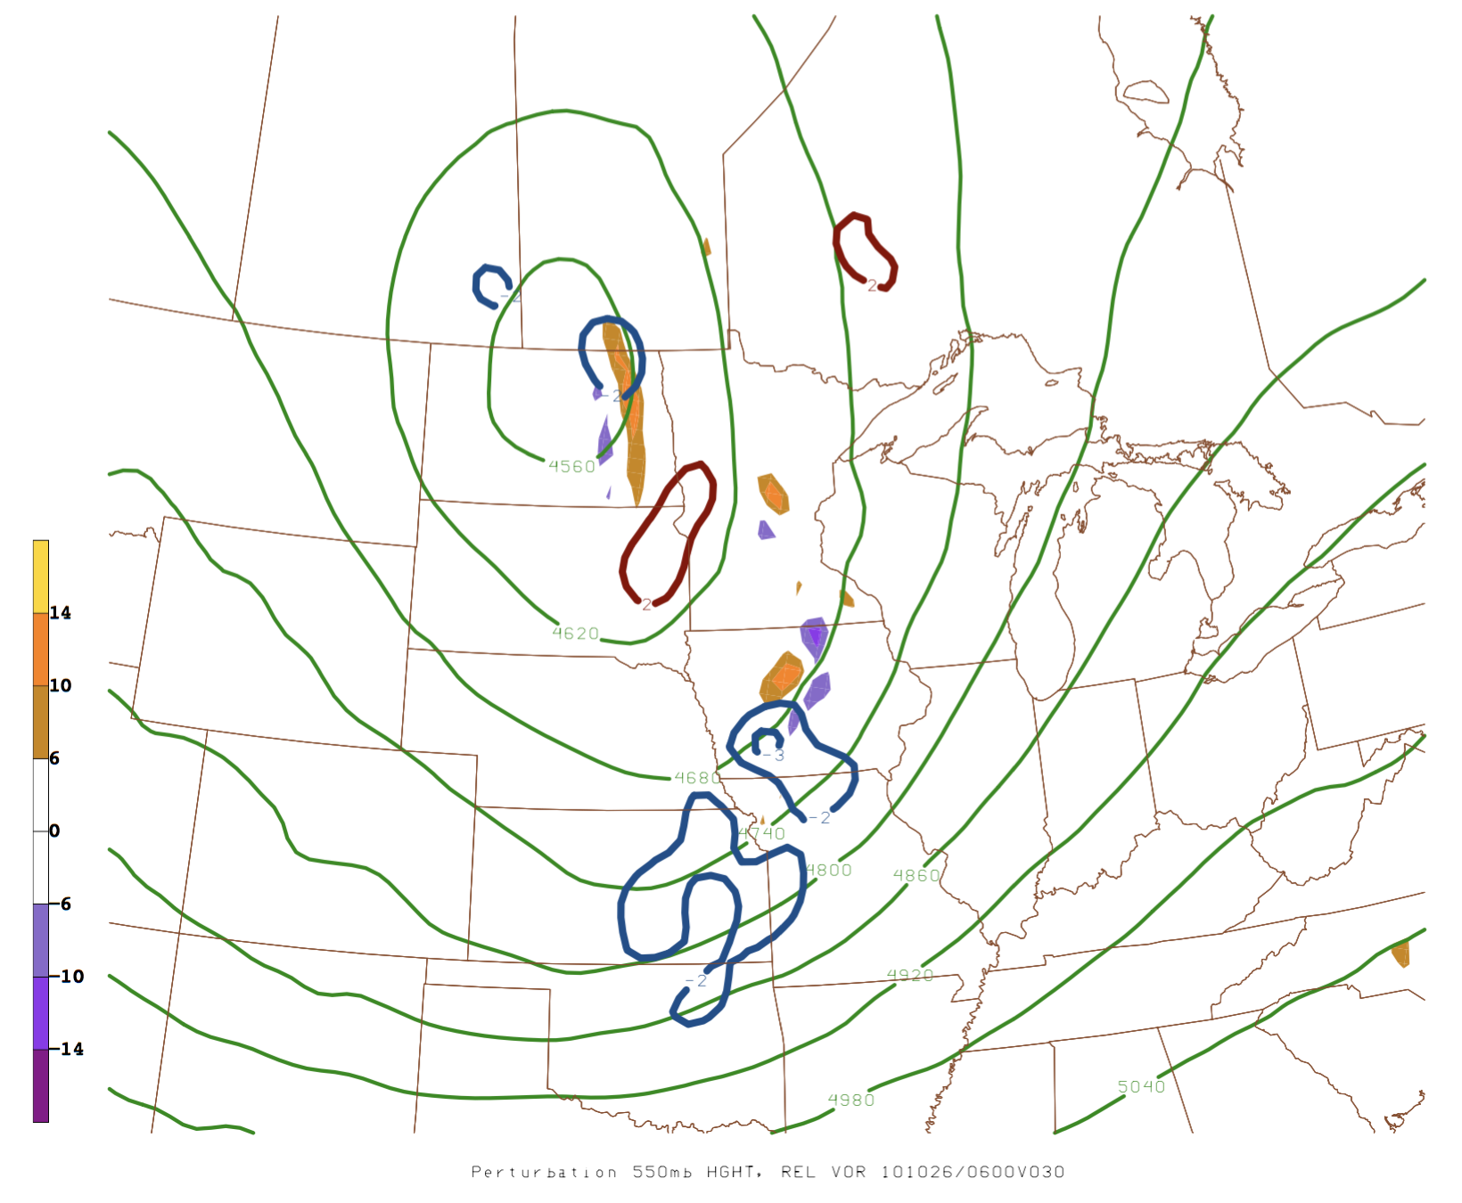
Perturbation Analysis - Perturbed NWP Simulation → 0600UTC 26 Oct./F30
- 550hPa relative vorticity perturbation (increased: yellow fill, decreased: purple fill)
- 550hPa height perturbations (lower: blue contours, higher: red contours)
- 550hPa height (control: green contours)
L
L

Slide 30
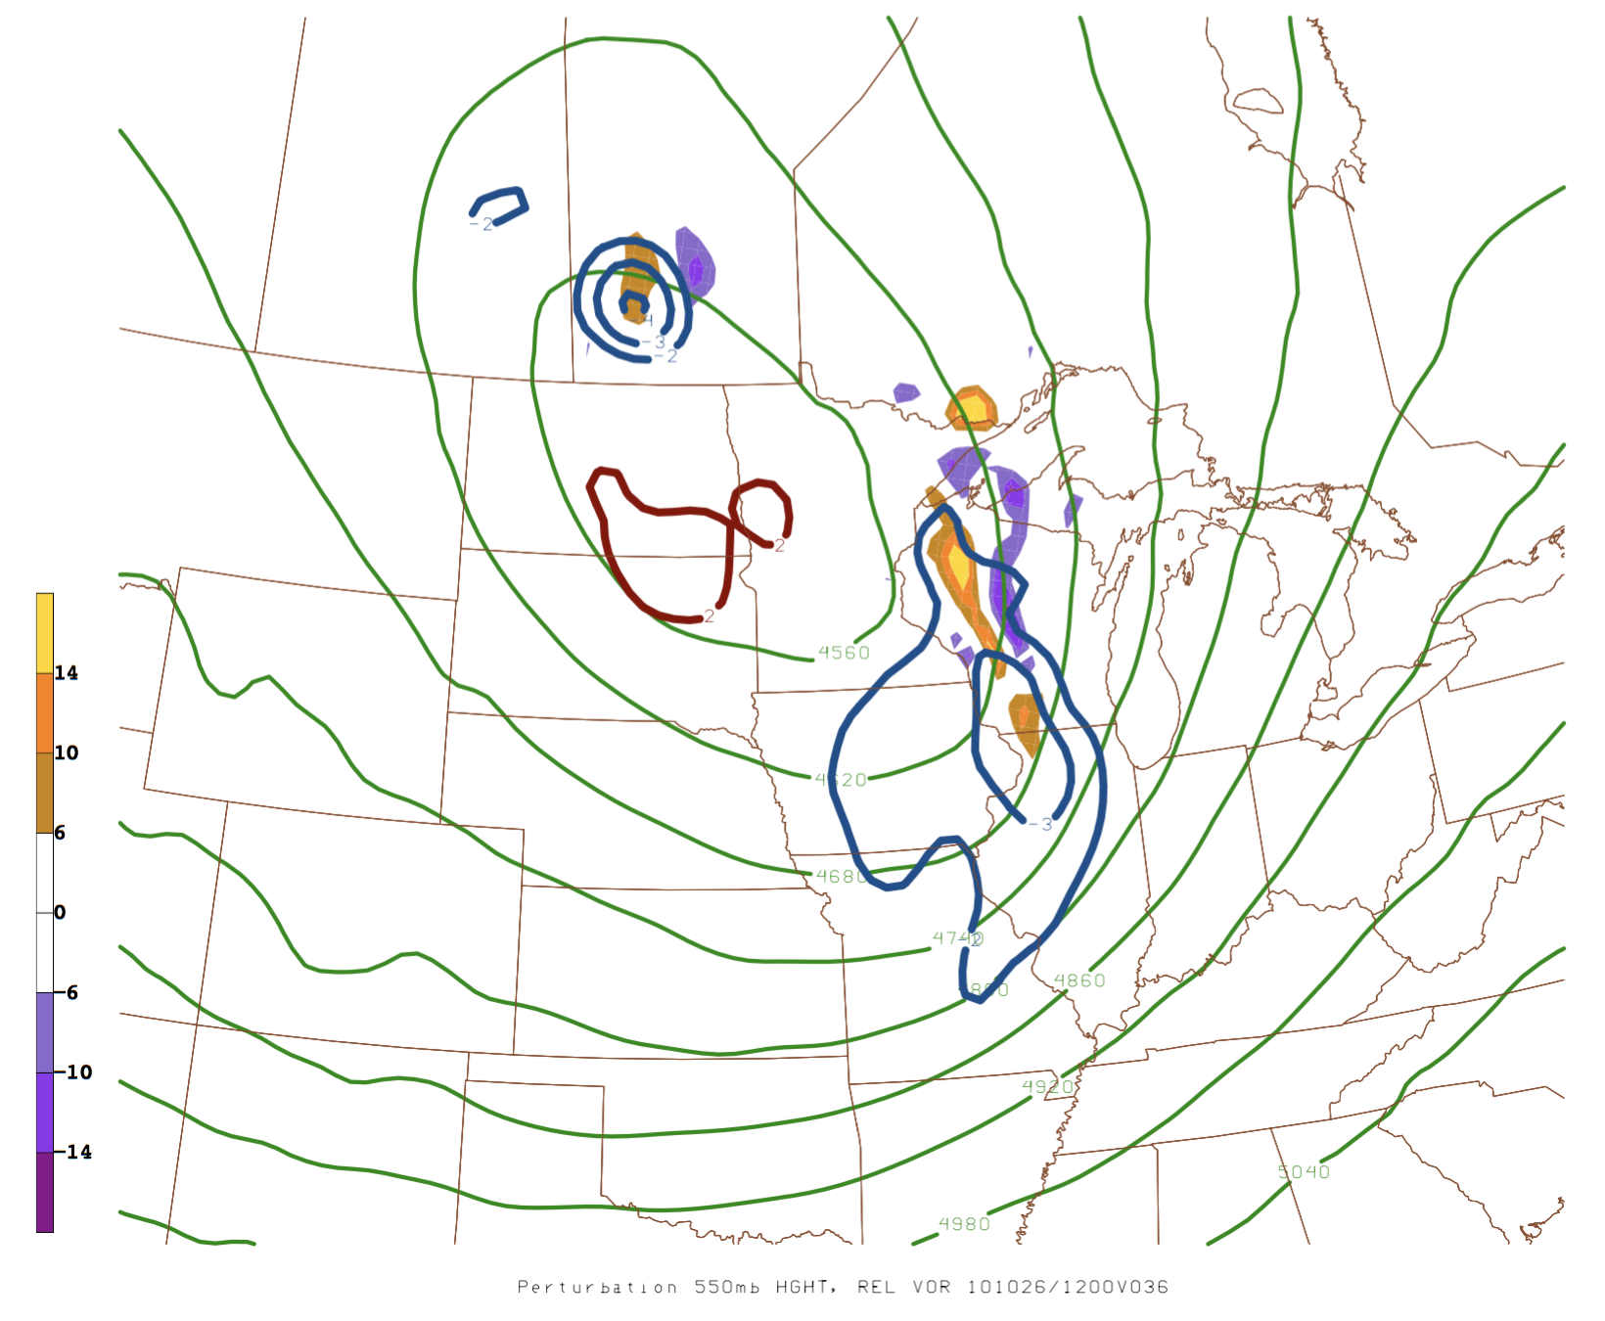
Perturbation Analysis - Perturbed NWP Simulation → 1200UTC 26 Oct./F36
- 550hPa relative vorticity perturbation (increased: yellow fill, decreased: purple fill)
- 550hPa height perturbations (lower: blue contours, higher: red contours)
- 550hPa height (control: green contours)
L

Slide 31
Conclusions - Increased shear within the jet contributes to enhanced development of the upper PV anomaly due to CAA early on as shown in the sensitivity analysis

Slide 32
Conclusions - Increased shear within the jet contributes to enhanced development of the upper PV anomaly early on as shown in the sensitivity analysis - An enhanced mid-level trough, likely due to enhanced PVA, is most important in producing a stronger cyclone

Slide 33
Conclusions - Increased shear within the jet contributes to enhanced development of the upper PV anomaly early on as shown in the sensitivity analysis - An enhanced mid-level trough, likely due to enhanced PVA, is most important in producing a stronger cyclone - Enhanced cyclone circulation also enhances the warm seclusion, further contributing to lower surface pressure, which is consistent with the 1hr adjoint analyses of sensitivity to temperature

Slide 34
Future Work - Further examine the baroclinically driven deepening of the upper and mid level troughs to determine changes in the PV, relative vorticity, and temperature structures
Notes:
- Adjoint analysis using PV, need to figure out what code to modify in WRF_PLUS for model to output sensitivity to PV.
Case study of modest extratropical cyclone to examine what a modest cyclone is most sensitive to, in order for it to achieve explosive cyclogenesis. Achieved by calculating and inserting ‘optimal perturbations’ into model using adjoint.
36 hour analysis as adjoint run is most accurate in short time spans. (tends to deviate on longer time scales due to linearity of model).
Optimal Perturbation: Specify the amount of change we wish to see in response function. And make a calculation to perturb the appropriate initial conditions to achieve the specified change in the response function that costs the least amount of energy.

Slide 35
Future Work - Further examine the baroclinically driven deepening of the upper and mid level troughs to determine changes in the PV, relative vorticity, and temperature structures - Complete the case study of a modest cyclone utilizing adjoint analyses to determine what is most important dynamically to achieve an explosive cyclogenesis event
Notes:
- Adjoint analysis using PV, need to figure out what code to modify in WRF_PLUS for model to output sensitivity to PV.
Case study of modest extratropical cyclone to examine what a modest cyclone is most sensitive to, in order for it to achieve explosive cyclogenesis. Achieved by calculating and inserting ‘optimal perturbations’ into model using adjoint.
36 hour analysis as adjoint run is most accurate in short time spans. (tends to deviate on longer time scales due to linearity of model).
Optimal Perturbation: Specify the amount of change we wish to see in response function. And make a calculation to perturb the appropriate initial conditions to achieve the specified change in the response function that costs the least amount of energy.

Slide 36
Future Work - Further examine the baroclinically driven deepening of the upper and mid level troughs to determine changes in the PV, relative vorticity, and temperature structures - Complete the case study of a modest cyclone utilizing adjoint analyses to determine what is most important dynamically to achieve an explosive cyclogenesis event - Complete an adjoint analyses utilizing PV (i.e. sensitivity to PV)
Notes:
- Adjoint analysis using PV, need to figure out what code to modify in WRF_PLUS for model to output sensitivity to PV.
Case study of modest extratropical cyclone to examine what a modest cyclone is most sensitive to, in order for it to achieve explosive cyclogenesis. Achieved by calculating and inserting ‘optimal perturbations’ into model using adjoint.
36 hour analysis as adjoint run is most accurate in short time spans. (tends to deviate on longer time scales due to linearity of model).
Optimal Perturbation: Specify the amount of change we wish to see in response function. And make a calculation to perturb the appropriate initial conditions to achieve the specified change in the response function that costs the least amount of energy.

Slide 37
Acknowledgements - Special thanks to the workshop travel committee for funding to attend this conference - Dr. Michael Morgan - Dr. Brett Hoover - Morgan/Martin research groups - Pete Pokrandt - NSF grant: AGS - 1638194

Slide 38
Extra Slides

Slide 39
Extra Slides
60% linearity met, should have seen a 1.7hPa decrease in cyclone.

Slide 40
Optimal Perturbation Analysis
Calculate optimal perturbations to increase cyclone strength by ~1hPa and add them to the WRF NLM and reintegrate
$λ$ = Lagrange multiplier
$W$ = Weighting matrix used in minimization of cost function
$\frac{∂R}{∂{\overset{⃑}{V}}_{0}}$ = Sensitivity gradient
- Optimal perturbation calculated by:
${\overset{⃑}{V}}^{′}$ = $λ∙W^{−1}∙\frac{∂R}{∂{\overset{⃑}{V}}_{0}}$
$\overset{⃑}{V}$ = ${\overset{⃑}{V}}_{control}$ + ${\overset{⃑}{V}}^{′}$
Max u-wind perturbation: 0.35m/s
Max v-wind perturbation: 0.44m/s
Max temperature perturbation: 0.37$°$C
Notes:
Lagrange multiplier – strategy for finding local maxima and minima of a function subject to equality constraints. Constraints must exactly satisfy one or more of the equations.

Slide 41
Perturbation Analysis (Perturbed NWP Simulation) - SLP, 2m temp(C), 10m wind(kts) → 0000UTC 27 Oct./F48
WRF Simulation: 957.7hPa SLP minimum
NCEP Analysis Data: 957.73hPa SLP minimum

Slide 42
Slides from here contain graphics from ‘sprdomain’, not ‘newdomain’.

Slide 43
Motivation
Let’s examine the mid-level wind and temperature sensitivities directly, how can perturbations to these parameters affect the mid-level dynamics and cyclone development?

Slide 44
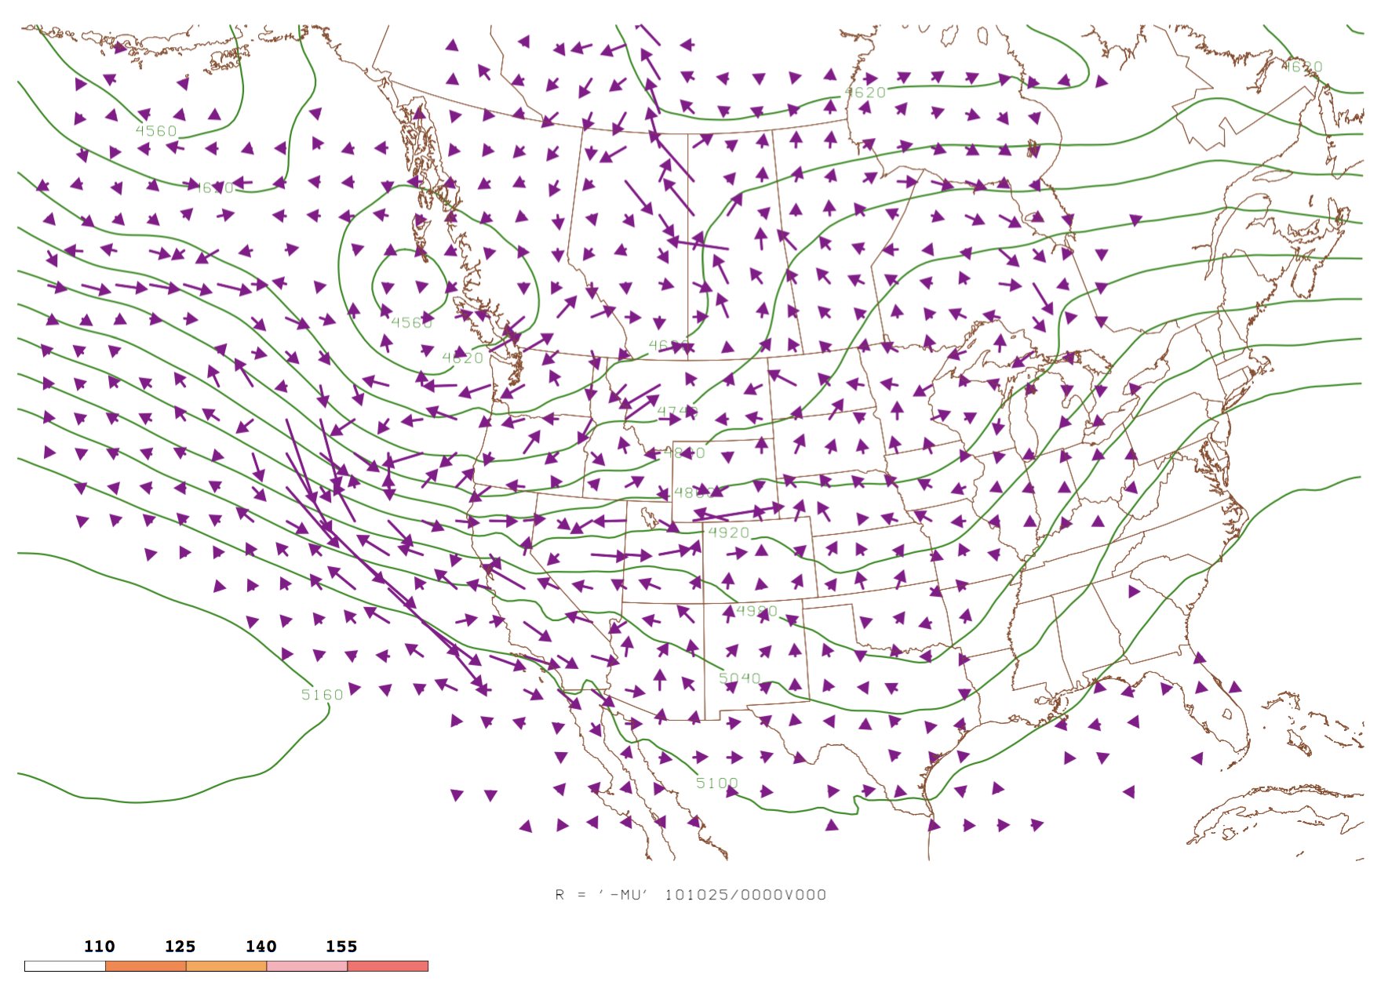
Adjoint Analysis (Sensitivity analysis) - Adjoint Simulation → 0000UTC 25 Oct./F00
- 550hPa height (m)
- Sensitivity to wind vectors
- Temperature (C)

Slide 45
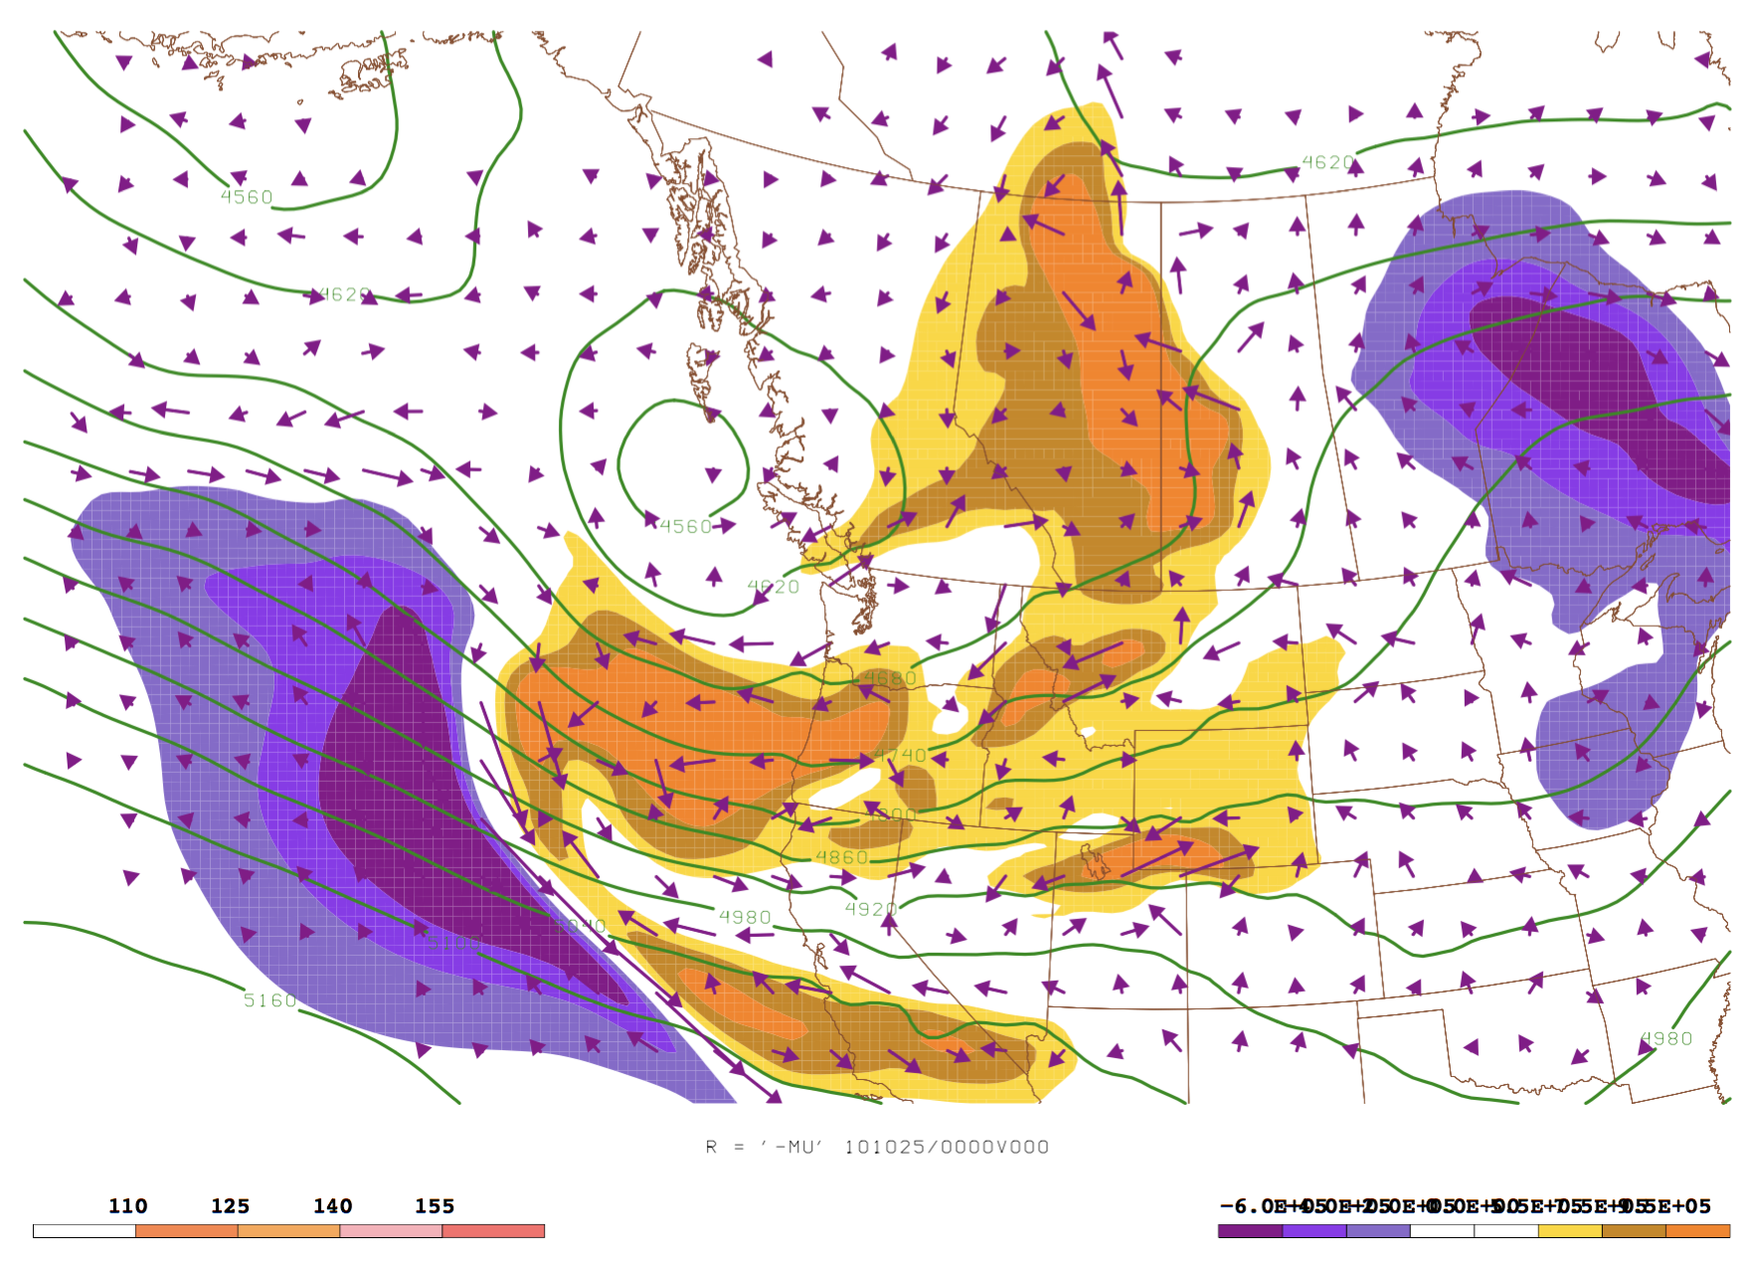
Adjoint Analysis (Sensitivity analysis) - Adjoint Simulation → 0000UTC 25 Oct./F00
- 550hPa height (m)
- Sensitivity to wind vectors
- Sensitivity to relative vorticity
$$(+)$$
$$\left(−\right)$$
$$(+)$$
$$\left(−\right)$$
$$(+)$$
Notes:
Deepen trough
Increase ridge downstream
Advect cold air into jet upstream, enhance subsidence in jet, increases PV anomaly

Slide 46
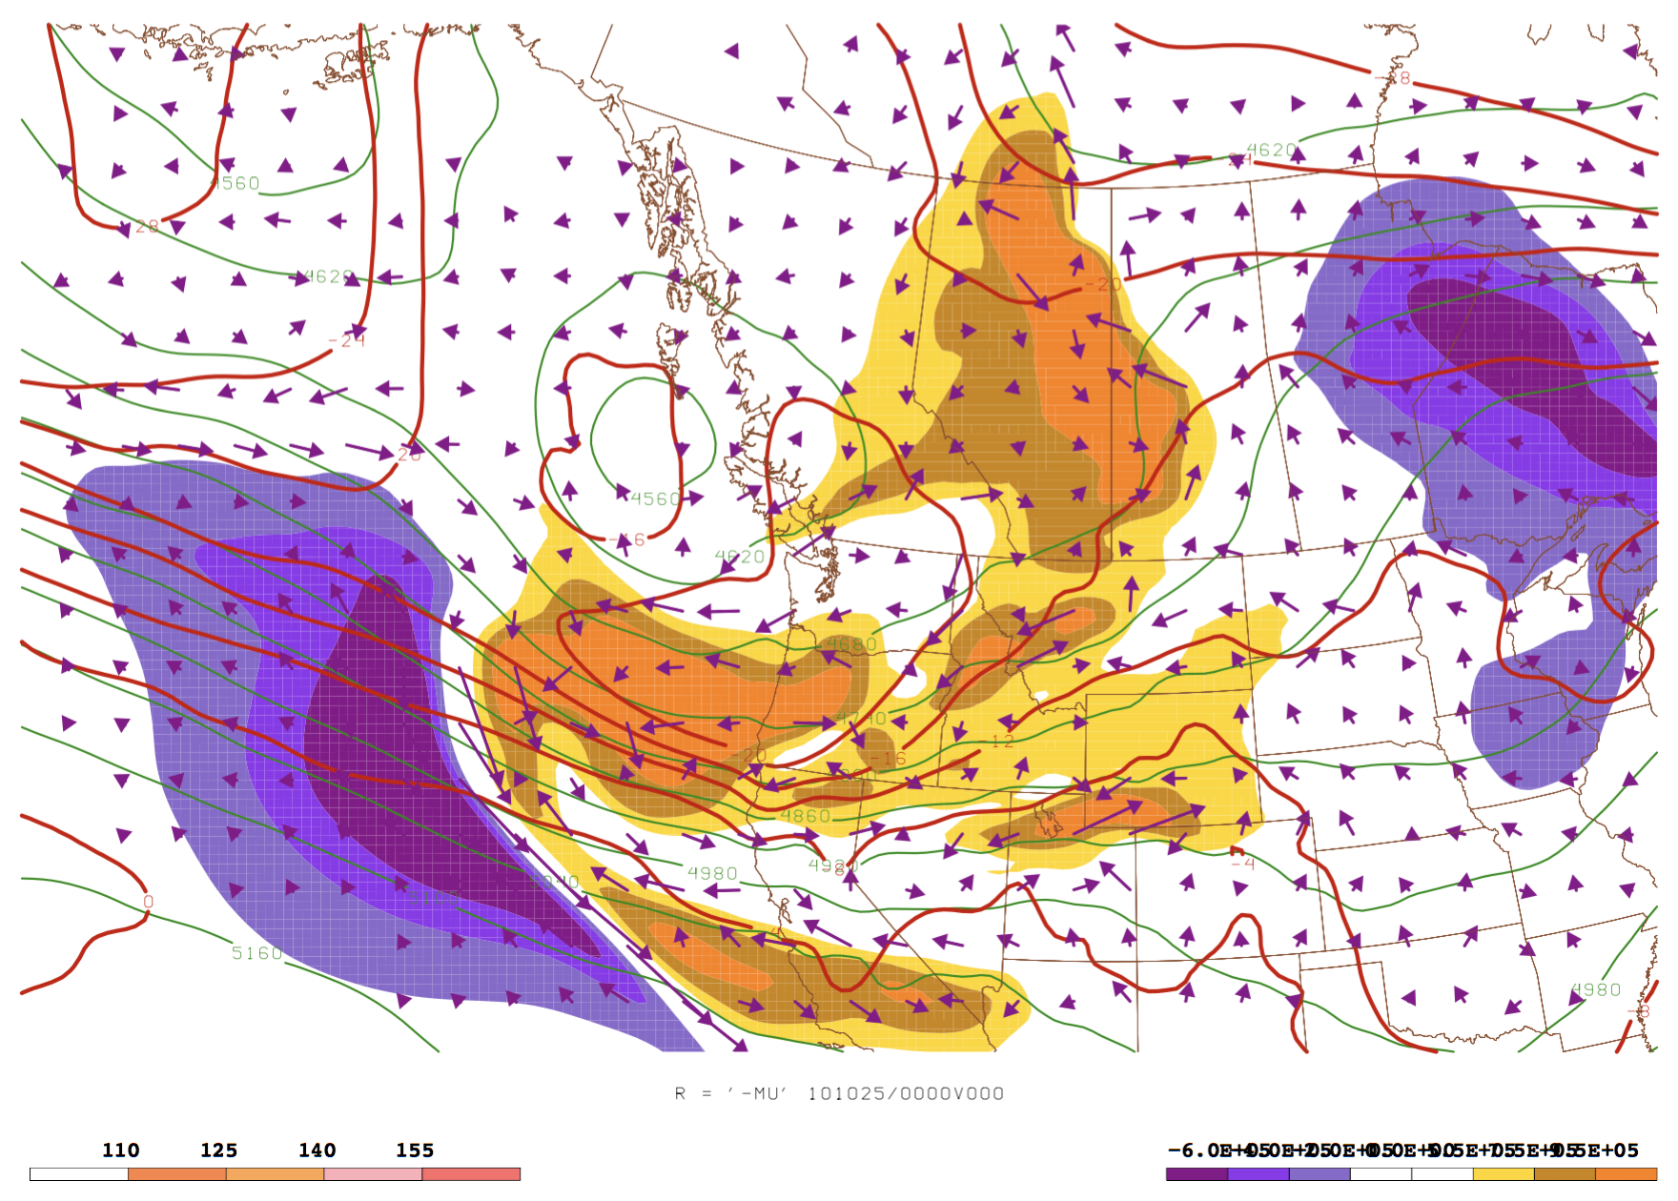
Adjoint Analysis (Sensitivity analysis) - Adjoint Simulation → 0000UTC 25 Oct./F00
- 550hPa height (m)
- Sensitivity to wind vectors
- Sensitivity to relative vorticity
- Temperature (C)
$$(+)$$
$$\left(−\right)$$
$$(+)$$
$$\left(−\right)$$
$$(+)$$
Notes:
Deepen trough
Increase ridge downstream
Advect cold air into jet upstream, enhance subsidence in jet, increases PV anomaly

Slide 47
Adjoint Analysis (Sensitivity analysis) - Adjoint Simulation → 0000UTC 25 Oct./F00
- 550hPa height (m)
- Sensitivity to wind vectors
- Sensitivity to relative vorticity
- Resultant wind enhancement vectors
- Temperature (C)
$$(+)$$
$$\left(−\right)$$
$$(+)$$
$$\left(−\right)$$
$$(+)$$
Notes:
Deepen trough
Increase ridge downstream
Advect cold air into jet upstream, enhance subsidence in jet, increases PV anomaly

Slide 48
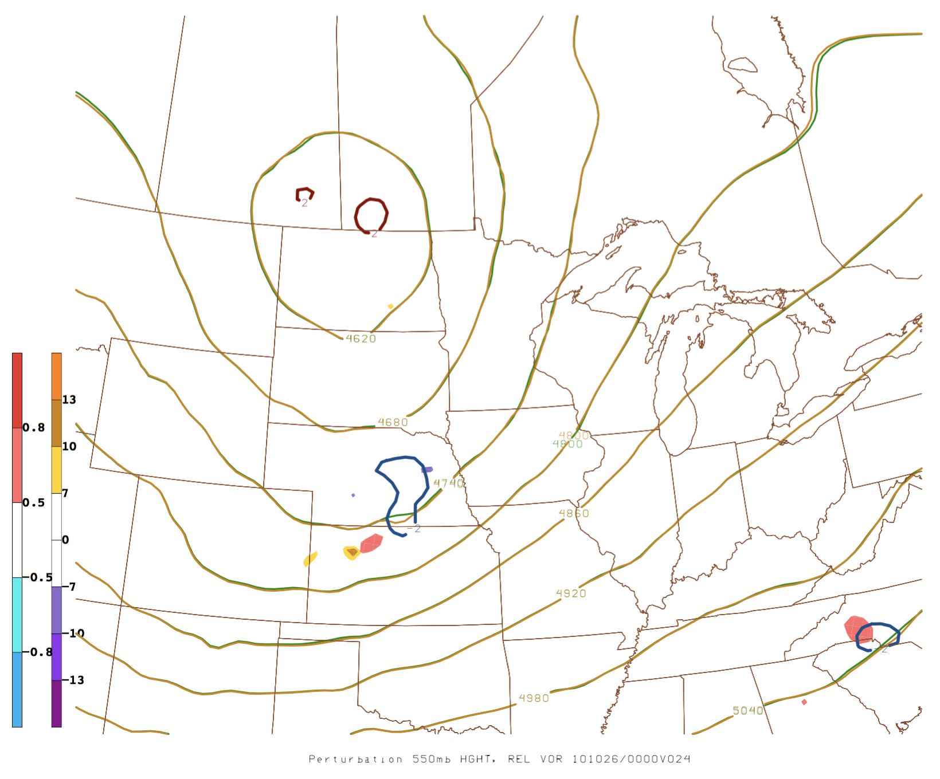
Perturbation Analysis - Perturbed NWP Simulation: Location of Cross Section→ 0600UTC 26 Oct./F30
L
A
L
B

Slide 49
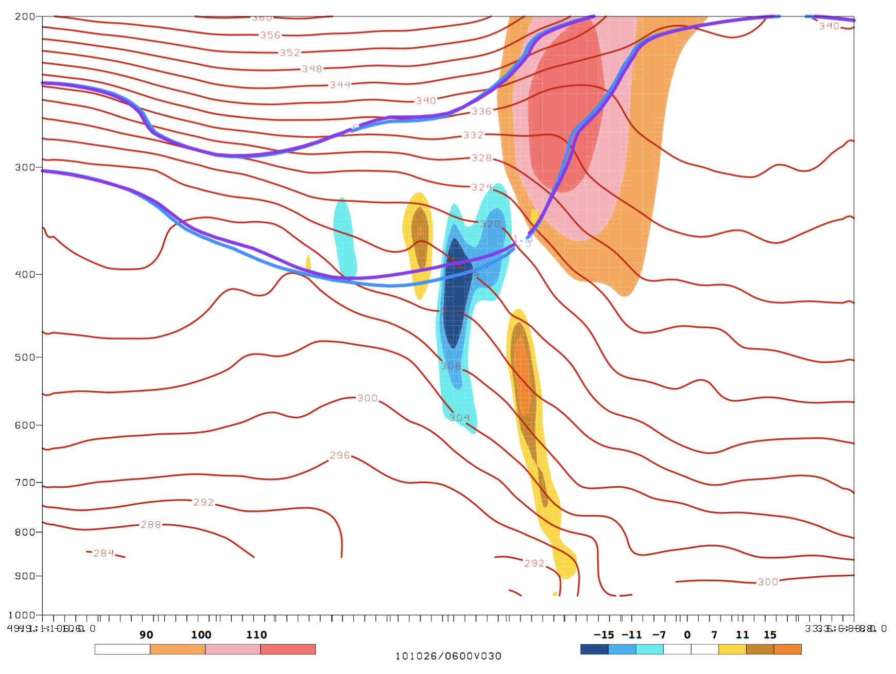
Perturbation Analysis - Perturbed NWP Simulation → 0600UTC 26 Oct./F30
- Wind (kts, peach fill)
- 1.5 and 3.5 PVU surfaces (control: blue contours, perturbation: purple contours)
- Control potential temp contours (red)
- Perturbation relative vorticity (1/s, increased: blue fill, decreased: yellow fill

Slide 50
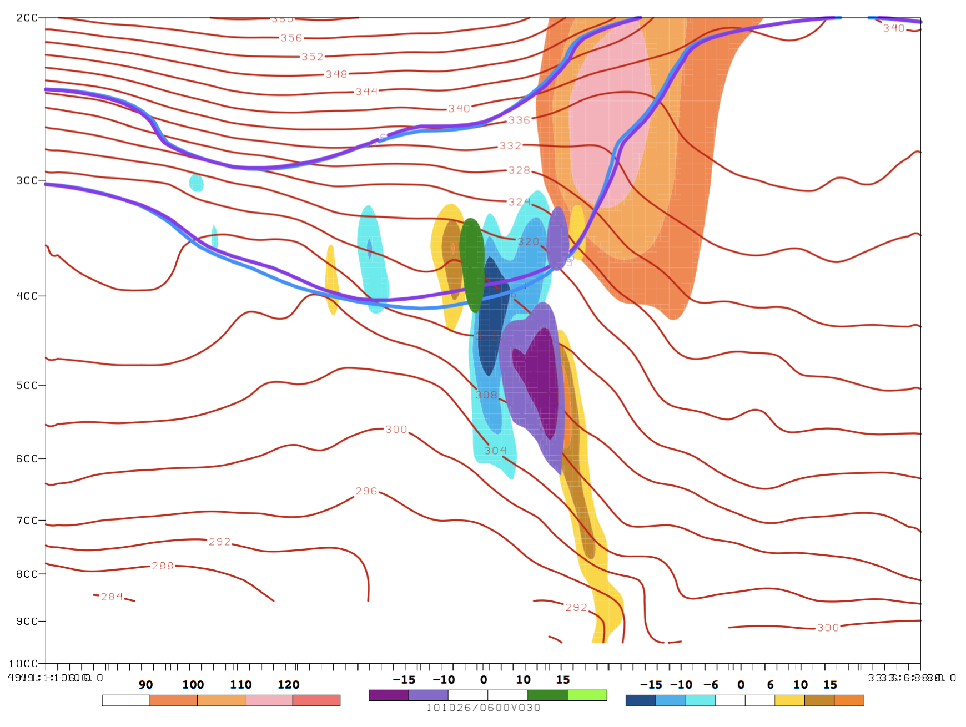
Perturbation Analysis - Perturbed NWP Simulation → 0600UTC 26 Oct./F30
- Wind (kts, peach fill)
- 1.5 and 3.5 PVU surfaces (control: blue contours, perturbation: purple contours)
- Control potential temp contours (red)
- Perturbation relative vorticity (1/s, increased: gold fill, decreased: blue fill)
- Perturbation wind (positive: green fill, negative: purple fill)

Slide 51
Perturbation Analysis - Perturbed NWP Simulation → 0600UTC 26 Oct./F30
- Wind (kts, peach fill)
- 1.5 and 3.5 PVU surfaces (control: blue contours, perturbation: purple contours)
- Control potential temp contours (red)
- Perturbation relative vorticity (1/s, increased: gold fill, decreased: blue fill)
- Perturbation wind (positive: green fill, negative: purple fill)

Slide 52
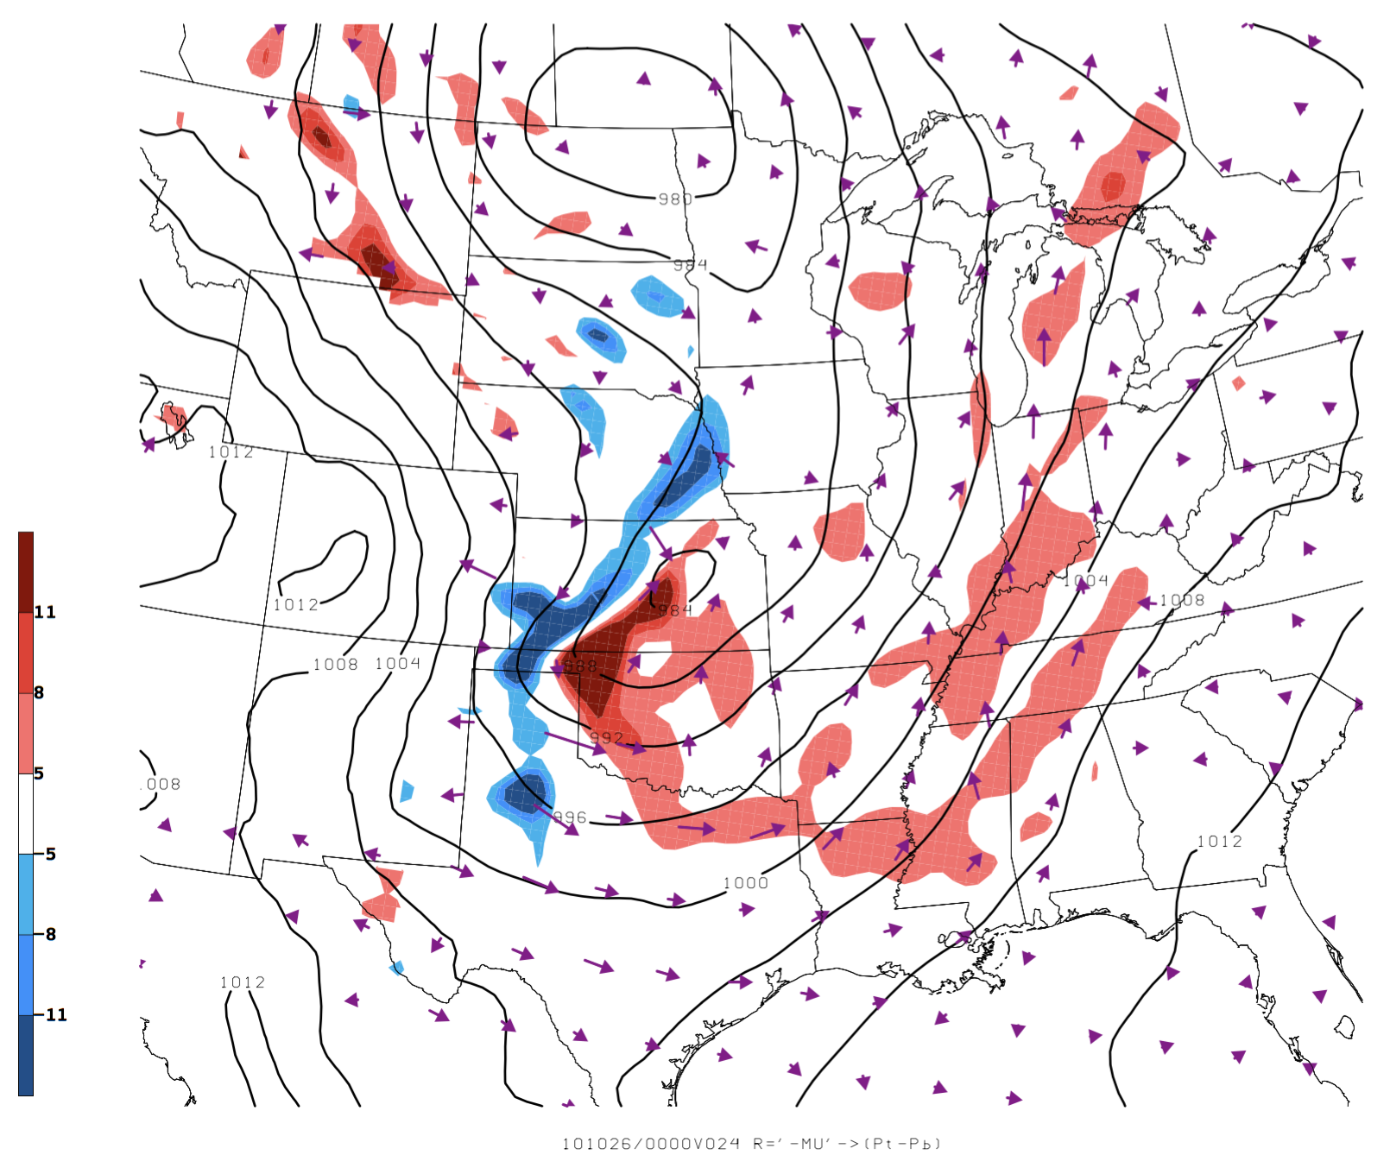
Adjoint Analysis (Sensitivity analysis) - Adjoint Simulation → 0000UTC 26 Oct./F24
SLP
850hPa sensitivity to temperature (C)
850hPa sensitivity to wind vectors

Slide 53
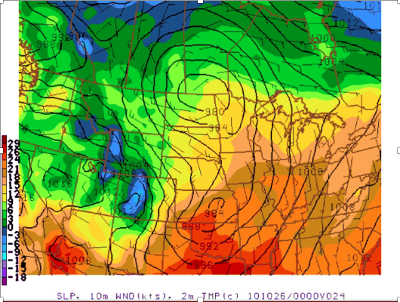
Adjoint Analysis (Sensitivity analysis) - Adjoint Simulation → 0000UTC 26 Oct./F24
SLP
2M temp (C)
10m wind (kts)

Slide 54
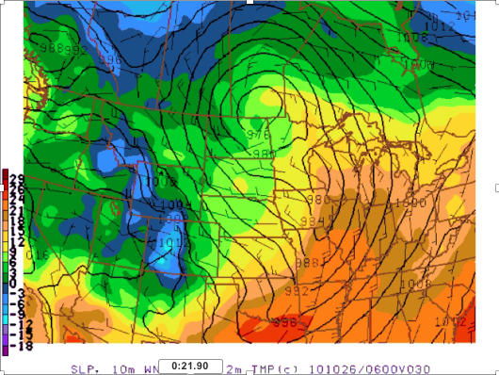
Adjoint Analysis (Sensitivity analysis) - Adjoint Simulation → 0000UTC 26 Oct./F30
SLP
2M temp (C)
10m wind (kts)

Slide 55
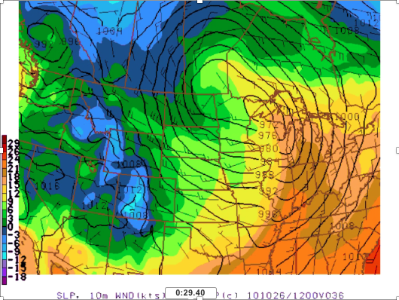
Adjoint Analysis (Sensitivity analysis) - Adjoint Simulation → 0000UTC 26 Oct./F36
SLP
2M temp (C)
10m wind (kts)

Slide 56
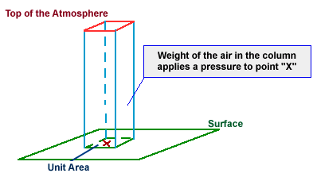
Adjoint Analysis (Response Function)
Define ‘R’ to be the dry mass of a vertical column of the atmosphere as measured at the surface
‘R’ represents the model variable ‘-µ’
µ = $p_{sfc}$ - $p_{top}$
As ‘R’ increases, ‘µ’ decreases. i.e. a positive sensitivity that would indicate an increase in the response function, means that column mass decreases over the averaged unit area
Top of Model
“Atmospheric Pressure”. NOAA, http://www.weather.gov/source/zhu/ZHU_Training_Page/winds/pressure_winds/Pressure.htm. Accessed 20 Feb 2018.
Notes:
-MU = Pb-Pt (pressure at bottom of model space minus pressure at top of model space)

Slide 57
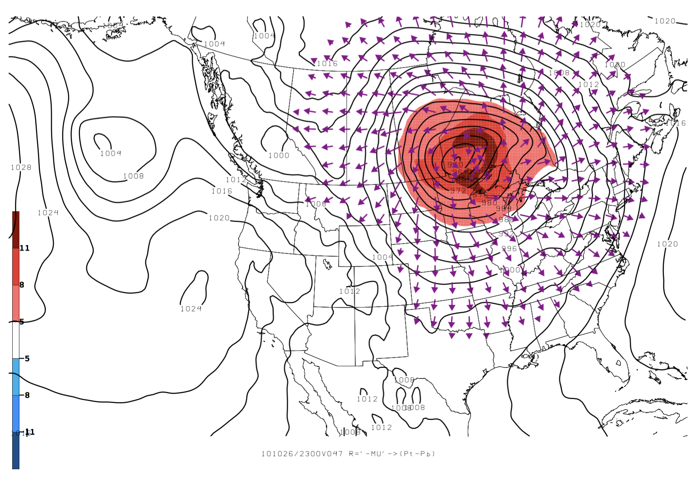
Adjoint Analysis (Sensitivity analysis) → Check - Adjoint Simulation → 2300UTC 26 Oct./F47
Sea level pressure
850hPa sensitivity to temperature
850hPa sensitivity to wind vectors

