Slide 1
The ECMWF weak constraint 4D-Var formulation
Patrick Laloyaux, Jacky Goddard, Simon Lang and Massimo Bonavita

Slide 2
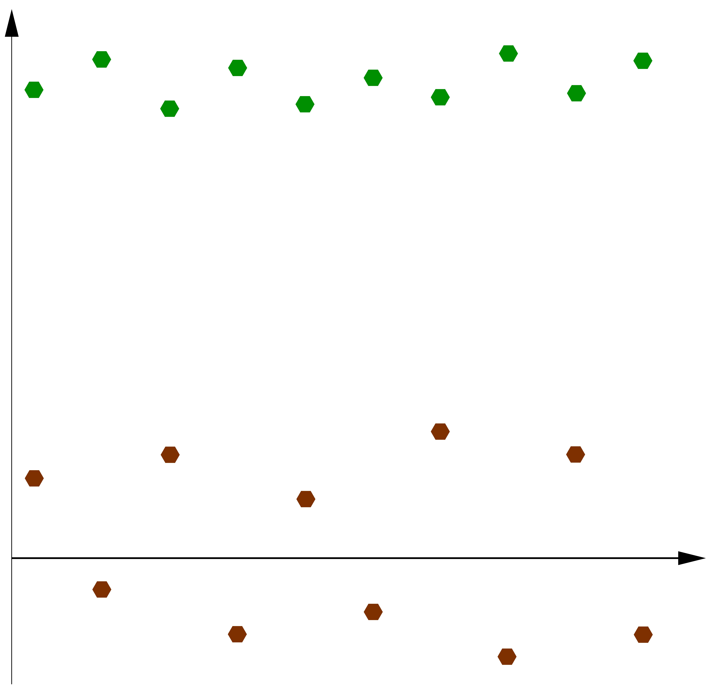
Data assimilation and biases
In most of the operational data assimilation systems, we assume that we have an unbiased model assimilating biased observations
First-guess
Observation
Error

Slide 3
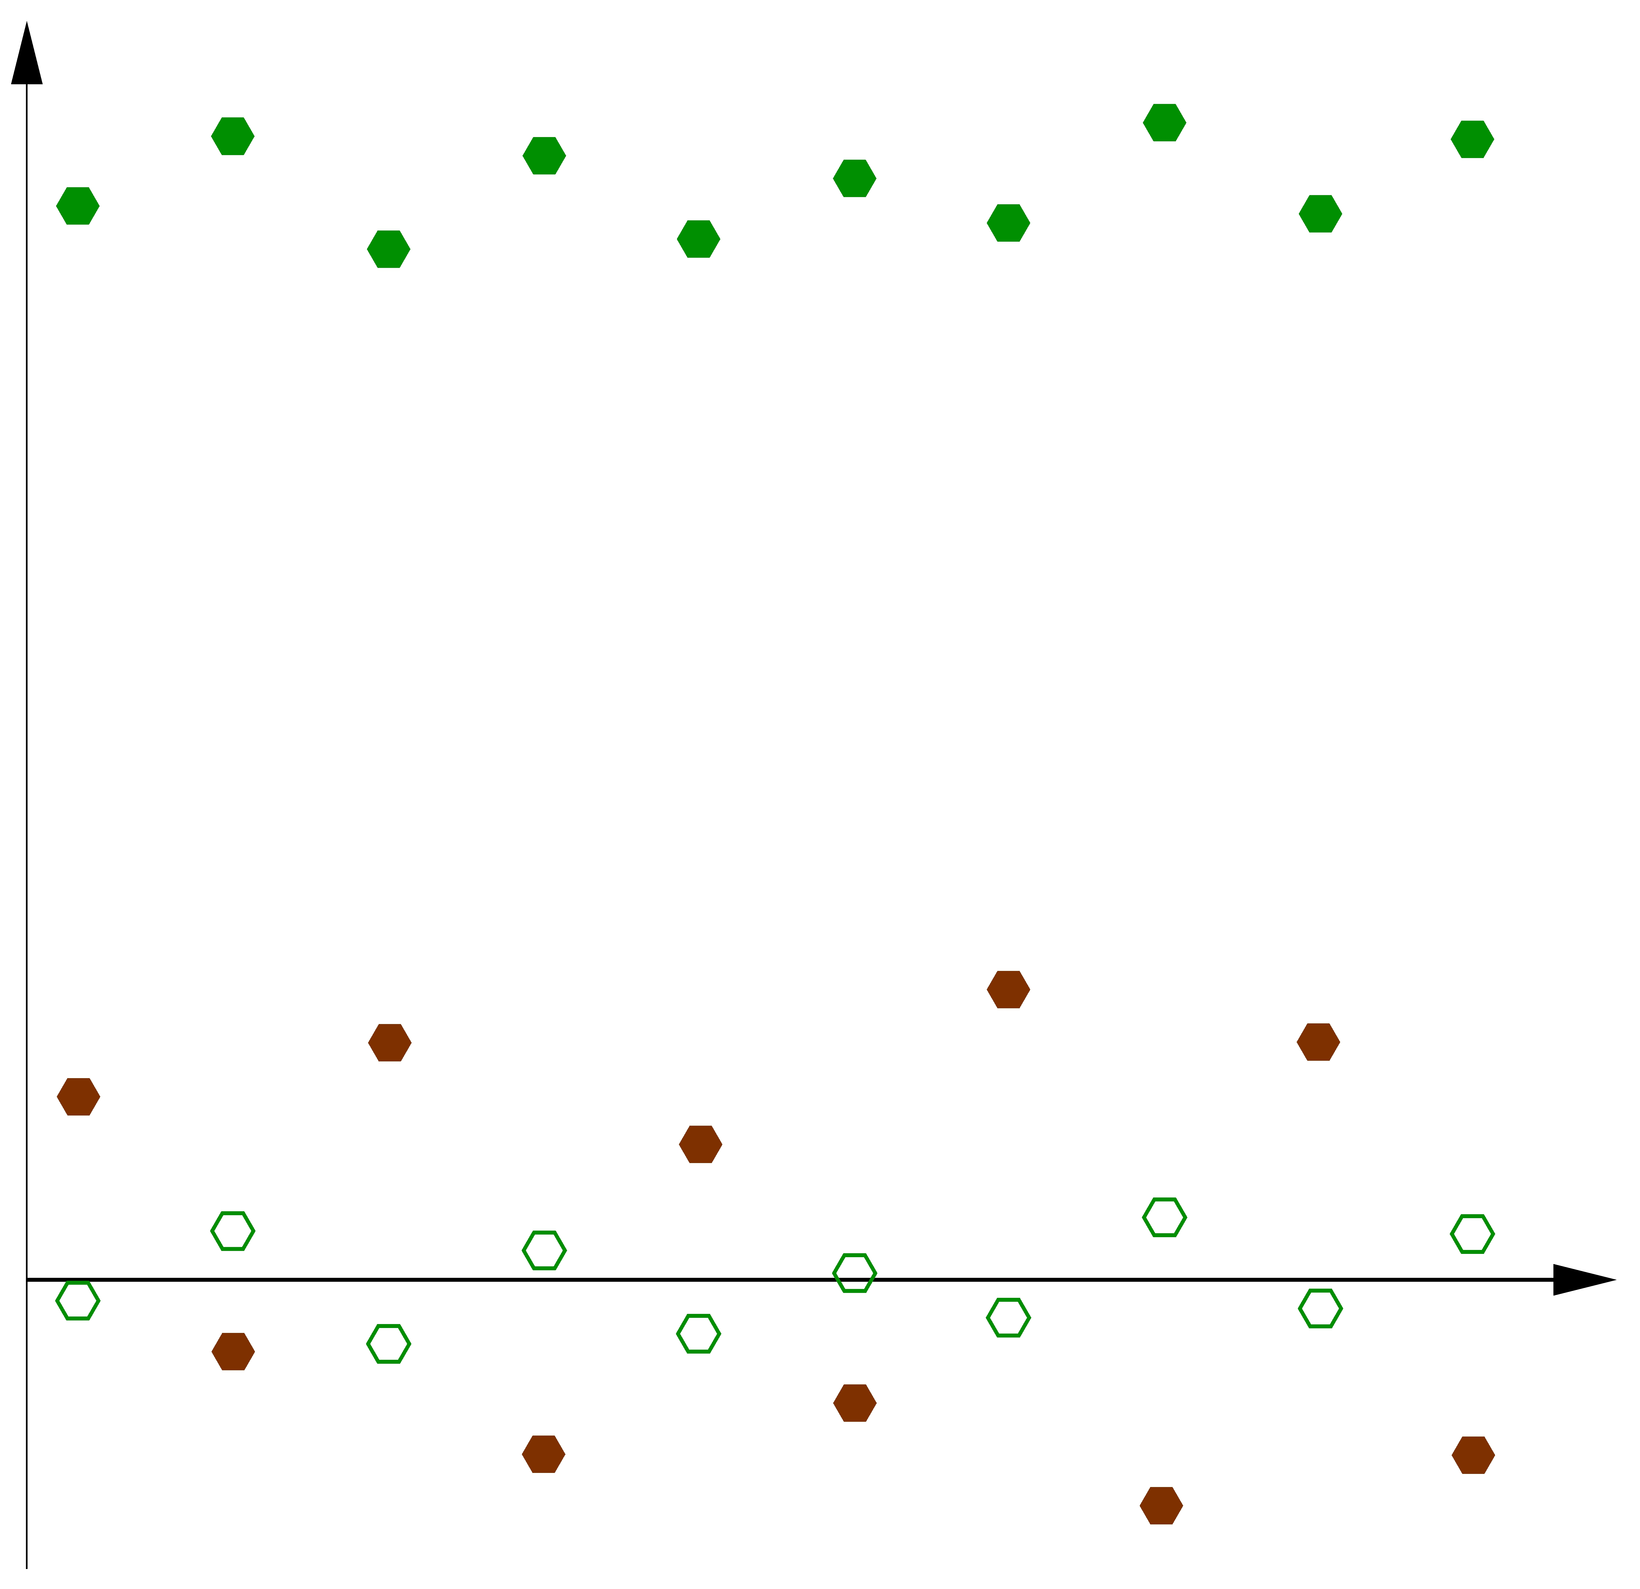
Data assimilation and biases
Departures between observations and first-guess are used to correct the observation bias
First-guess
Observation
Error

Slide 4
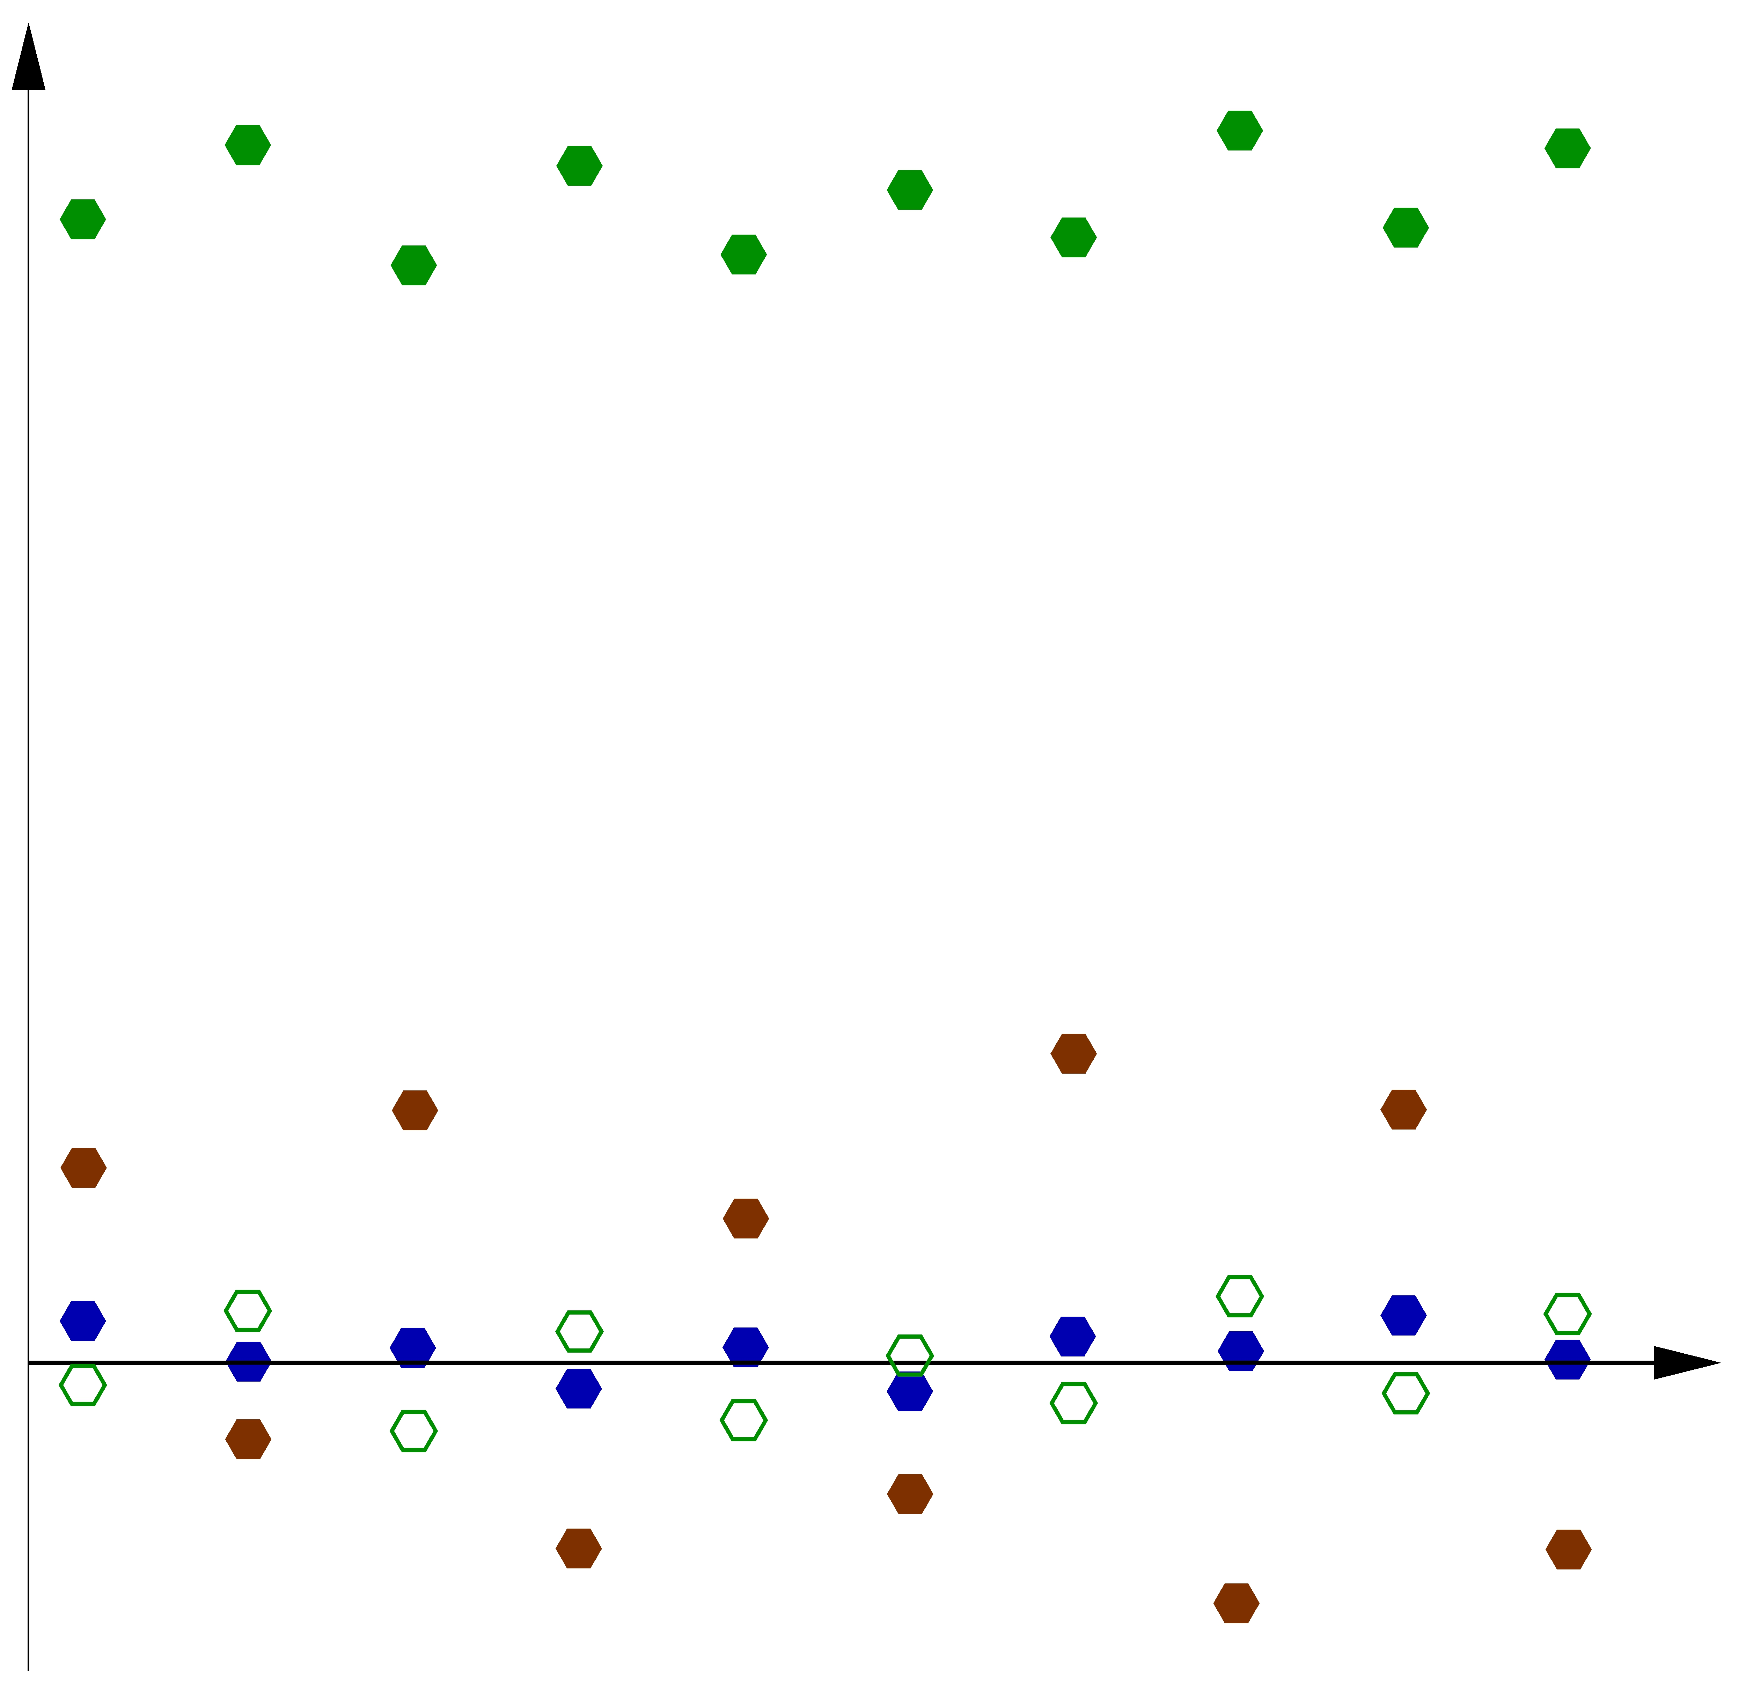
Data assimilation and biases
First-guess and bias-corrected observations are blended together to produce the analysis (unbiaised)
First-guess
Observation
Analysis
Error

Slide 5
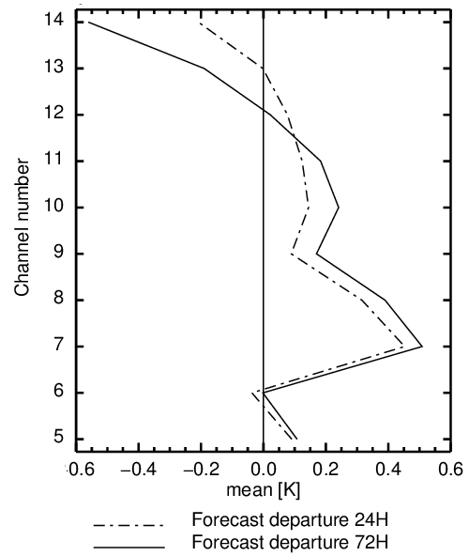
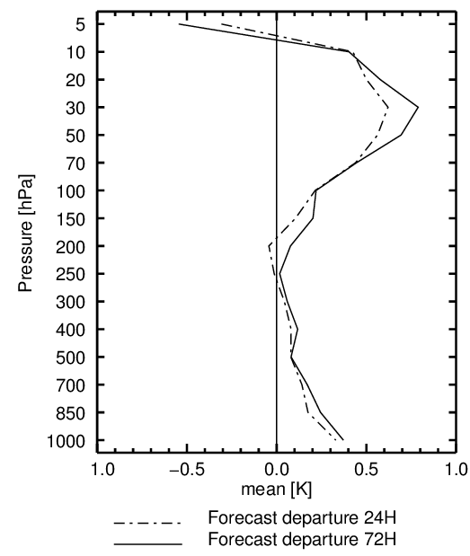
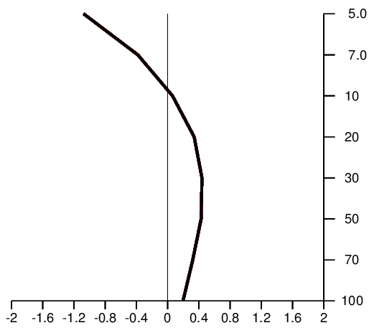
Models used for NWP are biased
Stratospheric temperature bias: forecasts compared to unbiased observations (observation – forecast)
GPS-RO retrieved T
AMSU-A
Radiosondes
Forecast departure 24H
→ Warm model bias above 10 hPa (0.5°C in 24h)
→ Cold model bias between 10 hPa and 100hPa (0.5°C in 24h)

Slide 6
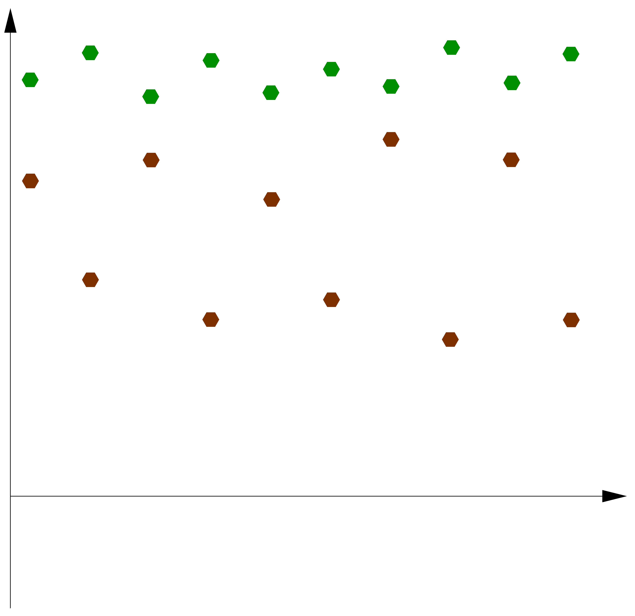
Data assimilation and biases
A biased model assimilating biased observations
First-guess
Observation
Error

Slide 7
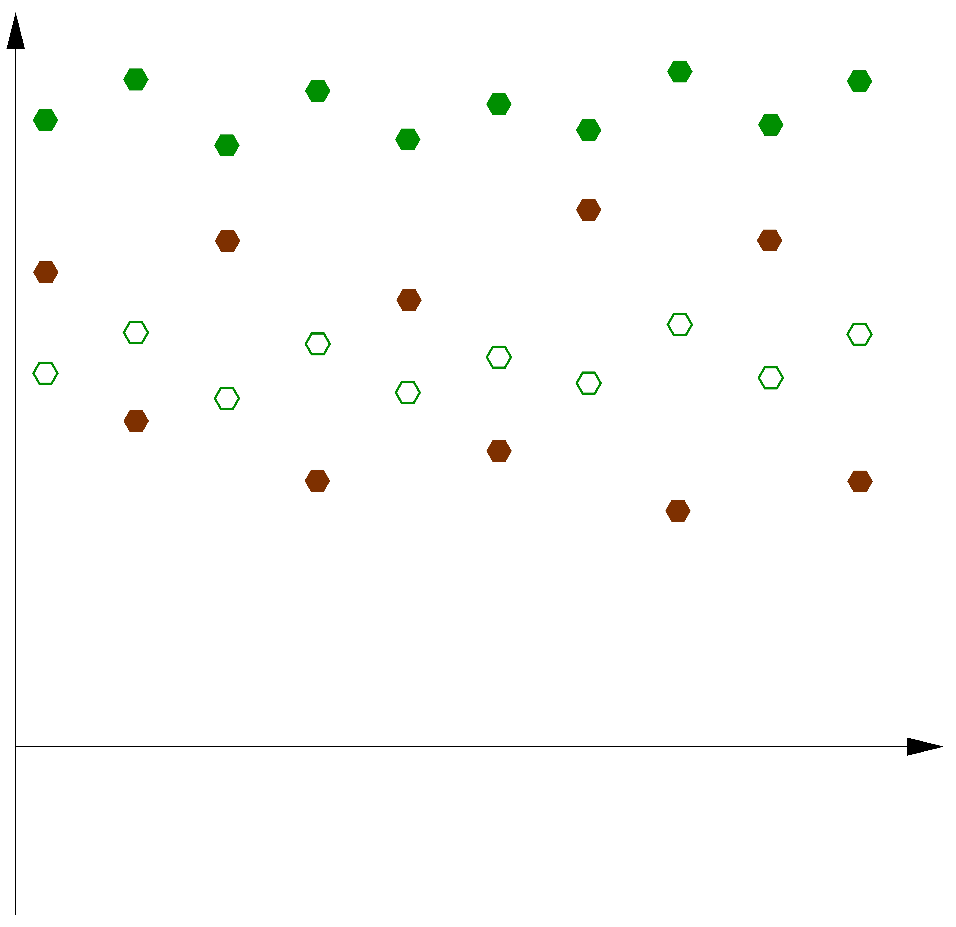
Data assimilation and biases
Using departures between observations and first-guess does not correct the observation bias
First-guess
Observation
Error

Slide 8
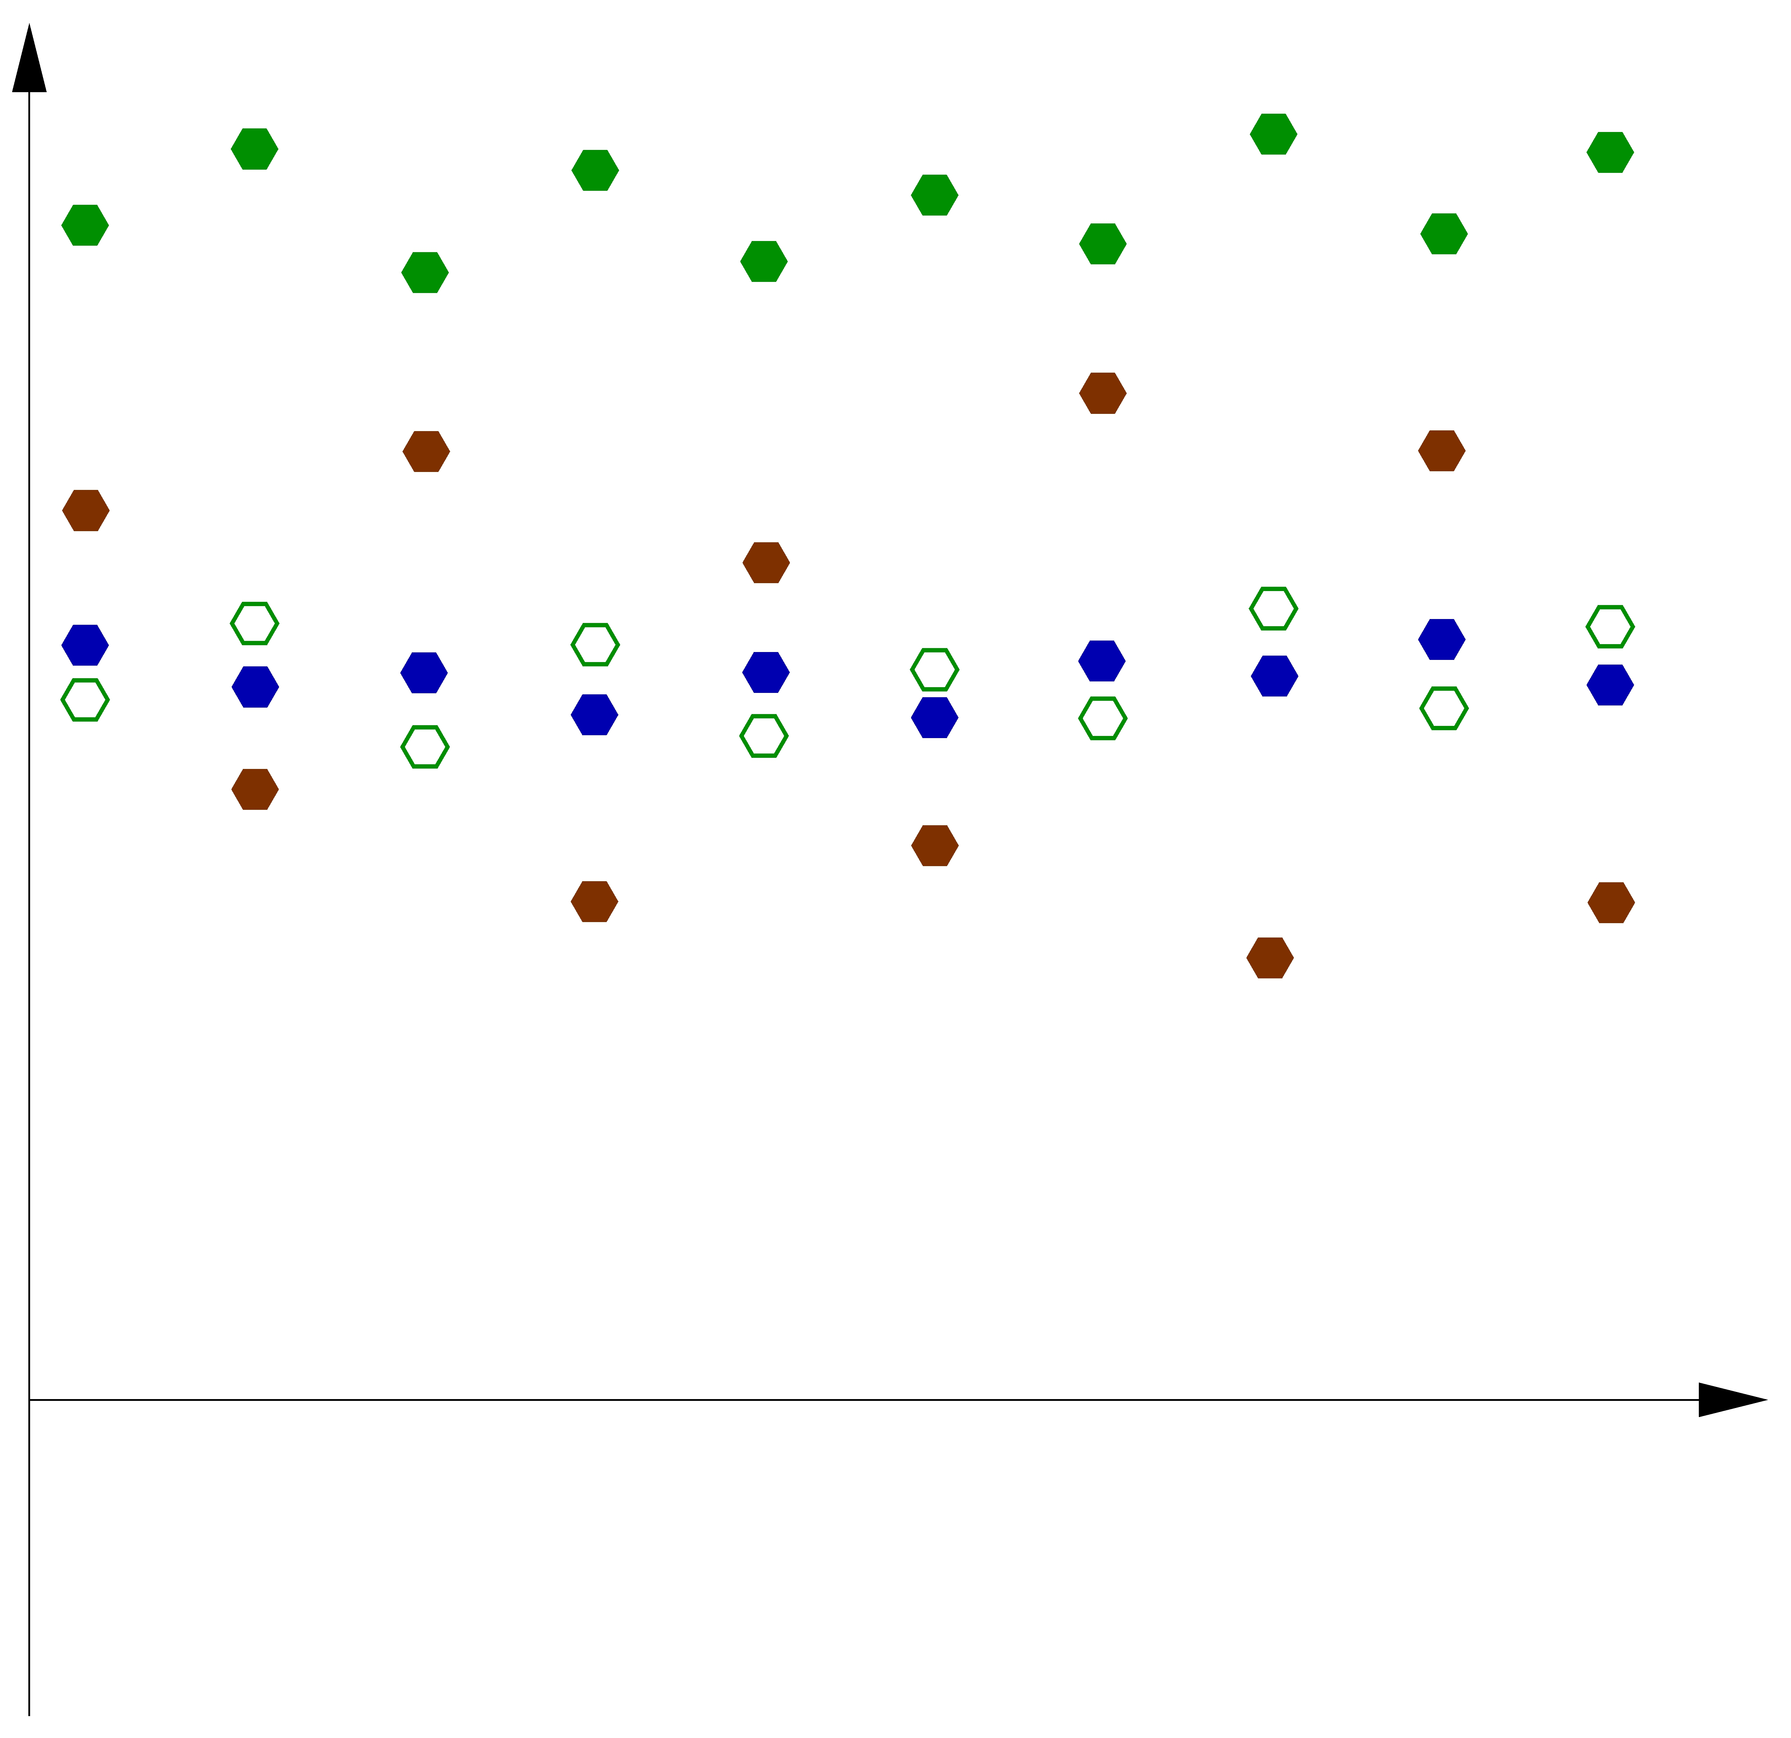
Data assimilation and biases
First-guess and bias-corrected observations produce a biased analysis
First-guess
Observation
Analysis
Error

Slide 9
Taking into account model biases in data assimilation
Bias-aware data assimilation (weak-constraint 4D-Var, Tremolet, Fisher, Dee, et al.)
Constant model error forcing over the assimilation window to correct the model bias
Model state
Observation bias parameters
Model error forcing
Introduce additional controls to target an unbiased analysis
The model error covariance matrix Q constrains the model error field

Slide 10
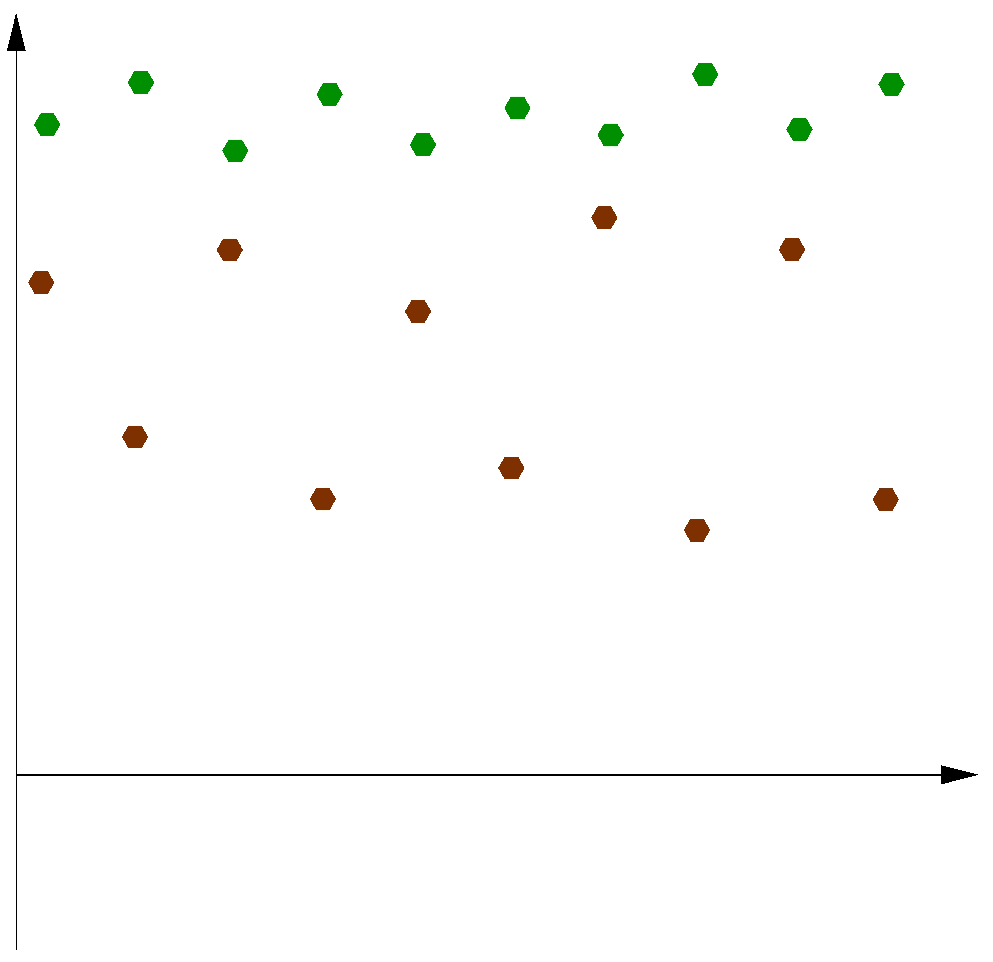
Data assimilation and biases
A biased model assimilating biased observations
First-guess
Observation
Error

Slide 11
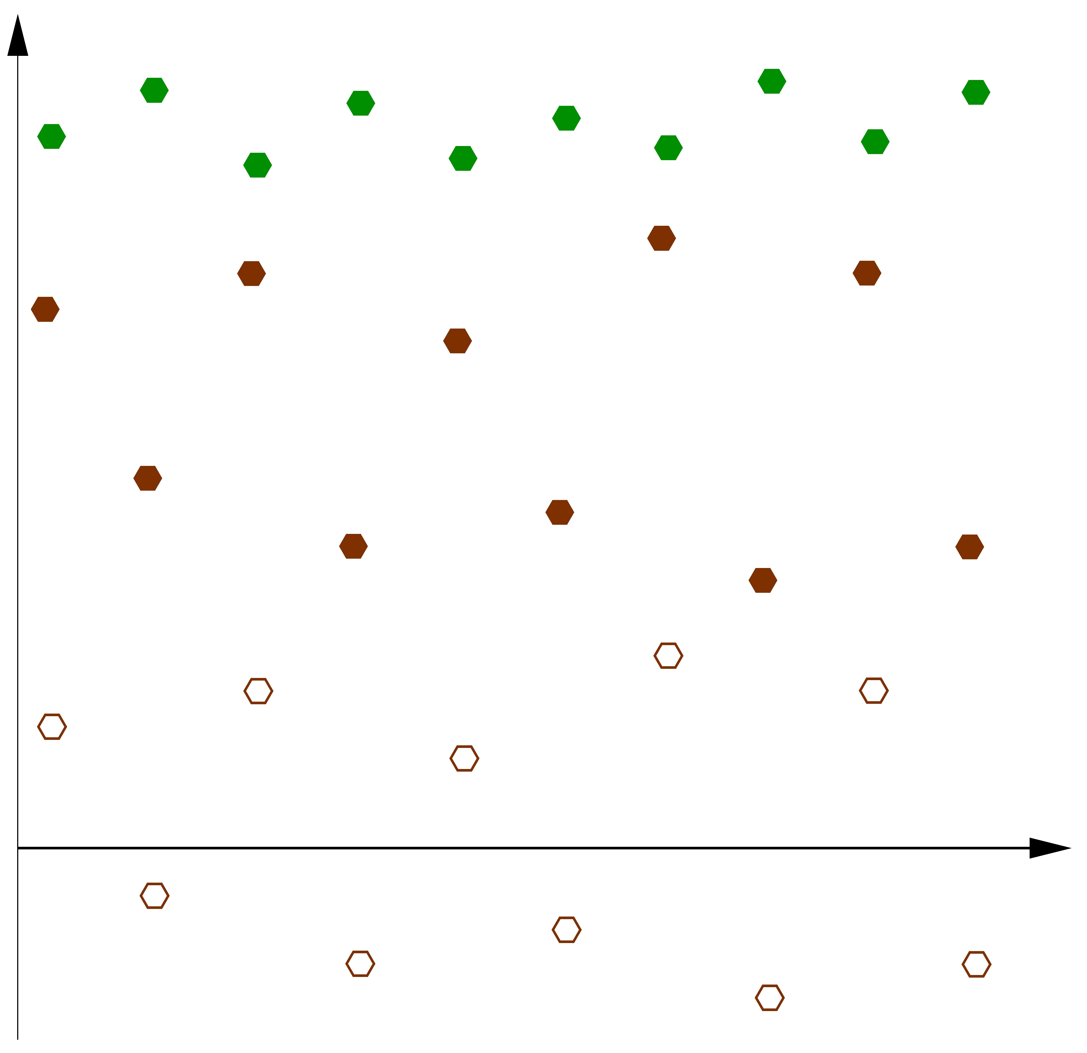
Data assimilation and biases
The model error forcing applied in the model integration corrects the bias in the model
First-guess
Observation
Error

Slide 12
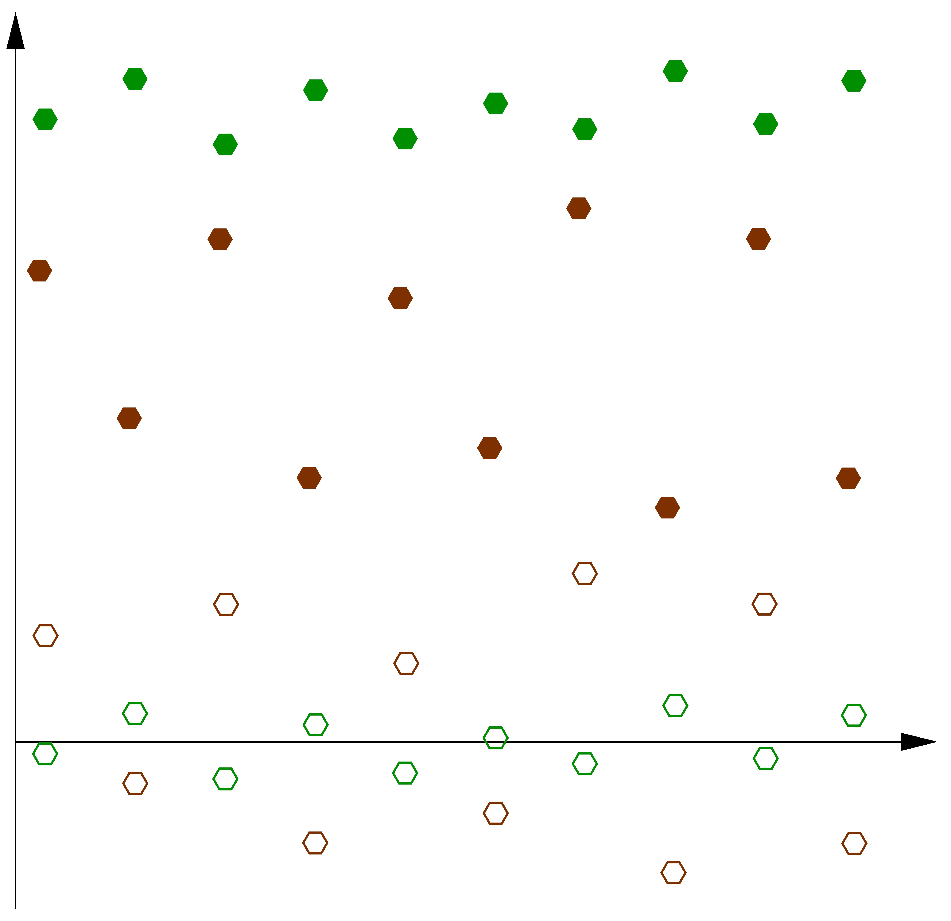
Data assimilation and biases
The unbiased first-guess is used to correct the bias in the observations
First-guess
Observation
Error

Slide 13
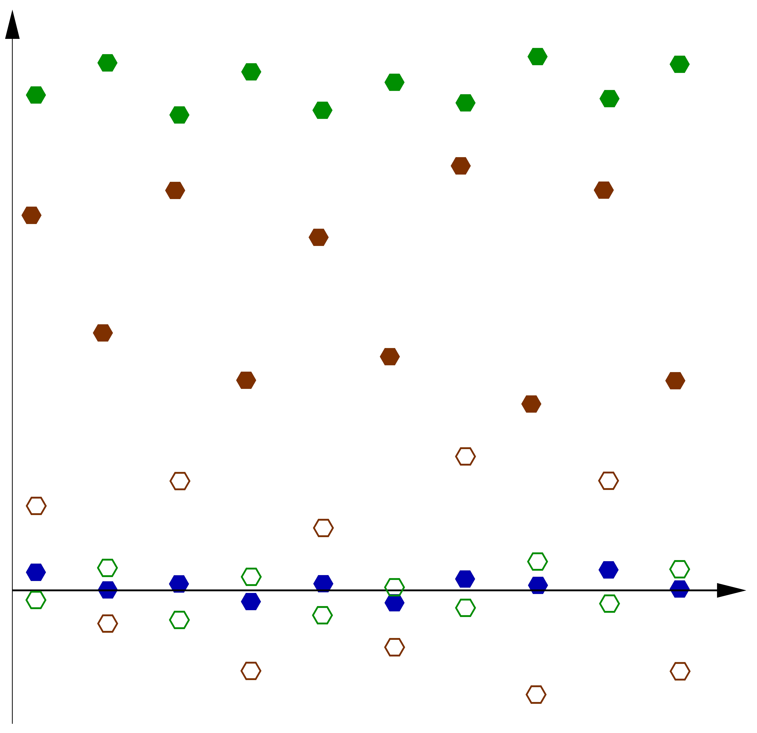
Data assimilation and biases
Bias-corrected first-guess and observations produce an unbiased analysis
First-guess
Observation
Analysis
Error

Slide 14
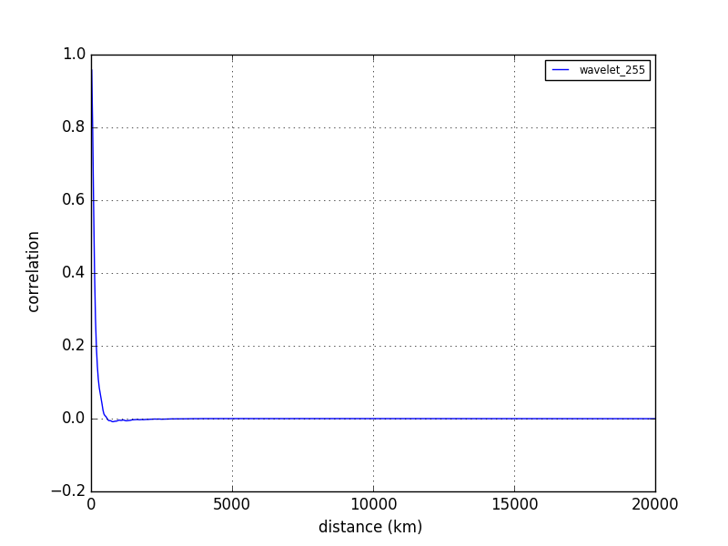
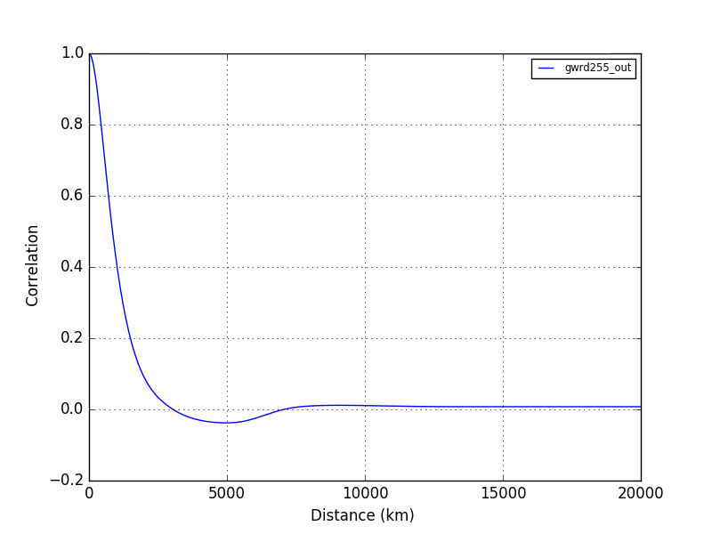
Error covariance matrices in weak-constraint 4D-Var
Model state
Observation bias parameters
Model error forcing
To disentangle the different sources of error, scale separation is enforced
Information spread in B (small scales)
Information spread in Q (long scales)
Correlation
Correlation
Distance (km)
Distance (km)

Slide 15
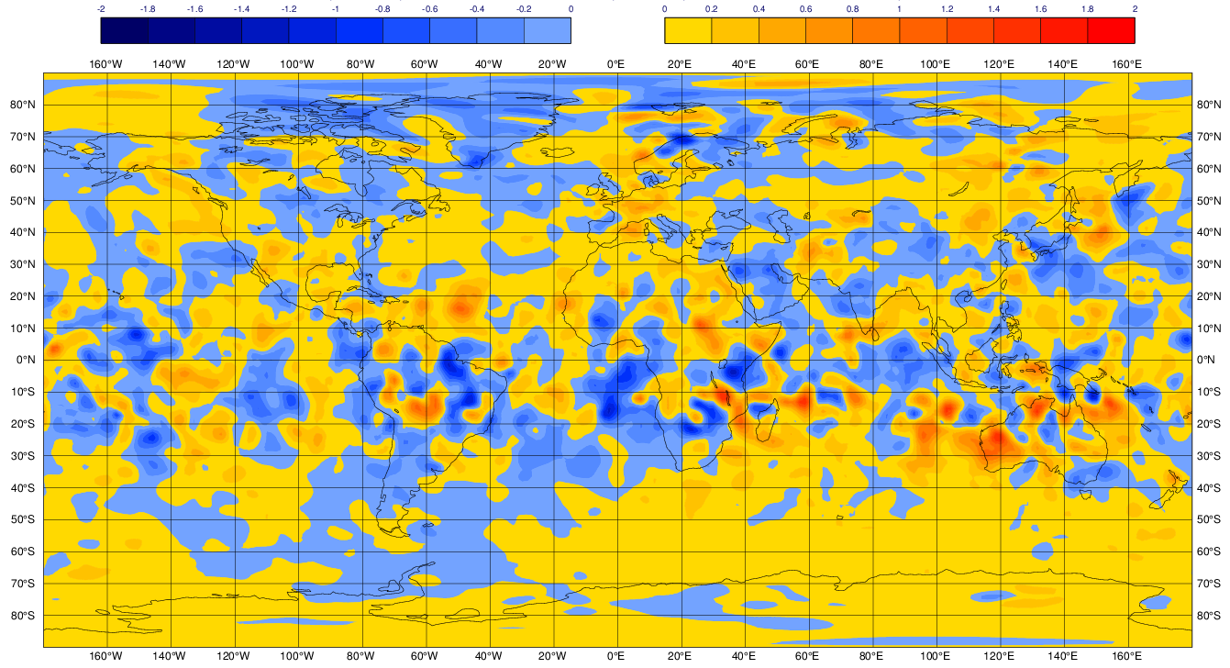
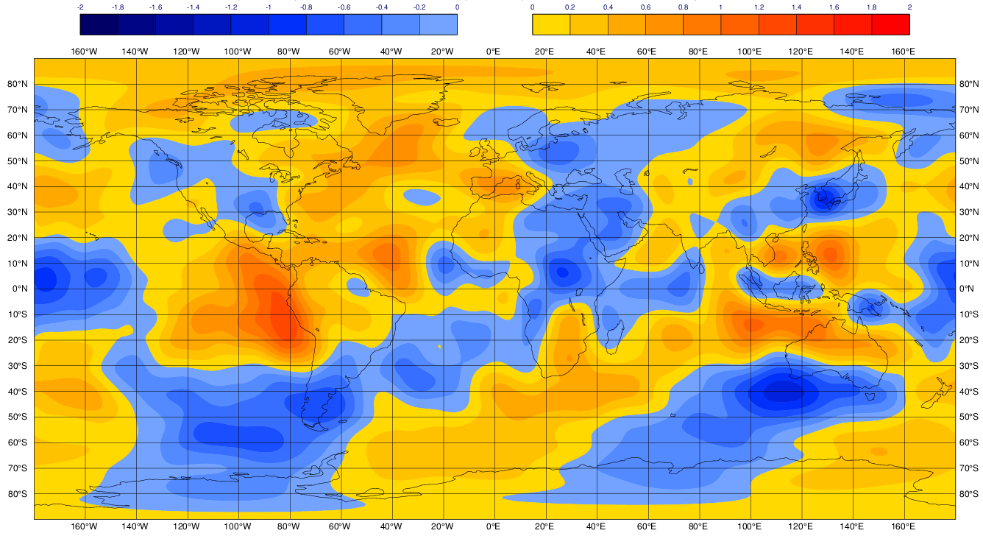
Error covariance matrices in weak-constraint 4D-Var
Model state
Observation bias parameters
Model error forcing
To disentangle the different sources of error, scale separation is enforced
Model state increment (small scales)
Model forcing error increment (long scales)

Slide 16
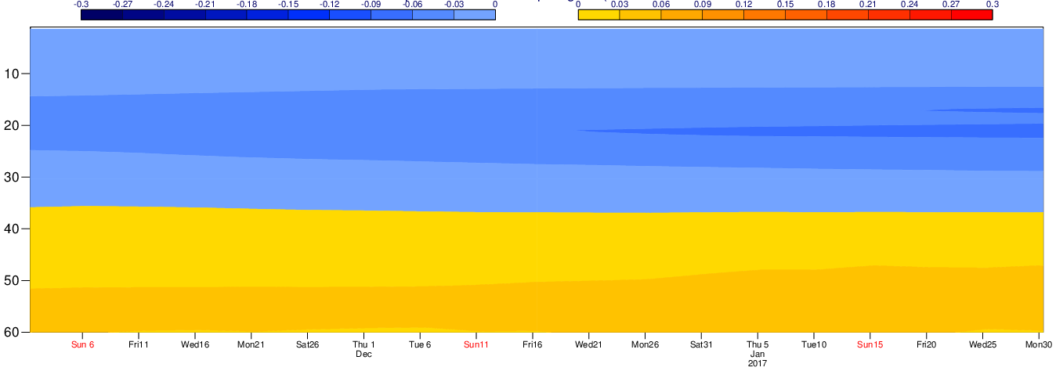
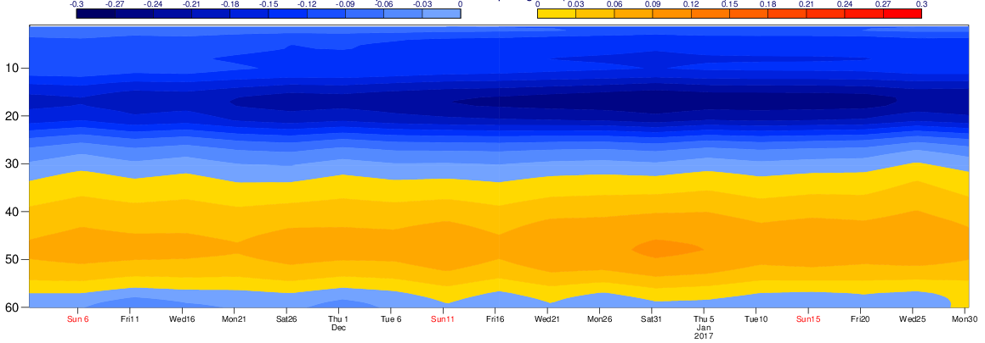
Weak-constraint 4D-Var for the stratospheric temperature bias
Model error forcing (Old Q)
GPS-RO retrieved T
Nov 2017
Feb 2018
Model error forcing (New Q with scale separation)
Forecast departure 24H
Nov 2017
Feb 2018

Slide 17
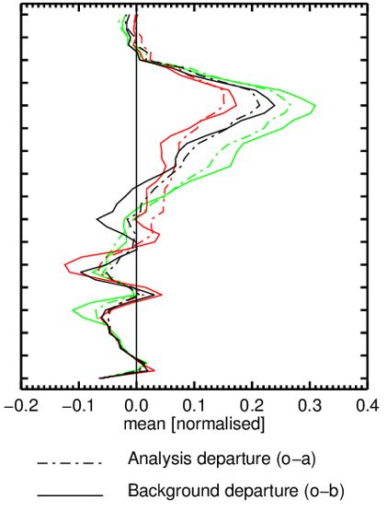
Weak-constraint 4D-Var for the stratospheric temperature bias
Analysis and first-guess departures with respect to GPS-RO bending angles
No model error term
Old Q
New Q
→ Significant reduction in the mean error

Slide 18
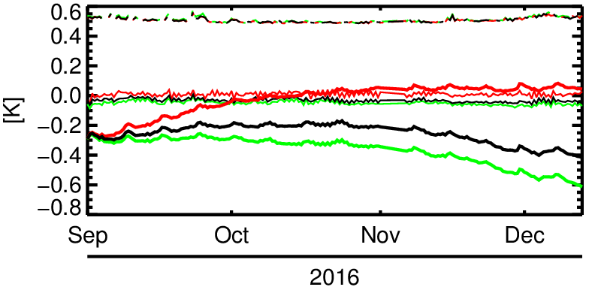
Weak-constraint 4D-Var for the stratospheric temperature bias
Timeseries of first-guess departure (fg_departure = obs – fg -VarBC) for AMSU-A 13
No model error term
Old Q
New Q
→ Smaller VarBC correction (thick lines) with new Q

Slide 19
Conclusions
4D-Var developed at ECMWF is getting more sophisticated
weak-constraint 4D-Var to take the model bias into account
Disentangle the different sources of error is challenging
scale separation between B and Q
reduce the tropospheric temperature bias
Weak-constraint 4D-Var in the troposphere might not be possible
properties of biases are different
scale separation is more challenging

