Slide 1
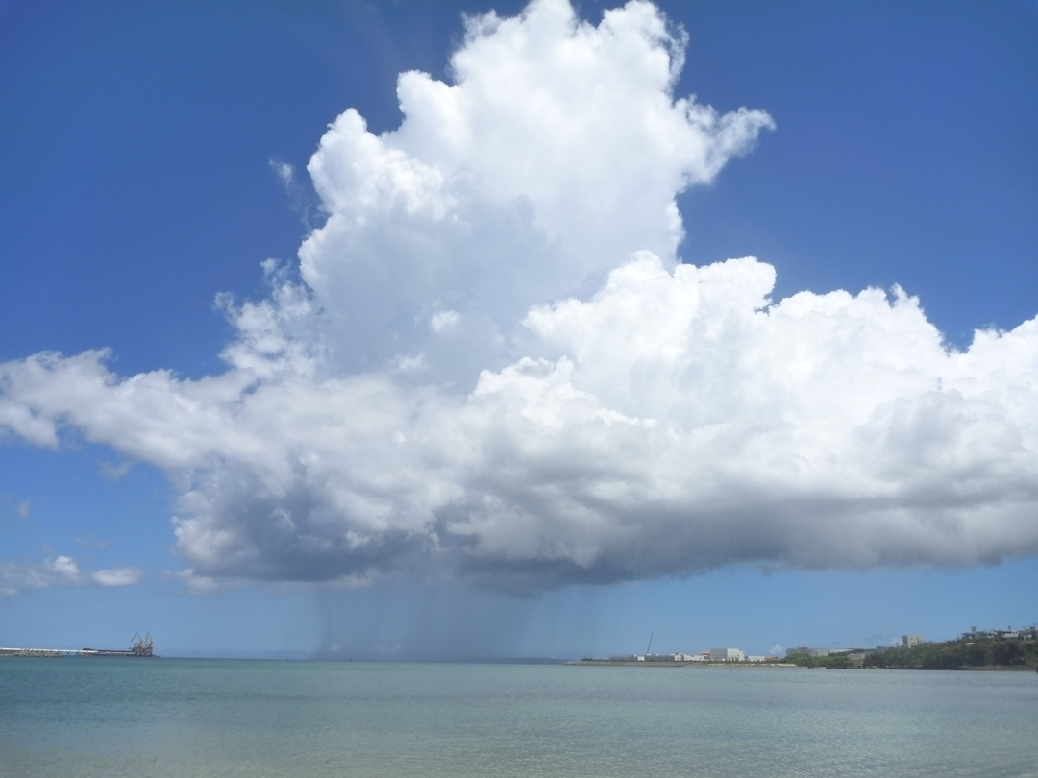
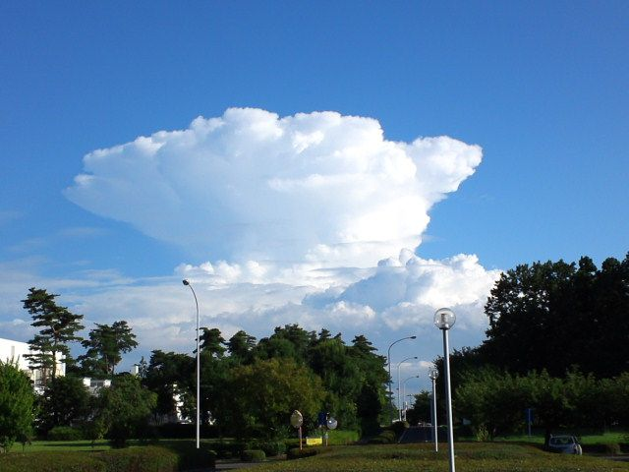
A storm-scale particle filter for investigating predictability of convection initiation and development
Difficult to predict
Takuya Kawabata
Meteorological Research Institute / Japan Meteorological Agency
Genta Ueno
The Institute of Statistical Mathematics
Many thanks to
Drs. Seko, Hotta, Yokota, Sawada, Hashimoto and Tsuyuki

Slide 2
Difficult to predict?
Answer: Low predictability
Next question:
What is indeed the source of chaos
in convective storms?
Chaos = Strong nonlinearity
→ Investigate it using an ensemble system dealing with nonlinearity!
Two types of predictability: Practical & Intrinsic (Lorenz 1996; F. Zhang et al. 2006)
Practical Predictability : Depends on NWP systems
Intrinsic Predictability : Upper bound of predictability even if perfect NWP systems were applied.
← depends on phenomenon itself
Zhang et al. (2006) showed intrinsic predictability on mesoscale prediction was originated in a cumulous parameterization.
→ It is clear that the upper bound of the predictability exists
as long as convective storms exist in predictions.
Chaotic system!

Slide 3
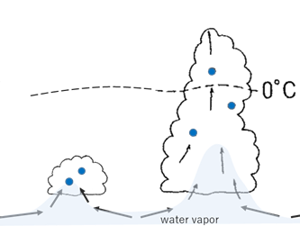
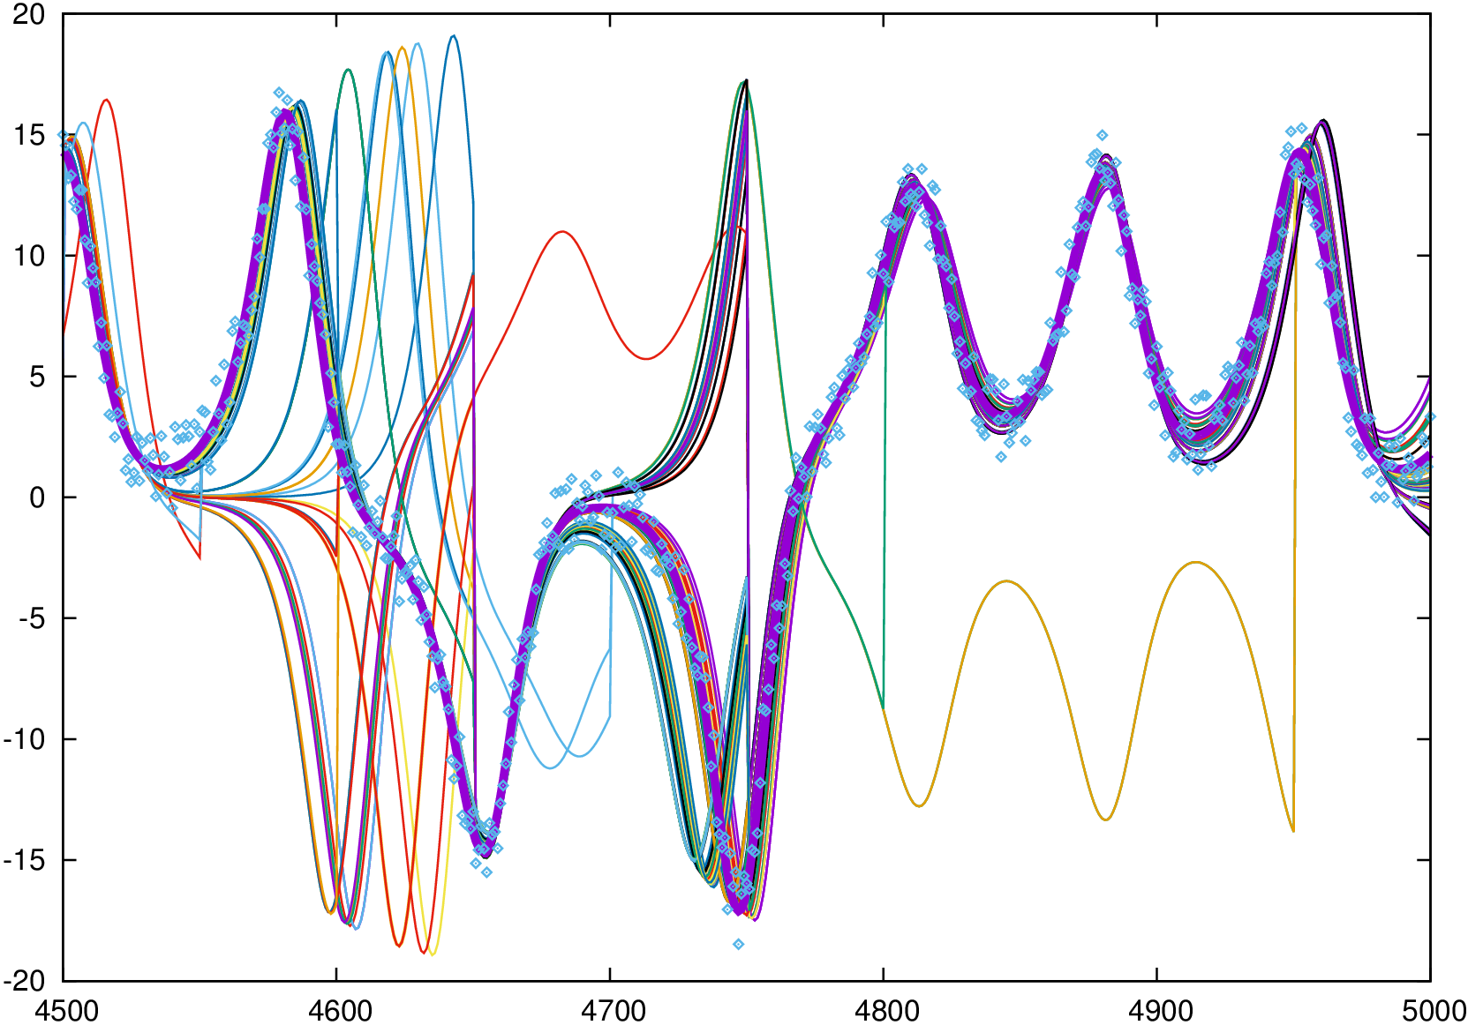
Concept of the study
Trajectories of 100 particles predicted and filtered by Lorenz model and PF
large spread
Single realization highly developed cumulonimbus
Obs
The PDFs should be non-Gaussian.
Need an ensemble system based on non-Gaussianity.
large variance in environment
Small spread
Hypothesis:
It will be observed large spread of the particles in environmental fields before the CI.
Time
Two groups at the initial stage of the Cb:
highly developed Cb or low developed Cu
Earlier or later developed

Slide 4
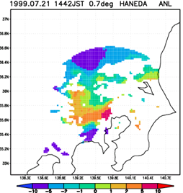
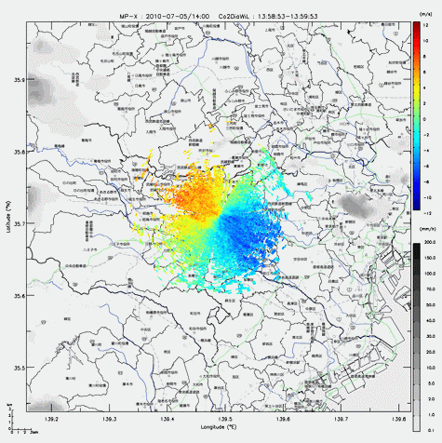
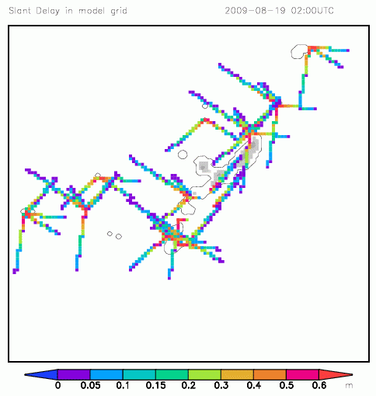
NHM-PF
Sampling Importance Resampling (SIR) filter
JMANHM (Saito et al. 2006; 2007; 2012)
The JMA mesoscale nonhydrostatic model
- 2-moment cloud microphysics (3-ice)
- MY 3.0 or Deadorff (1980)
Additive inflation with climatological noise
Dynamical estimation of R (Ueno and Nakamura 2016)
Advanced observational operators developed for NHM-4DVAR (Kawabata et al. 2007; 2011; 2014a; 2014b; 2018)
- Conventional data, wind profiler
- Radial velocity and reflectivity by weather radars
- Doppler lidar, GNSS IWV, ZTD, SPD, Dual Pol., RASS

Slide 5
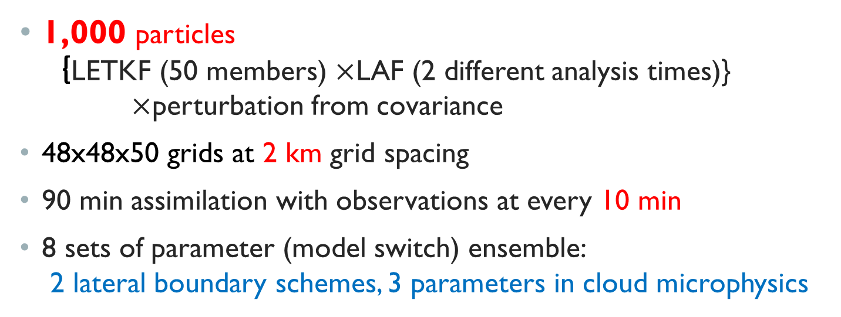
Design of osse
1,000 particles
｛LETKF (50 members) $×$LAF (2 different analysis times)}
$×$perturbation from covariance
48x48x50 grids at 2 km grid spacing
90 min assimilation with observations at every 10 min
8 sets of parameter (model switch) ensemble:
2 lateral boundary schemes, 3 parameters in cloud microphysics
NoDA
10 min
Obs
1000
particles
90 min

Slide 6
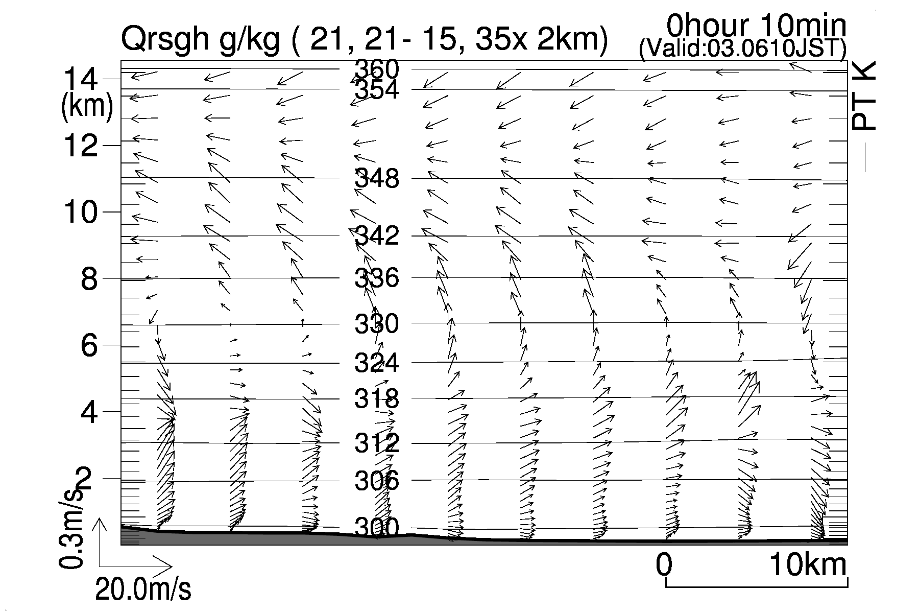
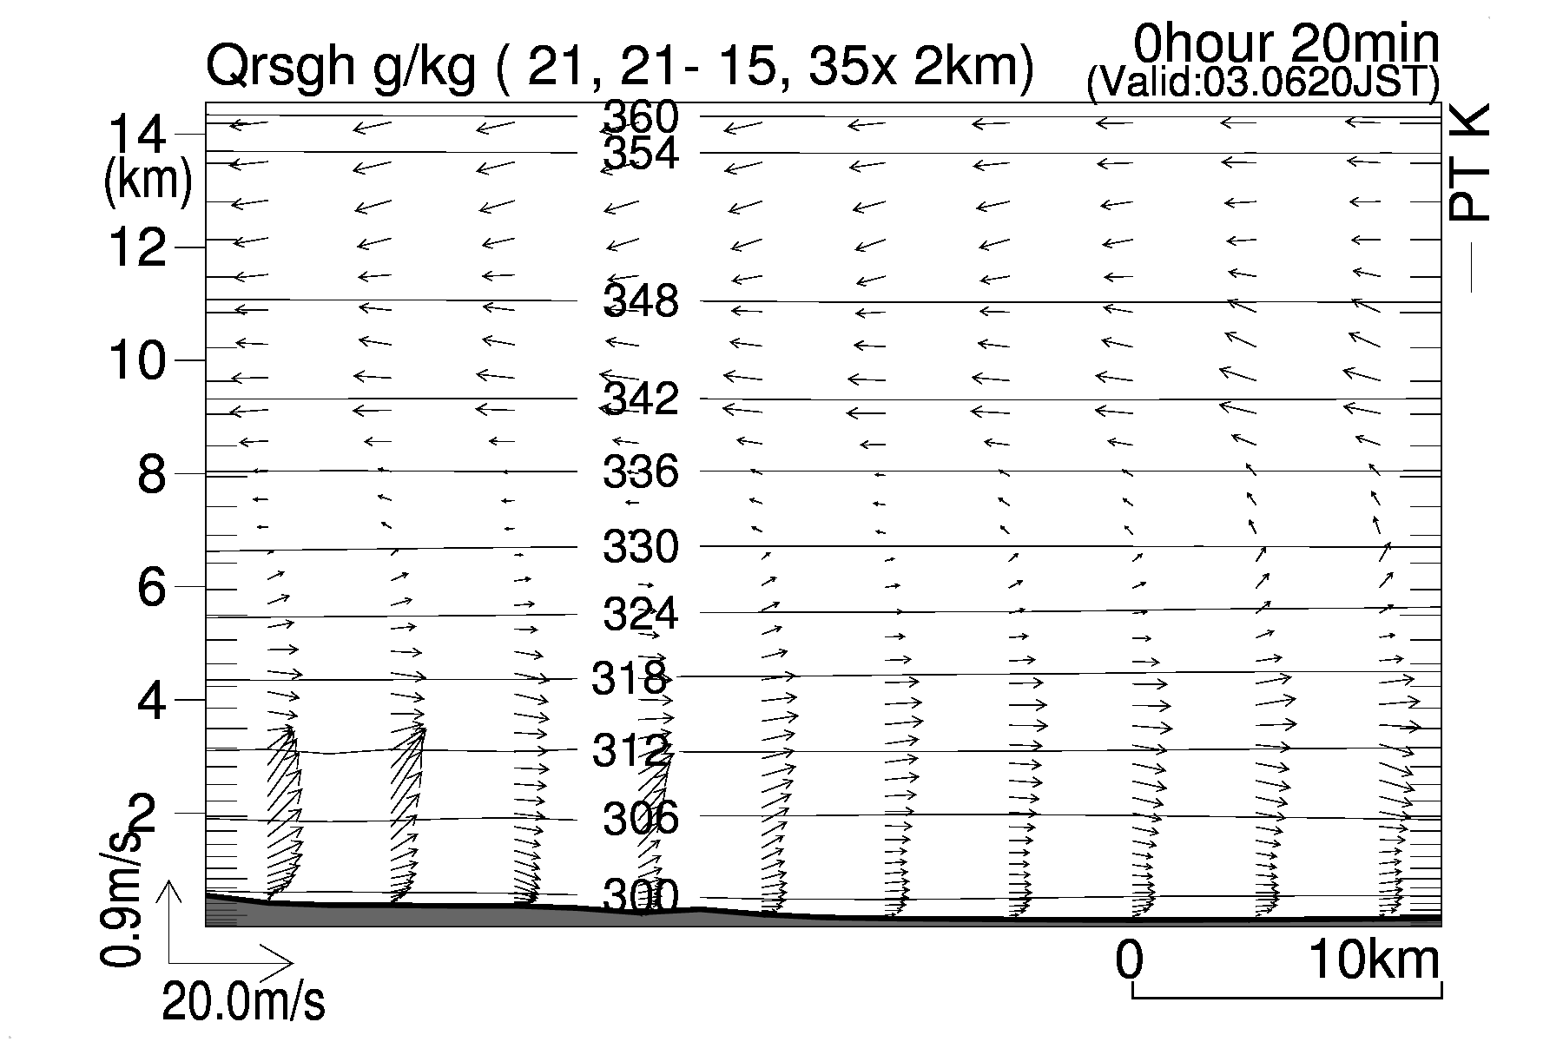
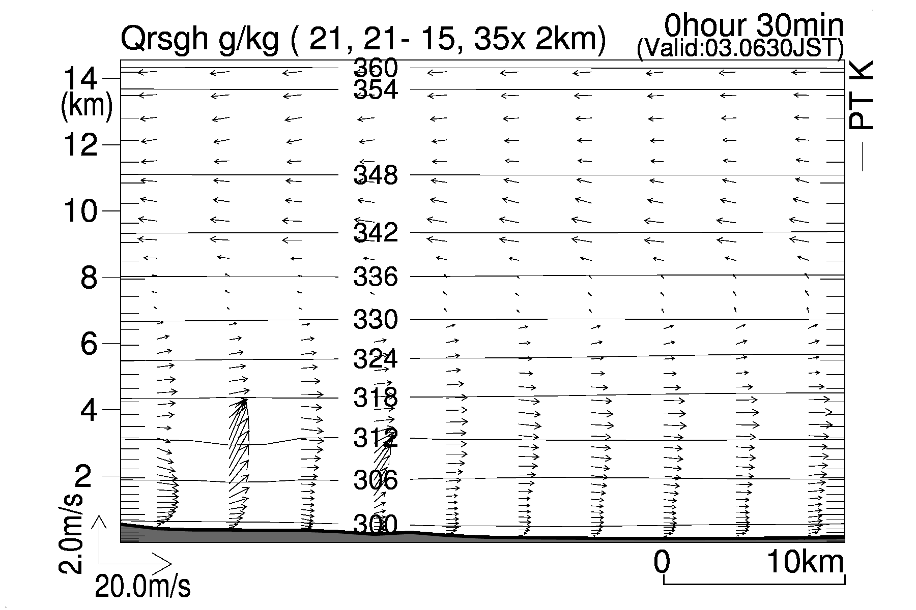
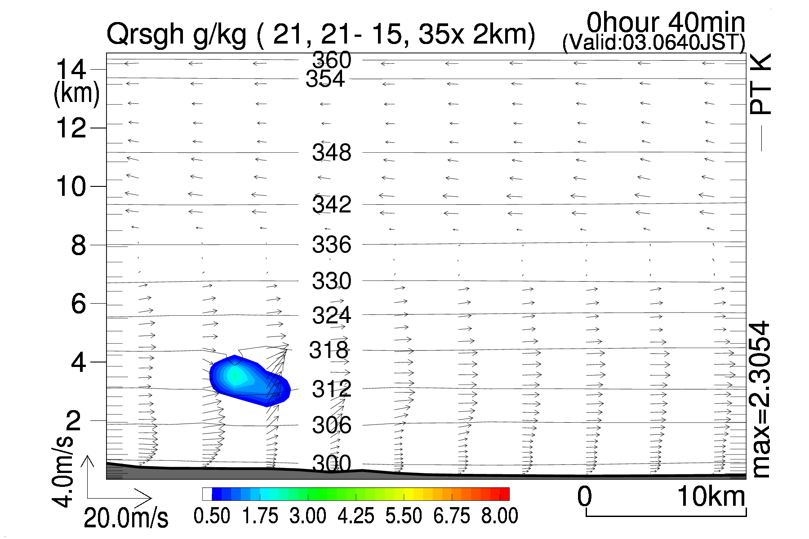
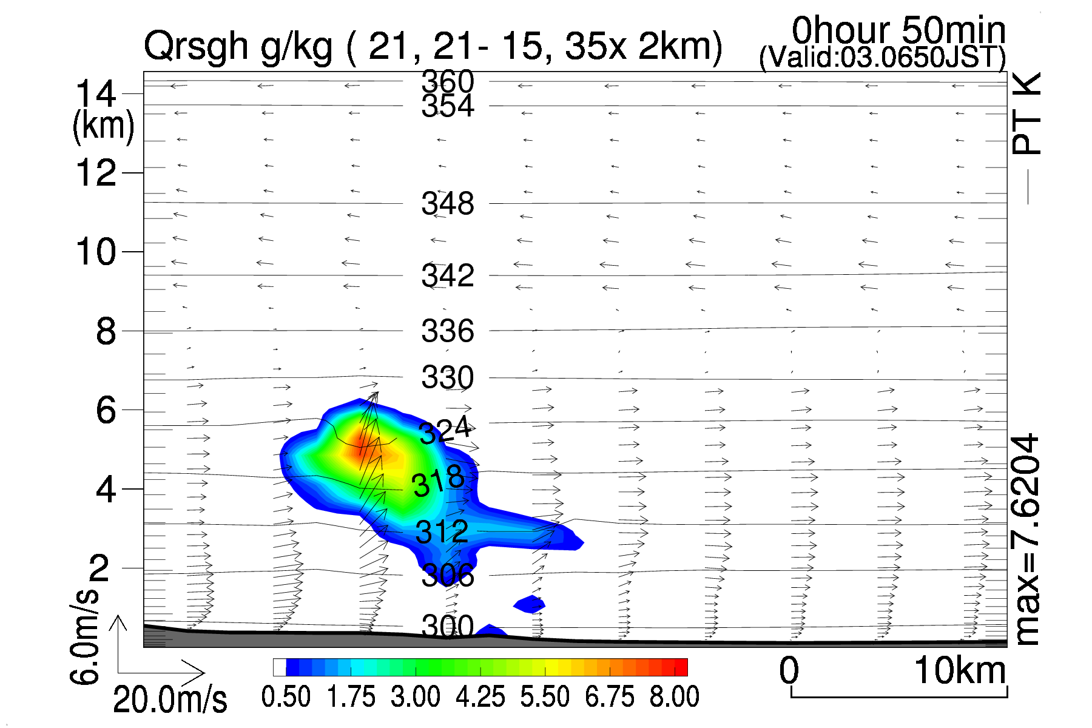
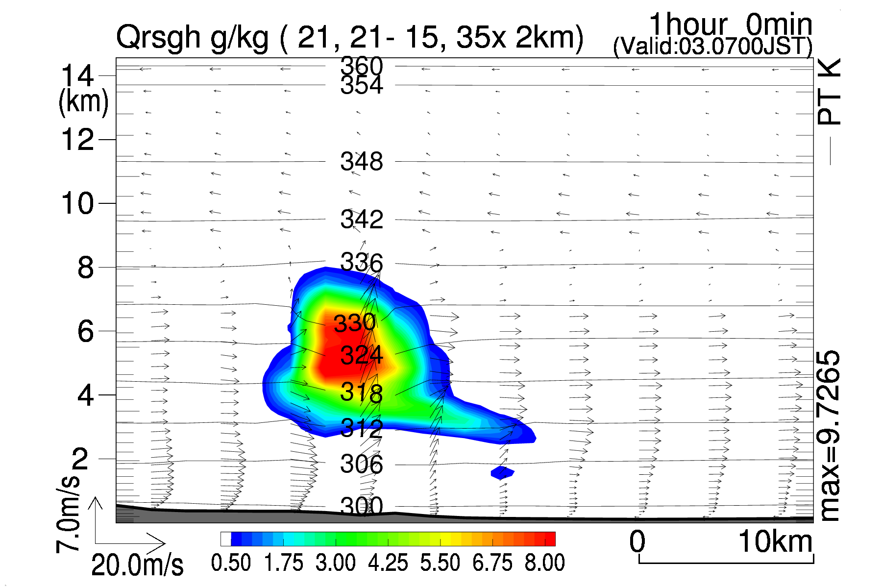
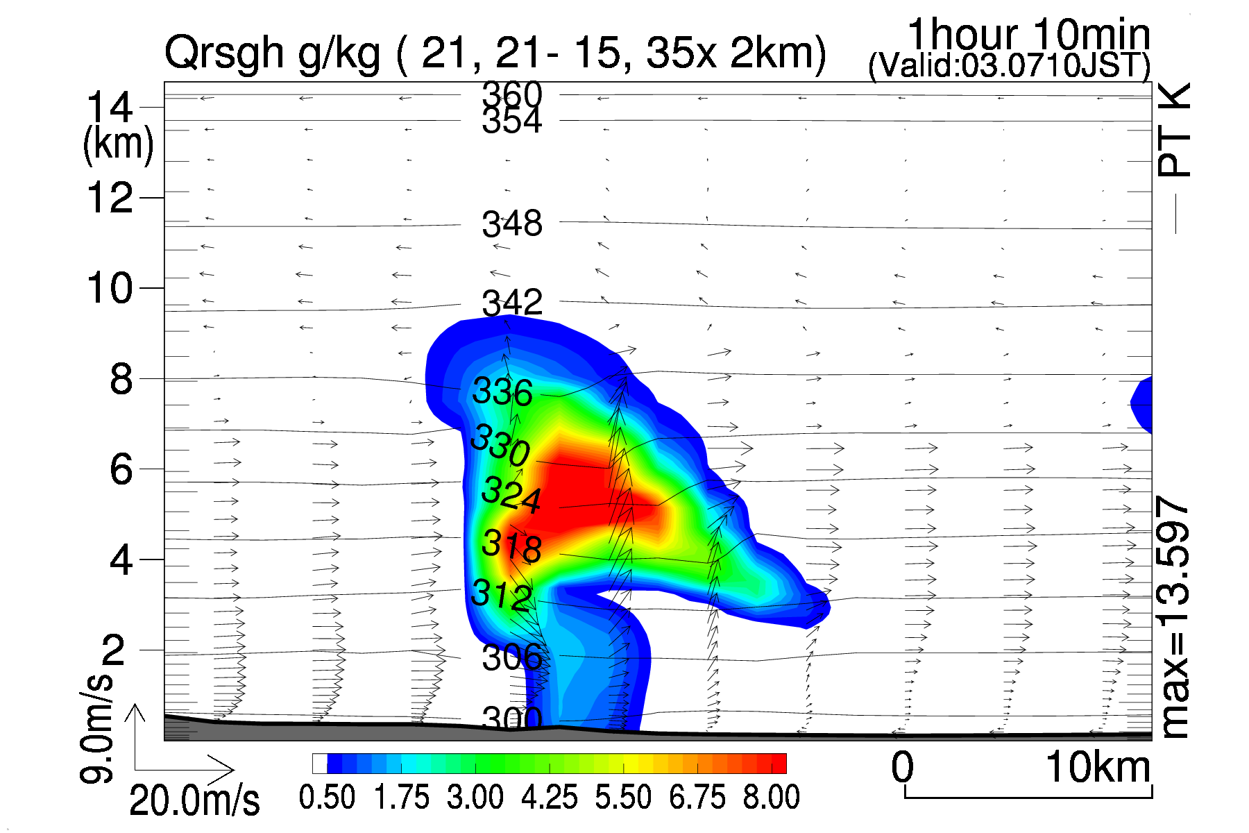
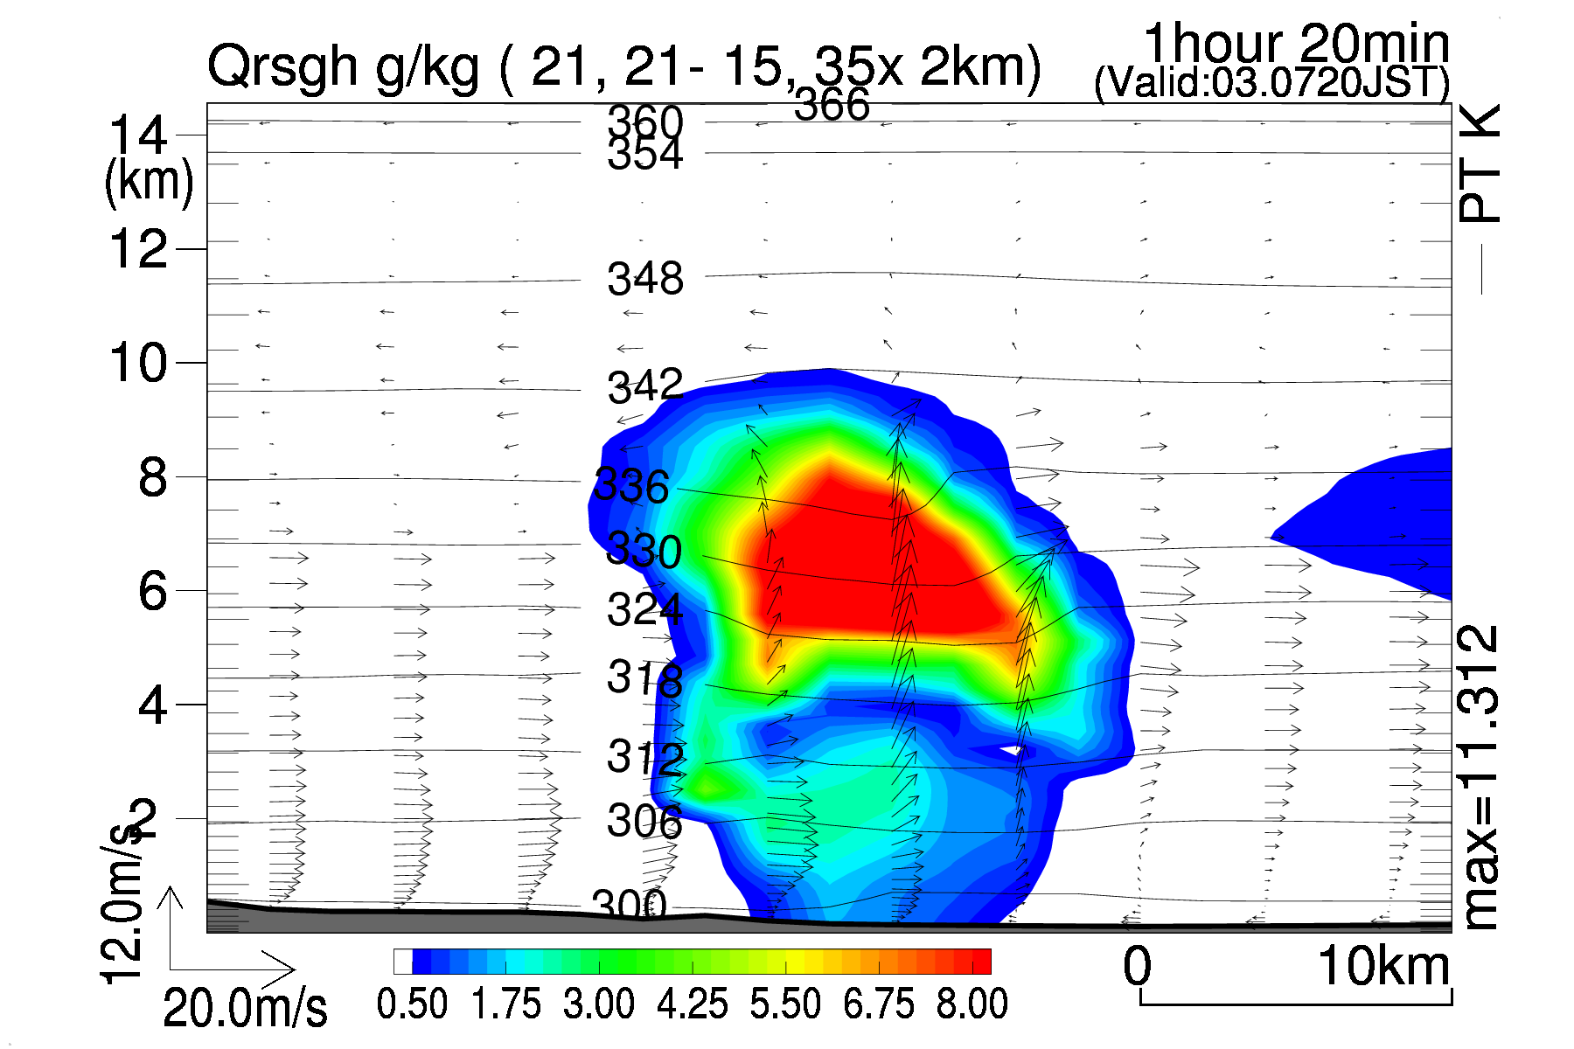
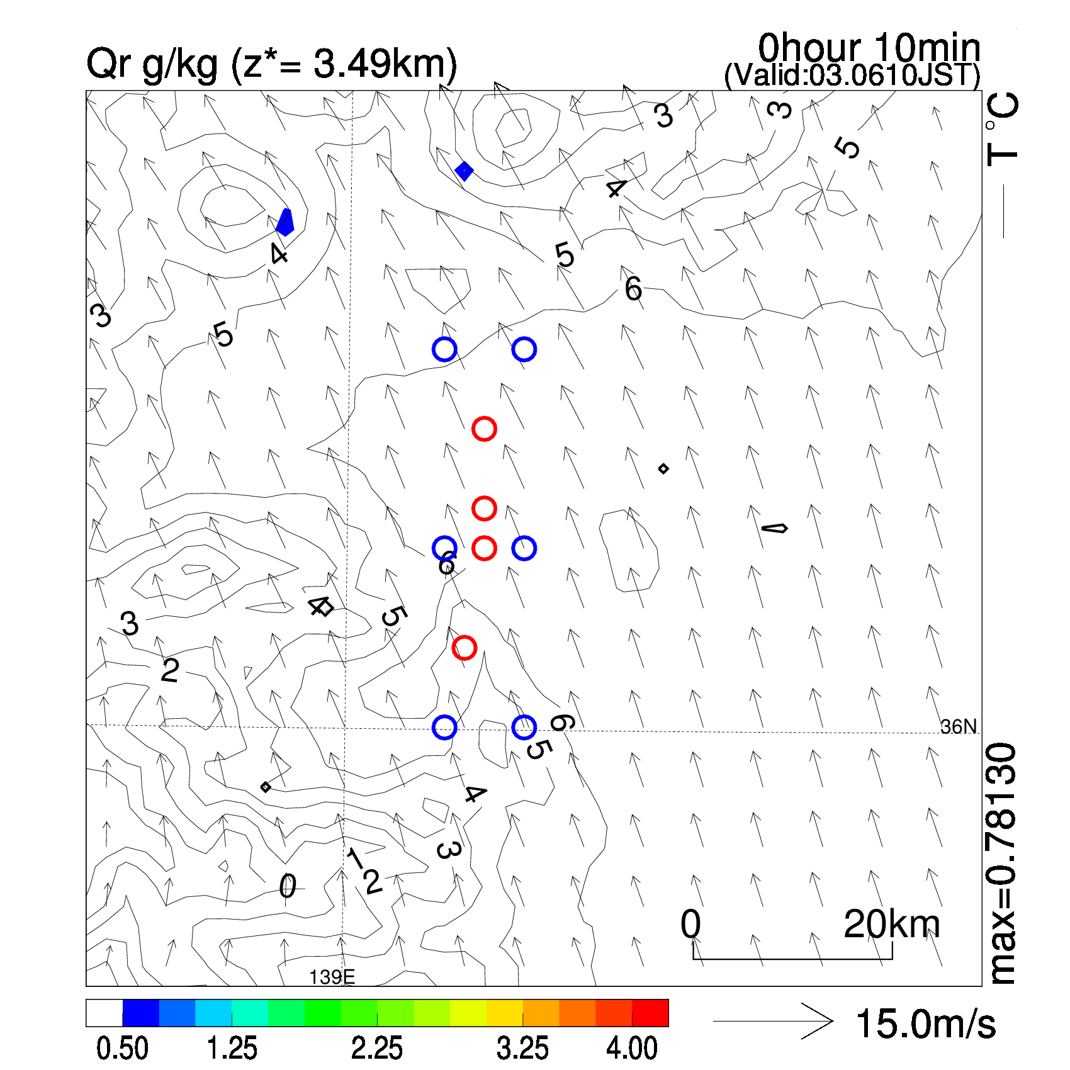
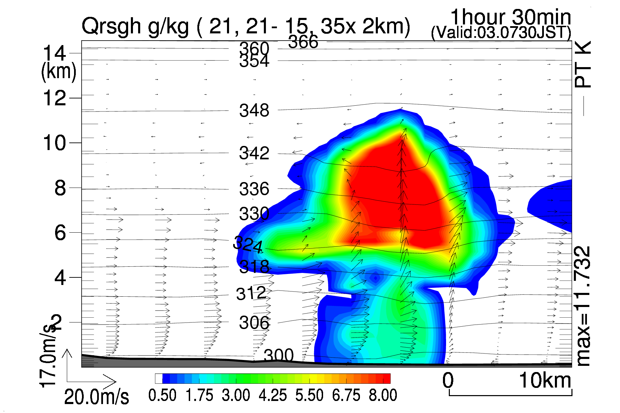
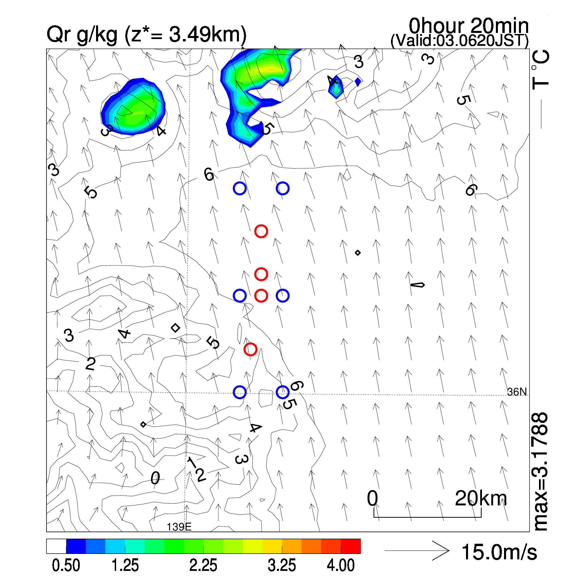
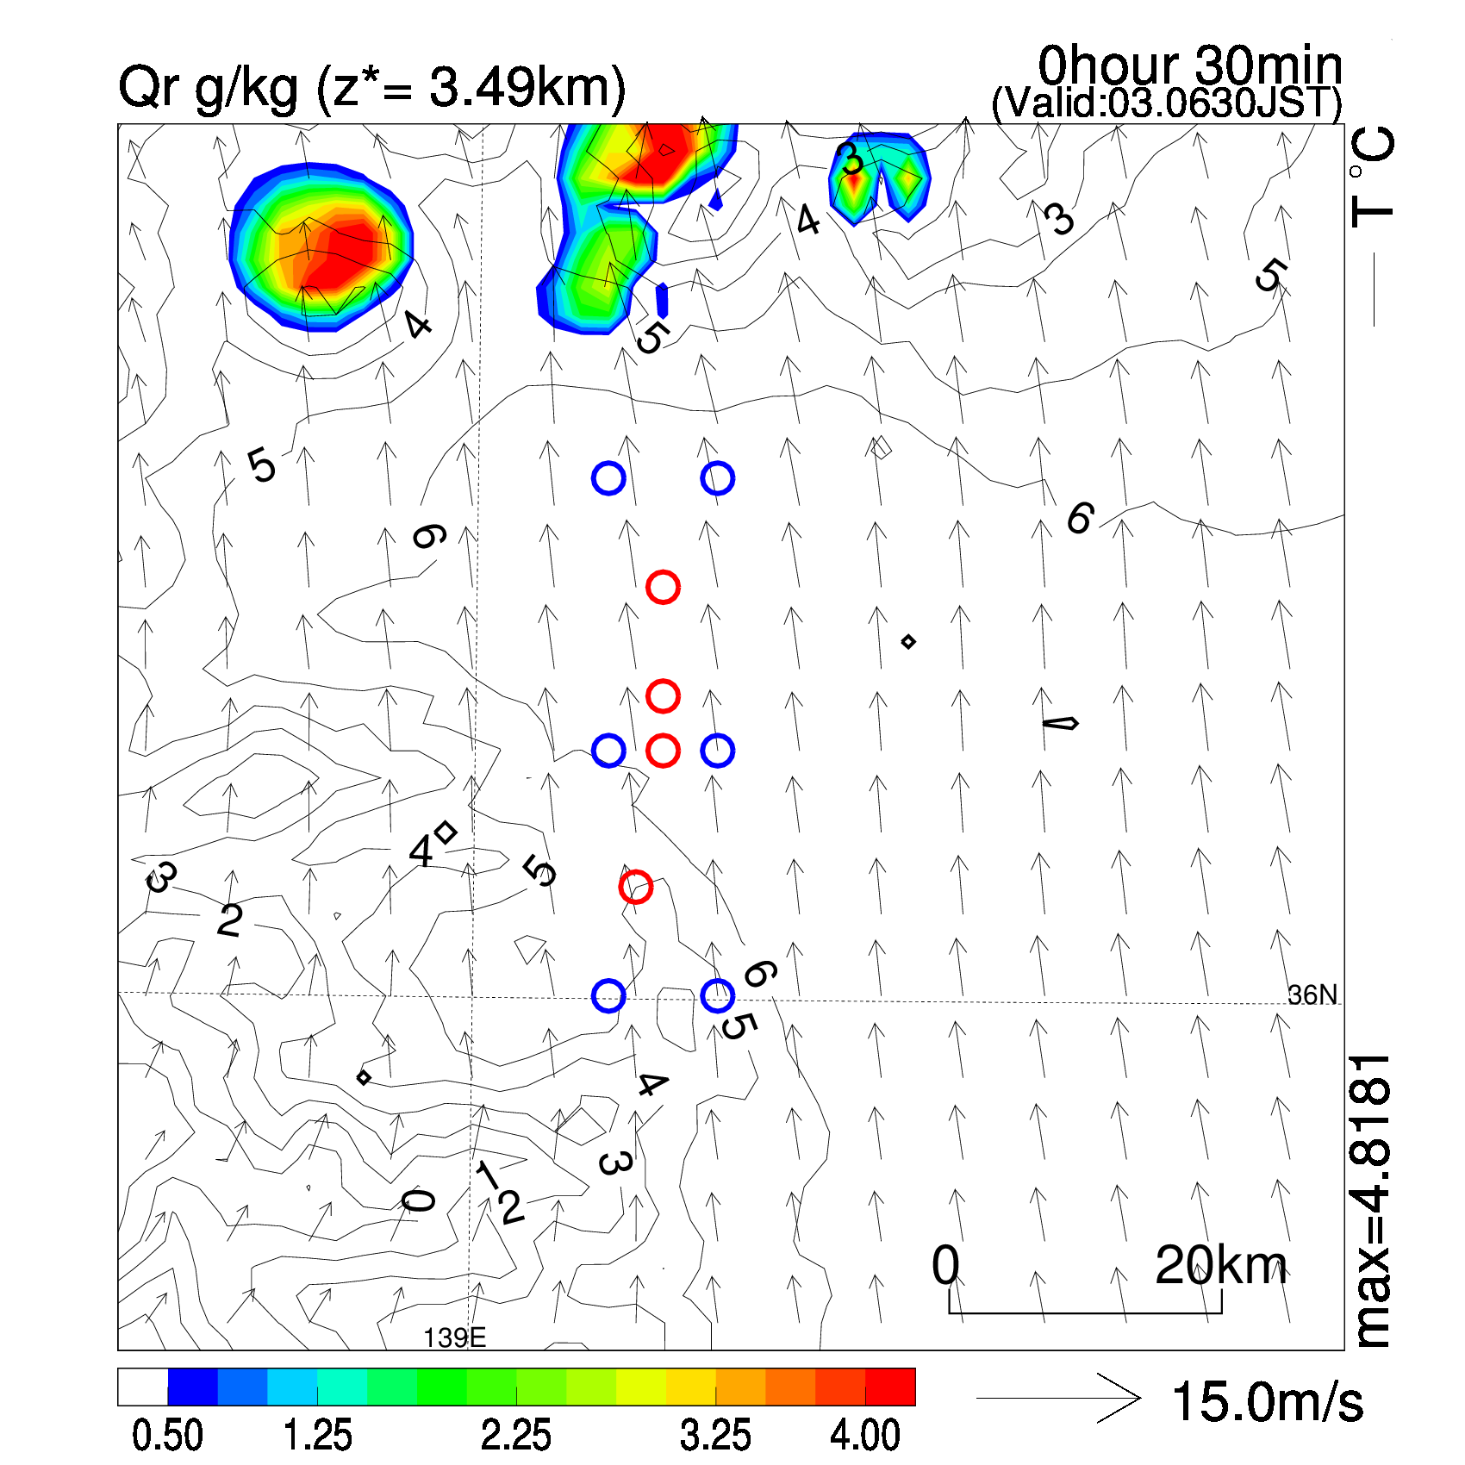
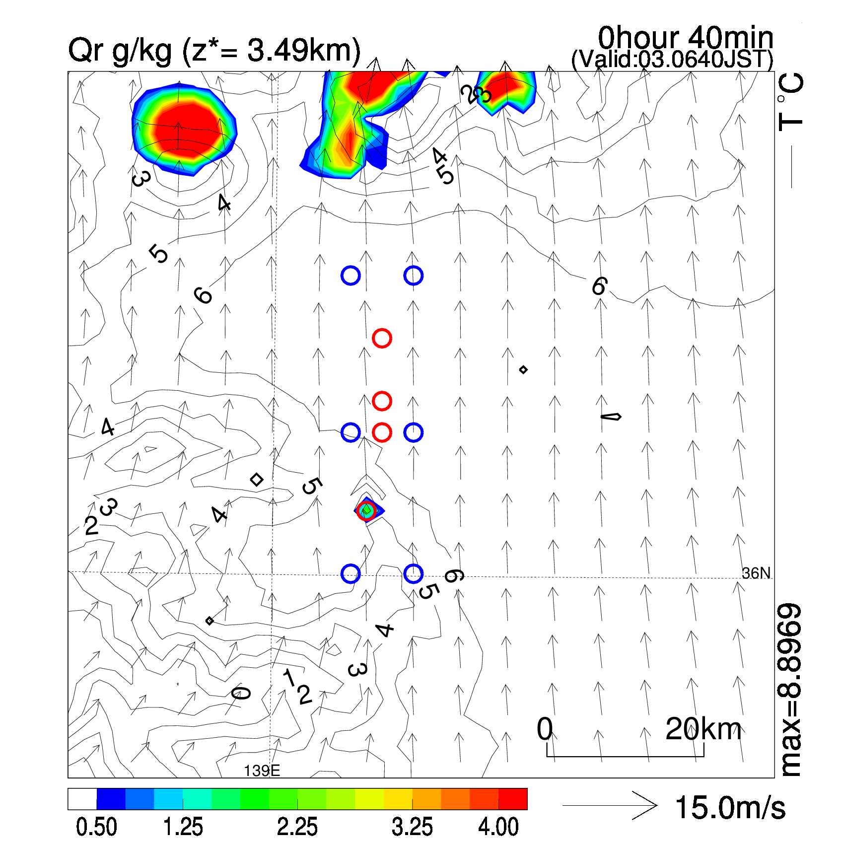
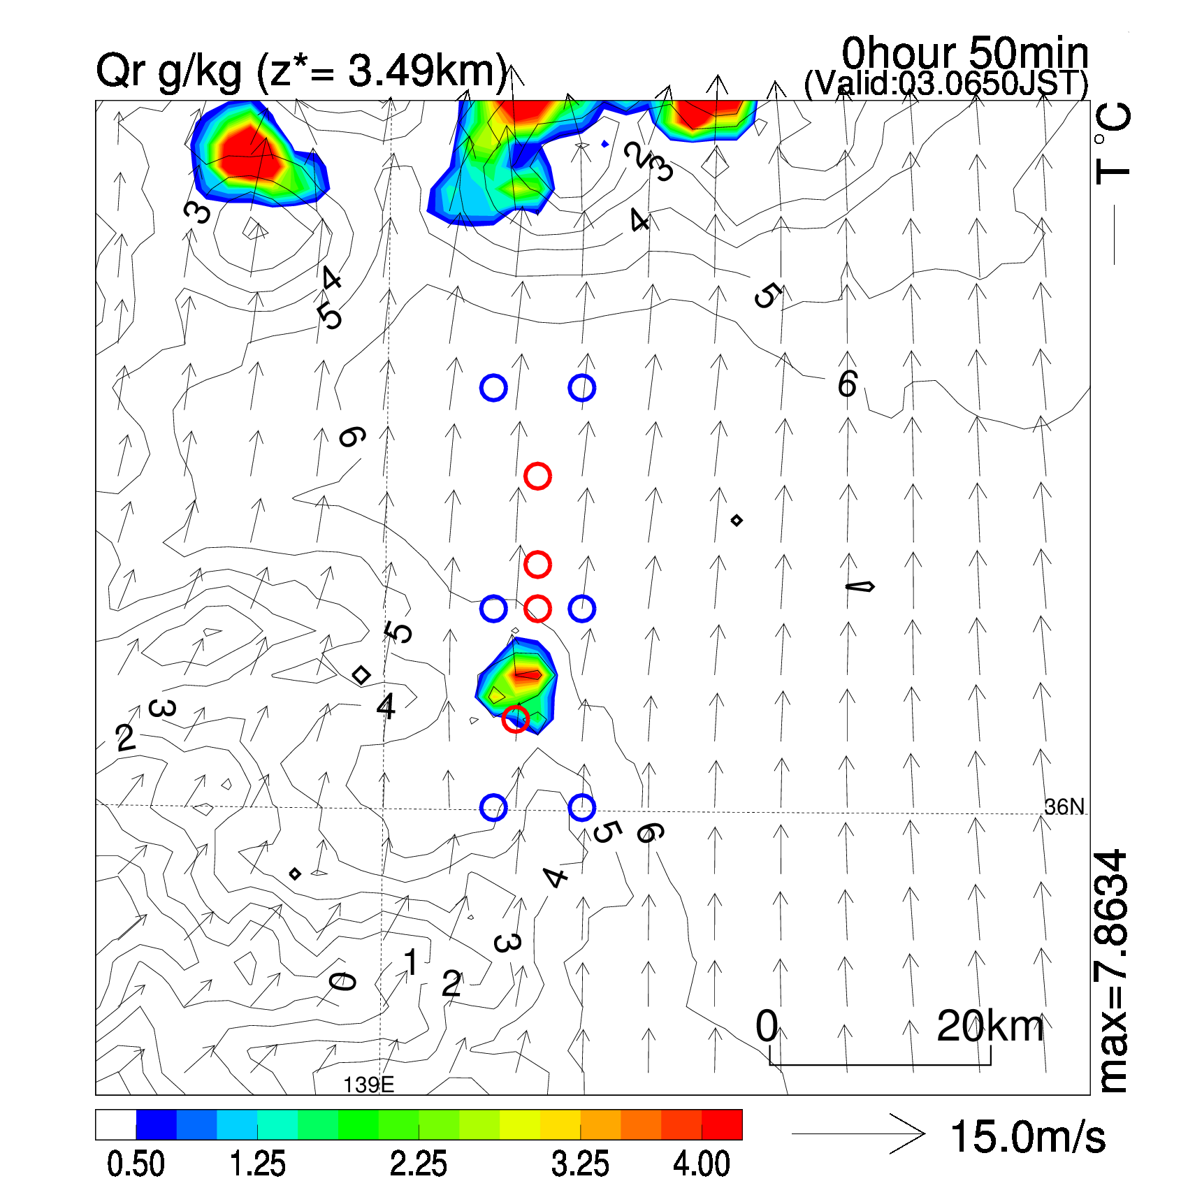
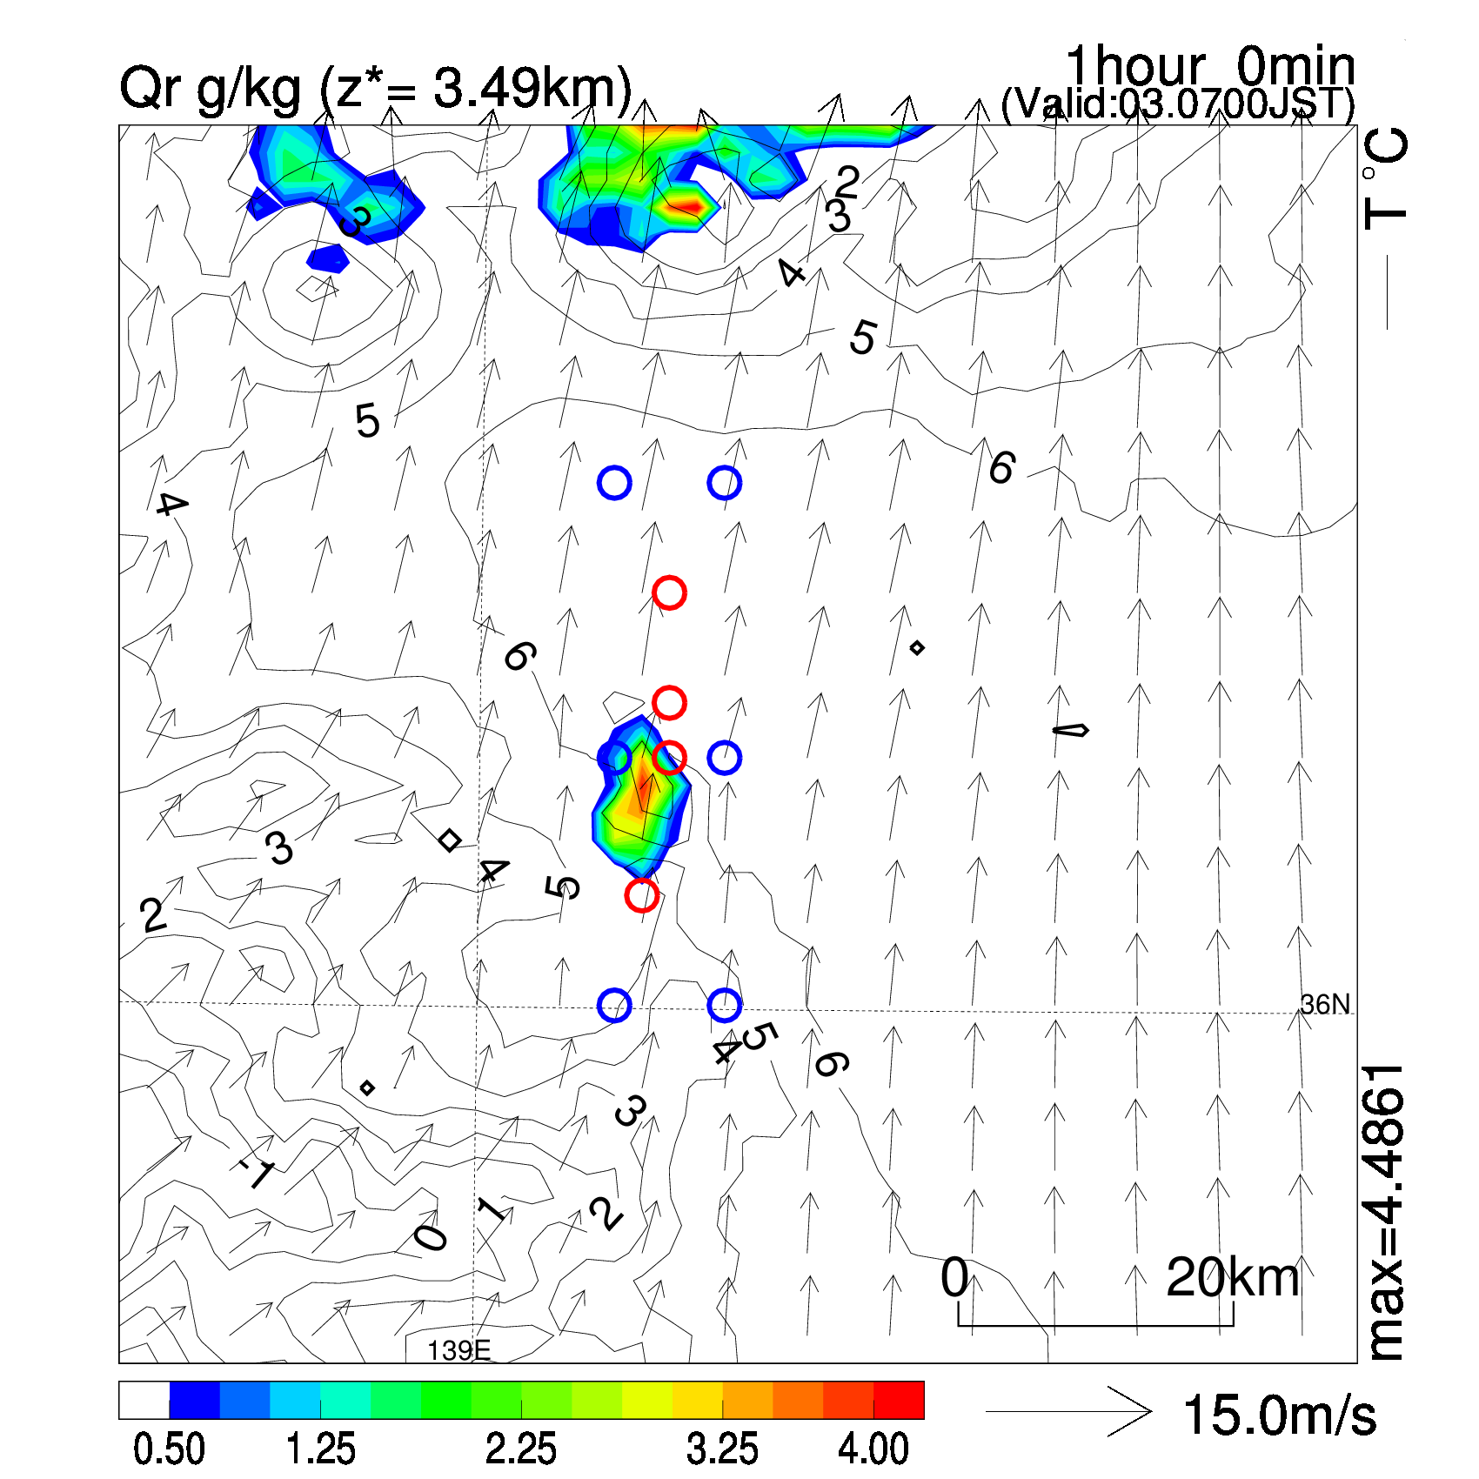
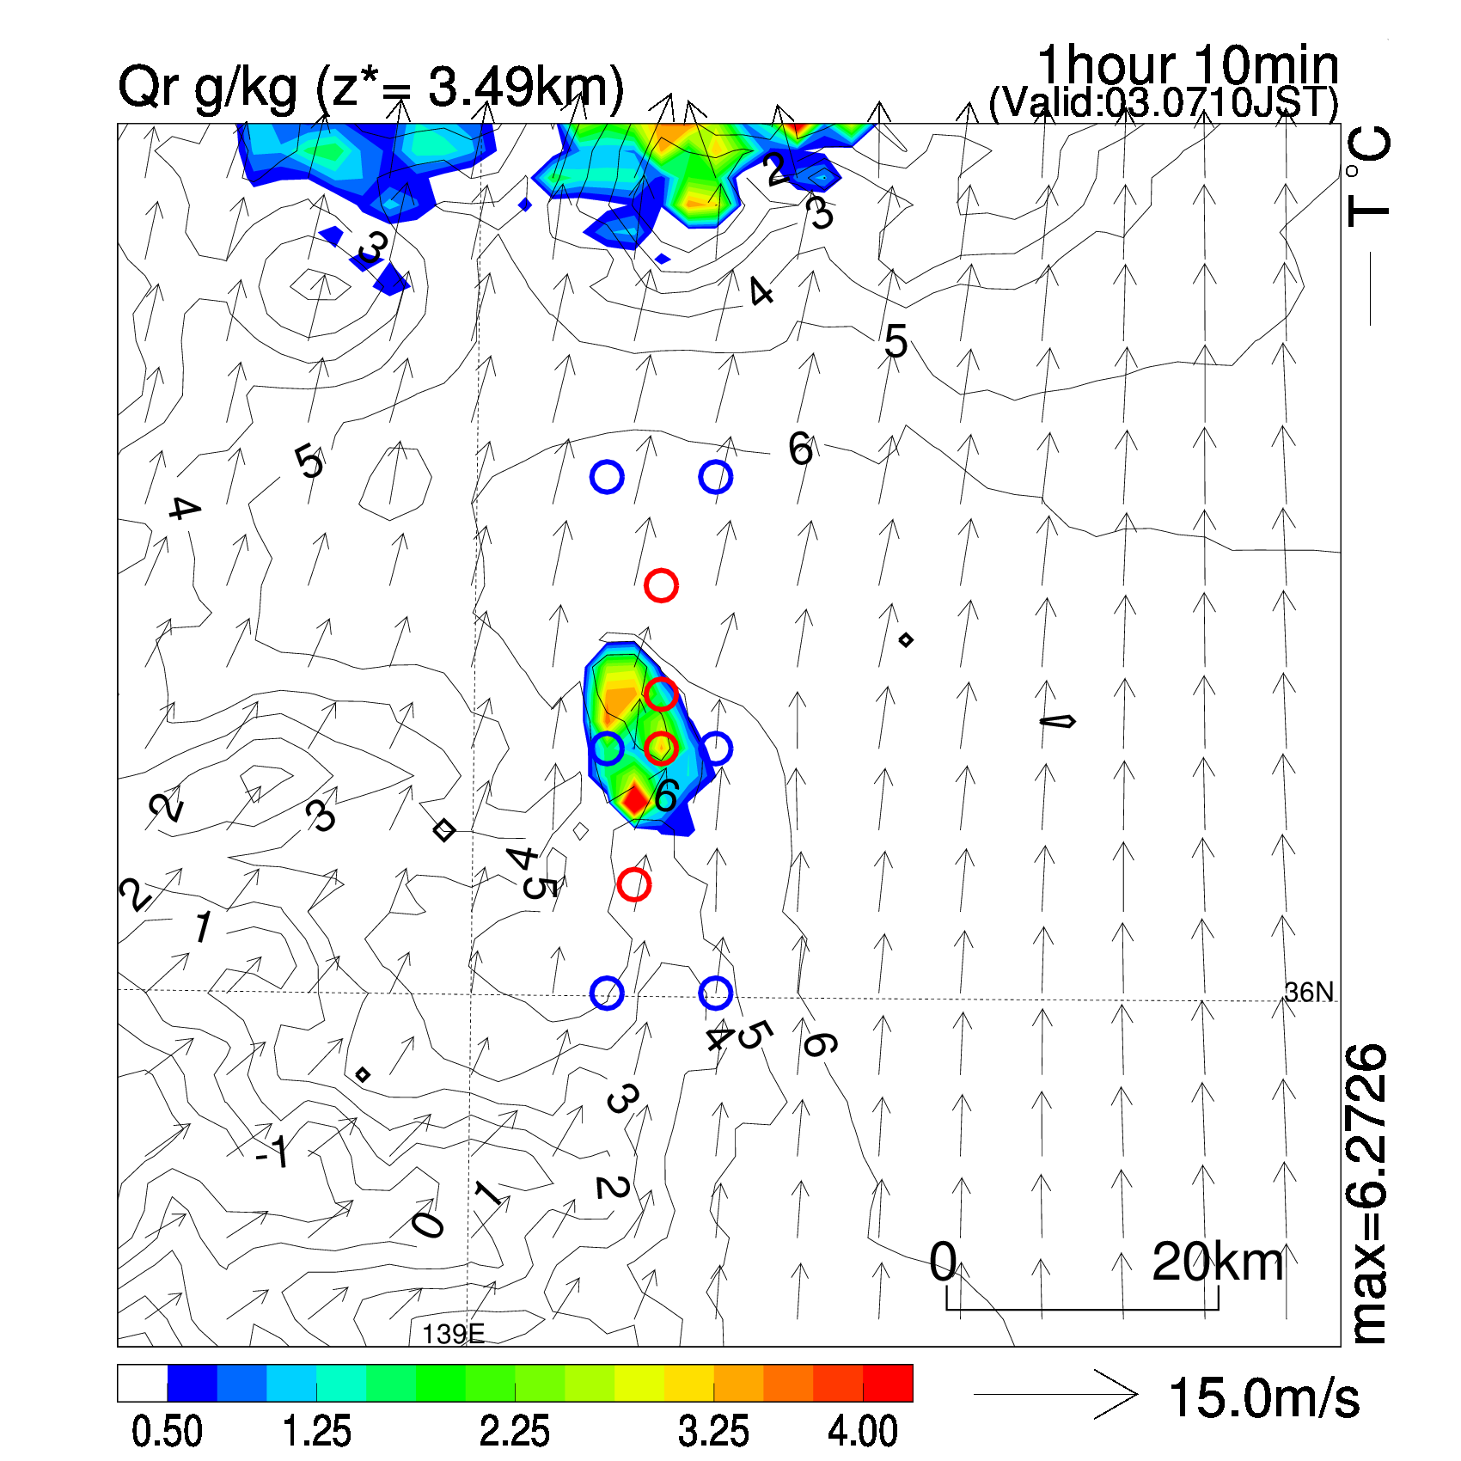
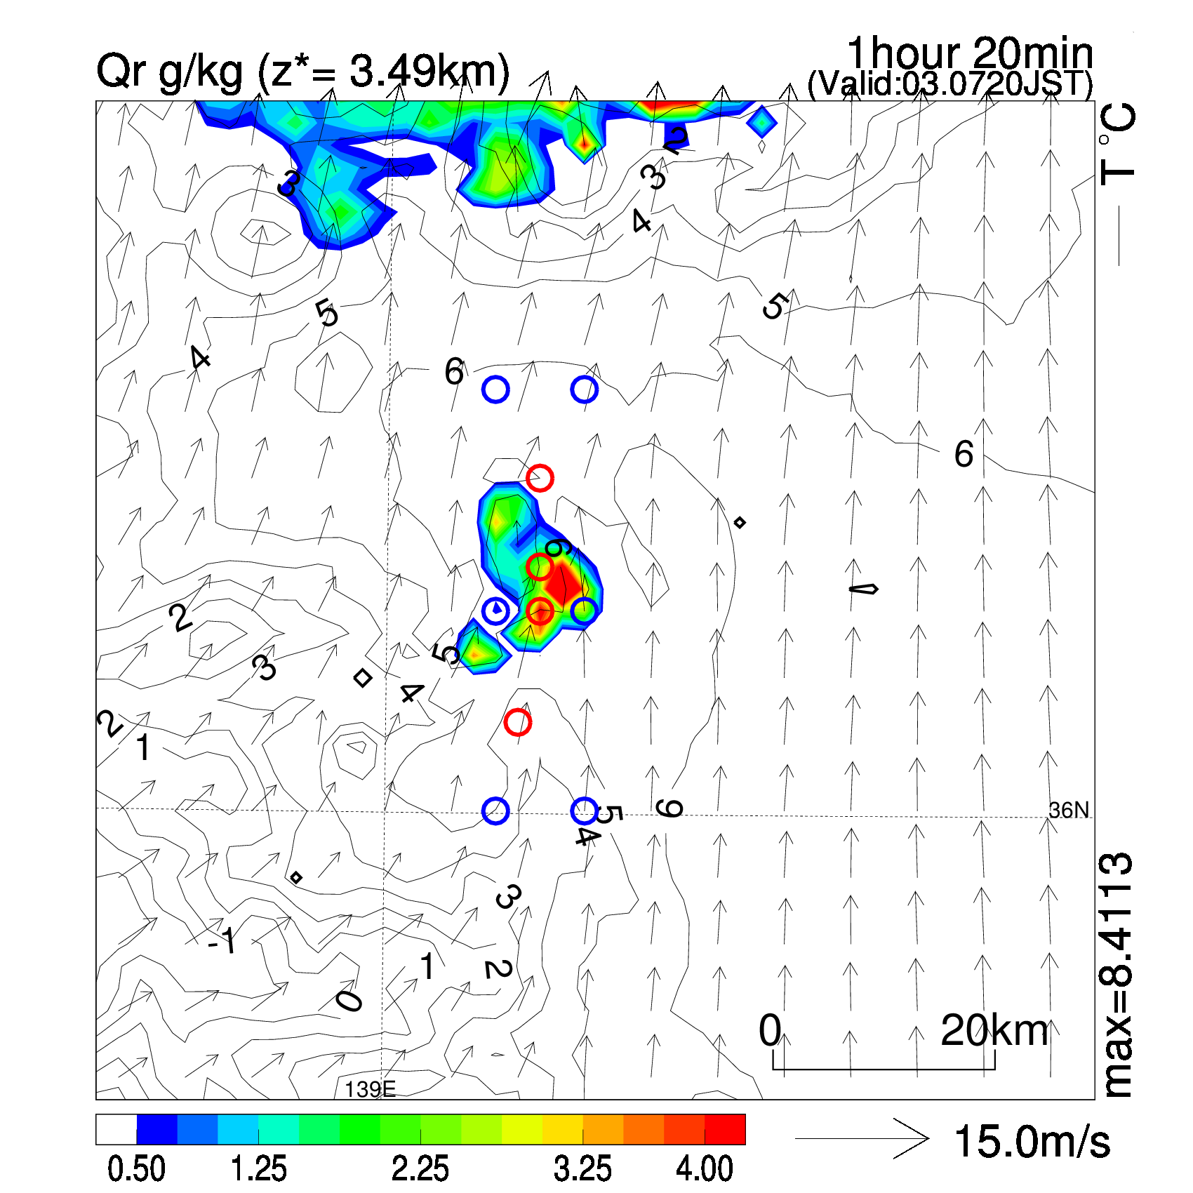
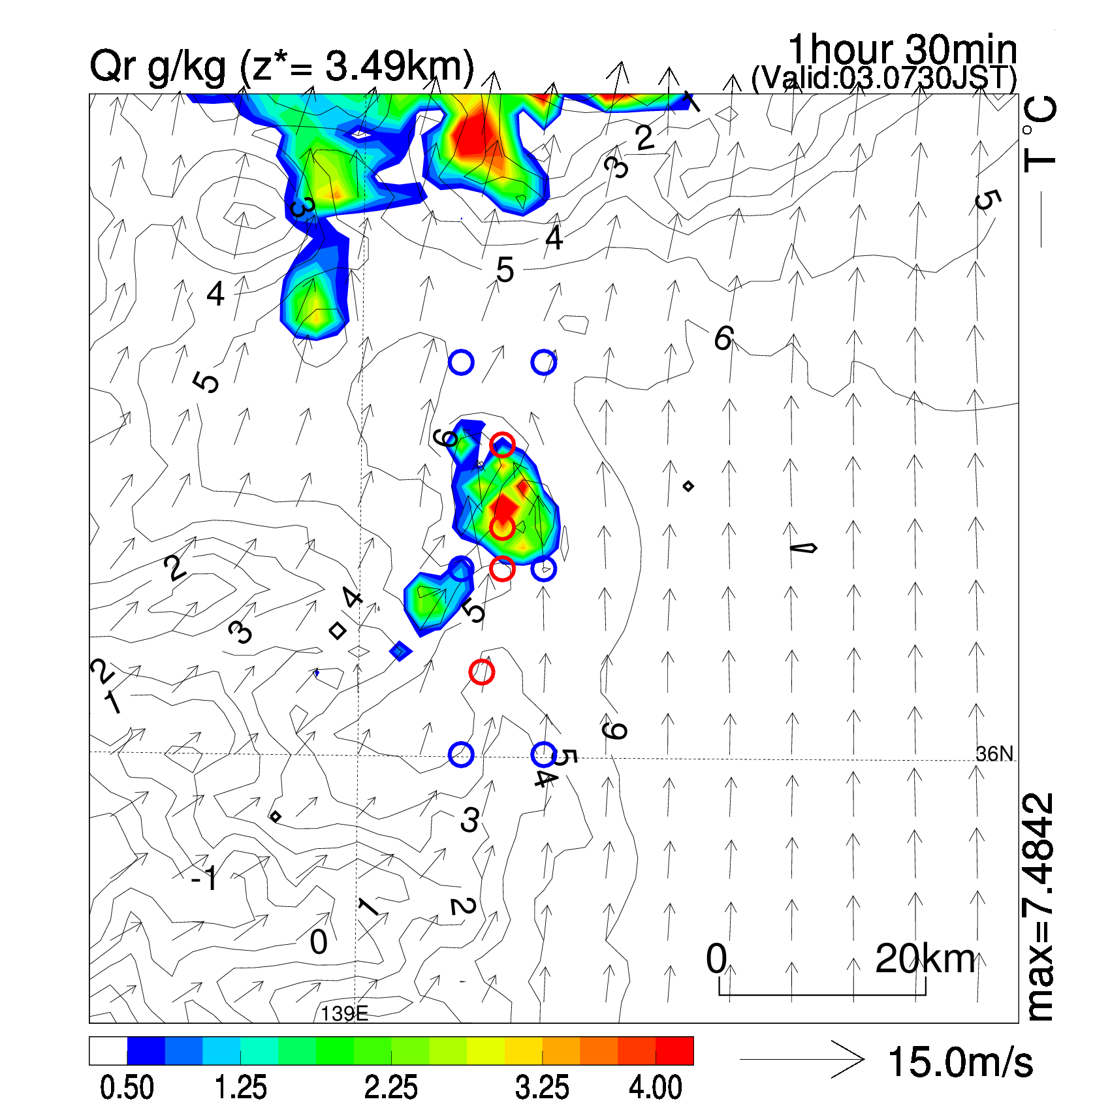
Nature run & observation network
Rainwater (3490m)
Vertical cross section (rain+snow+graupel+hail)
Initiate!
Observations (truth with Gaussian noise)
O (pseudo radar): mixing ratio of rainwater (4 points at 10, 15, 20th layer)
O (surface obs): wind, potential temperature, mixing ratio of water vapor (6 points at surface level)

Slide 7
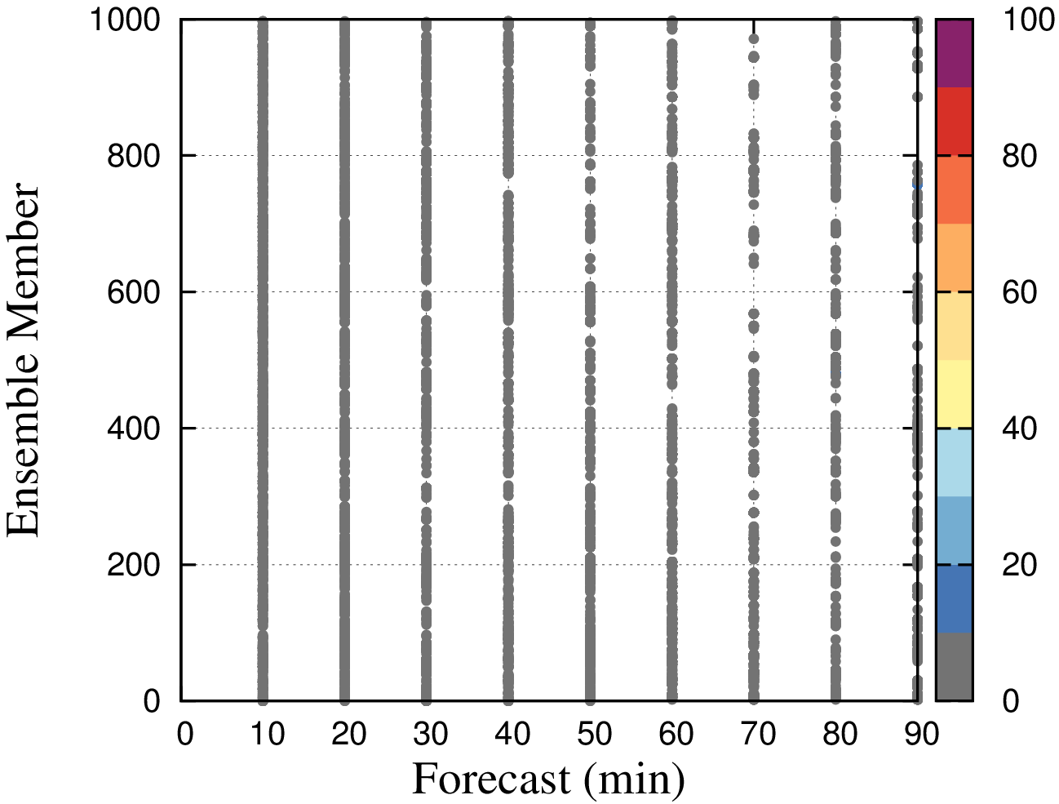
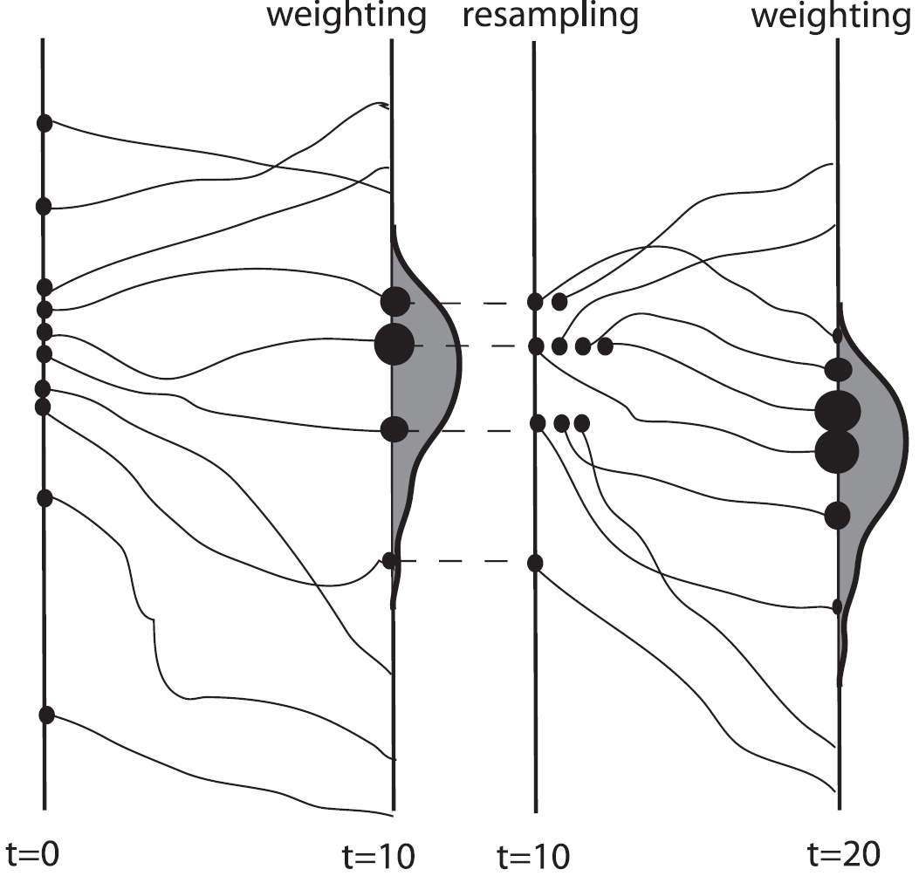
Result: Particles with weight along with time step
NHM-PF
>10％
Fig. 2 of P. J. van Leeuwen (2009, MWR)

Slide 8
Result: RMSE against observations
improved!
except for U
(K)
(m/s)
(m/s)
(g/kg)
(g/kg)

Slide 9
Result: RMSE against nature run
(grid to grid over the entire domain)
Potential temperature
Water vapor
Rainwater
Improved!

Slide 10
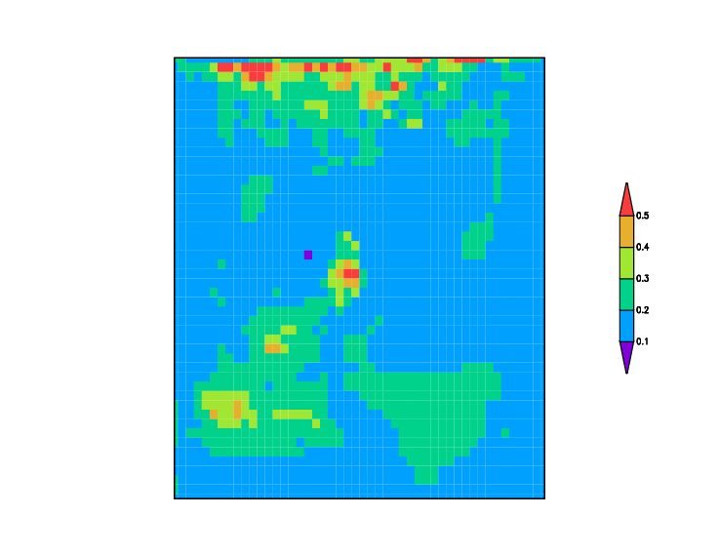
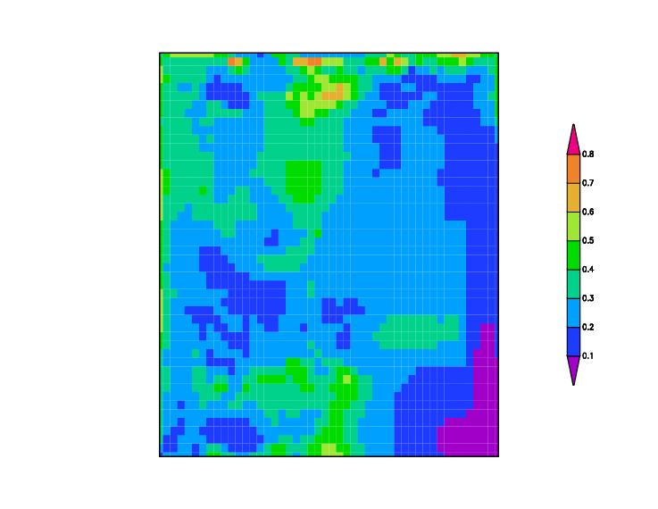
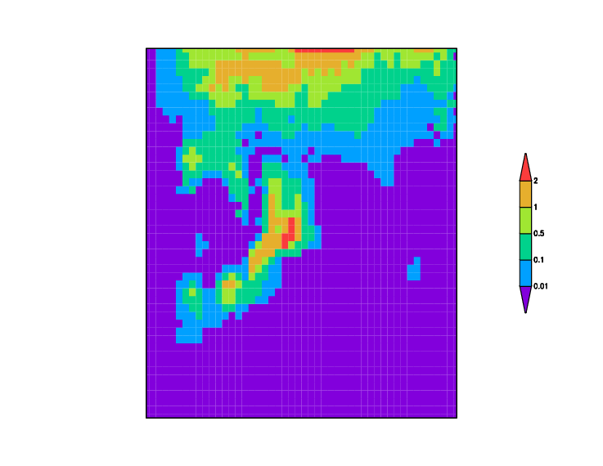
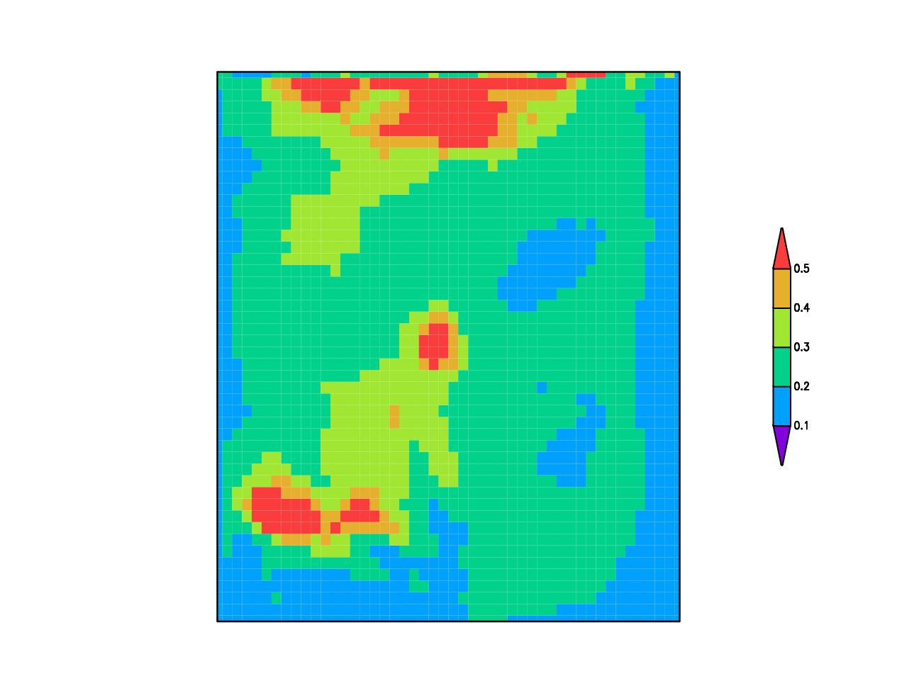
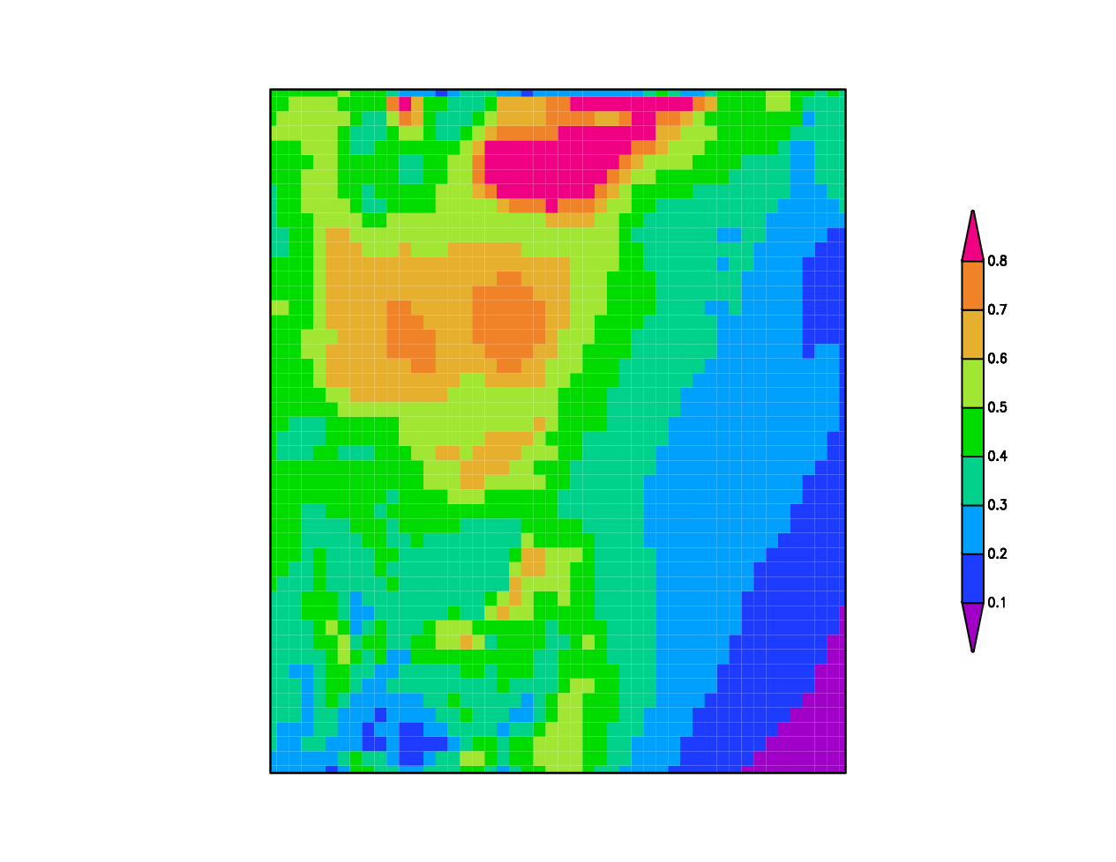
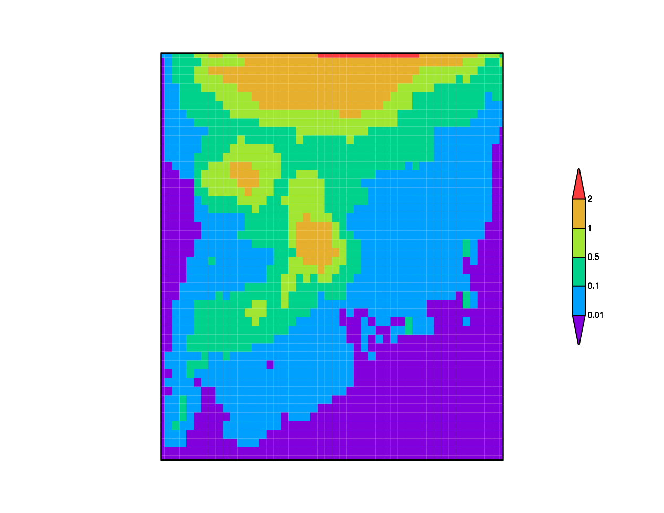
Result: Spread at 90 min
Potential temperature
Water vapor
Rainwater
PF
Spreads in PF are smaller than that in NoDA.
NoDA

Slide 11
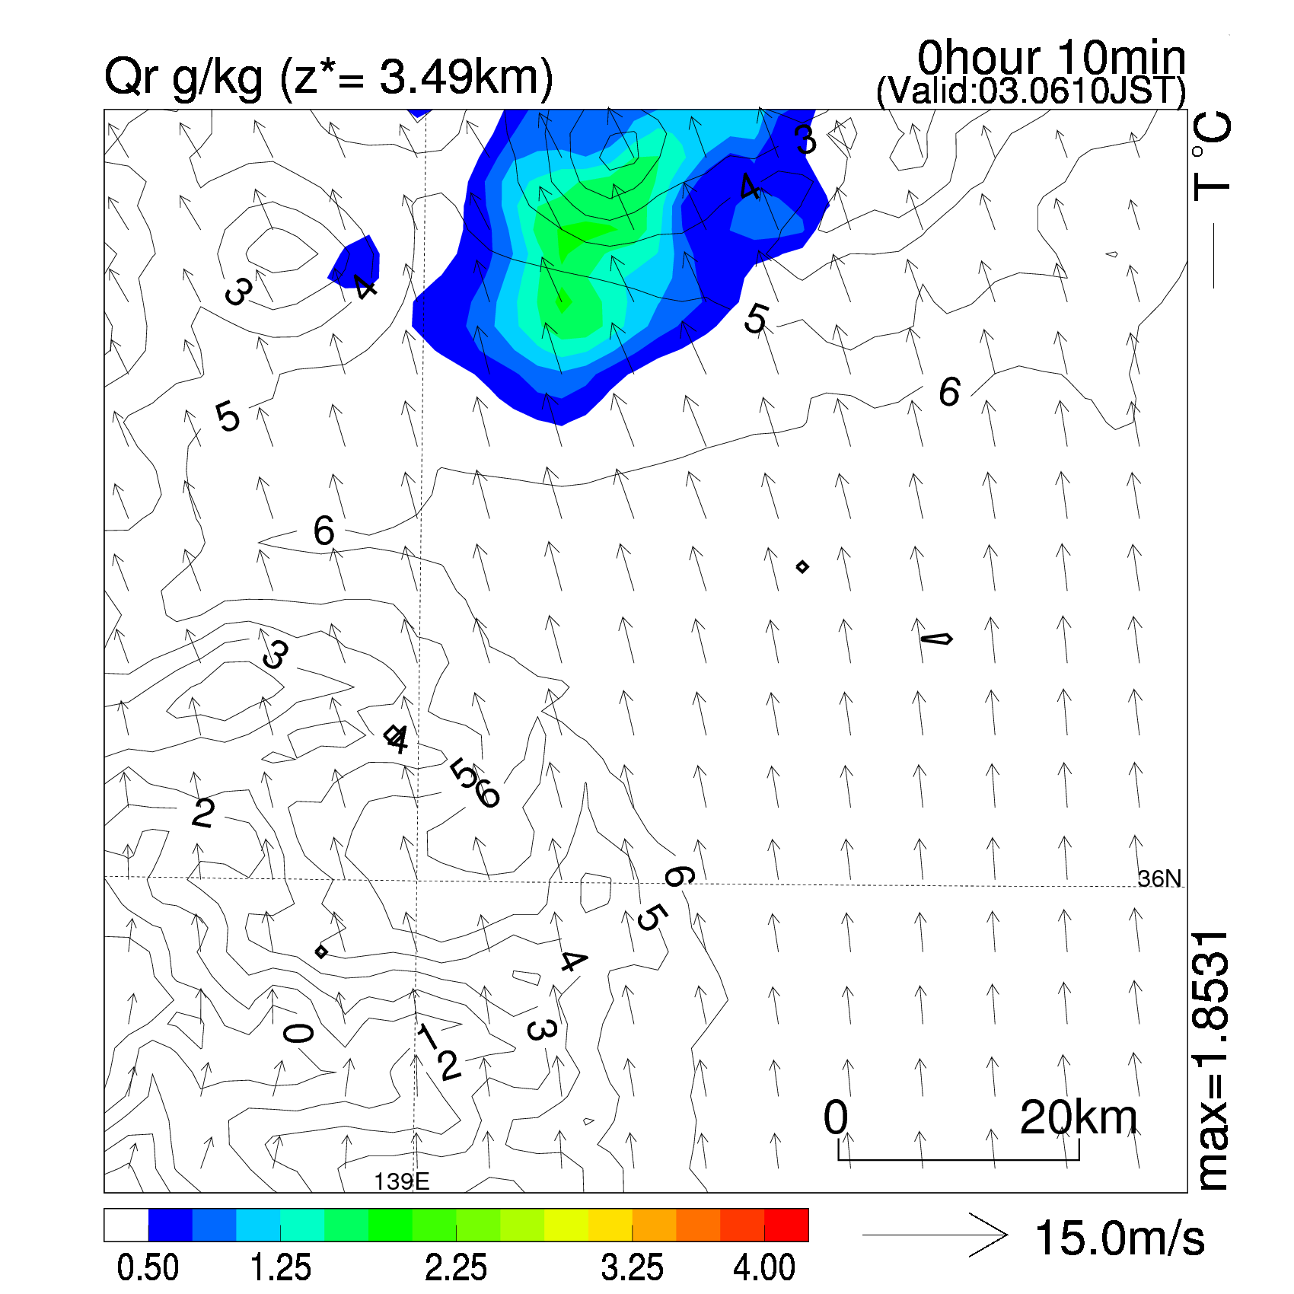
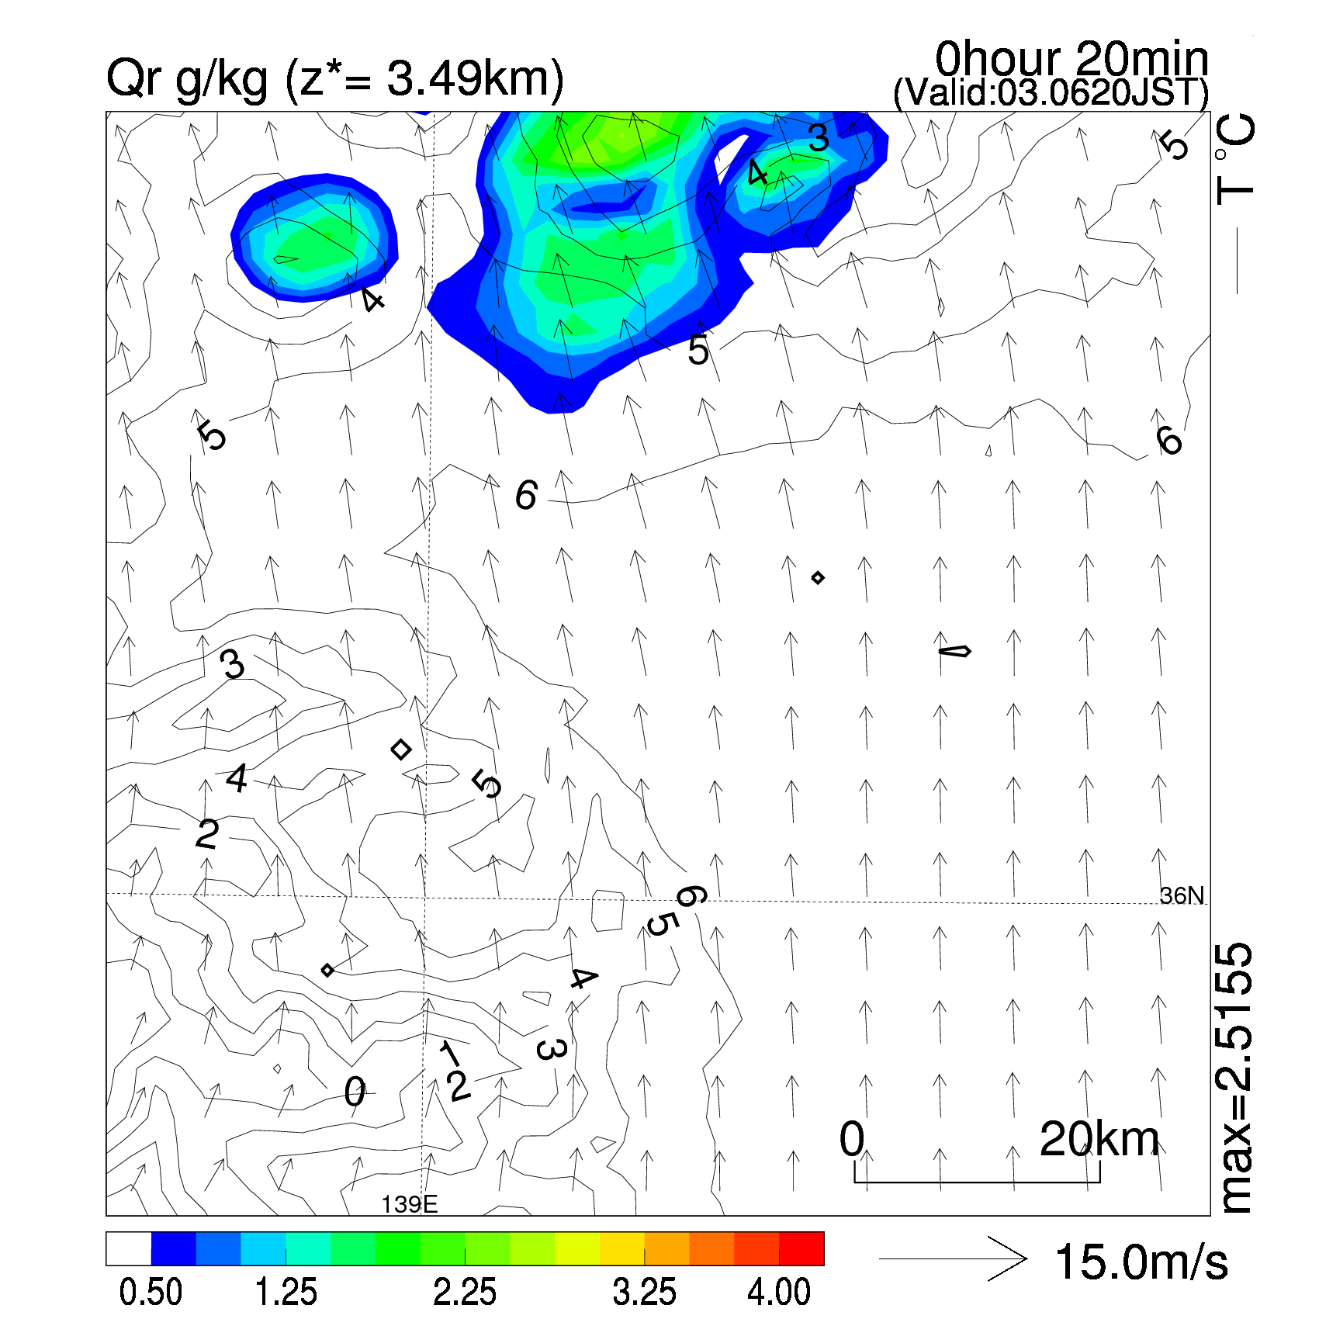
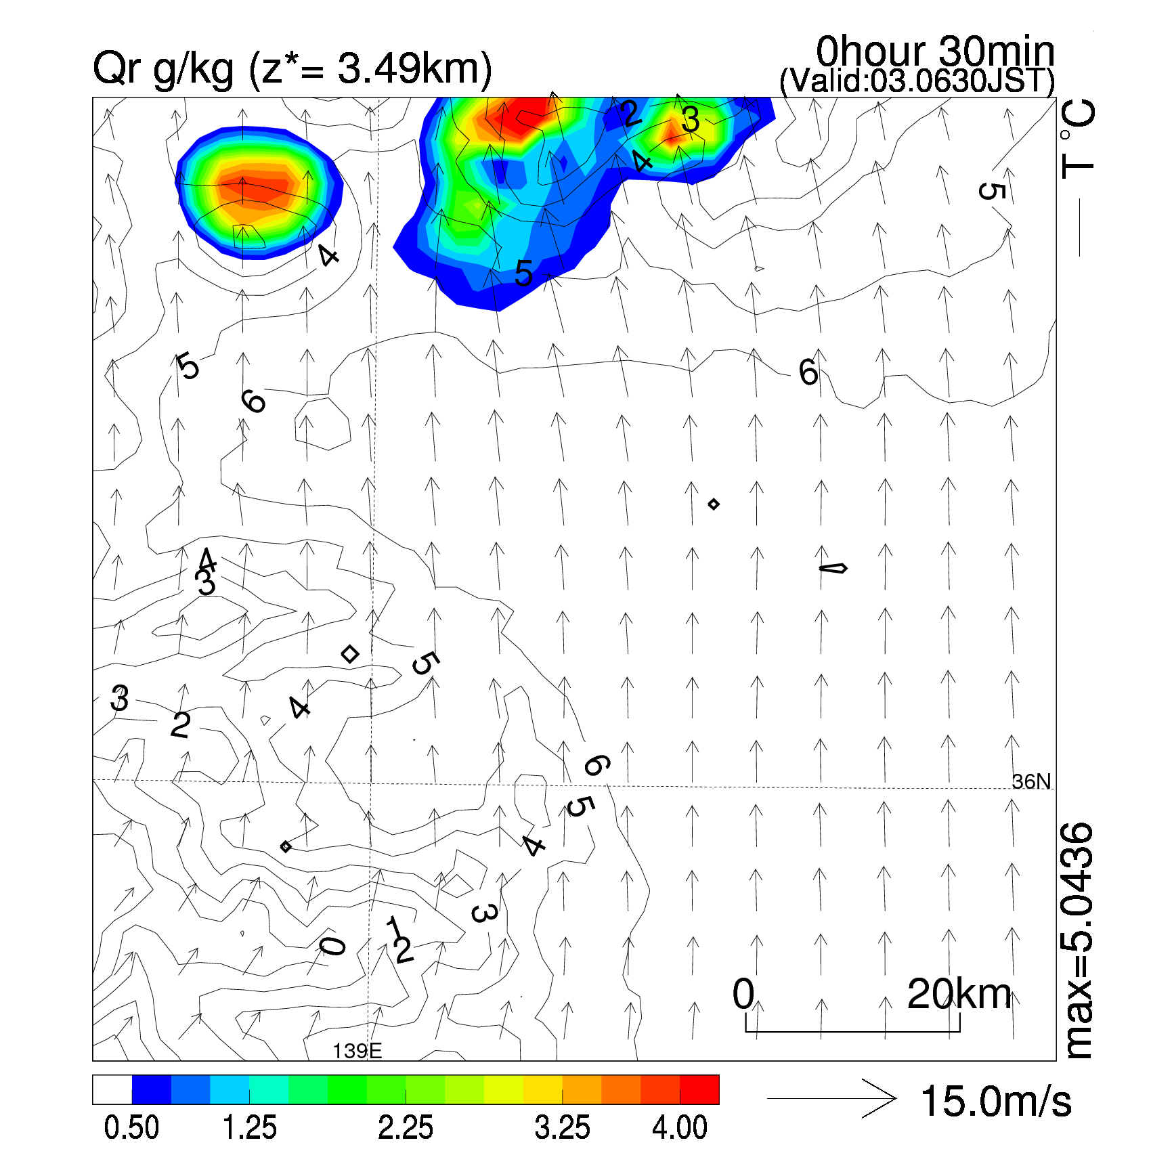
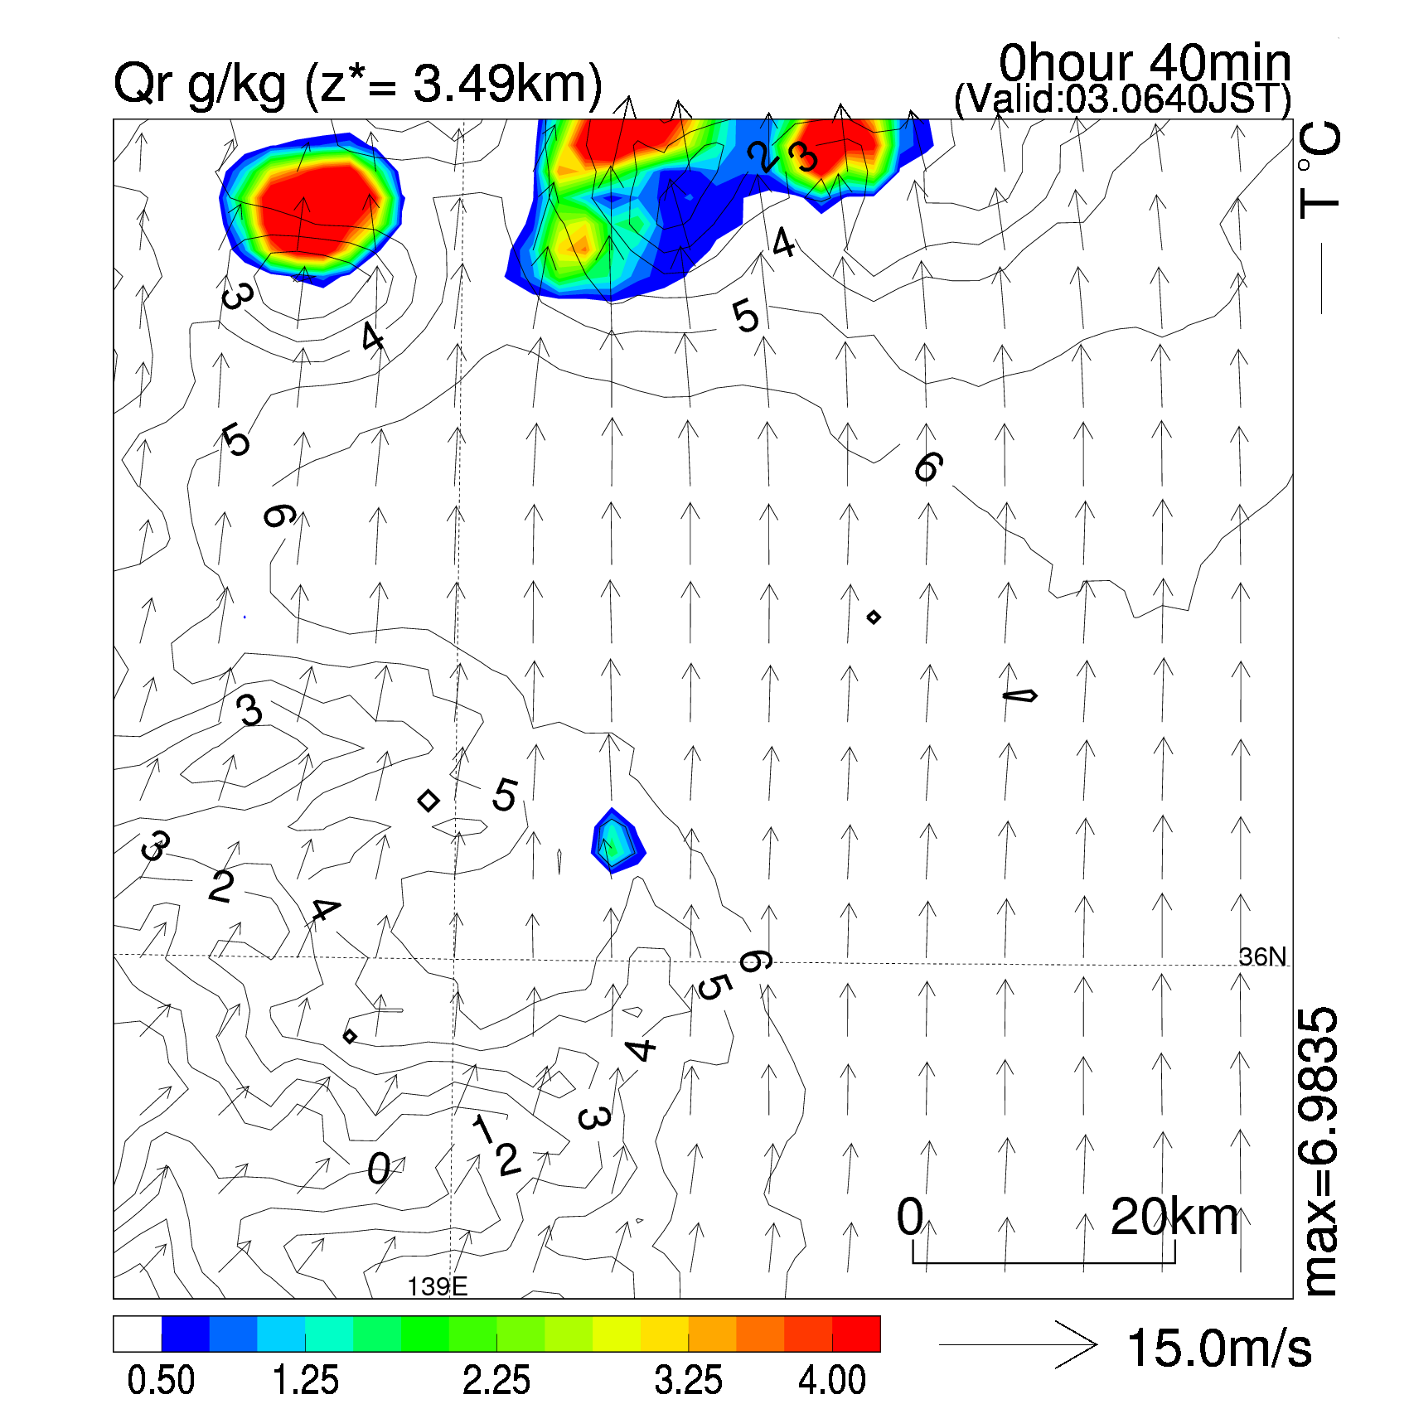
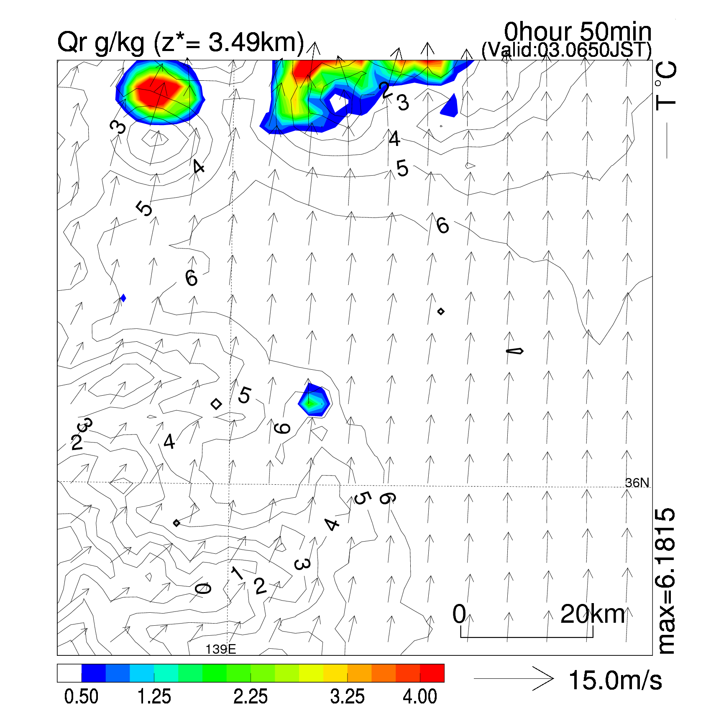
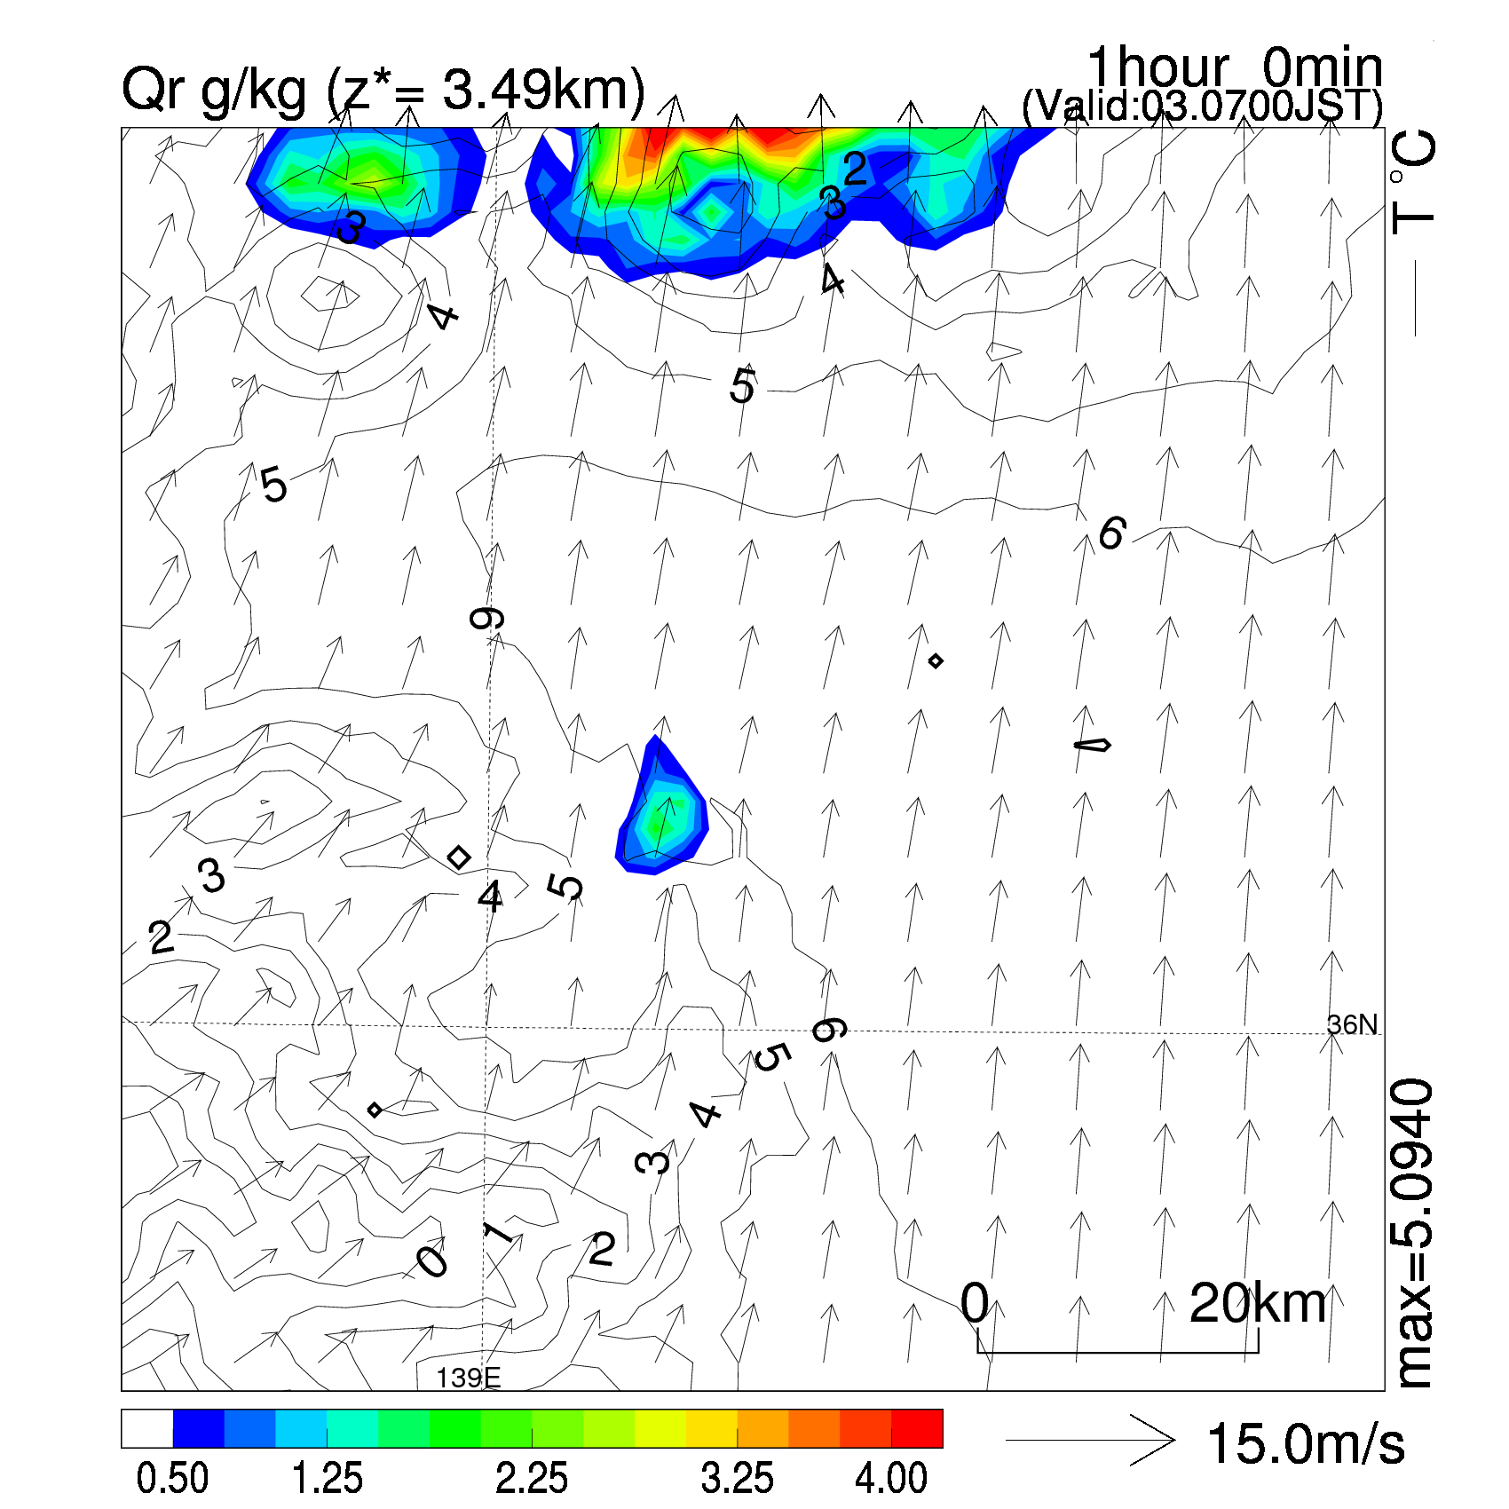
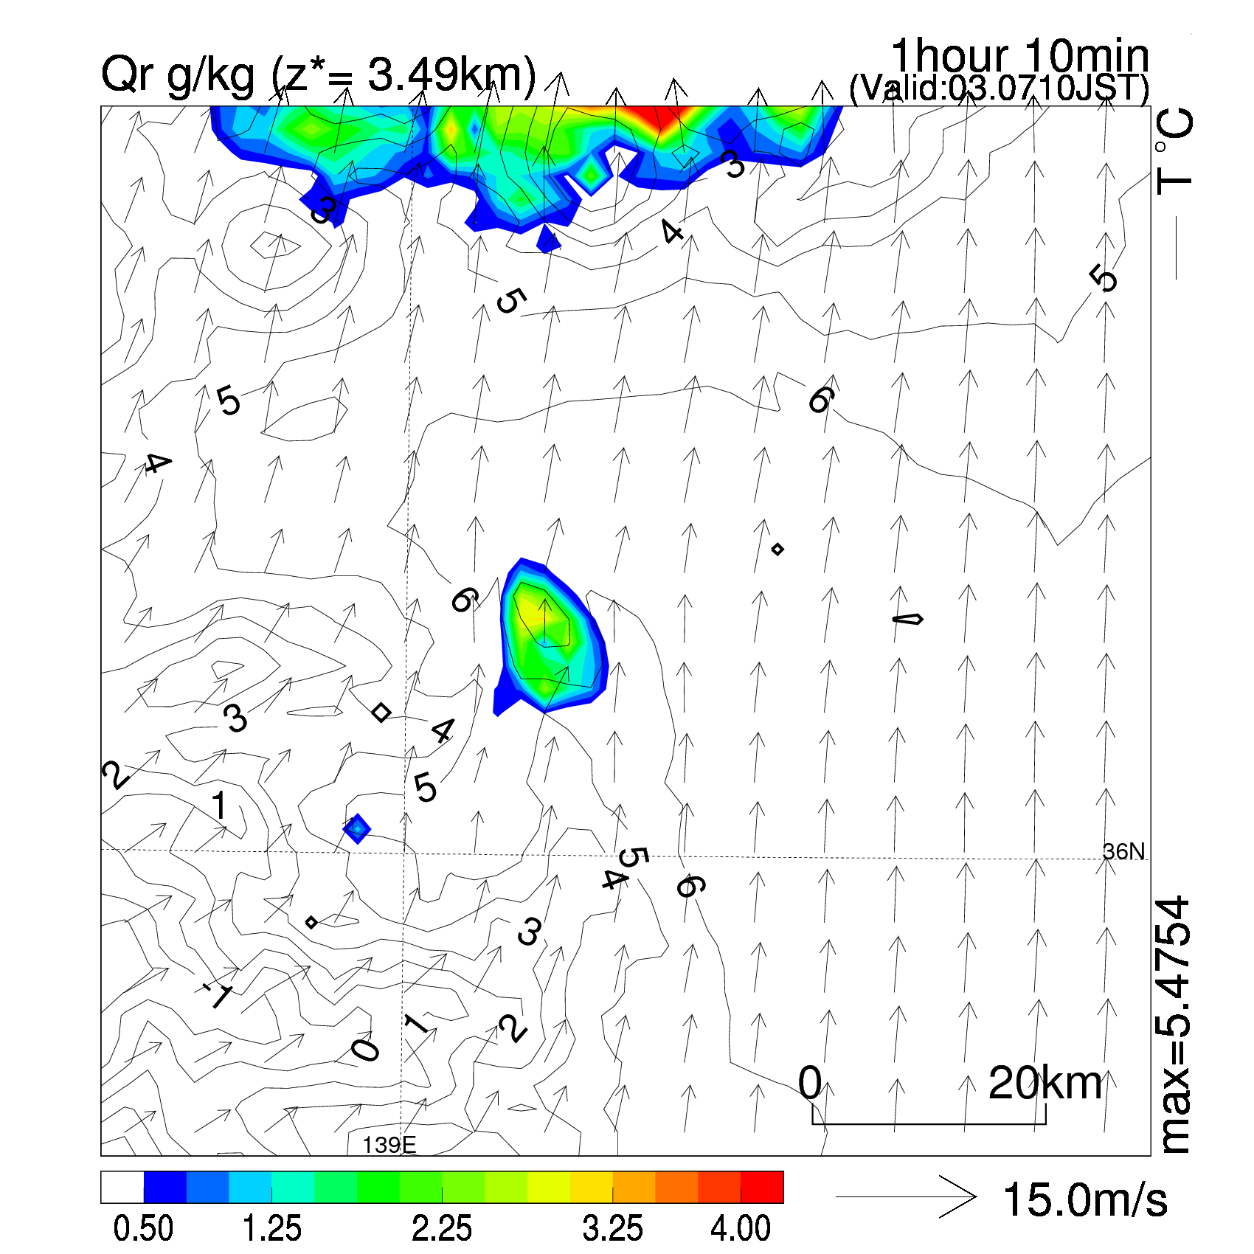
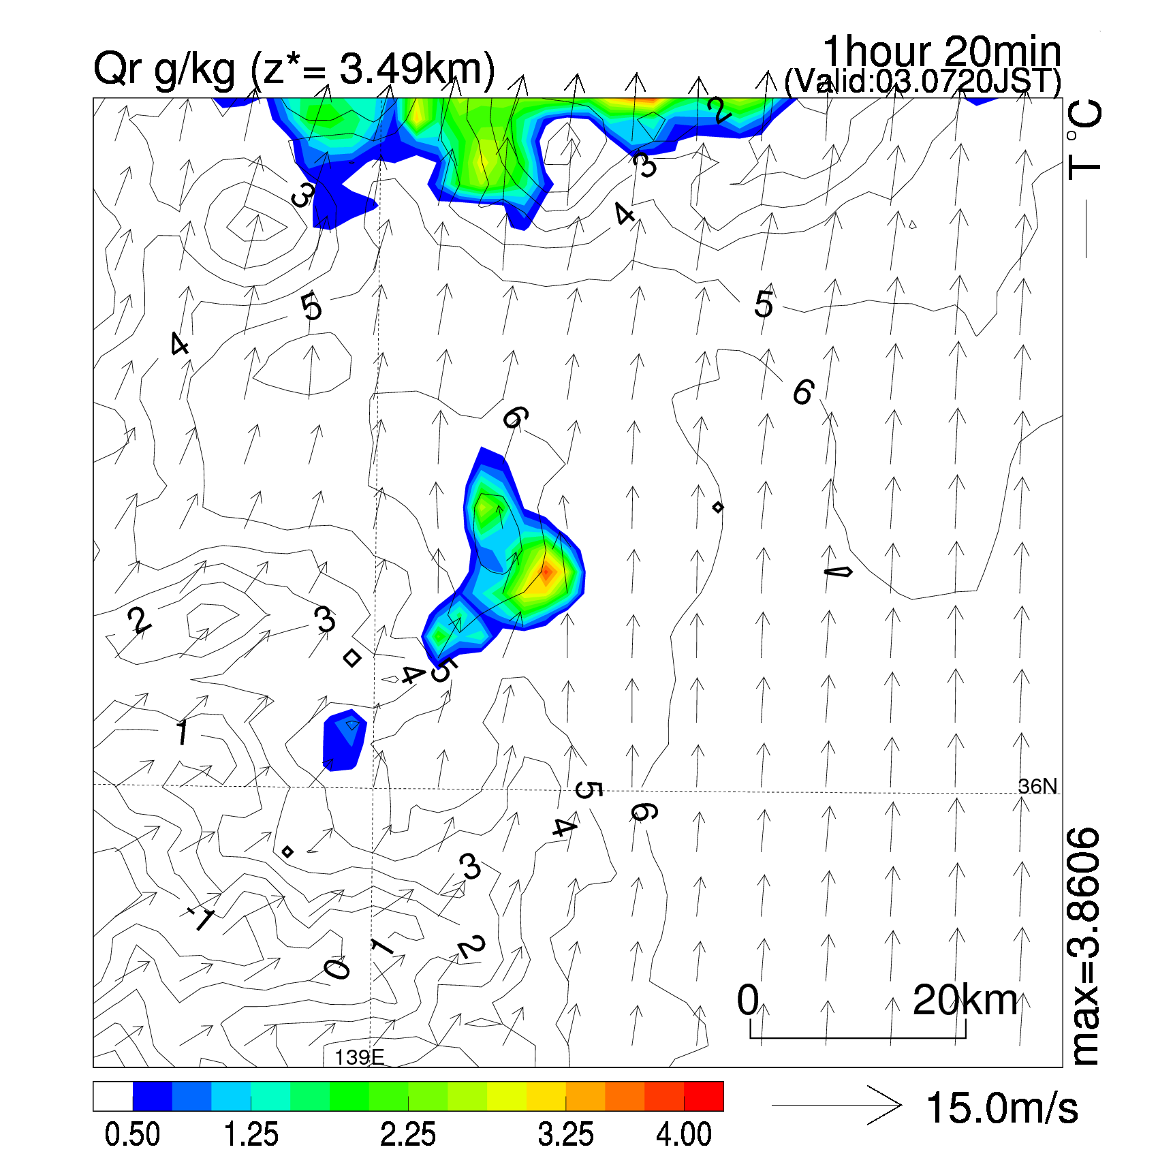
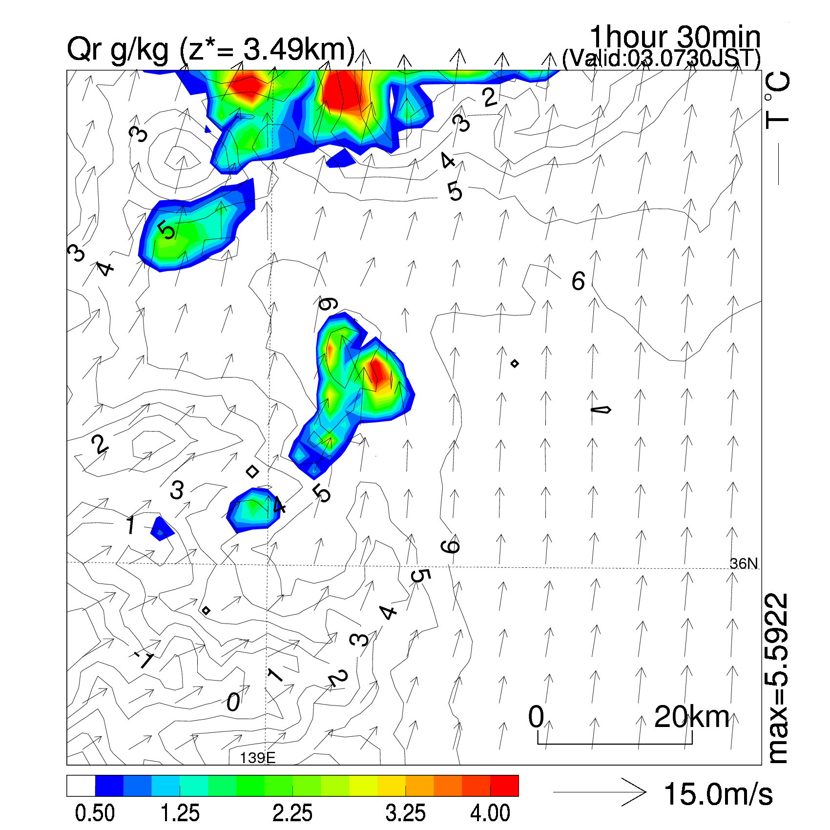

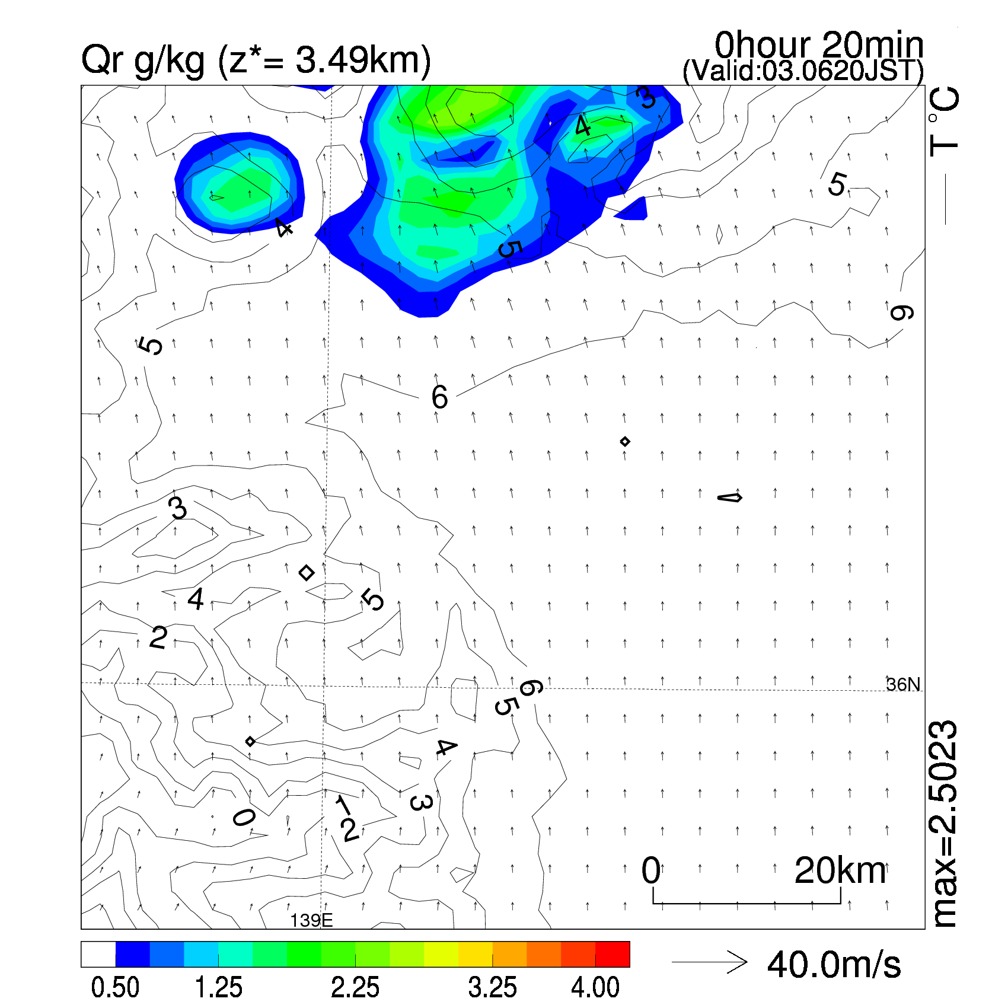
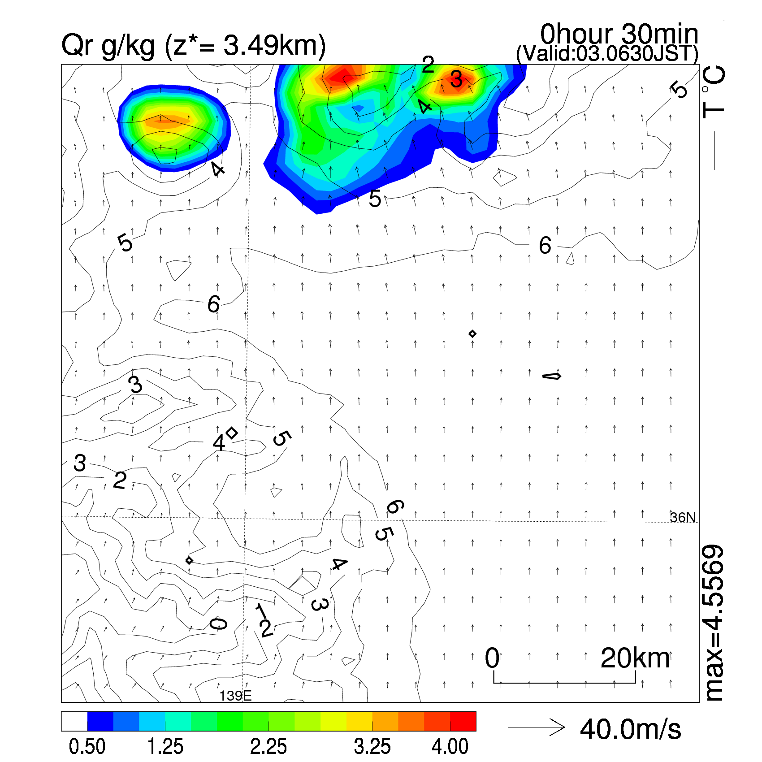
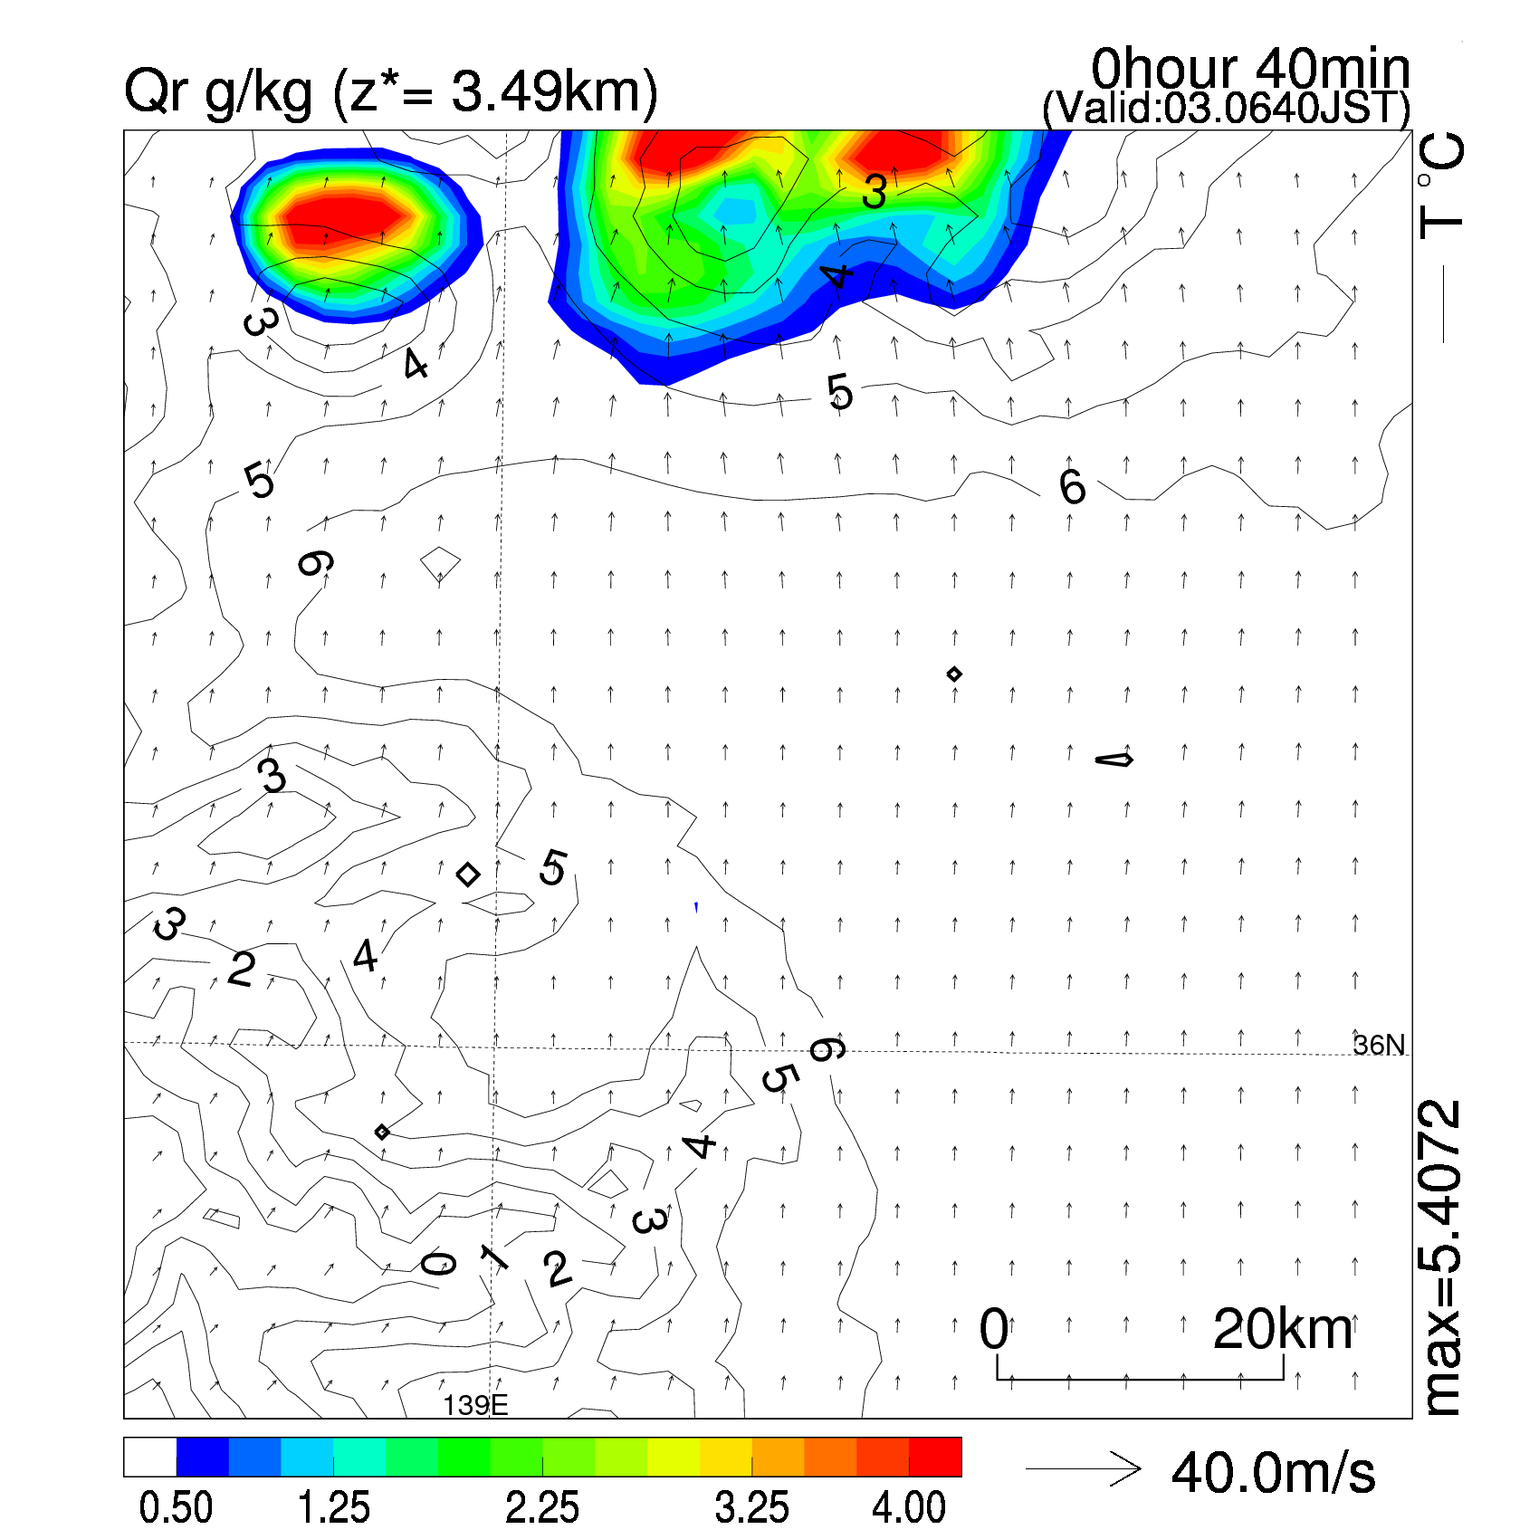
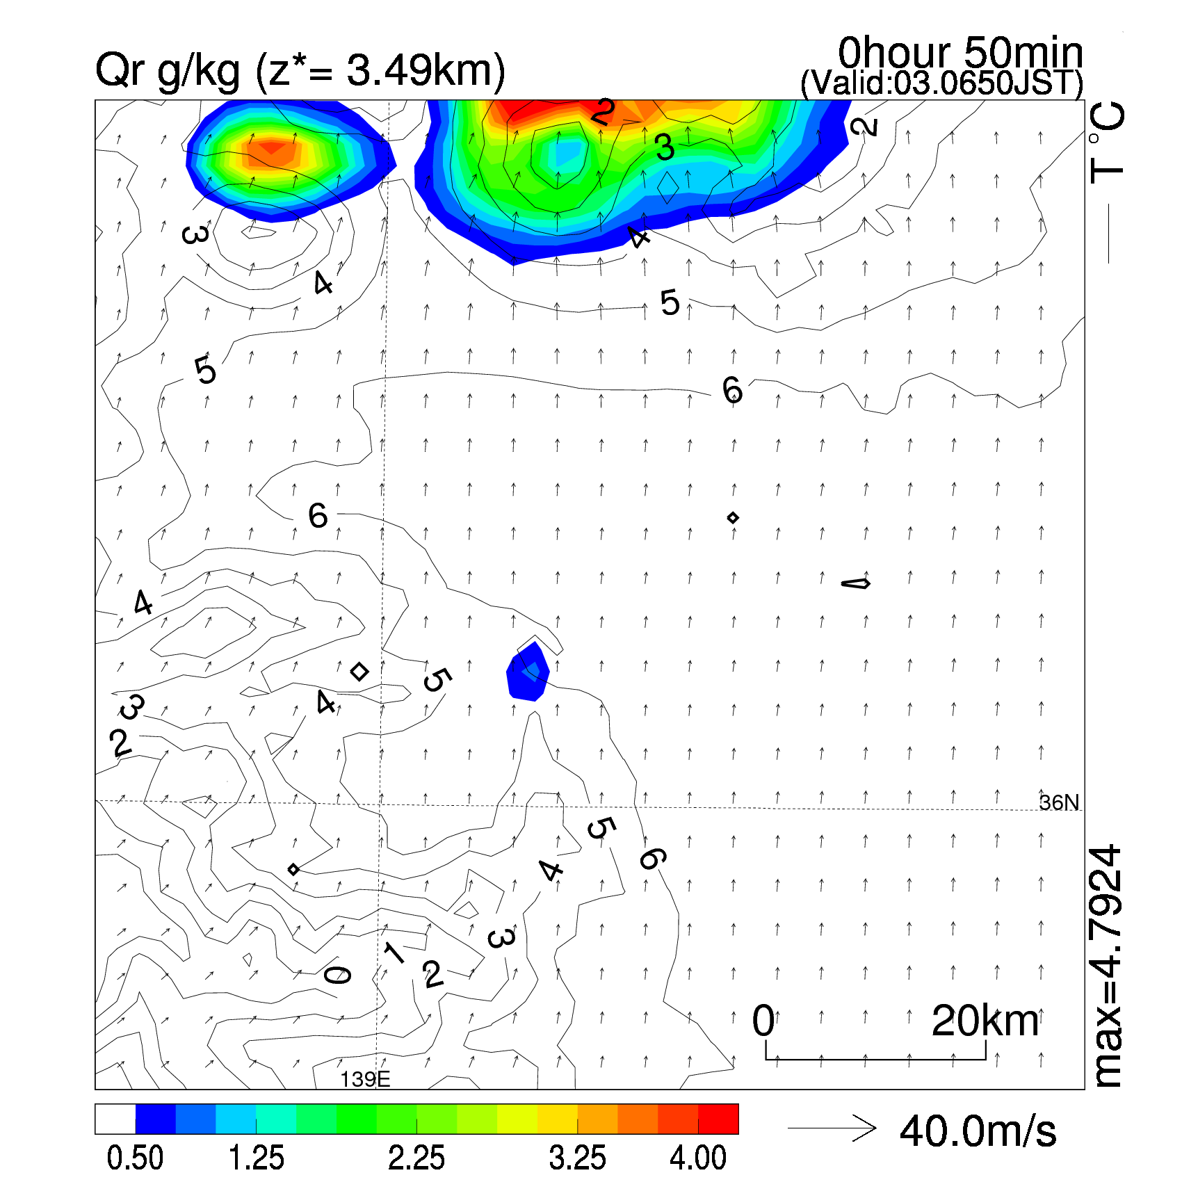
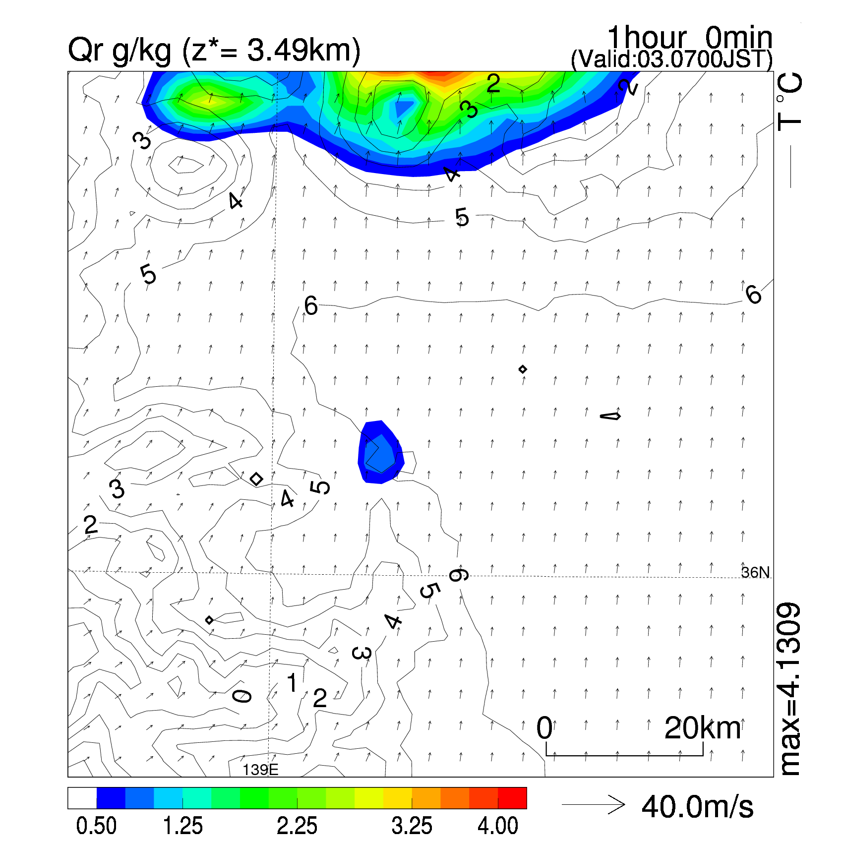
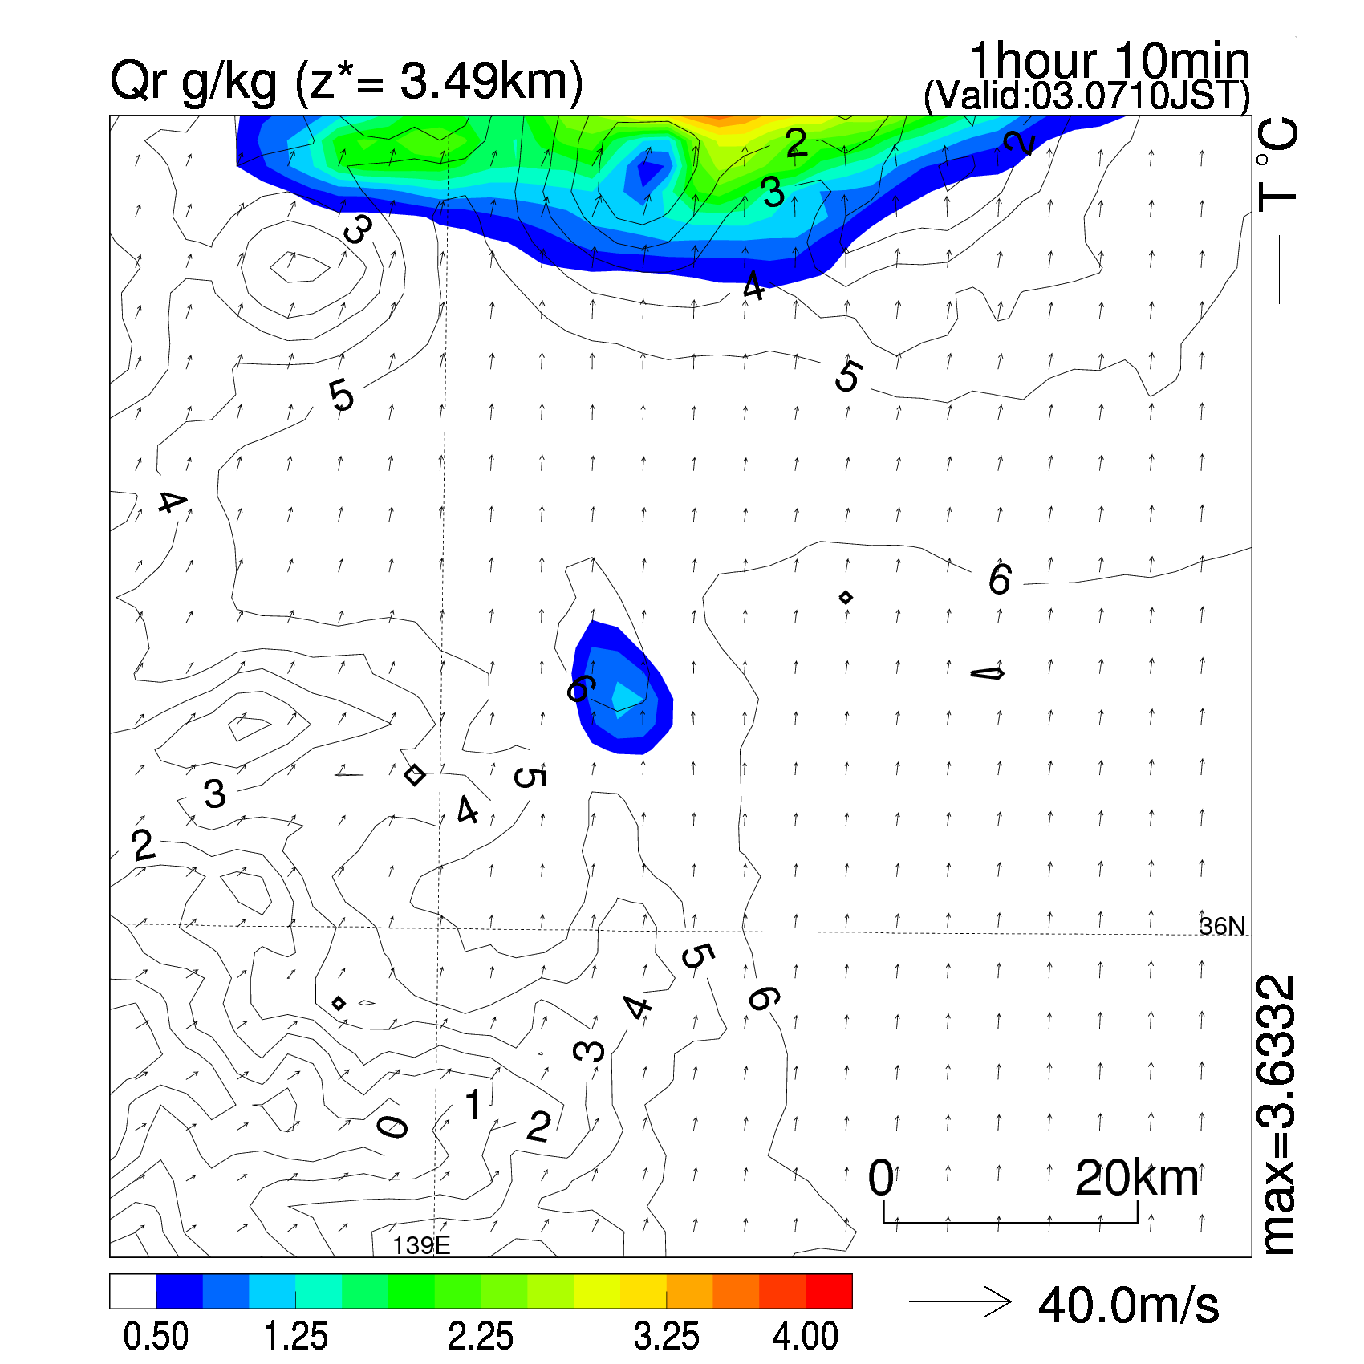
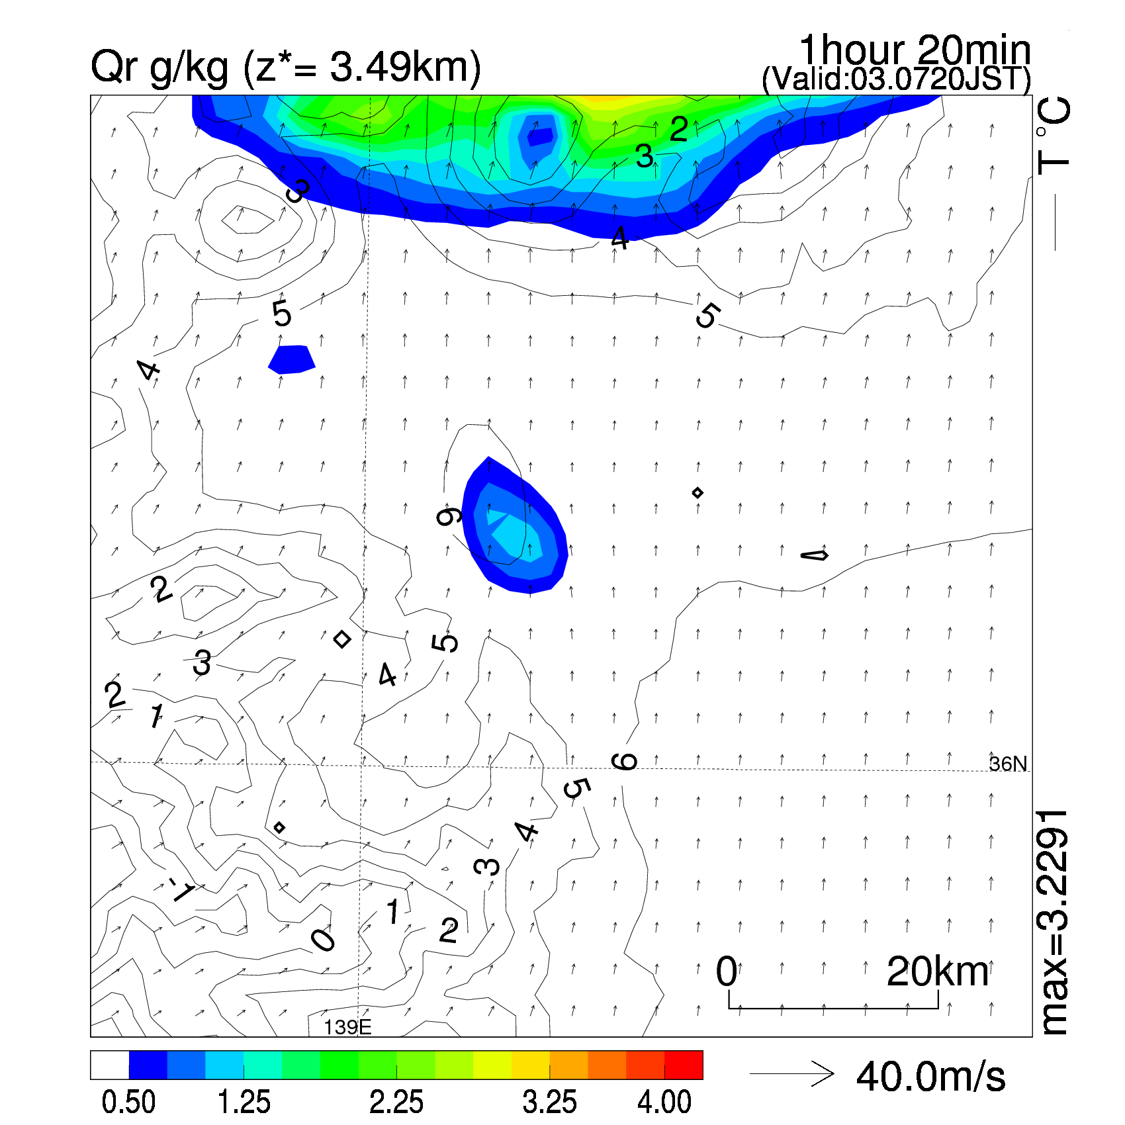

Result: Ensemble mean (rainwater)
PF
NoDA
Nature run
10 min
20 min
30 min
40 min
50 min
60 min
70 min
80 min
90 min
Successfully performed!
Intensity and horizontal scale of Cb core were significantly improved by NHM-PF.

Slide 12





PDFs on grids over convection initiation period
20 min
Before CI
Potential temperature
Water vapor
Cloud water
Rainwater
2820m
The PDFs are concentrated in 0.
=> No cloud and rain.
Mostly Gaussian

Slide 13





30 min
Cloud init
Potential temperature
Water vapor
Cloud water
Rainwater
2820m
Spiky and/or multi-modal PDFs are seen.
=> Saturated
PDFs of cloud water show CI.

Slide 14





40 min
Rain starts
Potential temperature
Water vapor
Cloud water
Rainwater
2820m
Rainwater generated
PDFs of cloud water shift to rich water.

Slide 15





50 min
Develop
Potential temperature
Water vapor
Cloud water
Rainwater
2820m
Move northward

Slide 16
summary
To investigate predictability on Cb and/or thunderstorms, we need nonlinear and non-Gaussian DA ensemble system.
A particle filter with JMANHM （NHM-PF) has been developed.
Horizontal resolution of NHM-PF is 2-km and advanced obs. operators for NHM-4DVAR are implemented.
Additive inflation and parameter (model switch) ensemble were applied in OSSE.
NHM-PF was successfully performed with 1,000 particles for 90 min: RMSEs and spread reduced, and the thunderstorm in the model was enhanced.
Non Gaussian (multimodal) PDFs are seen and would be precursor to CI.

Slide 17
Thank you for your attention.

