Slide 1
Assimilation of GPM/DPR in Km-scale Hybrid-4DVar system
Yasutaka Ikuta
Numerical Prediction Division / Japan Meteorological Agency
Acknowledgment: This research was supported by JAXA PMM RA 8th
Workshop on Sensitivity Analysis and Data Assimilation in Meteorology and Oceanography, 1-6 July 2018, Meliá Ria Hotel Aveiro, Portugal

Slide 2
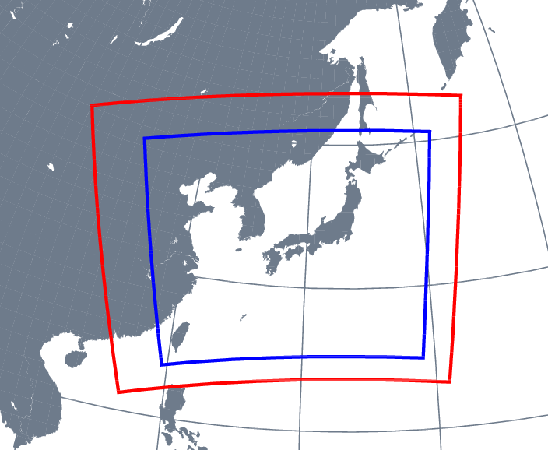
Operational Meso-scale NWP system
Meso-scale NWP system
Main purpose
  Disaster risk reduction
  Aviation weather forecast
Meso-Scale model (MSM)
  3-ice 6-class cloud microphysics process scheme
    Prognostic hydrometeors
      Water vapor, cloud, rain, ice, snow and graupel
Meso-Scale Analysis (MA)
  4D-Var data assimilation system
Global NWP System
Local NWP System
Grid spacing: 2 km
Meso-Scale NWP System
Grid spacing: 5km

Slide 3
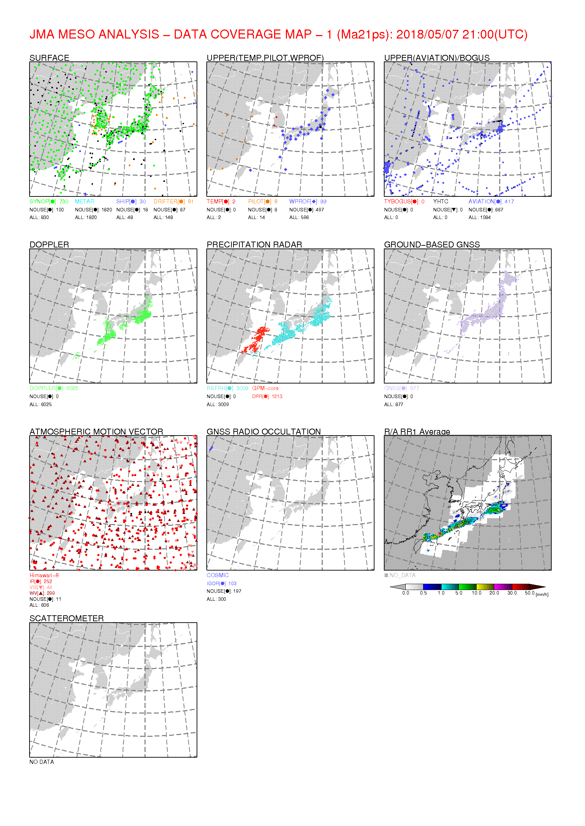
Current State of GPM/DPR Assimilation at JMA
In the operational Meso-Scale NWP system
  Traditional 4DVAR
    Climatological background error covariance
    Hydrometeors are “not” analysis variables.
  GPM/DPR assimilation method
    Indirect assimilation (1D+4DVAR)
    Assimilation of relative humidity profile
    retrieved from reflectivity
2018 05 07 21UTC
Assimilated as RH profiles
GPM/DPR
Ground-based Radar
Radar Analysis
Assimilated as precipitation

Slide 4
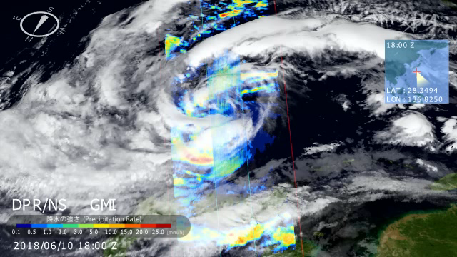
Further Utilization of GPM/DPR
Characteristics of DPR observation
  3-D information of hydrometeors
  Sensitivity to snow particles
Benefit of the direct assimilation of DPR in DA
  Improvement of hydrometeors in initial time
    Elementary processes (evap. / depo. , conversion, melting, latent heating …) work well on early time.
    -> Water vapor, temperature and precipitation become more accurate.
-> Improvement of precipitation forecast
can not be utilized in the current system
JAXA/EORC Tropical Cyclone Database
(http://sharaku.eorc.jaxa.jp/TYP_DB/index_j.shtml)

Slide 5
Next step of GPM/DPR Assimilation
  Future Plan: Implementation of Hybrid-4DVar with control variable of hydrometeors into the operational Meso-Analysis
Indirect assimilation
using retrieved RH profiles
in traditional 4DVAR
Direct assimilation of GPM/DPR
using reflectivity (KuPR, KaPR) profiles
in new Hybrid-4DVAR

Slide 6
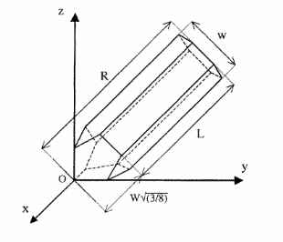
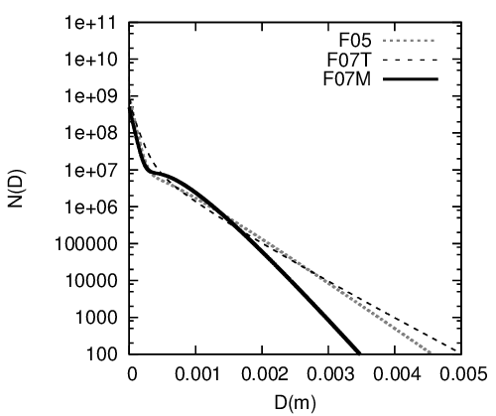
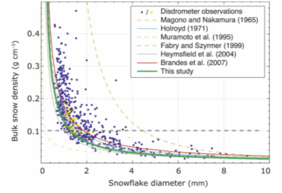
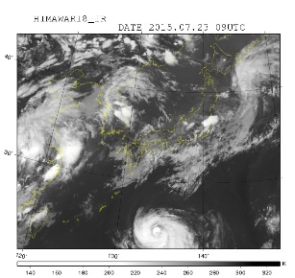
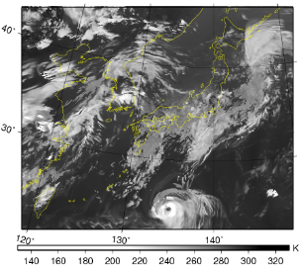





1-moment Cloud microphysics optimized for DA
Cloud microphysics scheme with TL/AD are needed for reflectivity and cloudy radiance direct assimilation in 4D-Var.
This scheme is developed to avoid strong non-linear code, numerical divergence and large bias.
Cloud particle
Ice particle
Snow particle
PSD: mono-dispersion
PSD: mono-dispersion
PSD: exponential + modified gamma
Mass:
$$m=6.9×{10}^{−2}D^{2} [\text{kg}]$$
Mass:
$$m=\frac{π}{6}D^{3} [\text{kg}]$$
Mass:
$$m=7×{10}^{−3}D^{2} [\text{kg}]$$
Bulk snow density:
T=-10 ℃, Qs=0.2 g kg⁻¹
$$ρ=1.3×{10}^{−1}D^{−1} [\text{kg}{ \text{m}}^{−1}]$$
Rain and graupel particle
Ice <--> large snow flake
PSD: exponential
Mass:
$$m=\frac{π}{6}D^{3} [\text{kg}]$$
Simulation
Observation
Heymsfield and Iaquinta (2000)
For midlatitude cloud (Field et al. 2007)
Thompson et al. (2008)

Slide 7
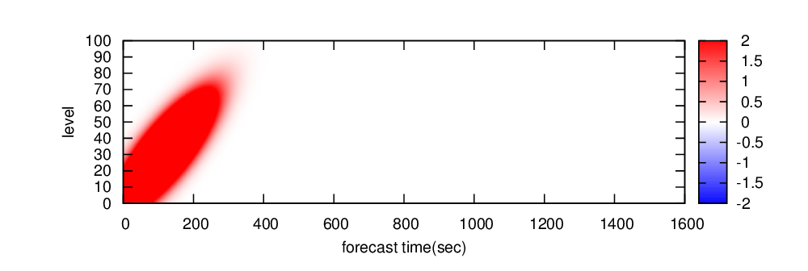
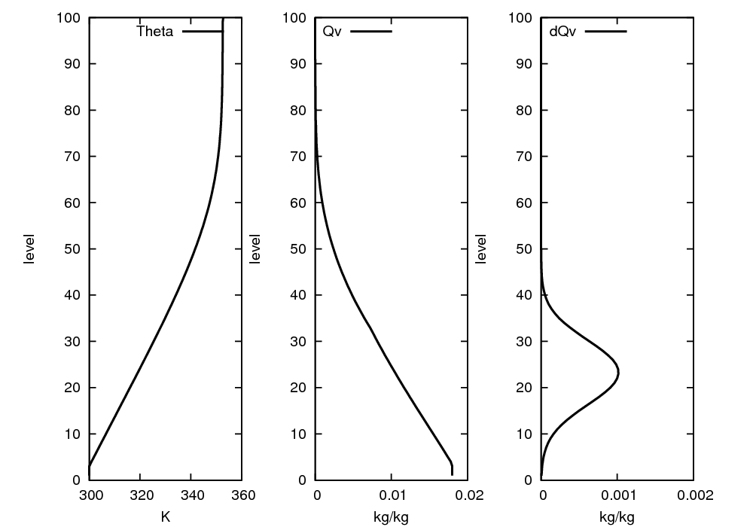
Test Case using Single Column Model
 | Single column TL/AD model based on KiD*
Variables | P(pressure), T(temperature), Qv(specific humidity), Qx(mixing ratio of hydrometeors x) x=cloud, rain, ice, snow and graupel
Vertical resolution / number of level | 160 m / 100 levels
Time step | 5 sec
* Shipway and Hill (2012)
Initial condition
Forcing
initial perturbation
Vertical velocity
time step

Slide 8
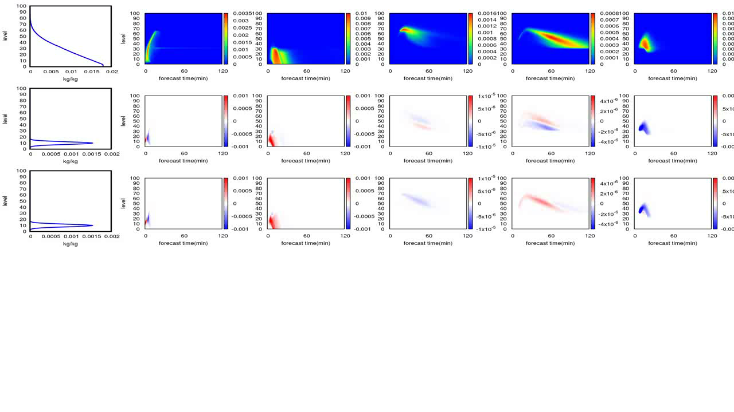





Tangent Linearization of Microphysics Scheme
Init. of Qv
Single column TL/AD model based on KiD. ( KiD, Shipway and Hill (2012) )
$$ℳ_{t}\left(x_{0}\right)$$
Qc
Qr
Qi
Qs
Qg
$$ℳ_{t}\left(x_{0}+δx\right)−ℳ_{t}\left(x_{0}\right)$$
Perturbation of Qv
Nucleation is a strongly nonlinear process.
Snow error is originated from difference in ice perturbation
$$M_{t}δx$$
Perturbation of Qv
Fixed variables on background trajectory
Air density and pressure
Diffusivity of water vapor, thermal conductivity of air
TL is almost consistent with NL.

Slide 9
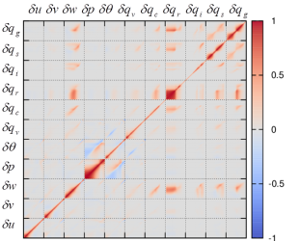
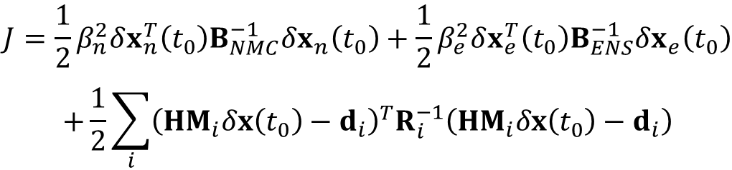
Formulation of Flow-dependent Assimilation
Cost function in hybrid 4D-VAR
Background error with hydrometeors
$$J=\frac{1}{2}β_{n}^{2}δx_{n}^{T}\left(t_{0}\right)B_{NMC}^{−1}δx_{n}\left(t_{0}\right)+\frac{1}{2}β_{e}^{2}δx_{e}^{T}\left(t_{0}\right)B_{ENS}^{−1}δx_{e}\left(t_{0}\right)$$
$$+\frac{1}{2}\sum_{i}{{\left(HM_{i}δx\left(t_{0}\right)−d_{i}\right)}^{T}R_{i}^{−1}\left(HM_{i}δx\left(t_{0}\right)−d_{i}\right)}$$
Observation term
Climatological term
BG covariance is given by statistics of forecast error.
Flow-dependent term
BG covariance is estimated from ensemble forecasts.
This term measures the fit based on the flow-dependent background error
in various meteorological situations.
Extended control variable method (Lorenc 2003)

Slide 10
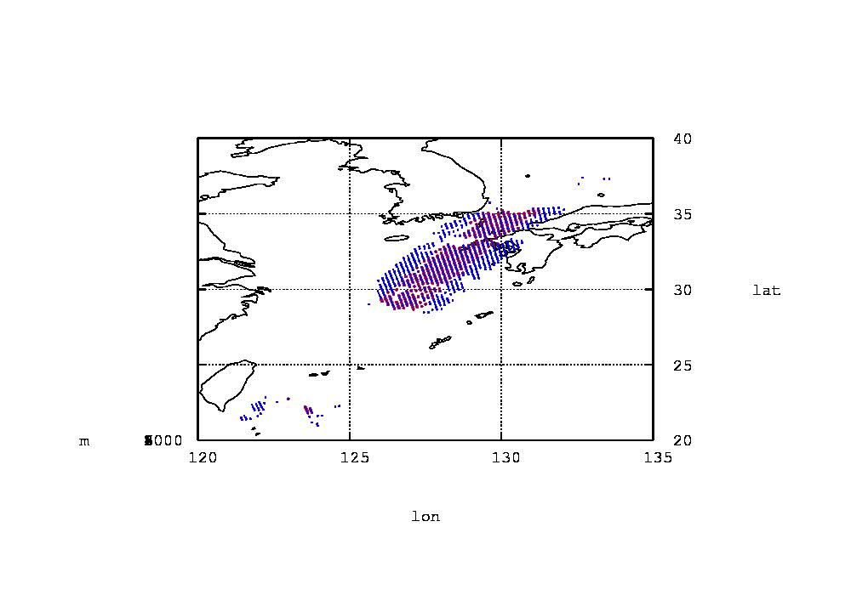
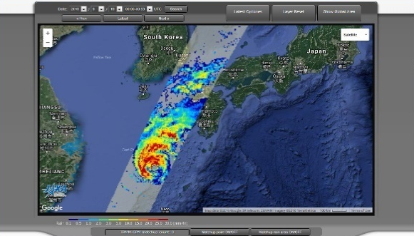
Impact Experiment using Real Observation Data
GPM/DPR
Corrected Ze (L2 Standard product)
  Liquid-phase: Use
  Solid-phase: Reject
Super Observation
Averaging area: 15x15 km²
Thinning
Vertical interval: 500 m
Now investigating .
KaPR(35.5GHz)
KuPR(13.6GHz)
after QC and thinning
GPM Near-realtime Monitor (http://sharaku.eorc.jaxa.jp/trmm/RT3/index.html)

Slide 11
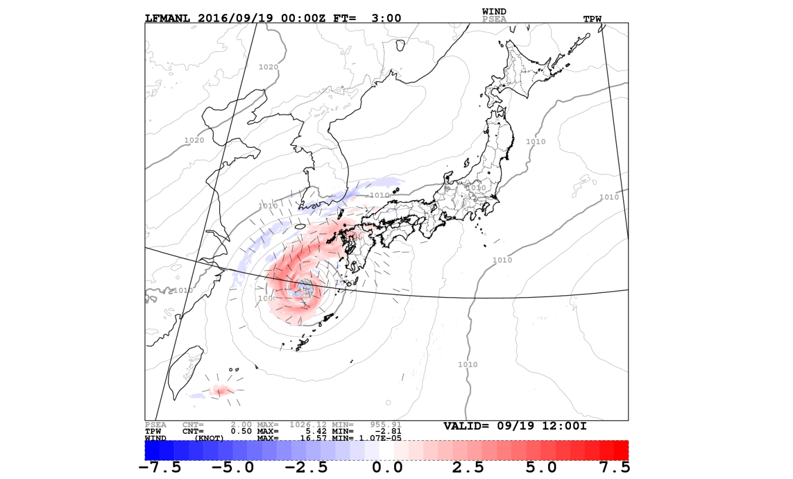
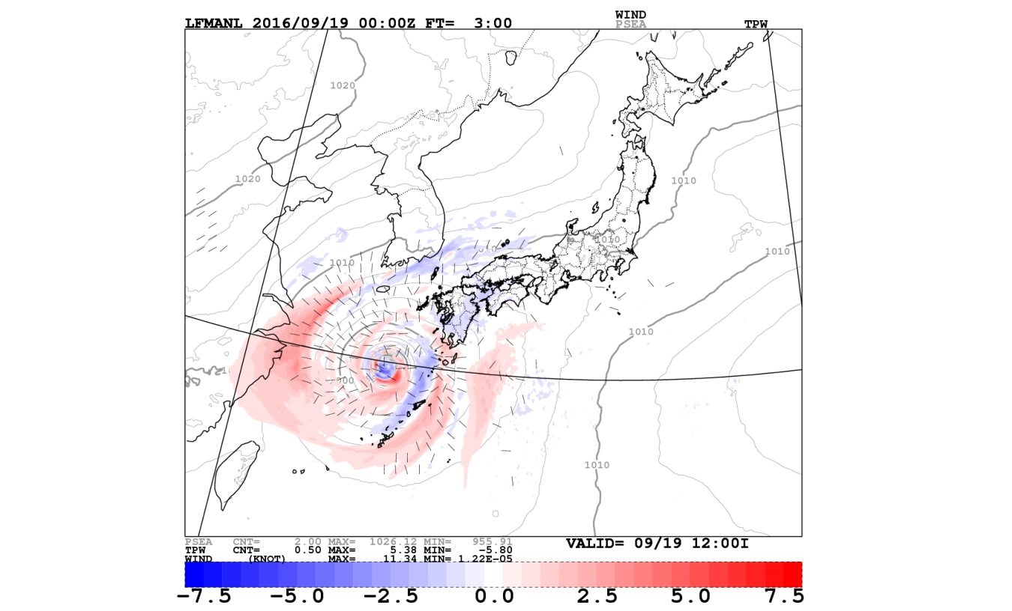
Analysis Increments
Traditional DA
Climatological(100%)+Ensemble(0%)
Hybrid DA
Climatological(50%)+Ensemble(50%)
Nens: 12+1
Widely changed
Color shade: Total Precipitable Water
Barbs: Surface Wind
Localization radius was set to 300 km.

Slide 12
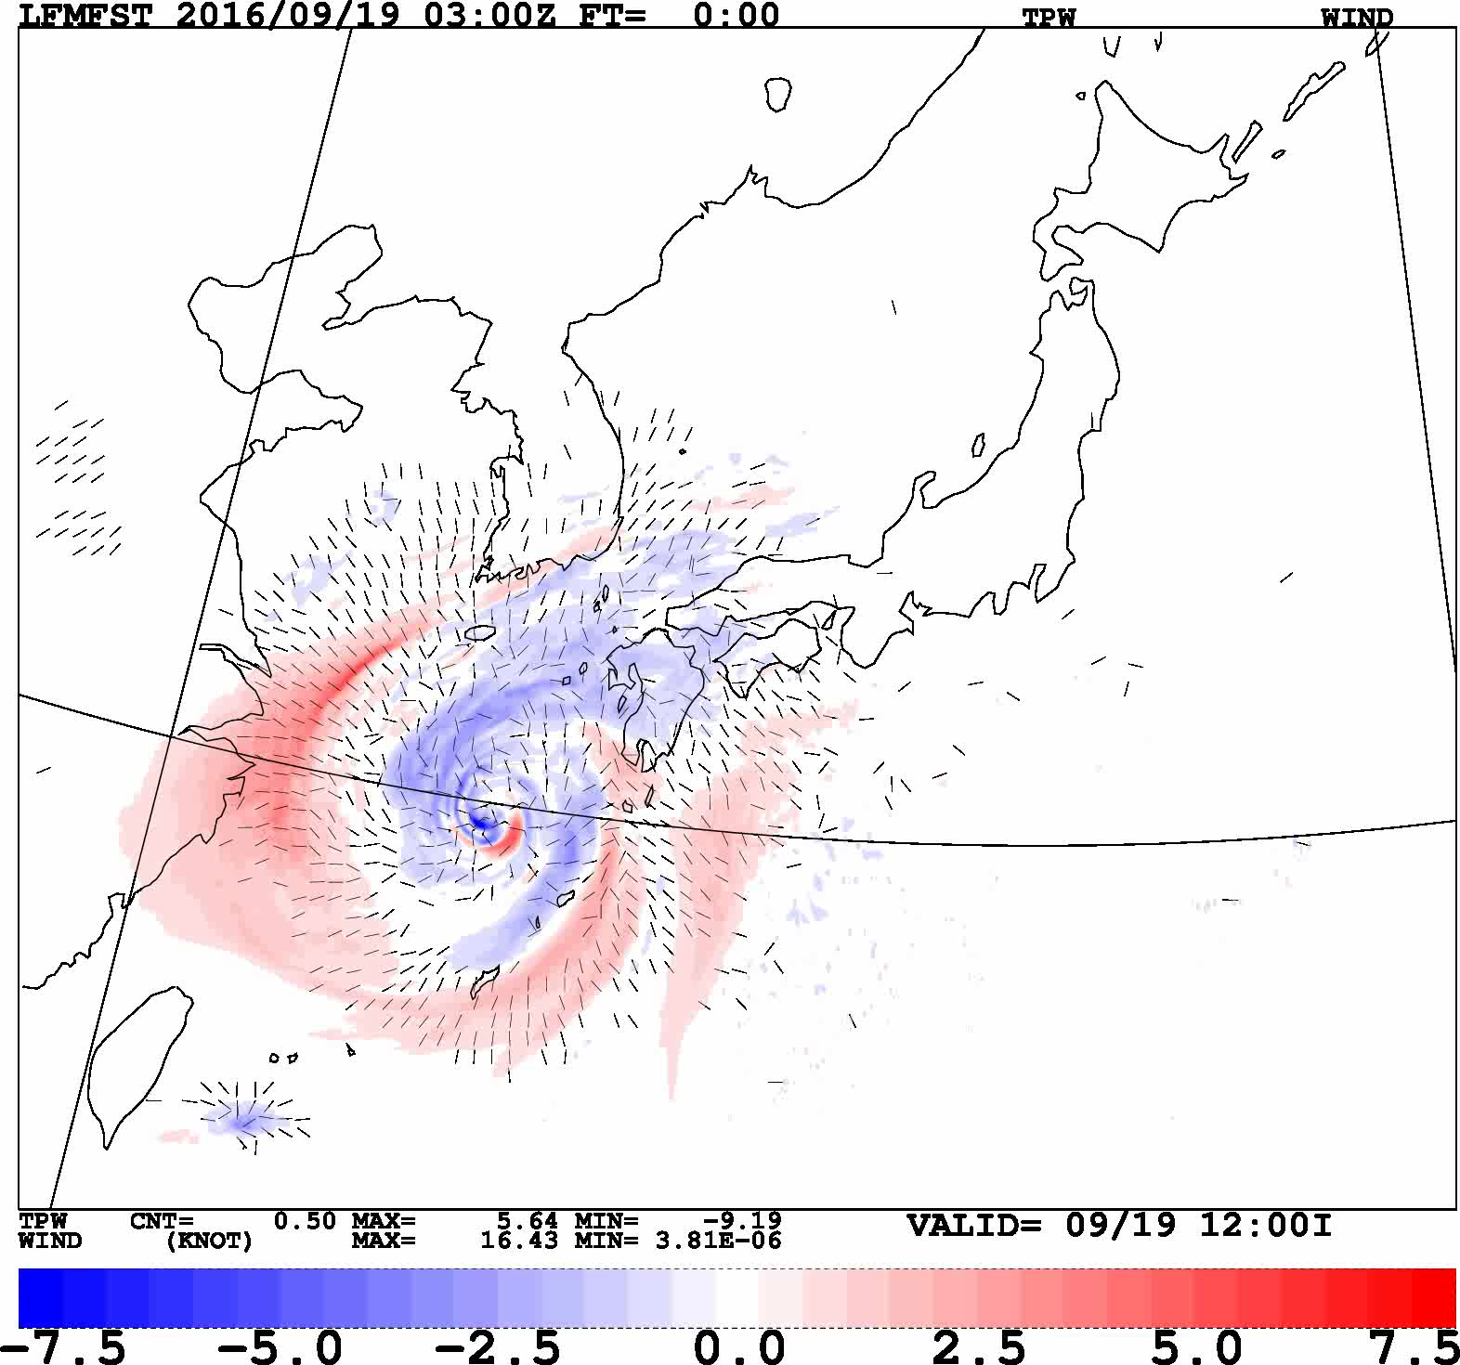
Traditional DA vs. Hybrid DA
CNTL
Forecast from Traditional DA
TEST
Forecast from Hybrid DA
Forecast
Grid spacing: 2 km
TEST – CNTL
Color shade: Total Precipitable Water
Barbs: Surface Wind
Dry
Wet

Slide 13
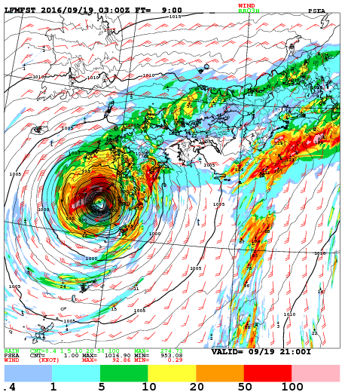
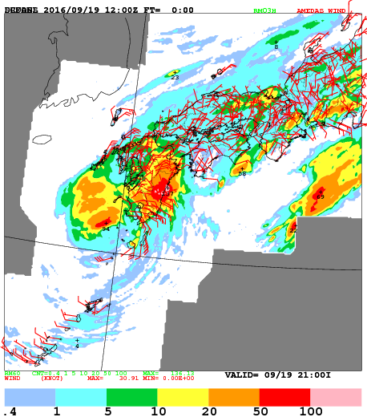
Precipitation of Forecast
Traditional DA Climatological(100%)+Ensemble(0%)
Observation
Lead time: 9-hour

Slide 14
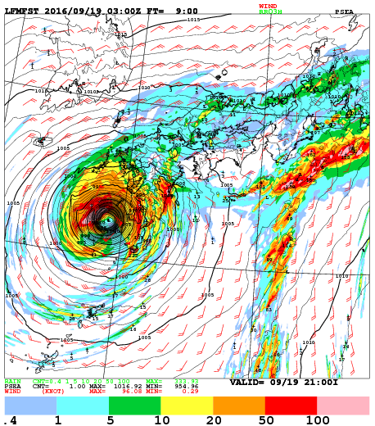
Precipitation of Forecast
Hybrid DA Climatological(50%)+Ensemble(50%)
Observation
Lead time: 9-hour

Slide 15
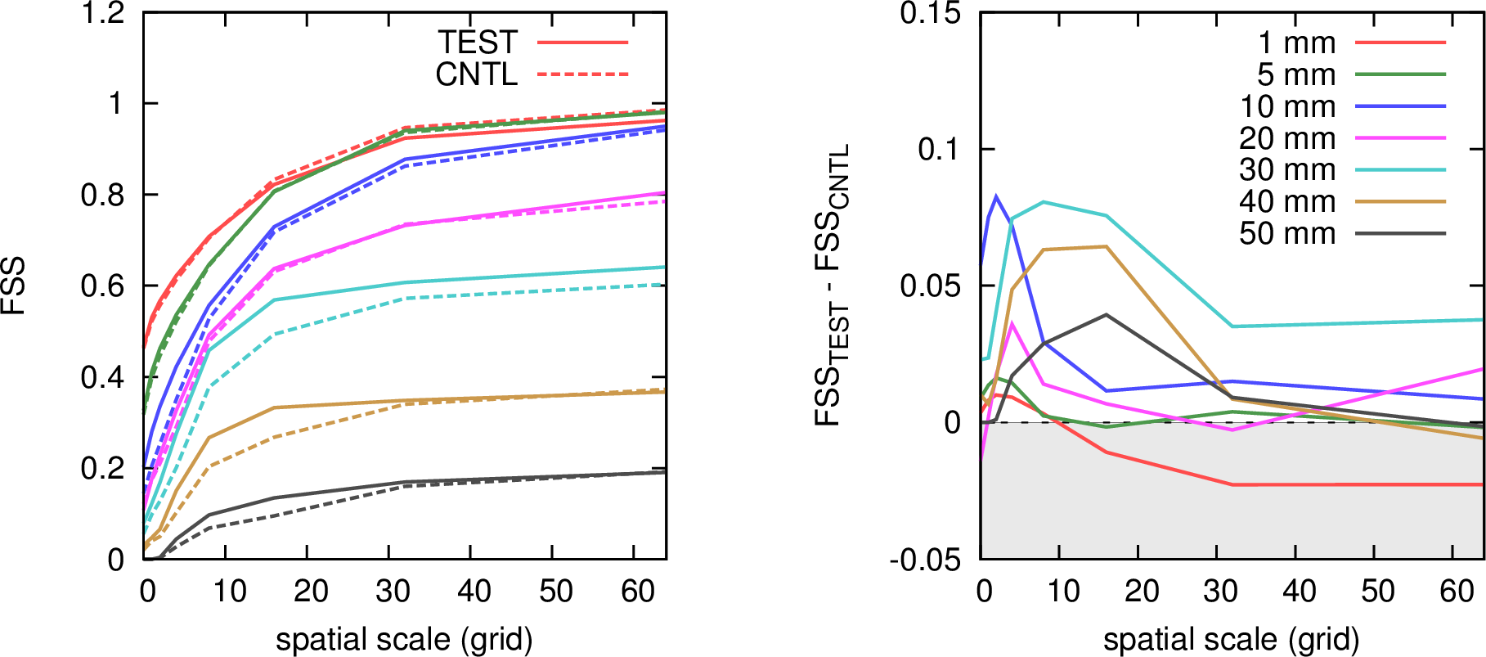
Fractions Skill Score
CNTL: Traditional DA
TEST: Hybrid DA
Improvement of heavy rain rate
perfect skill
Under estimation of weak rain on largescale

Slide 16
Utilization of Reflectivity from Solid Particles
In the current system, reflectivity to snow particles can not be assimilated.
Problem of assimilation for solid particle
  Scattering calculation
    -> Enhancement of reflectivity simulation
  Simulation Bias
    -> Obs: Application of adaptive bias correction method, eg. VarBC
    -> Model: Improvement of MP scheme.

Slide 17
Enhancement of Space-borne Radar Simulator
Space-borne radar simulator
    Simplified to reduce computation cost
  Beam: Not-bending
    Ignoring the slant beam path and beam width
  Effective particle: Rain, snow and graupel
    Ignoring cloud water and cloud ice particles
  Size distribution
    rain and graupel: Exponential distribution
    snow: Exponential + modified gamma distribution
  Particle type
    Non-spherical particle
  Scattering calculation
    LUT ( Lorenz-Mie, DDA)
    Single scattering
20 km

Slide 18
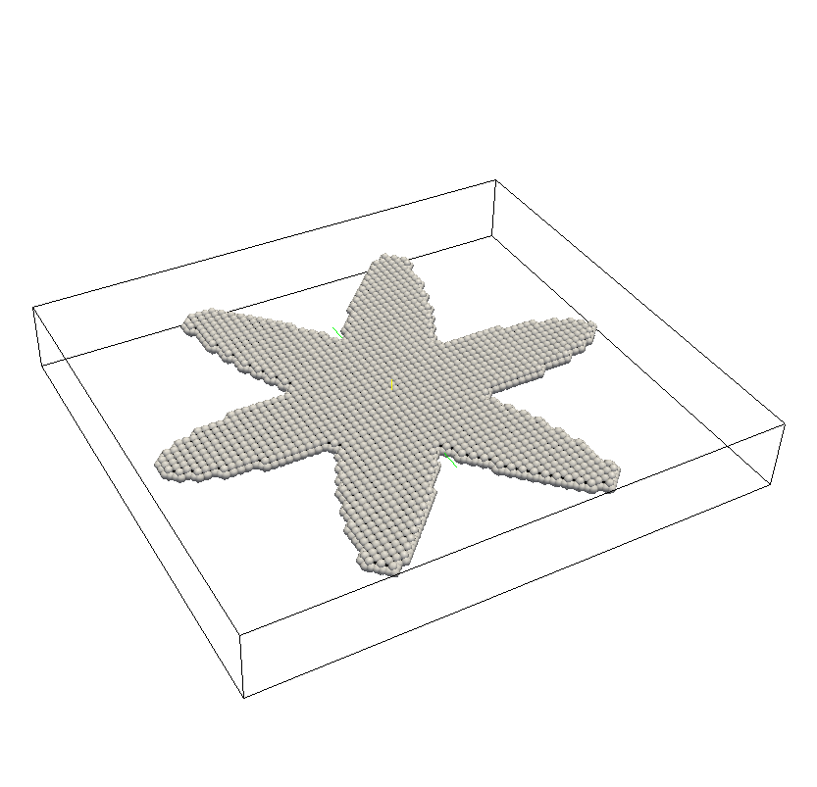
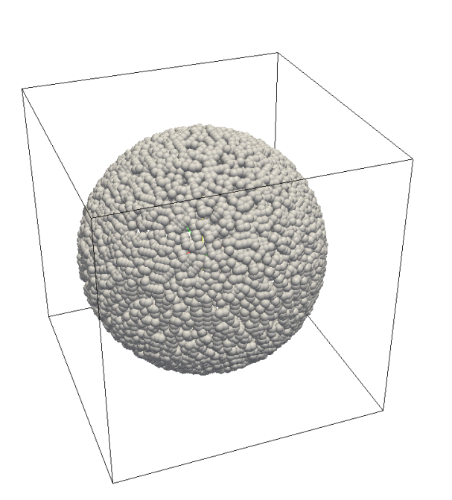
Shape of Snow Particle for Scattering
Spherical snow
Type-A snowflakes in Liu(2008)
Scattering: Lorentz-Mie
Scattering: DDA(Discrete Dipole Approximation)
In current method, snow particles are assumed as spherical particle.
These dipoles by DDSCAT 7.3

Slide 19
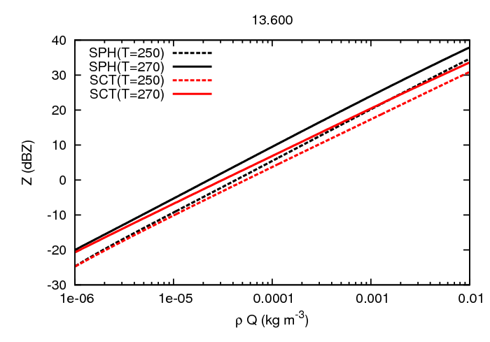
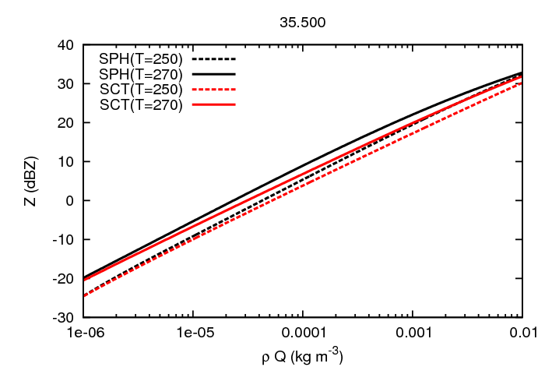
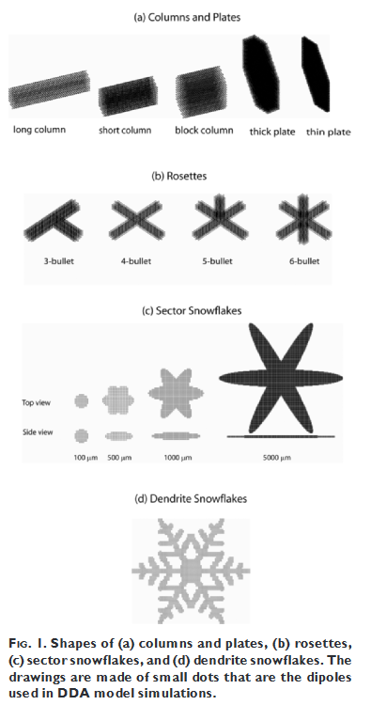
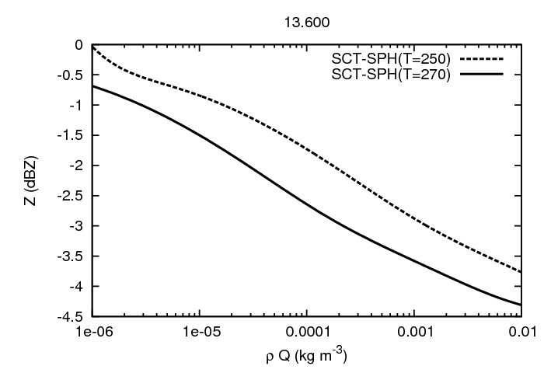
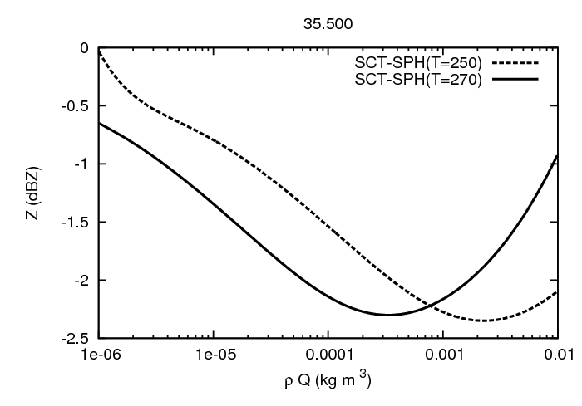

Radar Reflectivity of Snow
KuPR(13.6GHz)
KaPR(35.5GHz)
PSD: exponential + modified gamma
(Field et al. 2007)
Spherical snow particles
Bulk density:
$$ρ=1.3×{10}^{−1}D^{−1} [\text{kg}{ \text{m}}^{−1}]$$
Sector snowflakes
SCT Liu(2008)
SCT - SPH
SCT - SPH
Small Large

Slide 20
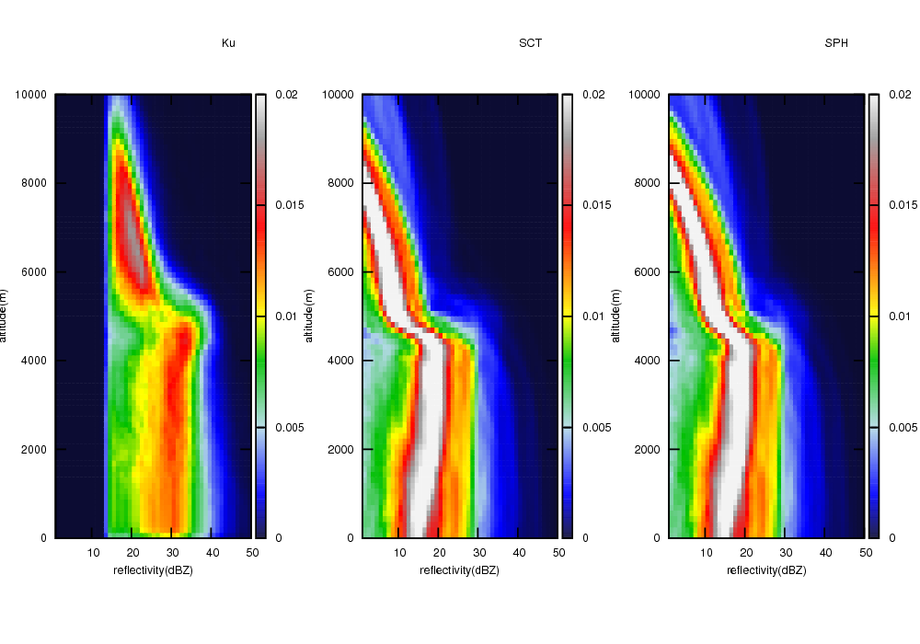
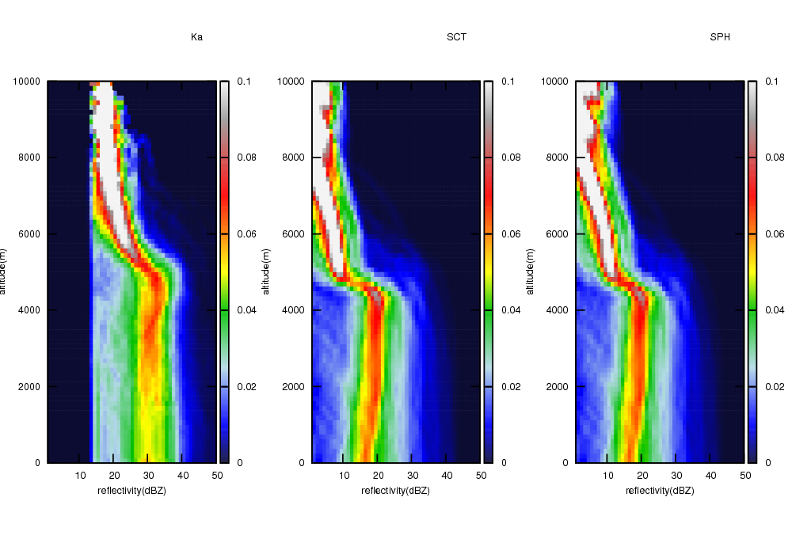
CFADs of Radar Reflectivity
Contour frequency by altitude diagrams (CFADs)
KuPR
KaPR
Observation
Simulation(SCT)
Simulation(SPH)
Observation
Simulation(SCT)
Simulation(SPH)
SCT: sector of snowflakes
SPH: spherical particle of snow
SCT is weaker than SPH, however model bias is larger than sensitivity to different particle shapes.

Slide 21
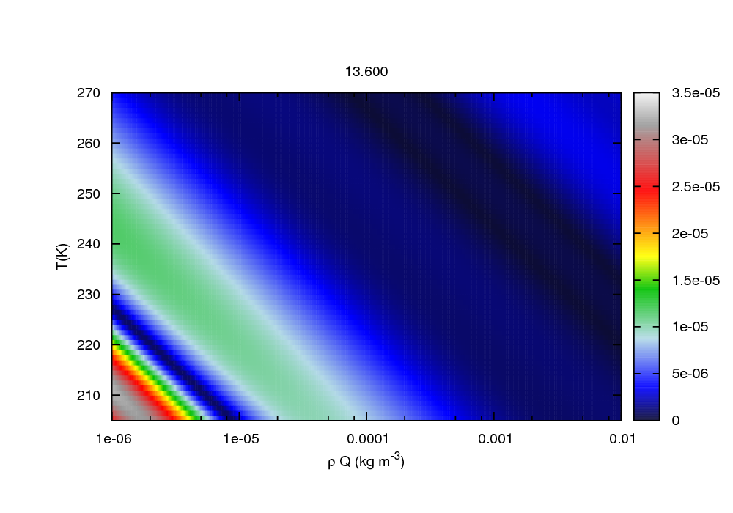
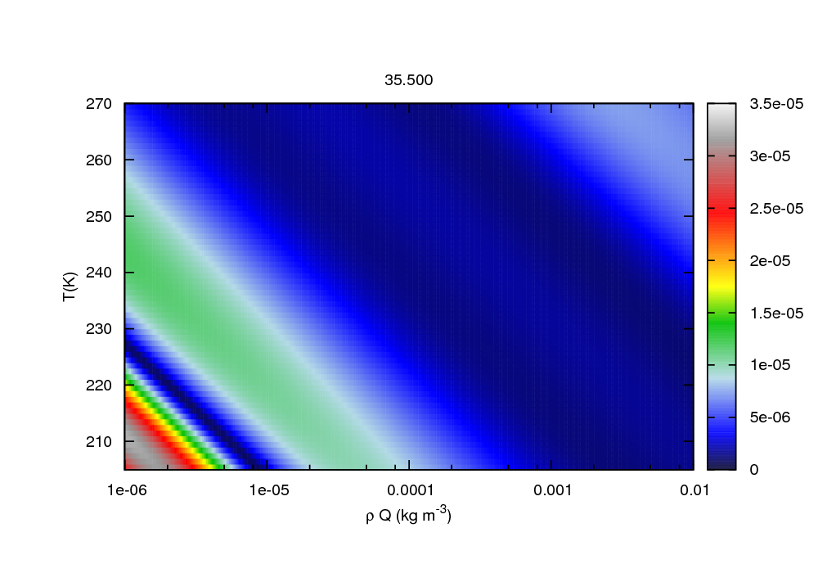

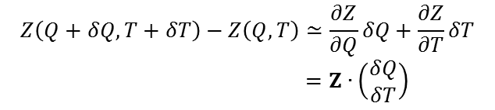

Tangent-linear and Adjoint of Radar Simulator
Function of reflectivity calculation
$$Z\left(Q+δQ,T+δT\right)−Z\left(Q,T\right)≃\frac{∂Z}{∂Q}δQ+\frac{∂Z}{∂T}δT$$
$=Z∙\left(\begin{matrix}δQ \\ δT\end{matrix}\right)$
: Tangent-linear operator
: Adjoint operator
Similarity between $Z\left(Q,T\right)$ and $Z$ .
$$ε=\left|Z∙\left(\begin{matrix}δQ \\ δT\end{matrix}\right) −Z\left(Q+δQ,T+δT\right)−Z\left(Q,T\right)\right|$$
$$δQ=Q×{10}^{−3}, δT=T×{10}^{−3}$$
KuPR (snow)
KaPR (snow)
Error increases in low temperature and low mass. However, it is a practically sufficient accuracy.
(Maximum error ～3.e-5 dBZ)

Slide 22
Summary and Future Plans
Development of Hybrid 4D-Var
  TL/AD of cloud-microphysics scheme
    The TL model grows the perturbation smoothly in almost processes.
    The AD model propagates the gradient with respect to hydrometeors.
  Benefit of flow-dependent DA
    Analysis increments based on atmospheric flow
    Improvement of precipitation forecast
Development of space-borne radar simulator with TL/AD
  Reflectivity of non-spherical particles
  Model bias is larger than influence from different scattering methods.
Future work
  Enhancement of quality control and bias correction for solid particles.
  More case studies targeting severe weather event.
  Log-term statistical verification.

Slide 23
Thank you for your attention

Slide 25
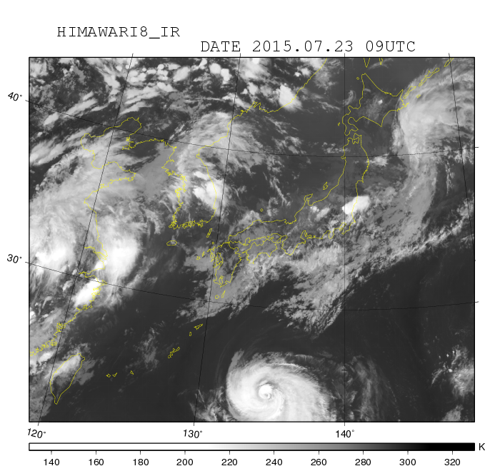

Comparison of Simulation and Observation
Simulation
Horizontal resolution: 2 km, Lead time: 9-hour
Shape: non-spherical, Snow-PSD: exponential+gamma
Observation (Himawari-8 AHI)
10.4 μm
Relaxation area

Slide 26
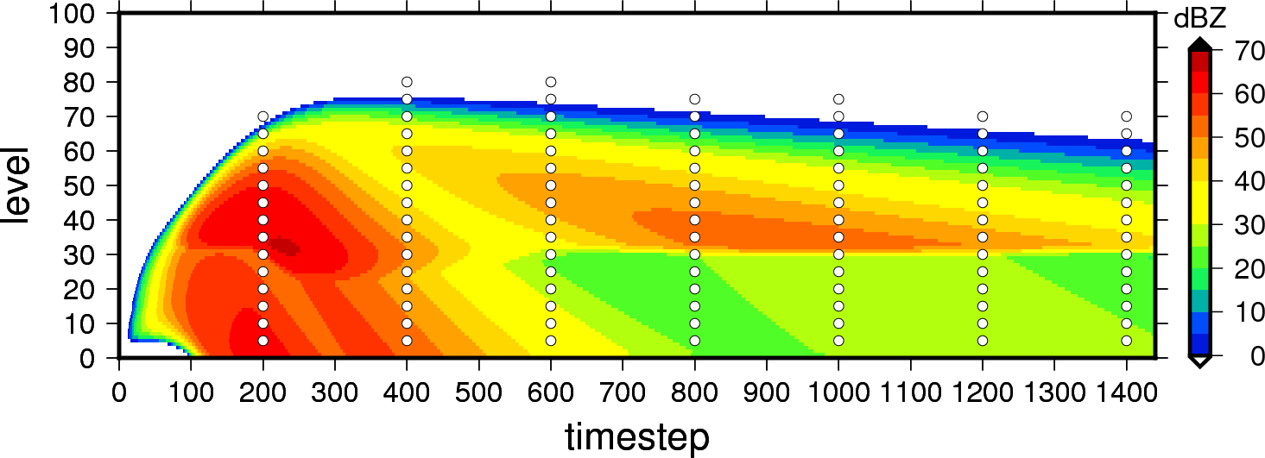
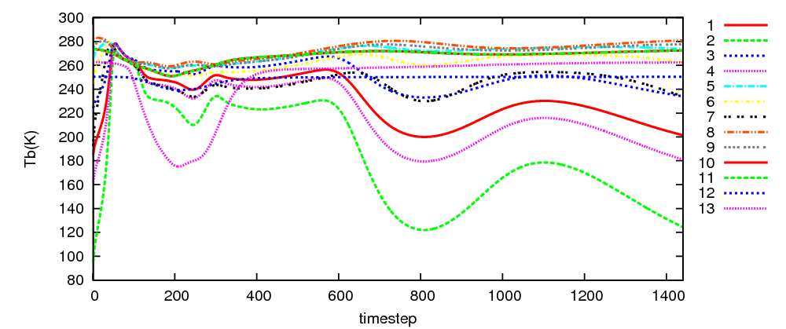
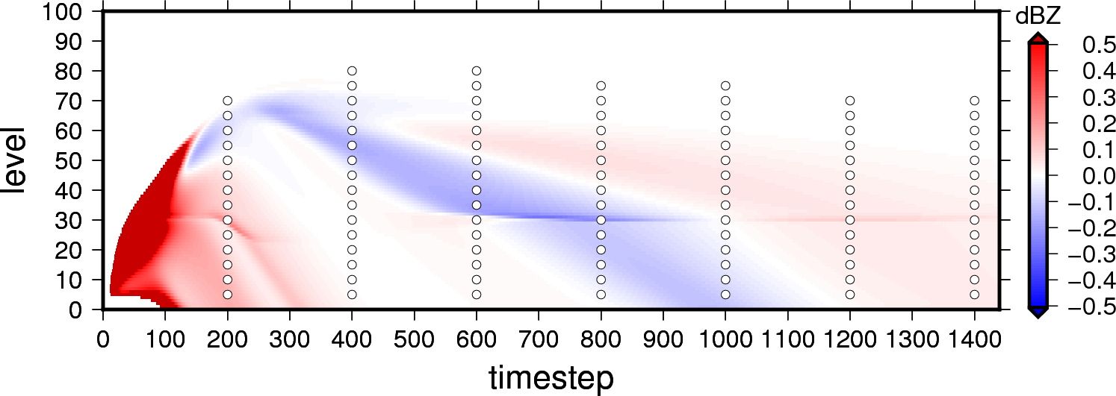
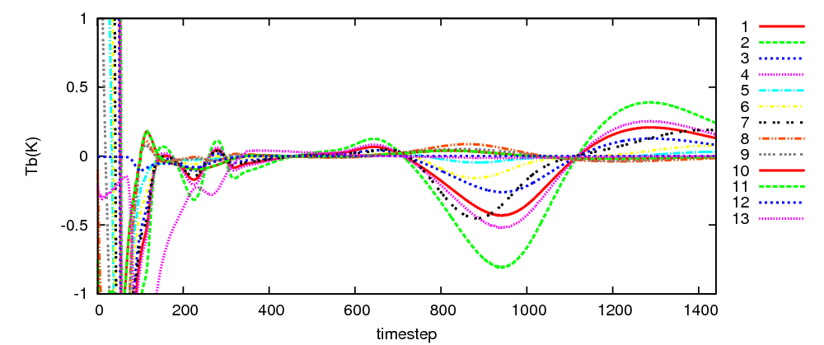
Function of AD Model of Cloud Microphysics in Identical Twin
Reflectivity (KuPR)
Brightness temperature (GMI)
Guess
Guess
True-Guess
True-Guess
RTTOVSCATT (rttov11.3)
Satellite: GPM, Sensor: GMI, Frequency: 1) 10.65 GHz(V), 2) 10.65 GHz(H), 3) 18.7 GHz(V), 4) 18.7 GHz(H), 5) 23.8 GHz, 6) 36.5 GHz(V), 7) 36.5 GHz(H), 8) 89.0 GHz(V), 9) 89.0 GHz(H), 10) 165.5 GHz(V), 11) 165.5 GHz(H), 12) 183.31±3 GHz, 13) 183.31±8 GHz
○: Pseudo Observation points

Slide 27
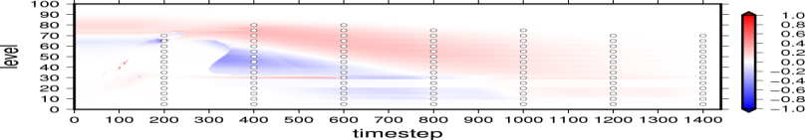
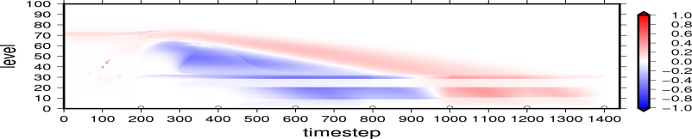
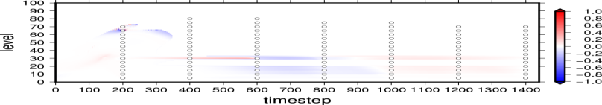
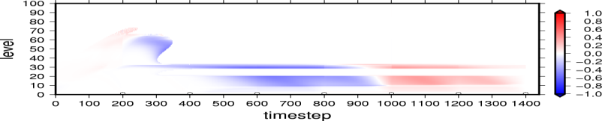
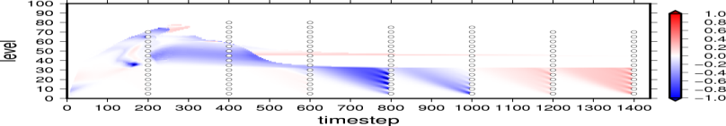
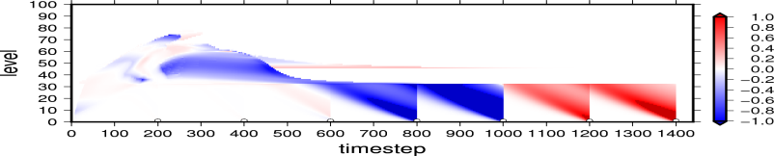
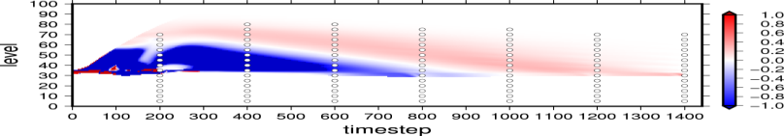
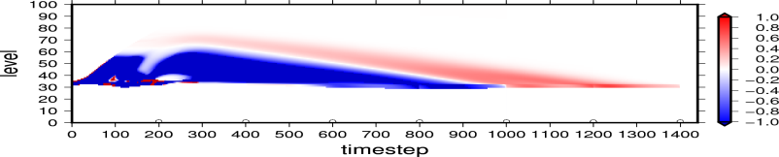
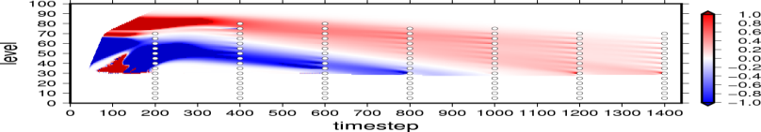
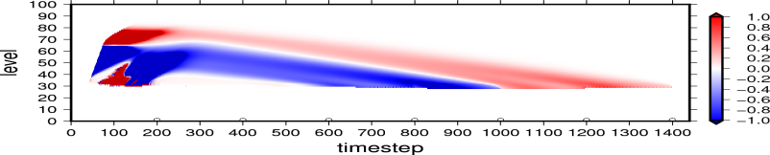
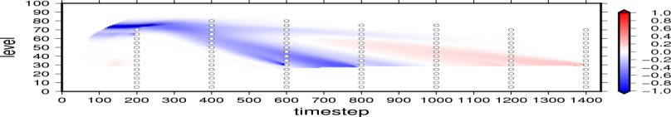

Gradient vector from pseudo observation
Reflectivity
Observation
Brightness temperature
Observation
Qv
Qc
Qr
Qi
Qs
Direction of time integration is backward in AD
Qg
Reflectivity doesn’t have direct sensitivity of water vapor, cloud and ice.
Gradient vector

Slide 28
Gradient Vector from pseudo observation
Reflectivity
Observation
Brightness temperature
Observation
Qv
Saturated layer
Qc
Gradient of water vapor, cloud and ice are given by AD model.
Qr
Qi
Qs
Adjoint of solid-phase processes propagate the observation information to upper atmosphere.
Qg
Gradient vector

Slide 29
Gradient Vector from pseudo observation
Reflectivity
Observation
Brightness temperature
Observation
Qv
Saturated layer
Qc
Gradient of water vapor, cloud and ice are given by AD model.
AD of Microphysics Processes with ice and water vapor.
Autoconversion_AD: δQs, δQi
Nucleation_AD: δQv, δQi
Evap/Dep_AD: δQv, δQr, δQi, δQs, δQg
Melting_AD: δQr, δQi
Freezing_AD: δQi, δQc
Collection_AD: δQc , δQi, δQs, δQg
Qr
eg.
Qi
Qs
Adjoint of solid-phase processes propagate the observation information to upper atmosphere.
Qg
Gradient vector

Slide 30


2. Enhancement of quality control and space-borne radar simulator
SCATDB (Liu 2008, Honeyager et al. 2016)
  Database of scattering coefficients for non-spherical particle.
13GHz
36GHz
Liu (2008)

Slide 31
Flow-dependent Term
The flow-dependent method is employed extended control variables method.
Extended control variable method (Lorenc 2003)
Background error covariance
Mixing the climatological BG error and the ensemble estimated BG error
Preconditioning
Control variables
Extended control variables
The analysis variable is given by control variable and extended control variables.
Cost function
Spatial localization

Slide 32



Statistical BG Error Vertical Covariance
Correlation in Jul ( sample # 8x31 forecasts )
Covariance
Correlation in Jan ( sample # 8x31 forecasts )
* Cov are rescaled

Slide 33
Statistical BG Error Vertical Covariance
Dependence on seasons and meteorological situations
-> We need flow-dependent BG Error covariance.
Correlation in Jul ( sample # 8x31 forecasts )
Covariance
Correlation in Jan ( sample # 8x31 forecasts )
hydrometeors
hydrometeors
hydrometeors
Large correlation
Correlation with hydrometeors
* Cov are rescaled

Slide 34
Simplification of Background Error Covariance
Analysis variables
Additional variables in this study
Rank reduction
Horizontal velocity
  Weak correlations between δu and δv
Vertical velocity
  Effect is lost on early time.
Pressure
  Substituted with hydrostatic pressure

