Slide 1
Adjoint model development, validation, and application
Daniel Holdaway
(with a lot of guidance from Ron over the years!)
Sunday July 1st 2018

Slide 2
Introduction
What is the adjoint?
It's a version of a model that propagates gradients of model variables (sensitivity) backwards in time.
Why do we need adjoint models?
4DVAR data assimilation.
Observation impact calculations.
Sensitivity studies.
Singular vector calculations.
To gain understand of the underlying model.
Training of neural networks using back propagation.

Slide 3
Introduction
In data assimilation we essentially need to balance two pieces of information to produce a new ‘best guess’ of the current atmospheric state x₀, winds, temperature etc.
This is achieved by minimizing a cost function:
Previous forecast x_{b}
Observations
y_{k}
Whole atmosphere.
Balanced.
But error details not well known.
Small, well described errors.
But under representative ~150/1.
Using its gradient:
adjoint of the model
Notes:
!Adjoint!

Slide 4
Outline
Introduction
Derivation of the linearized model
How to write an adjoint model
Validation of the linearized model
Practical issues
Sensitivity examples
Optimal perturbations

Slide 5
Derivation of the linearized model
We have a, most likely, nonlinear model,
where x and y are discrete model variables at an old and new time. From a DA perspective we regularly find ourselves asking a couple of questions:
How does y_{i} change with respect to x_{j}? If we make perturbations to x_{j} how do they affect y_{i}? Suppose x_{j} has some error. How does that error grow?
We’re analyzing something about y_{i} . This could be a forecast bust or just some interesting physical behavior. What specifically was it about x_{j} that led to this?

Slide 6
Derivation of the linearized model
We’re trying to get a handle on perturbations so we ‘linearize’ model variables by separating into reference and perturbation parts,
The output perturbation can be approximated by Taylor expansion,
The above equation is the tangent linear model (TLM) and gives an approximation for the growth of perturbations xj′.

Slide 7
Derivation of the linearized model

Slide 8
Derivation of the linearized model
We’re trying to get a handle on perturbations so we ‘linearize’ model variables by separating into reference and perturbation parts,
The output perturbation can be approximated by Taylor expansion,
The above equation is the tangent linear model (TLM) and gives an approximation for the growth of perturbations x_{j}′.

Slide 9
Derivation of the linearized model

Slide 10
Derivation of the linearized model
The TLM is a useful tool but it doesn’t help us with our second question. To get somewhere towards doing so we first simplify things by introducing a scalar measure of the outputs, .
Using the Taylor series again,
or,
The two estimates are equivalent when both functions are linear.

Slide 11
Derivation of the linearized model
The latter equation is of greater interest since it depends on the model’s inputs, rather than outputs. Since J is a function of a function we can use the chain rule to
expand,
Notice how powerful this equation is on its own. Even before using it to estimate J′ we can integrate a forecast time gradient (sensitivity) back to beginning time.

Slide 12
TLM vs. adjoint
Let’s adopt a vector notation to compute all grid points. First a matrix for the gradients:
Now the TLM can be rewritten:
For the TLM we sum over the columns while for the J’ model we sum over rows. To use the vector notation the matrix is transposed (also known as taking the adjoint),

Slide 13
TLM vs. adjoint
The matrix M is known as the resolvent of the TLM or Jacobian of the nonlinear model. The model which maps sensitivities backwards is known as the adjoint model because it uses the adjoint of the TLM.
We generally use a compact notation for the adjoint model,
Jointly the TLM and adjoint are frequently referred to as the linearized version of the model.

Slide 14
TLM vs. adjoint
Both the TLM and adjoint depend on the model gradient. They pick out the structures that evolve along the steepest gradients, either forwards or backwards.
The tangent linear model maps a specific perturbation onto all forecast aspects. This allows us to investigate the first question we posed.
The adjoint maps a specific sensitivity backwards with respect to all possible perturbations. This allows us to investigate the second question.
The adjoint is generally more useful but the TLM plays a crucial role in validating the linearized model.

Slide 15
Assumptions being made
All of this is based on the Taylor series expansion. So what assumptions have we actually made?
The Taylor series is a good approximation when |x′| is ‘small’.
The nonlinear model is continuous and is differentiable.
However for most modern atmospheric models this is not the case:
In actual applications x′ can be large, e.g. the specific humidity analysis increment and errors can be of the order of 100%.
Unresolved processes are not represented with continuous equations.
Adjoint development means validating the extent to which these assumptions hold true.

Slide 16
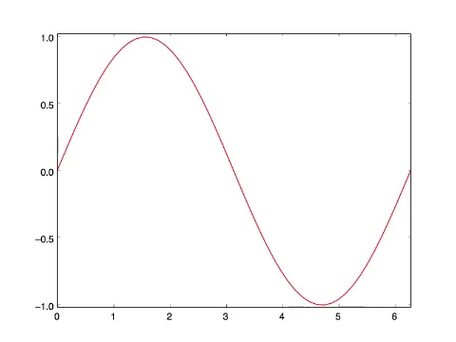
Interpretation of adjoint fields
Sine wave advected with first order scheme

Slide 17
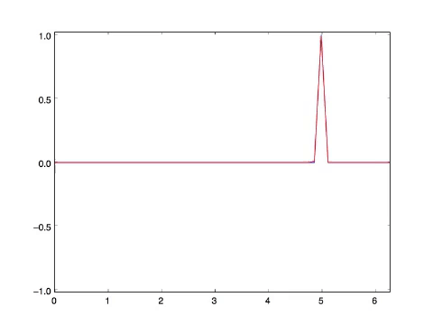
Interpretation of adjoint fields
Sine wave advected with first order scheme
Adjoint initialized with point.

Slide 18
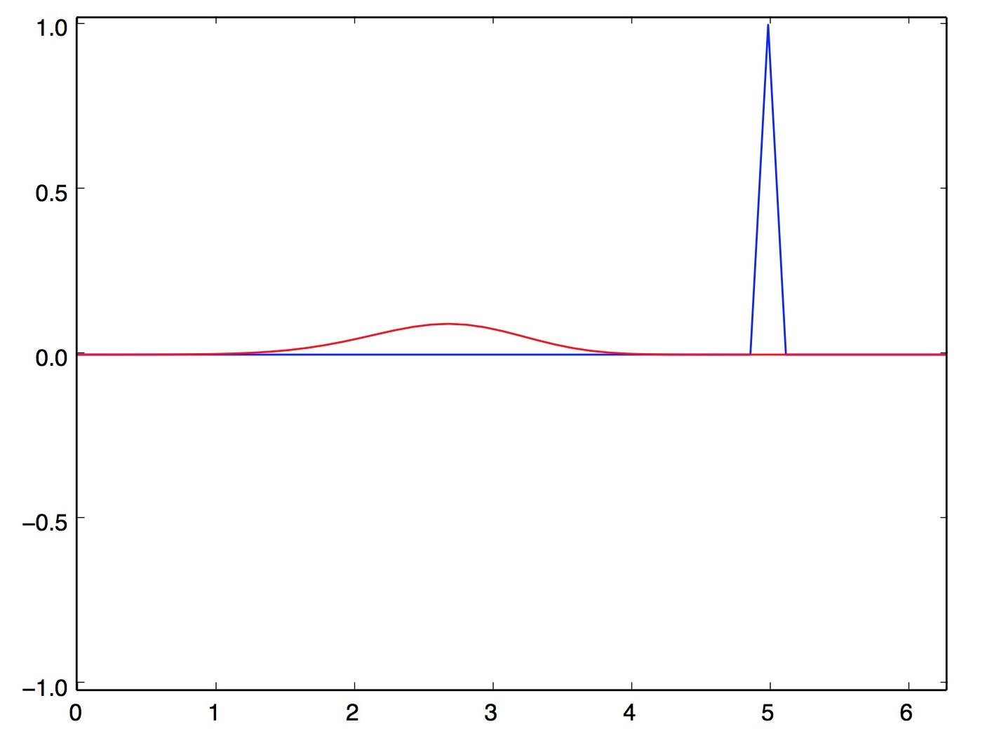
Interpretation of adjoint fields
You could think of the initial condition here as an error, say a missing cloud.
Through the adjoint we learn where the initial condition needs to be adjusted to reduce the difference between the forecast and observation.
In 4D-Var the adjoint is used in this way but for all observations simultaneously and balanced by covariance matrices.

Slide 19
Outline
Introduction
Derivation of the linearized model
How to write an adjoint model
Validation of the linearized model
Practical issues
Sensitivity examples
Optimal perturbations

Slide 20
1D advection example
One dimensional advection of a tracer
The important variables are u and q. Linearize by splitting into e.g.
Eliminate all terms not including one perturbation term,
Continuous TLM

Slide 21
1D advection example (in practice)
Typically we are working with a model that has been discretized, e.g.:
Split the key variables into sum of reference and perturbation parts.
Discrete TLM

Slide 22
1D advection example matrix form

Slide 23
Steps for coding success
Make a list of ‘dependent’ variables, here q and u.
Write (re-write) your model so all calculations dependent on these variables are within a module.
Only arguments should be dependent variables and constants.
Do things in double precision within modules if possible.
Minimize your use of intrinsic functions.
Write the tangent linear model first.
Don’t write the adjoint until you’ve tested the TLM.

Slide 24
The nonlinear model
subroutine FirstOrderAdvection(qr,ur,dx,dt,Nx,Nt)
implicit none
argument definitions
qnewr = 0.0
do n = 1,Nt
do j = 1,Nx
if (j .eq. 1) then
qnewr(1) = qr(1) - ur(j)*dt/dx*(qr(1) - qr(Nx))
else
qnewr(j) = qr(j) - ur(j)*dt/dx*(qr(j) - qr(j-1))
endif
enddo
enddo
qr = qnewr aenddo
end subroutine

Slide 25
TLM code example
subroutine FirstOrderAdvectionTLM(qr,ur,qp,up,dx,dt,Nx,Nt)
...declarations...
do n = 1,Nt
do j = 1,Nx
if (j .eq. 1) then
qnewr(1) = qr(1) - ur(j)*dt/dx*(qr(1) - qr(Nx))
qnewp(1) = qp(1) - dt/dx*( ur(1)*(qp(1) - qp(Nx)) &
+ up(1)*(qr(1) - qr(Nx)) )
else
qnewr(j) = qr(j) - ur(j)*dt/dx*(qr(j) - qr(j-1))
qnewp(j) = qp(j) - dt/dx*( ur(j)*(qp(j) - qp(j-1)) &
+ up(j)*(qr(j) - qr(j-1)) )
endif
enddo
qp = qnewp
enddo
end subroutine
This code is correct but coding the TLM this way is a mistake!

Slide 26
TLM code example
Order is often important!
qnewr(j) = qr(j) - ur(j)*dt/dx*(qr(j)-qr(j-1))
qnewp(j) = qp(j) - dt/dx*(ur(j)*(qp(j)-qp(j-1)) + up(j)*(qr(j)-qr(j-1)))
Should be written as ...
qnewp(j) = qp(j) - dt/dx*(ur(j)*(qp(j)-qp(j-1)) + up(j)*(qr(j)-qr(j-1)))
qnewr(j) = qr(j) - ur(j)*dt/dx*(qr(j)-qr(j-1))

Slide 27
Guidelines for coding adjoint models
Writing the TLM and transposing the matrix is not practical for large systems.
Create a copy of the TLM module.
Strip out all non-perturbation lines.
Reverse the order of everything (including reversing loops).
For each line:
For every perturbation variable that occurs on the RHS make a new line with that variable on the LHS
Set it equal to itself with a plus, e.g. qp(j) = qp(j) +
Include the original LHS variable and multiply by the coefficient of the original RHS variable, e.g. qp(j) = qp(j) + qnewp(j) ∗ (−ur(j) ∗ dx/dt)
If a variable is overwritten do not add to itself.
Order is important!

Slide 28
Adjoint code example
subroutine FirstOrderAdvectionADM(qr,ur,qp,up,dx,dt,Nx,Nt)
...declarations...
do n = Nt,1,-1
qnewp = qp
do j = Nx,1,-1
if (j .ne. 1) then
qp(j) = qp(j) + (1 - dt/dx*ur(j)) * qnewp(j)
qp(j - 1) = qp(j - 1) + dt/dx*ur(j) * qnewp(j)
up(j) = up(j) + dt/dx*(qr(j) - qr(j-1))*qnewp(j)
qnewp(j) = 0
else
qp(1) = qp(1) + (1 - dt/dx*ur(1)) * qnewp(1)
qp(Nx) = qp(Nx) + dt/dx*ur(1) * qnewp(1)
up(1) = up(j) + dt/dx*(qr(1) - qr(Nx))*qnewp(1)
qnewp(1) = 0
endif
enddo
enddo
end subroutine

Slide 29
Adjoint: check-pointing vs re-calculation
Check-point the trajectory (increases memory use).
STEP1 First run though nonlinear code
saving what you later need:
do n = 1,Nt
qtraj(n,:) = qr
utraj(n,:) = ur
do j = 1,Nx
...
enddo
enddo
STEP2 As you integrate the adjoint read back in:
do n = Nt,1,-1
qr = qtraj(n,:)
ur = utraj(n,:)
do j = Nx,1,-1
...
enddo
enddo

Slide 30
Adjoint: check-pointing vs re-calculation
Forward sweep
MEMORY FOOTPRINT
Backward sweep

Slide 31
Adjoint: check-pointing vs re-calculation
Re-compute the trajectory within adjoint loop (increases computational time):
subroutine FirstOrderAdvectionADM(qr,ur,qp,up,dx,dt,Nx,Nt)
...declarations...
do n = Nt,1,-1
do n1 = 1,n
do j = 1,Nx
...
enddo
enddo
do j = Nx,1,-1
...
enddo
enddo
end subroutine
For complex models you need a combination of these two techniques.

Slide 32
Adjoint: check-pointing vs re-calculation
Forward sweep 1
Forward sweep 2
Forward sweep 3
‘Nt+1 choose 2’ forward steps.

Slide 33
Auto-differentiation
Coding adjoint by hand is error prone and time consuming, especially for today’s complex NWP models. Thankfully there are lots of great tools available to help.
Tapenade (http://tapenade.inria.fr:8080/tapenade/)
Taf (http://www.fastopt.de/)
OpenAD
Pass them a subroutine and they return TLM and ADM! Some considerations though:
Code not usually the most efficient it can be.
They cannot tell you if you should differentiate (next section).
Tools have different characteristics.

Slide 34
Outline
Introduction
Derivation of the linearized model
How to write an adjoint model
Validation of the linearized model
Practical issues
Sensitivity examples
Optimal perturbations

Slide 35
Validation of the TLM
It is crucial to validate the linearized model carefully when developing code. This is done using the TLM and verifying that,
But really what we want to look at is:
for realistic x′. Look at the correlations between the two, root mean squared error and the root mean square of each.

Slide 36
Validation of the TLM
Note that
will actually fail for most modern atmospheric models that include physics, even if the TLM is coded correctly!
This is because under switches, even though you make the denominator infinitesimal, the numerator will remain finite. So instead the result can tend to infinity.

Slide 37
Validation of the TLM

Slide 38
Validation of the adjoint
Once you are happy with the TLM performance, the correct coding of the adjoint is confirmed using a dot product test.
The result wont generally be zero but something on the order allowed by
precision.
For double precision:
For single precision:
If your result is larger than this you likely have a bug somewhere.

Slide 39
Validation for sensitivity studies
For sensitivity studies you can alos check the linearity with J included.
This is done by comparing the nonlinear J′ with the linearized approximation.

Slide 40
Outline
Introduction
Derivation of the linearized model
How to write an adjoint model
Validation of the linearized model
Practical issues
Sensitivity examples
Optimal perturbations

Slide 41
Real World example of an issue
Consider the linear 1D advection problem again,
Linearized and with constant wind, u′ = 0,
The problem is exactly linear. So long as we choose a linear scheme then whatever perturbation we choose the linearization is exact

Slide 42
Advection of the reference part
In these runs a top-hat profile is advected once around the domain with a selection of horizontal differentiation schemes.
These schemes are all linear except the limited PPM scheme, as used in GEOS.

Slide 43
Advection of a perturbation
Now a point perturbation is applied to the top-hat at the initial time and the advection is done again.
Blue curves show the difference between two nonlinear runs. The red curve shows the TLM.

Slide 44
Examining TLM stability
When encountering problems one way to examine the behavior is to numerically assemble the Jacobian:
Set x1′ =1 and x2′ =0 and run the TLM model to get,
Repeat, setting each element of x to 1 and running the TLM to obtain the corresponding column of the Jacobian.

Slide 45
Stability analysis
Having the Jacobian lets us examine the gradients of the model directly, which can be very useful.
It also allows for stability analysis,
where ,
are the eigenvalues of .
Eigenvalue spectrum of the limited PPM advection scheme. There is no hope of linearizing this any kind of meaningful and stable way.

Slide 46
Stability analysis
When we see an eigenvalue spectrum like this it immediately tells us that this scheme should not be linearized, and has saved us the bother of writing the adjoint.
Fortunately, the reasons that linear schemes are not used for advection are not so important when it comes to transporting perturbations and sensitivities.
In this instance the nonlinear model and linearized model will be based on different equations, a so called “perturbation model”.
Note that stability analysis can be less useful for high dimensional problems.

Slide 47
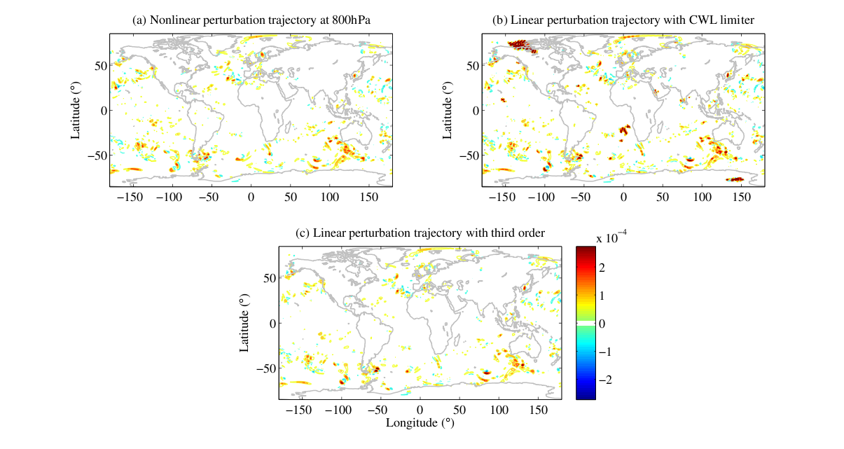
Cloud liquid water perturbation in GEOS

Slide 48
Problems with physics
These issues with advection aren’t due to the equations but the scheme that is chosen.
For the physics the issues are often due to the equations themselves.
Below shows the equation for cloud fraction in GEOS-5,
Nonlinear cloud fraction perturbations are bounded between 0 and 1. The TLM of this part of the model produces cloud fraction perturbations that are O(10³)!

Slide 49
Problems with physics
Now we have to do some analysis and make a decision on how to proceed.
Do we try to find a new way of computing cloud fraction that is more linear and does not support rapid perturbation growth?
or
Do we try to predict and eliminate when situations where the TLM will fail.

Slide 50
1. A new scheme (approach taken by the ECMWF)
Advantages:
The new scheme can be fast and so suited to 4DVAR.
Designed from the ground up means reliable results.
Disadvantages:
Requires lots of cross-discipline interaction.
Tuning new physics schemes is very tedious.
The nonlinear model will have different behavior from the linearized model.

Slide 51
2. Scheme analysis (approach taken by NASA)
Advantages:
Keeps the linearized model close to the nonlinear model.
Allows DA scientists to stick to what they know.
Much faster to develop and redevelop.
We learn much as we go and find bugs.
Disadvantages:
May be slower to run.
Always the chance that you miss something.

Slide 52
3. Do both
Depending on application the ideal situation could be to analyze the behavior but also have an alternative scheme to use when we notice a problem.

Slide 53
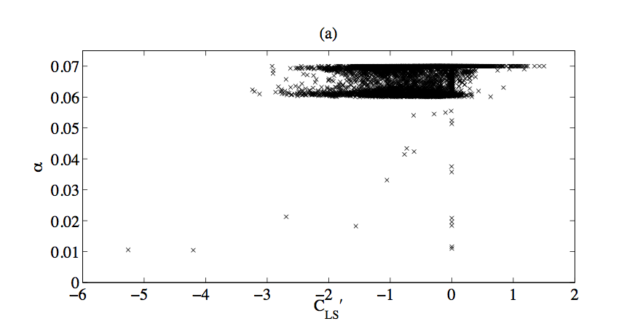
Correlation with trajectory
Start by making plots of the problem perturbation against aspects of the trajectory.
Sometimes this can work incredibly well and give you a way to control problems. It can also speed the code up by limiting the places where the TLM and adjoint are used.
Assume no cloud perts at this cut off for example.

Slide 54
Correlation with trajectory
Sometimes this approach can be used with great success. The linearized convection scheme in GEOS, for example, remains stable by computing a single column of the Jacobian only when the convection is a certain depth and analyzing the magnitude of the elements at three specific model levels. Occasions where the moist physics suffers an instability in the system are extremely rare.
For other schemes you can exhaust all possibilities without finding a useful and efficient approach. In these cases it’s best to implement a perturbation model. However, unlike for advection this mean inventing something new.

Slide 55
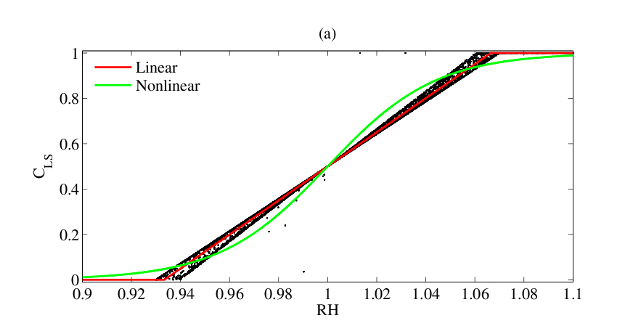
A new model (the simple way)
As complex as the model sometimes seems it is not always the case.

Slide 56
A new model (the simple way)
In this situation we can replace,
With
and get almost the same result for the nonlinear forecast. This function is piecewise linear and we always know the gradient. We simply tune one value until results are satisfactory.

Slide 57
Problems with physics
Most likely no perfect solution is possible so pick the lesser of the multiple evils!
Unrealistically large perturbation growth has to be avoided.
Piecewise linear functions have problems at the switches.
But smoothing introduces ‘development drift’ from the true model.
Learning from adjoint work. It is interesting to look at physics schemes in this way. Use of steep gradients and switches implies a certain confidence in the scheme’s ability to ‘determine’ the cloud fraction. But can it fundamentally achieve that? And should that really be the aim?

Slide 58
Outline
Introduction
Derivation of the linearized model
How to write an adjoint model
Validation of the linearized model
Practical issues
Sensitivity examples
Optimal perturbations

Slide 59
North East blizzard of January 2015
This case presented some interesting forecasting challenges.
Initialize the adjoint with energy, surface pressure or circulation in the box.
Sea level pressure with wind field

Slide 60
North East blizzard of January 2015
Initialize the adjoint with surface pressure and run backwards 36 hours.
Positive means positive sensitivity, i.e. a positive perturbation would increase J.
Increasing moisture in these key regions decreases surface pressure – makes the storm stronger.

Slide 61
Sensitivity to dust example
Using the adjoint metric centered over the forming hurricane Helene we examine sensitivity to dust. Figure shows dust and sensitivity at 800hPa.
In regions of negative sensitivity a positive change to dust would reduce surface pressure in the box (increase the strength of the storm)

Slide 62
Outline
Introduction
Derivation of the linearized model
How to write an adjoint model
Validation of the linearized model
Practical issues
Sensitivity examples
Optimal perturbations

Slide 63
Optimal perturbations
The general idea is that we want to maximize,
subject to a constraint, chosen as,
Could also minimize C subject to J′. This is Lagrange multiplier problem, which has the solution,

Slide 64
Optimal perturbations
Effectively we look for the location where gradient vectors of the function and the condition are parallel by differentiating I and setting equal to 0.
The optimal perturbation is,
The constant λ results from the two parallel gradients generally having different magnitudes. It is calculated by plugging x_{j}′ back into the constraint. The weights w_{j} are required to account for uneven grid spacing and mass changes with height.

Slide 65
North East blizzard optimal perturbation
Now the units and magnitudes of the fields are more realistic and can be propagated the nonlinear model. This reveals how uncertainty with with this structure would behave.
The structures are also evolved with the TLM to validate the experiment.

Slide 66
SLP difference after optimal perturbation
With these optimal perturbations the storm is drastically weakened and the track shifts, moving the storm away from the coast much faster.

Slide 67
Conclusions
The adjoint and TLM are very useful tools, used in a wide variety of applications, as we’ll see this week.
The derivation uses relatively straightforward principles but developing adjoint models in non-trivial.
Development can be tedious but automatic tools can help significantly.
Care is required to understand the underlying behavior of the model but this in itself is very useful and we learn a lot. There are lots of tools for looking at behavior.
Looking at adjoint sensitivity can provide basic understanding of atmospheric behavior as well as informing us how to improve data assimilation.

Slide 68
The future of adjoints in NWP
4DVar data assimilation has proven to the best formulation over the past 20 years. The Met Office and ECMWF produce arguably the best forecasts and much of this is due to the initial conditions.
However the complexity of models is growing rapidly now. Physics is increasingly more complex and nonlinear and modern dynamical cores are aiming to relax assumptions and resolve small scales (not a characteristic of ECWMF and the Met Office’s dynamical cores).
Scientifically it seems likely that 4D-Var will continue to be the optimal approach for the time being. However, for it to remain practically viable in the face of this growing complexity will require technological changes. It will have to evolve into a highly interdisciplinary problem, bringing computer science and mathematics together to build dynamical core adjoints and perhaps machine learning to build nimble perturbation models for the physics. We need bright enthusiastic people willing to learn a lot!

