Slide 1



New Methods for the
Calculation and Analysis of
Quasi-Iterative Optimal Perturbations
Alexander M.Goldstein¹
Brett T. Hoover^{1,2}
Michael C. Morgan¹
Daniel Holdaway³
¹Department of Atmospheric and Oceanic Sciences, University of Wisconsin- Madison
²Space Science and Engineering Center, Cooperative Institute for Meteorological Satellite Studies, University of Wisconsin - Madison
³Global Modeling and Assimilation Office, NASA Goddard Space Flight Center
This project is possible due to the support from NASA NIP award NNX14AI38G

Slide 2

Response Functions
A response function can be defined as some aspect of the model state that we are interested in, and implies the question, ‘how will this aspect of interest change under the influence of perturbations to the initial state?’.
In previous studies, an average surface pressure within a box surrounding a cyclone response function has been considered, and can be expressed as:
D
$$R_{1}=−{\left.\overline{P_{s}}\right|}_{D}$$
Notes:
del P is a smooth field, easily identifiable analog for intensity.
R is some aspect of the forecast state were interested in, and dimples the question, how will aspect of interest within forecast change under the influence of initial state perts?
This R is aimed at final time intensity, and the intensity can change over entire course of integration to get to target R.

Slide 3
Response Functions
The current method however calculates perturbations aimed only at changing the response function at a discrete point in time.
Notes:
EVOLVES!!!!!
TLM EVOLVES perts under the constraint of linearity

Slide 4
Response Functions
The current method however calculates perturbations aimed only at changing the response function at a discrete point in time.
Notes:
EVOLVES!!!!!
TLM EVOLVES perts under the constraint of linearity

Slide 5
Response Functions
The current method however calculates perturbations aimed only at changing the response function at a discrete point in time.
Notes:
EVOLVES!!!!!
TLM EVOLVES perts under the constraint of linearity

Slide 6
Response Functions
The current method however calculates perturbations aimed only at changing the response function at a discrete point in time.
Notes:
EVOLVES!!!!!
TLM EVOLVES perts under the constraint of linearity

Slide 7
Response Functions
The current method however calculates perturbations aimed only at changing the response function at a discrete point in time.
Can we create perturbations aimed at changing a time-dependent field such as intensification rate?
Notes:
EVOLVES!!!!!
TLM EVOLVES perts under the constraint of linearity

Slide 8
Response Functions
The current method however calculates perturbations aimed only at changing the response function at a discrete point in time.
Can we create perturbations aimed at changing a time-dependent field such as intensification rate?
Notes:
EVOLVES!!!!!
TLM EVOLVES perts under the constraint of linearity

Slide 9
Response Functions
The current method however calculates perturbations aimed only at changing the response function at a discrete point in time.
Can we create perturbations aimed at changing a time-dependent field such as intensification rate?
Notes:
EVOLVES!!!!!
TLM EVOLVES perts under the constraint of linearity

Slide 10
Explosive Mid-latitude Cyclogenesis
24 hPa decrease in 24-h (Sanders and Gyakum 1980)
Grow primarily through traditional baroclinic growth processes.
Likely undergo “explosive” deepening due to non-linear interactions on small diabatic processes (Uccellini 1990; Wang and Rogers 2001; Heo et al. 2015)
Near surface thermodynamics likely incredibly important in distinguishing between “ordinary” and “explosive” cyclones (Langland et al. 1995; Doyle et al. 2014).
  *denotes adjoint study
Notes:
Make sure to emphasize that given the conflicting information between chu and langland/doyle, this is still an active area of research that is not fully understood.

Slide 11

A New Response Function
$$R_{1}=−{\left.\overline{P_{s}}\right|}_{D}$$
Notes:
change in intensification over a discrete time vs. R1 = intensity at an instantaneous time

Slide 12
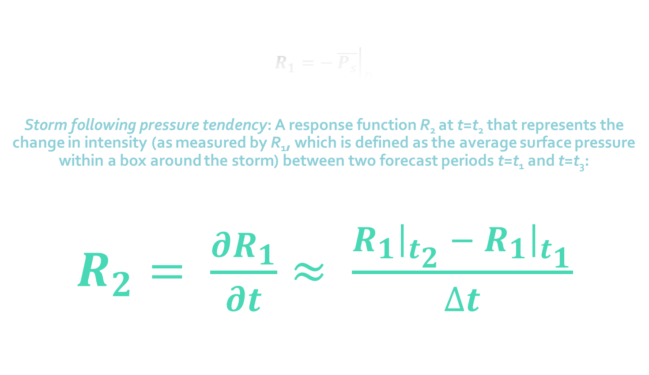
A New Response Function
$$R_{1}=−{\left.\overline{P_{s}}\right|}_{D}$$
Storm following pressure tendency: A response function R₂ at t=t₂ that represents the change in intensity (as measured by R₁, which is defined as the average surface pressure within a box around the storm) between two forecast periods t=t₁ and t=t₃:
$R_{2}= \frac{∂R_{1}}{∂t}≈ \frac{{\left.R_{1}\right|}_{t_{2}} −{\left.{ R}_{1}\right|}_{t_{1}}}{∆t}$
Notes:
change in intensification over a discrete time vs. R1 = intensity at an instantaneous time

Slide 13
Method
Run non-linear model (NASA GEOS-5) forward to define control simulation.

Slide 14

Method
Run non-linear model (NASA GEOS-5) forward to define control simulation.
Create adjoint-derived sensitivities for R = $\frac{dp}{dt}$, where p is defined as the average pressure in a 9º by 9º box centered around the cyclone.

Slide 15
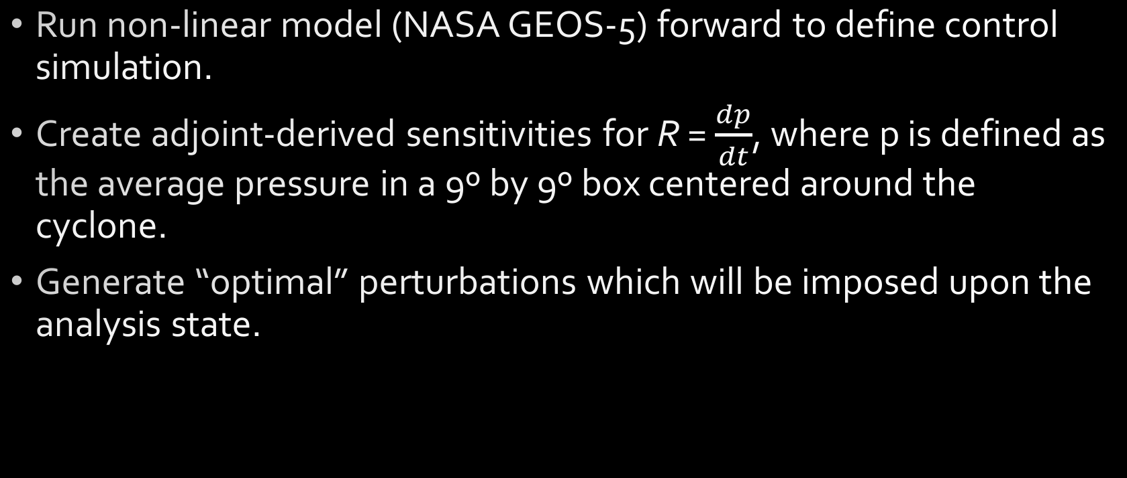
Method
Run non-linear model (NASA GEOS-5) forward to define control simulation.
Create adjoint-derived sensitivities for R = $\frac{dp}{dt}$, where p is defined as the average pressure in a 9º by 9º box centered around the cyclone.
Generate “optimal” perturbations which will be imposed upon the analysis state.

Slide 16
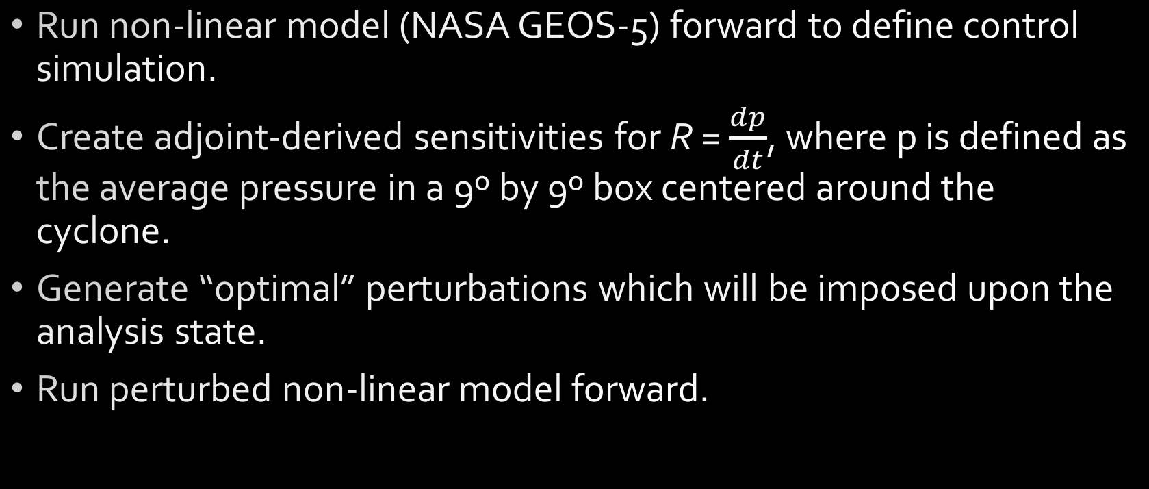
Method
Run non-linear model (NASA GEOS-5) forward to define control simulation.
Create adjoint-derived sensitivities for R = $\frac{dp}{dt}$, where p is defined as the average pressure in a 9º by 9º box centered around the cyclone.
Generate “optimal” perturbations which will be imposed upon the analysis state.
Run perturbed non-linear model forward.

Slide 18
How can we do better?
MULTIPLE ITERATIONS!

Slide 19
Iterative Technique
Compose a ”quasi-optimal perturbation” by adding successively derived optimal perturbations from iterative forward/adjoint integrations: x’_{tot} = x’₁ + x’₂ + … + x’_{n}

Slide 20
Iterative Technique
Compose a ”quasi-optimal perturbation” by adding successively derived optimal perturbations from iterative forward/adjoint integrations: x’_{tot} = x’₁ + x’₂ + … + x’_{n}
  This method helps relax the constraints of the tangent linear assumption.

Slide 21
Iterative Technique
Compose a ”quasi-optimal perturbation” by adding successively derived optimal perturbations from iterative forward/adjoint integrations: x’_{tot} = x’₁ + x’₂ + … + x’_{n}
  This method helps relax the constraints of the tangent linear assumption.
  Similar to method used within incremental 4DVAR.

Slide 22
Iterative Technique
Compose a ”quasi-optimal perturbation” by adding successively derived optimal perturbations from iterative forward/adjoint integrations: x’_{tot} = x’₁ + x’₂ + … + x’_{n}
  This method helps relax the constraints of the tangent linear assumption.
  Similar to method used within incremental 4DVAR.
  Our technique uses multiple “outer loops” and “inner loops”, where the outer loop stops upon violating semi-arbitrary linearity criterion (as in the following figures, Tremolet 2007; Courtier et al. 1994)

Slide 23
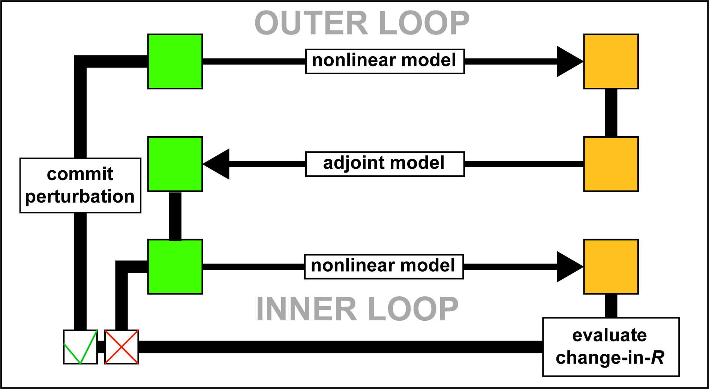
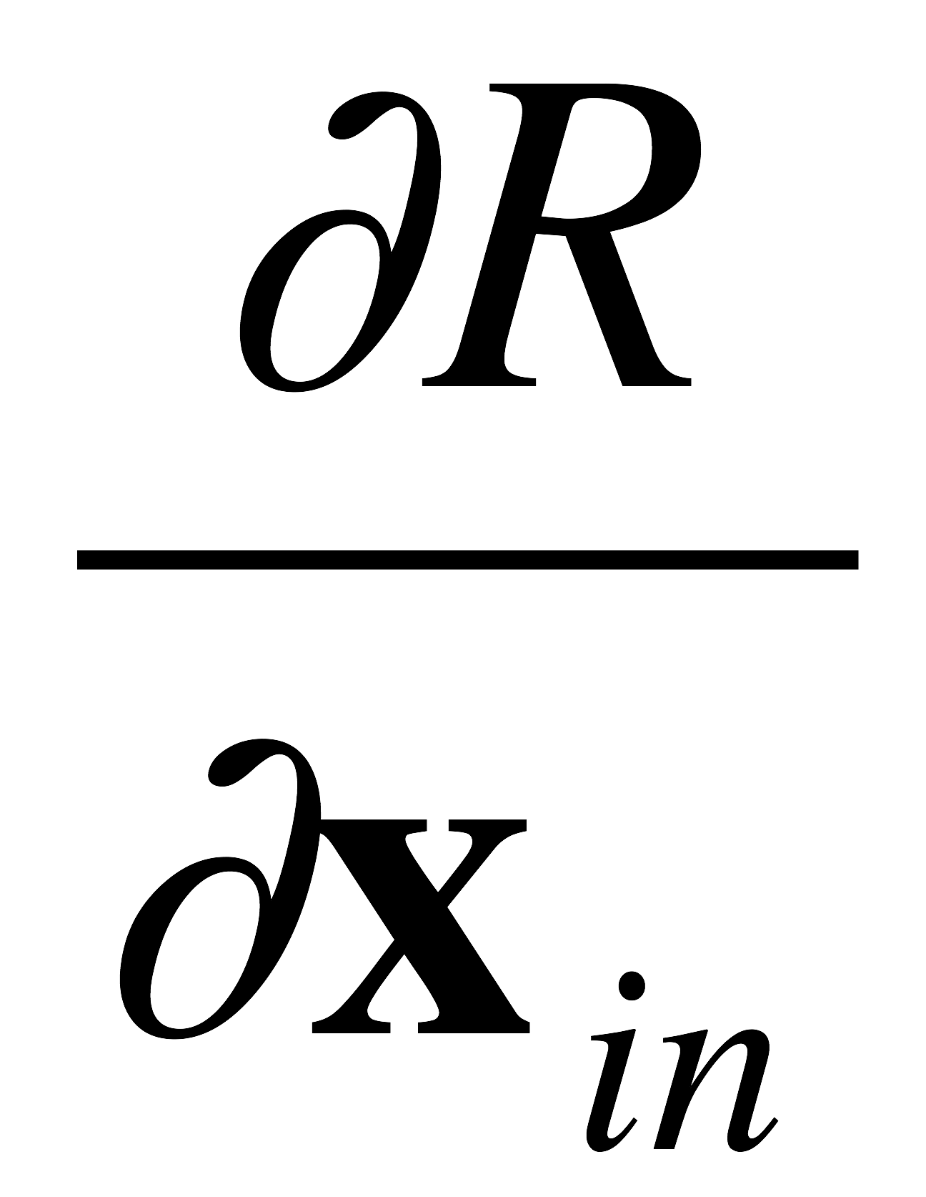


x₀
x_{f}
x'₀
x'_{f}
$$\frac{∂R}{∂x_{0}}$$
$$\frac{∂R}{∂x_{f}}$$
Adapted with permission from Hoover (2017): Adjoint Models Beyond 4DVAR: Forecast uncertainty, impact of assimilated observations, and east coast snowstorms. Colloquium Presentation, University of Wisconsin - Madison, Department of Atmospheric and Oceanic Sciences. November 29, 2017.

Slide 25
25-27 January 2015

Slide 26
12-13 March 1993

Slide 27
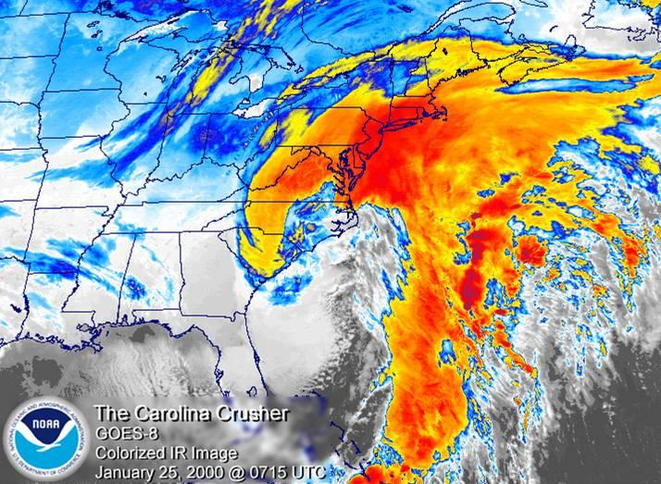
“The Surprise Snowstorm"
January 2000
http://www4.ncsu.edu/~nwsfo/storage/cases/20000125/carolina.crusher.jpg

Slide 29
“Forecast Elasticity”

Slide 30
“Forecast Elasticity”

Slide 31
“Forecast Elasticity”

Slide 32
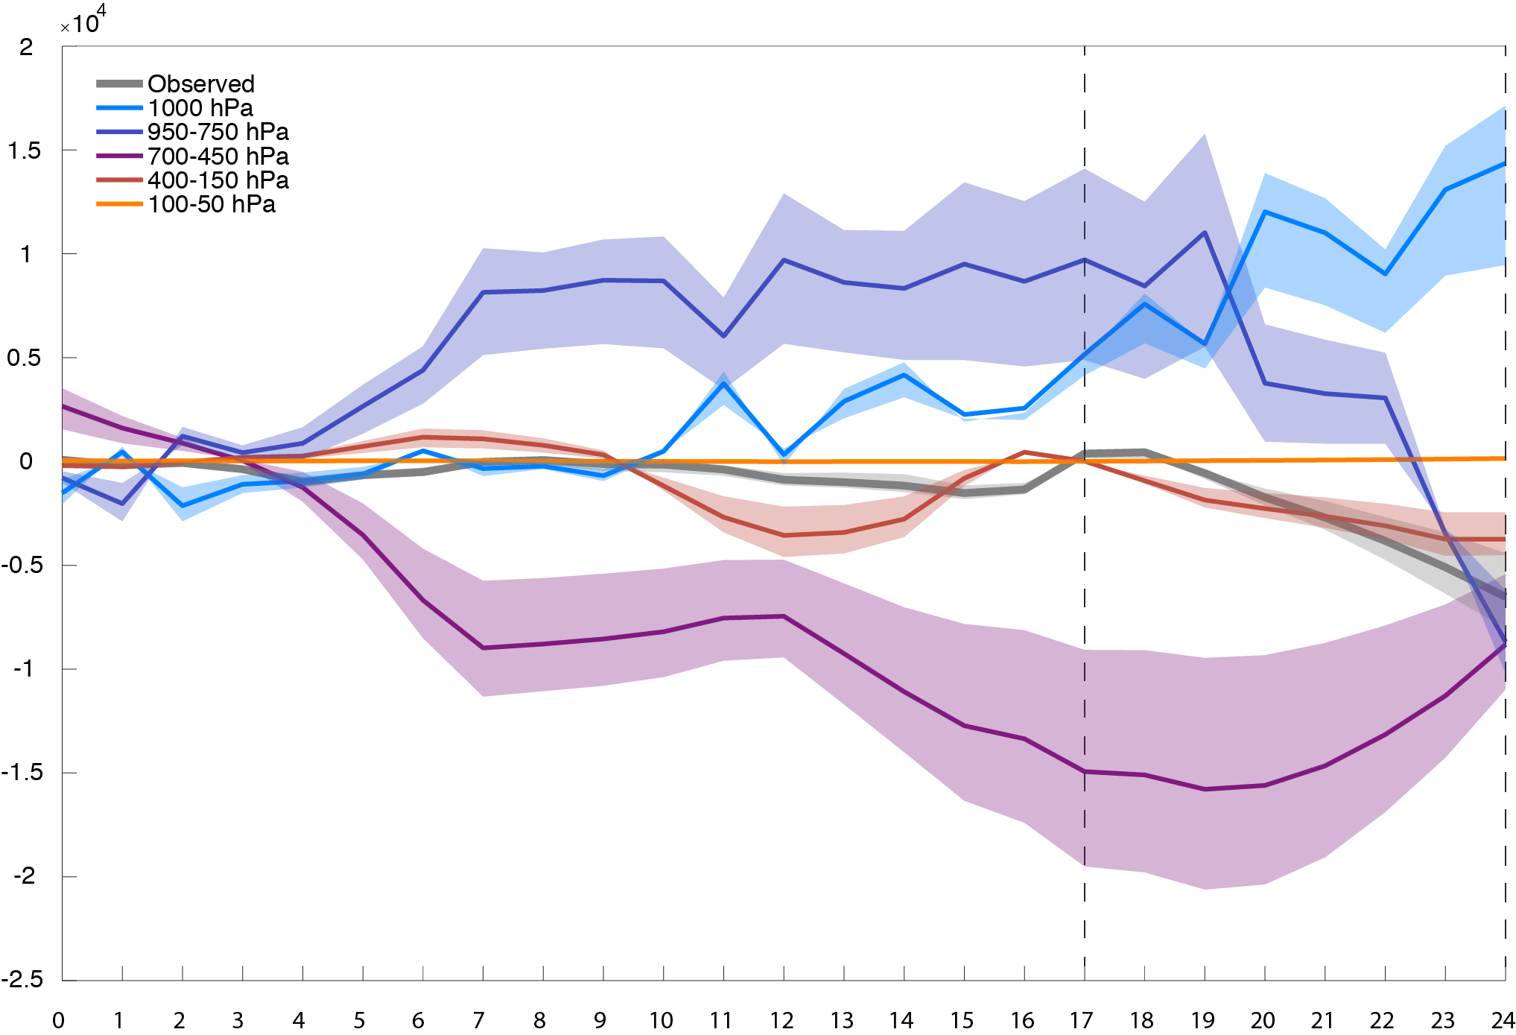
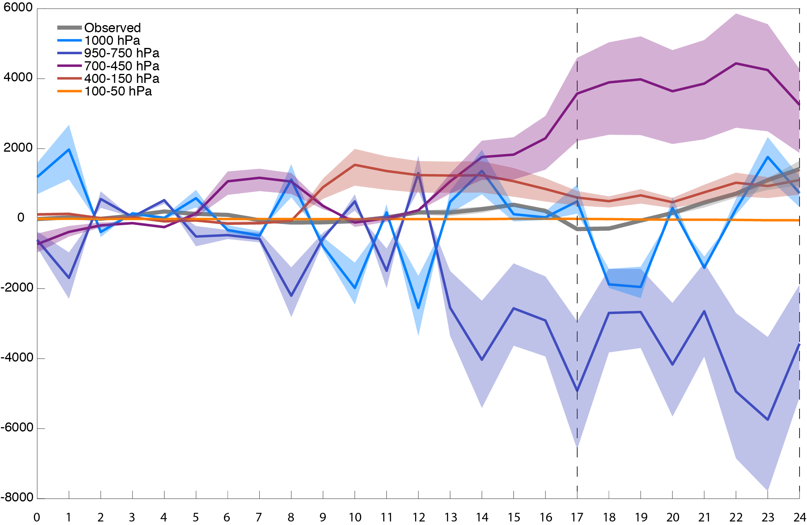
*900 hPa

Slide 33
F017
F024

Slide 34
F017
F024

Slide 35
Conclusions
Small perturbations to the initial state can be calculated that modulate the intensification rate of a mid-latitude cyclone over a particular window within its life cycle.

Slide 36
Conclusions
Small perturbations to the initial state can be calculated that modulate the intensification rate of a mid-latitude cyclone over a particular window within its life cycle.
Multiple iterations can be used to define “Forecast Elasticity”.

Slide 37
Conclusions
Small perturbations to the initial state can be calculated that modulate the intensification rate of a mid-latitude cyclone over a particular window within its life cycle.
Multiple iterations can be used to define “Forecast Elasticity”.
Iterative technique relaxes the tangent linear assumption, allowing for non-linear interactions to occur.

Slide 38
Conclusions
Small perturbations to the initial state can be calculated that modulate the intensification rate of a mid-latitude cyclone over a particular window within its life cycle.
Multiple iterations can be used to define “Forecast Elasticity”.
Iterative technique relaxes the tangent linear assumption, allowing for non-linear interactions to occur.
It is possible to partition and invert the perturbation QGPV to ascertain the relative contribution by the perturbations.

Slide 39
Future Work
Employ this tool with a higher-resolution, non-hydrostatic model (GEOS-5 or WRF)
Analyses of tropical cyclone intensification rates.
Expanding from case studies to composite analyses of sensitivities/perturbations.

Slide 40
Acknowledgements
Dr. Brett Hoover
Dr. Michael Morgan
Dr. Daniel Holdaway
Dr. Jonathan Martin
The Morgan and Martin lab groups
The conference organizing committee for travel support
This project is possible due to the support from NASA NIP award NNX14AI38G

Slide 41
Extra Slides

Slide 42
F017
F024

Slide 46
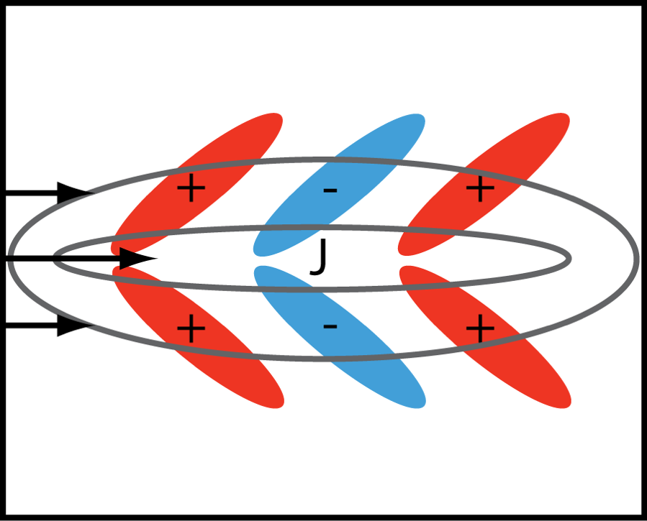

$E⋅D=ε_{r}= ε_{x}+ ε_{y}= \left[\frac{1}{2}\left({v^{′}}^{2}−{u^{′}}^{2}\right)\left(\frac{∂U}{∂x}−\frac{∂V}{∂y}\right)\right]+\left[\left(−u′v′\right)\left(\frac{∂V}{∂x}+\frac{∂U}{∂y}\right)\right]$

Slide 49
NASA GEOS-5
Global, finite-volume FV3 core on a cube sphere grid
0.5º latitude x 0.625º longitude effective resolution
Hydrostatic
Initialized using MERRA-2 analyses
Hybrid sigma-pressure vertical coordinate
7.5 minute time step (forward model); 15 minute time step (adjoint)

Slide 50
14º Box

Slide 51
14º Box

