Slide 1



Observation operators for assimilation of satellite observations in river inundation forecasting
Elizabeth Cooper¹, Sarah Dance^{1,2}, Javier Garcia-Pintado³, Nancy Nichols^{1,2}, Polly Smith².
  ¹ Department of Meteorology, University of Reading, UK
  ² Department of Mathematics and Statistics, University of Reading, UK
  ³ MARUM Center for Marine Environmental Sciences and Department of Geosciences,
  University of Bremen, Germany
Acknowledgements:
The authors gratefully acknowledge the NERC SCENARIO studentship supporting Elizabeth Cooper, and CASE sponsorship from the Satellite Applications Catapult.
This work was also supported in part by NERC grants NE/K00896X/1 and NE/K008900/1 as well as EPSRC grant EP/P002331/1.

Slide 2
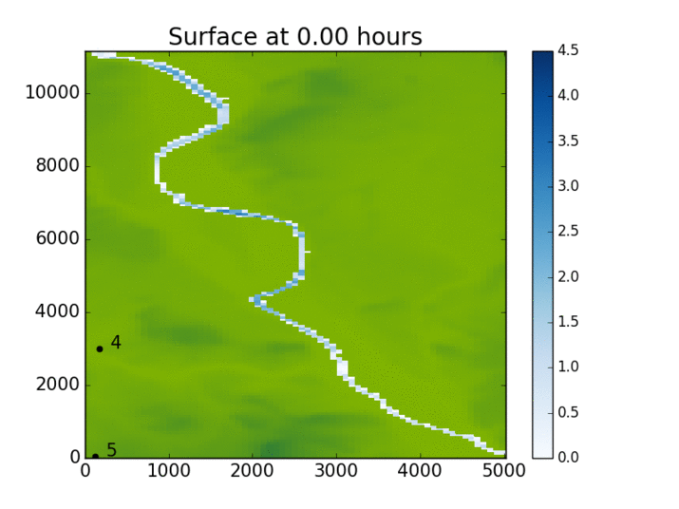
Inundation Forecasting
Inflow (m³/s)
Time (h)
Topographical information e.g. (DTM)
Shallow water equations with good parameter values
e.g. channel friction parameter
Uncertainty in inputs leads to uncertainty in inundation forecast.

Slide 3
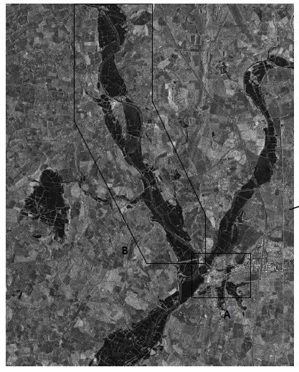
Observations from synthetic aperture radar (SAR)
Light areas are dry (rough surface, higher backscatter values)
Dark areas are wet (smooth surfaces, lower backscatter values
TerraSar-X image taken from Mason et al. doi:10.1016/j.rse.2012.06.017
© DLR 2007

Slide 4


Data assimilation: ensemble transform Kalman filter
Ensemble transform Kalman filter (ETKF) approach.
Mean and perturbations updated separately.
Observation operator, H, maps state vector into observation space.
Update equation:
Mean forecast observation equivalent
Innovation, d

Slide 5

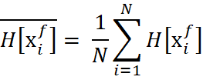

Using observations from SAR in DA
Ensemble of i= 1,N state vectors

Slide 6
Flood edge WLOs from SAR water level observations
1.Observation
At flood edge, water elevation = terrain elevation
2. H [x]
Extracts elevation at observation position from each ensemble member

Slide 7


Water level observations
Simple assimilation of the water elevation at the flood edge works well when the forecast is deeper than the truth…...
Mean forecast observation
$$\overline{x^{f}}$$
innovation
$$x^{t}$$
Observation

Slide 8


Water level observations
…. but not when the forecast is shallower than the truth…..
$$x^{t}$$
Observation = mean forecast observation
$$\overline{x^{f}}$$
Innovation = zero

Slide 9
Water level observations
…. unless we use a ‘nearest wet pixel’ approach.
$$x^{t}$$
Observation
innovation
Mean forecast observation
$$\overline{x^{f}}$$
Not easy to locate ‘nearest wet pixel’ in practise

Slide 10
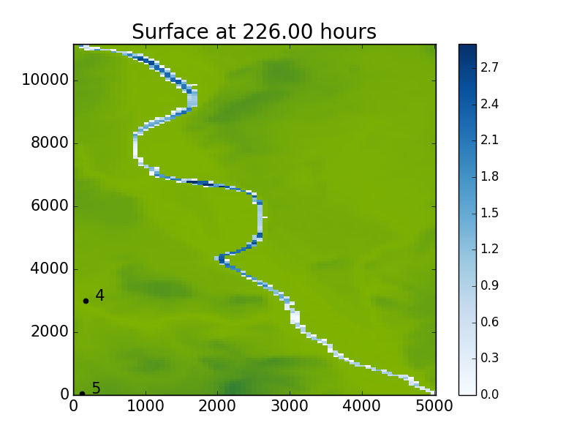
Nearest wet pixel
X
X

Slide 11
New approach: backscatter observations
OBSERVATION: measured backscatter value in chosen pixels
md
mw
Dry pixels
Wet pixels
As per : L. Giustarini et al., "Probabilistic Flood Mapping Using Synthetic Aperture Radar Data," in IEEE Trans on Geoscience and Remote Sensing,Dec. 2016.
Fit two Gaussian curves to give mean and variance of wet and dry pixel distributions
H(x): assign value of md to pixel if forecast predicts dry; mw if model predicts wet

Slide 12
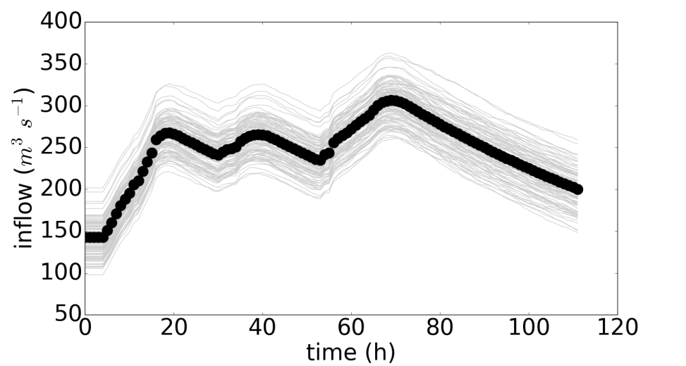
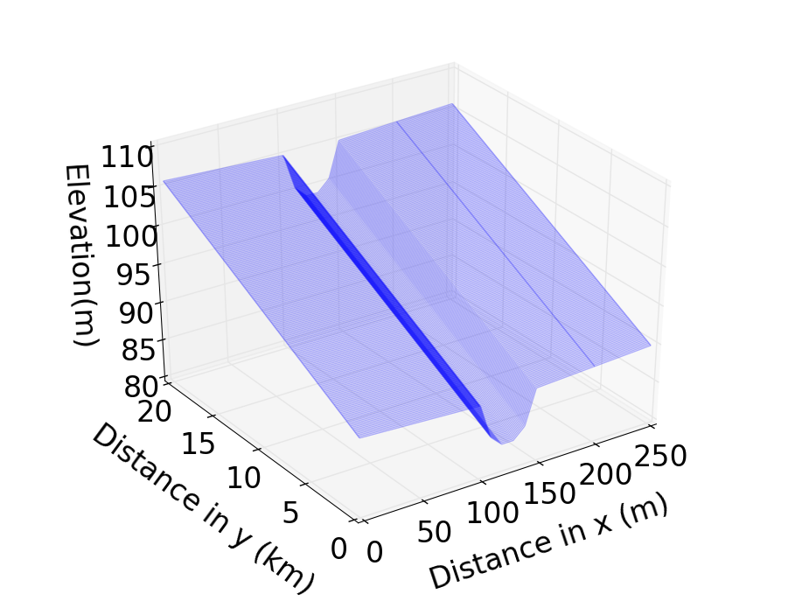
Methodology
Twin experiments in idealised topography
  3 observation operator approaches
  Noisy synthetic observations from `truth’
  12 hourly intervals
  3 observation positions
Ensemble forecast system with 100 members
Inflows and channel friction parameter perturbed
12

Slide 13
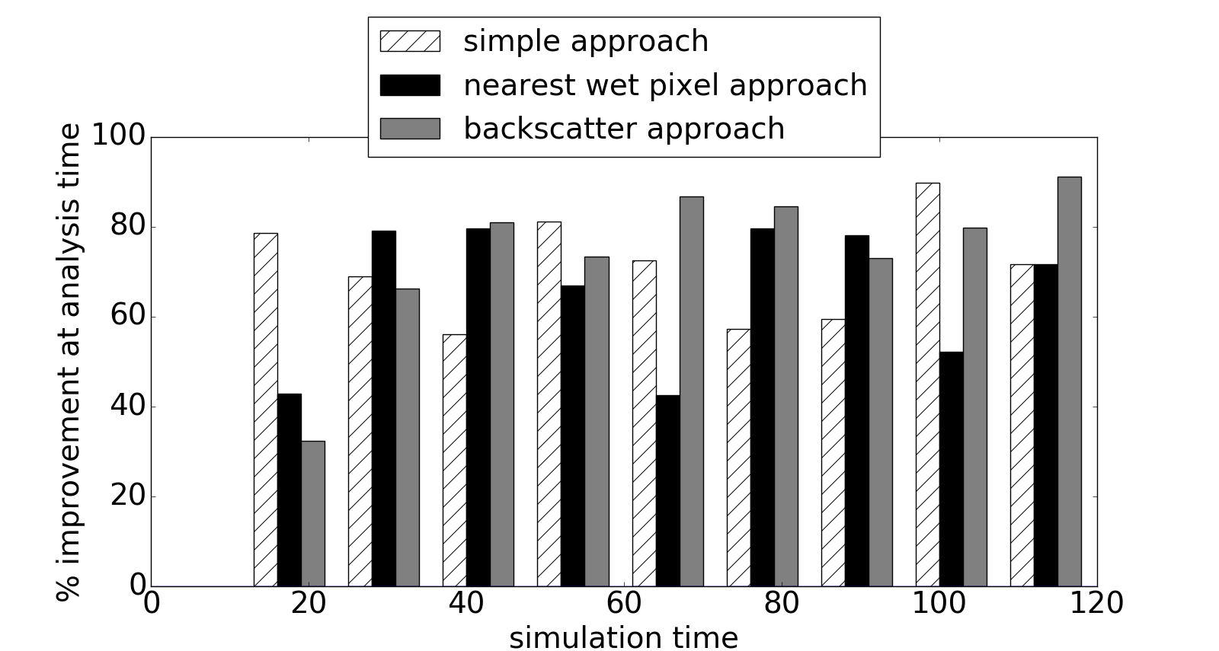
Results: state estimation
Channel friction parameter too HIGH: forecast water levels too DEEP
CONCLUSION: all of the operators do a good job at assimilation times

Slide 14
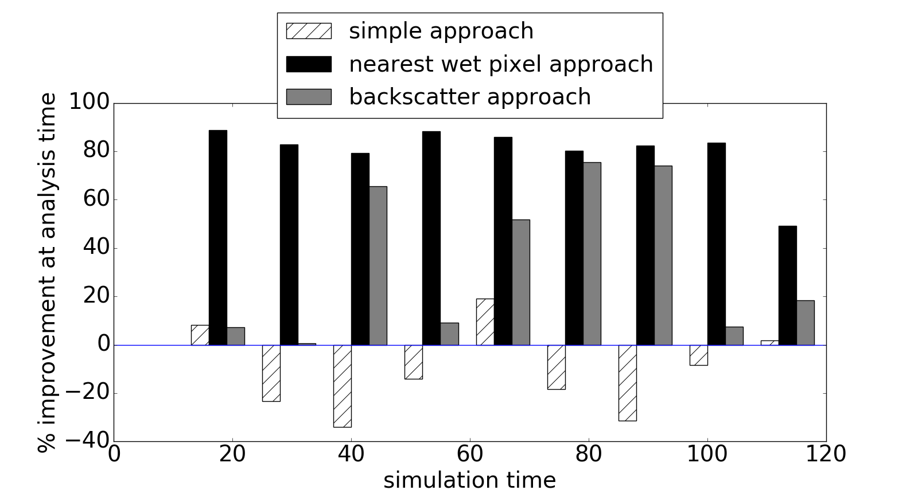
Results: state estimation
Channel friction parameter too LOW: forecast water levels too SHALLOW
CONCLUSION:
simple flood edge operator does a bad job (as expected)
nearest wet pixel operator slightly better than backscatter operator

Slide 15
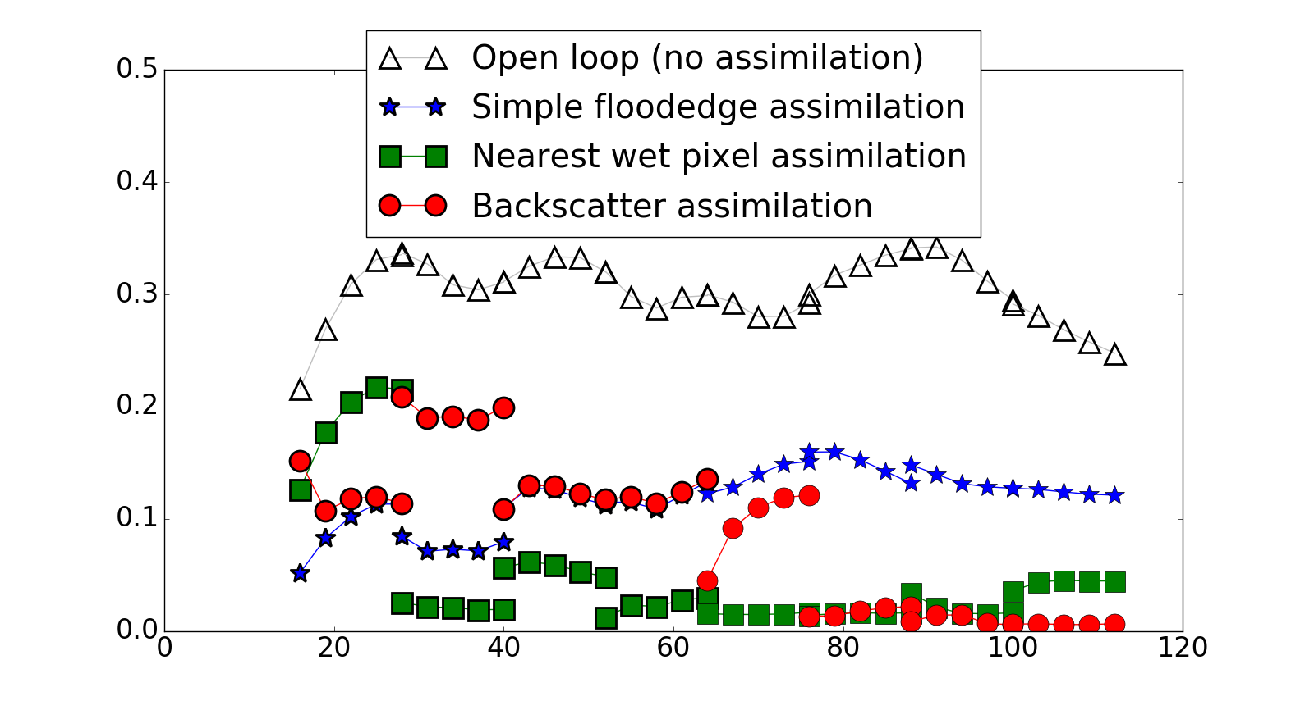
Results:
Joint state-parameter estimation
Channel friction parameter too HIGH: forecast water levels too DEEP
CONCLUSION: All operators improve the forecast relative to open loop.

Slide 16
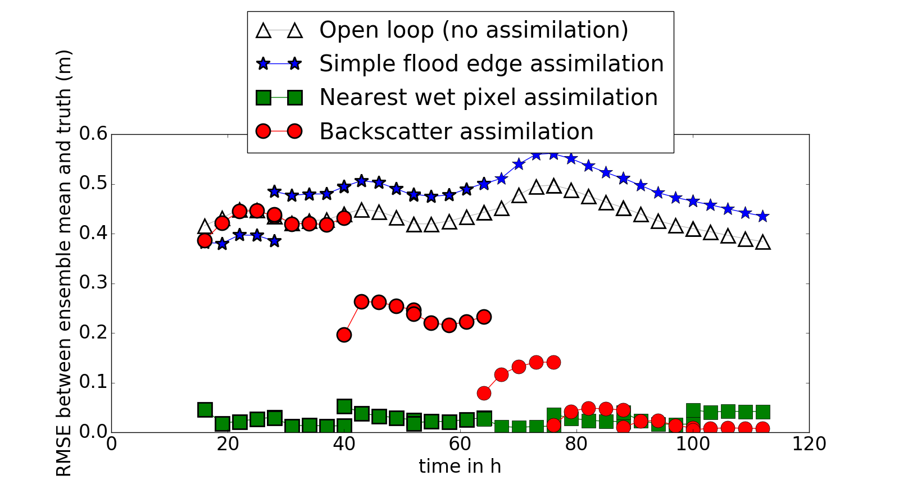
Results:
Joint state-parameter estimation
Channel friction parameter too LOW: forecast water levels too SHALLOW
CONCLUSION: Simple operator does not work
Backscatter operator shows potential

Slide 17
Conclusions
Our experiments have shown:
    Choice of observation operator is REALLY IMPORTANT!
    `Nearest wet pixel’ in these experiments works well…. but best case scenario as no complicated terrain
    Our novel approach using backscatter observations is promising
      Can use more observations from all of domain
      No terrain complications: may be cheaper
    Further experiments required to determine
      how operators compare in operation (real SAR and topography)
      how many observations can we use?

Slide 18
Conclusions
Our experiments have shown:
    Choice of observation operator is REALLY IMPORTANT!
    `Nearest wet pixel’ in these experiments works well…. but best case scenario as no complicated terrain
    Our novel approach using backscatter observations is promising
      Can use more observations from all of domain
      No terrain complications: may be cheaper
    Further experiments required to determine
      how operators compare in operation (real SAR and topography)
      how many observations can we use?
      Thanks for listening!

Slide 19
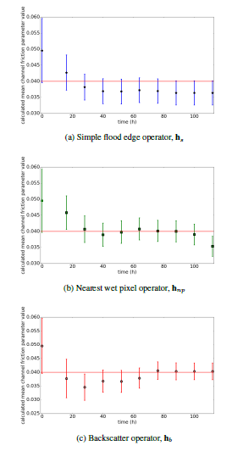
Positive nch bias

Slide 20
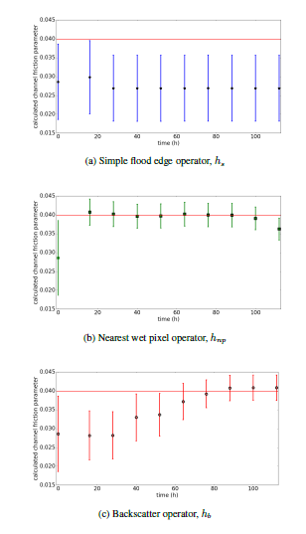
Negative nch bias

