Slide 1
Accelerating Local Ensemble Tangent Linear Models with order reduction Craig H. Bishop The University of Melbourne, Parkville, Australia Joanna (Asia) S. Pelc Selina, Medellin, Columbia With Acknowledgements to Sergey Frolov, Doug Allen, Rolf Langland, Karl Hoppel and David Kuhl, Naval Research Laboratory, USA
Notes:
Thanks Alan for outlining some of the coming NWP challenges. Thanks also for helping inspire in so many of us, scientific curiosity and a sense of how privileged we were to live in a time where we would actually be paid to do research – even if it wasn’t very much – 11000 pounds per year in my case.

Slide 2
Outline
Motivation
LETLM method
LETLM results
Acceleration of LETLM with order reduction
Results using reduced order LETLM
Conclusions

Slide 3
Background and Motivation
True TLM matrix perfectly predicts the difference between any two nonlinear model trajectories whose initial state differs by an infinitesimal amount.
Its transpose or adjoint gives the rate of change of each forecast variable with respect to each initial condition variable.
It is an essential ingredient for 4DVAR DA, FSOI and some variations of ensemble DA
The prospect of maintaining accurate TLM and adjoints of coupled ocean-atmosphere-ice-aerosol-LSM-chem models is daunting.
Because of statements like “If A > 0 call parameterization”, environmental models do not have true TLMs. Artful approximations must be made. How to automate?

Slide 4
The Local Ensemble TLM: a possible enabler for strongly coupled 4DVAR
Variables in a very local region around a model variable determine its change over a time step.
Typically, only 27 – 350 variables will have any influence on the evolution of a single variable over a single time step.
In a 2D model x₁₁’s evolution might only be affected by the variables within this local patch.

Slide 5
The Local Ensemble TLM: an enabler for strongly coupled 4DVAR
If an ensemble of K perturbations are small enough to (automatically) satisfy the linearized governing equations then

Slide 6
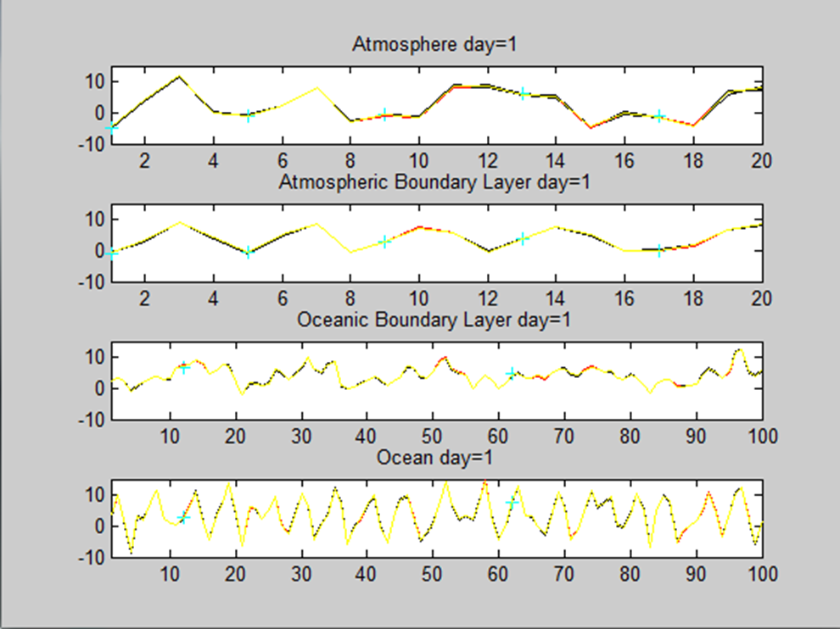
Predictability of coupled model 16 members of atmosphere-ocean ensemble forecast

Slide 7
Construction of Local Ensemble TLM (LETLM) for simple coupled model
Simple coupled model (based on Model 1 of Lorenz, 2005) uses 2nd order Runge-Kutta time stepping. Vertical coupling via relaxation to neighbouring levels.
Thus, patch size required 2-3 levels of 9 grid points.
Hence, needed K>27 ensemble members to precisely describe the linear dynamics – regardless of total number of variables in the model (240).

Slide 8
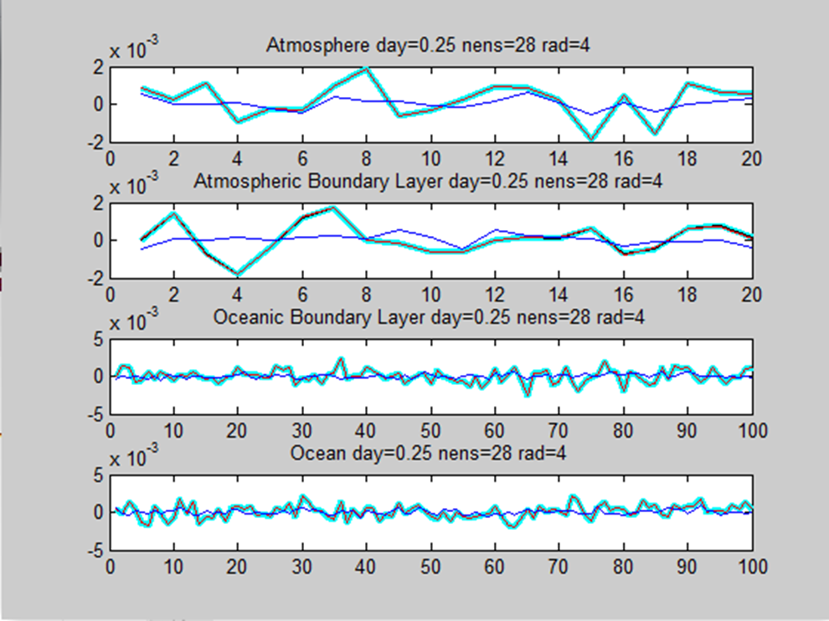
Tests of coupled LETLM with K=28 ensemble members
Mean square difference of LETLM and non-linear pert divided by mean square of non-linear pert over 5 day period is 0.0007. For ETLM, this ratio is 0.7.
Black: Difference between 2 non-linear trajectories (perfect TL predicts this
Cyan line is global ETLM with K=480 members: (Tracks black line perfectly)
Red line is LETLM: (Often hidden by black line)
Blue line is global ETLM with 28 members: (Terrible performance)

Slide 9
LETLMs enable 4DVAR: Convergence of outer loop over 5 day window
Mean square
error
Outer loop iteration
Convergence of mean square error (the ordinate axis) of the 4DVAR four-dimensional guess trajectory from 0 hr to 120 hrs in 6 hr intervals as a function of outer-loop iteration number (the abscissa axis) for LETLM enabled strong-constraint 4DVAR over 10 outer loops.
(See Bishop et al. 2017, QJRMS, for details)

Slide 10
Motivation for accelerating LETLM
At T47, poorly tuned LETLM is better than TLM currently used for operational 4DVAR and FSOI
TLM
LETLM
(360 members)
However,
A single run of LETLM takes ~10 times longer than the operational TLM. (Additional runs might be shorter)
Cost of ensemble size required for accuracy is burdensome.
For 360 members
LETLM NRMSE (01-60) = 0.337
TLM NRMSE (01-60) = 0.350
(Frolov et al. 2018, MWR)

Slide 11
Motivation for accelerating LETLM
At T47, poorly tuned LETLM is better than TLM currently used for operational 4DVAR and FSOI
TLM
LETLM
(360 members)
However,
A single run of LETLM takes ~10 times longer than the operational TLM. (Additional runs might be shorter)
Cost of ensemble size required for accuracy is burdensome.
For 360 members
LETLM NRMSE (01-60) = 0.337
TLM NRMSE (01-60) = 0.350
Method would be more attractive if it was faster!

Slide 12
Idea for reducing order of LETLM
The LETLM for each model variable is just a row vector
In climate studies, they find reduced order representations of state vectors using the eigenvectors or EOFs of the covariance matrix of the climatological distribution of state vectors.
Why not try the same thing with LETLM vectors?

Slide 13
Idea for reducing order of LETLM
Each black line is a realization from a climatology of states.
Pick the red one, say, and compute and store the LETLM vectors for it.
Now do the same for every other climatological state.
One now has a climatology of LETLM vectors.
Compute the mean vector and covariance matrix of the climatological distribution of LETLM vectors found at each vertical level.

Slide 14
LETLM Reduced using LETLM Climate
LETLM-RLC

Slide 15
Derivation of LETLM-RLC
Note that A, the matrix of scaled projections of the leading eigenvectors onto the K ensemble perturbations is an r x K matrix.

Slide 16
Derivation of LETLM-RLC

Slide 17
Computational costs
With LETLM-RLC, ensemble size smaller and cost of matrix formation and inversion also less!

Slide 18
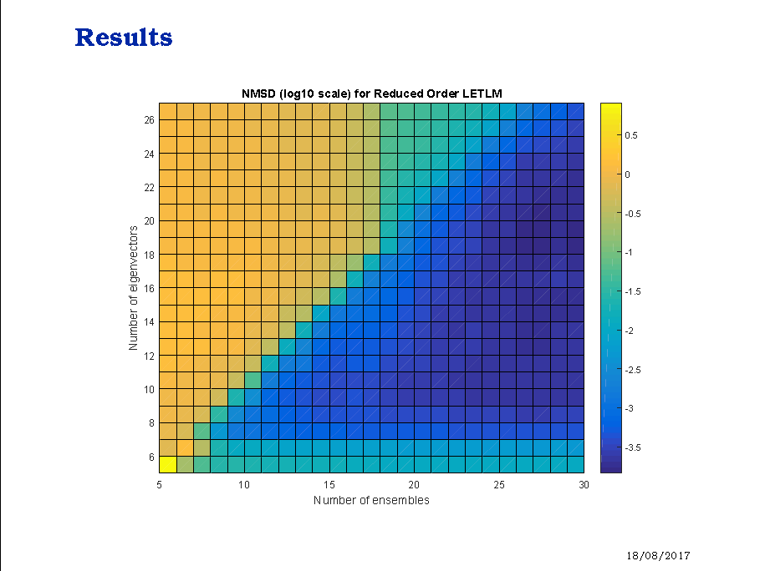
Tests of LETLM-RLC
LETLM-RLC
LETLM
r
Number of eigenvectors, r
K
Number of ensemble members, K
Note that LETLM-RLC with just 9 retained eigenvectors and 14 ens members appears to be as accurate as LETLM with 30 ens members!

Slide 19
Tests of LETLM-RLC
LETLM (with no reduction)
Crude estimate of the LETLM-R speed up for this point:
matrix formulation speed up:
(r)
Number of eigenvectors, r
$\frac{LETLM }{LETLM−R }=\frac{N^{2}K}{r^{2}K_{R}+rNK_{R}}$ $= \frac{{27}^{2}∙30}{9^{2}∙14+9∙27∙14}$ $=$4.82
matrix inversion speed up:
r=9
$\frac{LETLM }{LETLM−R }=\frac{N^{3}}{r^{3}}$ $= \frac{{27}^{3}}{9^{3}}$ $=$27
Number of ensemble members, K
K=14

Slide 20
Concluding remarks
LETLM is a simple tool, which accurately calculates TLMs
The LETLM method is computationally expensive
The reduced order LETLM-R enables accurate LETLMs with smaller ensemble sizes.
In the 240 variable, Lorenz 96 based coupled model considered here, LETLM-R with 9 retained eigenvectors and a 14 member ensemble was as accurate as LETLM with 30 members.
The local-row-vector form of the LETLM and the LETLM-R raises the possibility that the entire LETLM for a 6 hr data assimilation window could be held in memory once it was formed. The marginal cost of such an LETLM for each additional 4DVAR sweep of the LETLM/adjoint might be considerably smaller than that of a traditional TLM/adjoint.

Slide 21
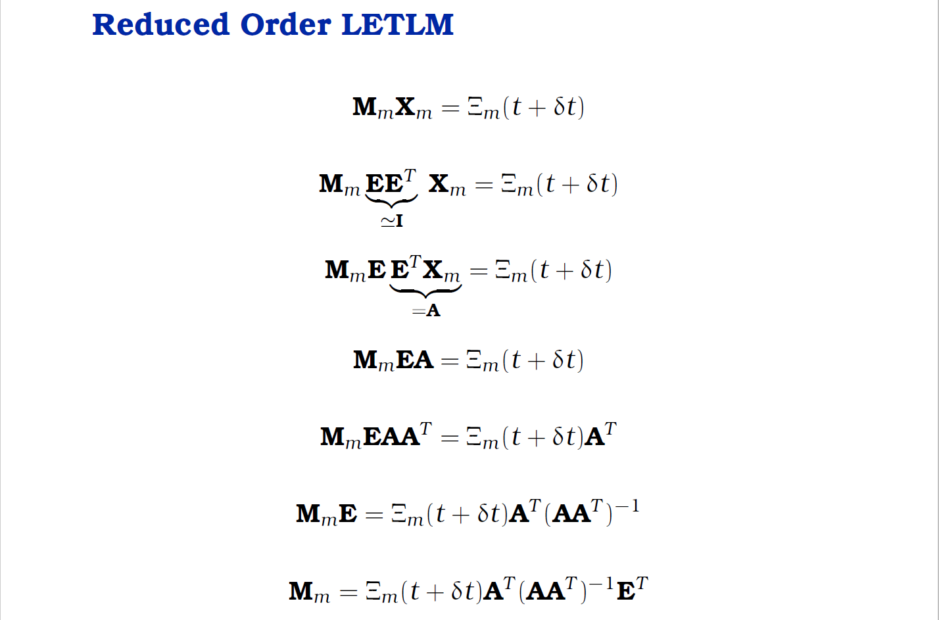
Future work: Generalized reduced order LETLM
Let E be some arbitrary orthonormal set of vectors, then
E could be based on the leading EOFs of, say, a climatology of (i) analysis corrections, or (ii) full model tendencies, or (iii) analysis correction tendencies, etc. How much improvement might be obtained from those sort of reductions.

