Slide 1


The Impact of Warm Conveyor Belt Forecast Errors on the Downstream Waveguide
Jeremy Berman¹ and Ryan Torn¹
¹University at Albany
Monday 2 July 2018
Aveiro, Portugal
Workshop on Sensitivity Analysis and Data Assimilation
NSF Grant 1461753

Slide 2
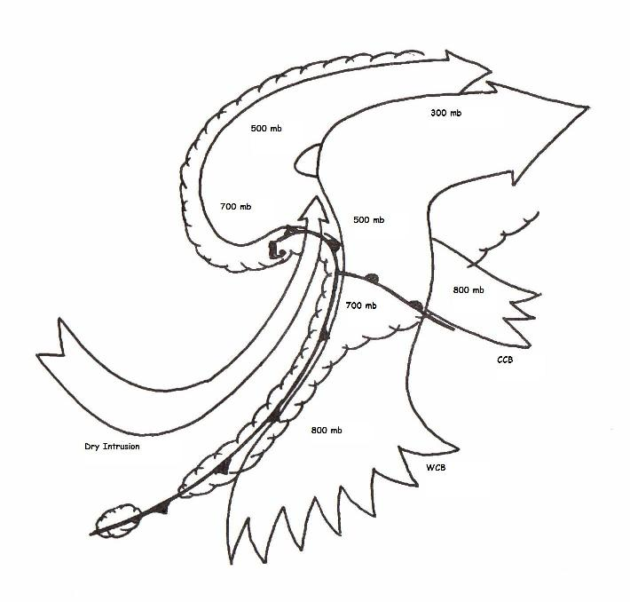
Warm Conveyor Belts (WCBs)
One of the coherent airstreams in extratropical cyclones (ECs)
Transports relatively warm and moist air poleward and upward
Majority of EC’s precipitation, clouds, latent heat release
Conveyor Belt Model for Extratropical Cyclones
500 mb
300 mb
L
700 mb
500 mb
Dry Air Intrusion
800 mb
700 mb
Cold Conveyor Belt
800 mb
Warm Conveyor Belt
Adapted from Fig. 9 of Carlson (1980)
Notes:
Say: “One study that documents the effects of LHR on waveguide perturbation is Massacand et al 1993”

Slide 3
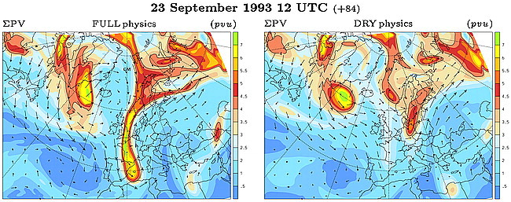
Influence of WCB on Waveguide
Massacand et al. (2001): Ridge building and PV streamer formation can be enhanced by diabatic processes
Suggested ridge building associated with outflow and latent heat release in the WCB of an upstream cyclone
Control simulation
Dry simulation
PV Streamer
Fig. 3 in Massacand et al. (2001)

Slide 4
Influence of WCB on Waveguide
Massacand et al. (2001): Ridge building and PV streamer formation can be enhanced by diabatic processes
Suggested ridge building associated with outflow and latent heat release in the WCB of an upstream cyclone
Control simulation
Dry simulation
L
Cyclone
PV Streamer
Stronger Ridge
Fig. 3 in Massacand et al. (2001)

Slide 5
Methodology
Hypothesis:
Uncertainty in WCB has large impact on downstream variability
Evaluate this quantitatively through model ensemble forecasts
Notes:
Mention that Massacand study is a brute force way to test this hypothesis. Turning off latent heat release doesn’t say much about the physical processes at play.

Slide 6
Methodology
Case Study: 12-15 Nov 2013
Strong cyclogenesis followed by amplification of downstream flow over North Atlantic
51-member ECMWF model forecasts initialized 1200 UTC 08 Nov 2013
Notes:
Mention the forecasts are interpolated to 1.0° x 1.0° grid

Slide 7
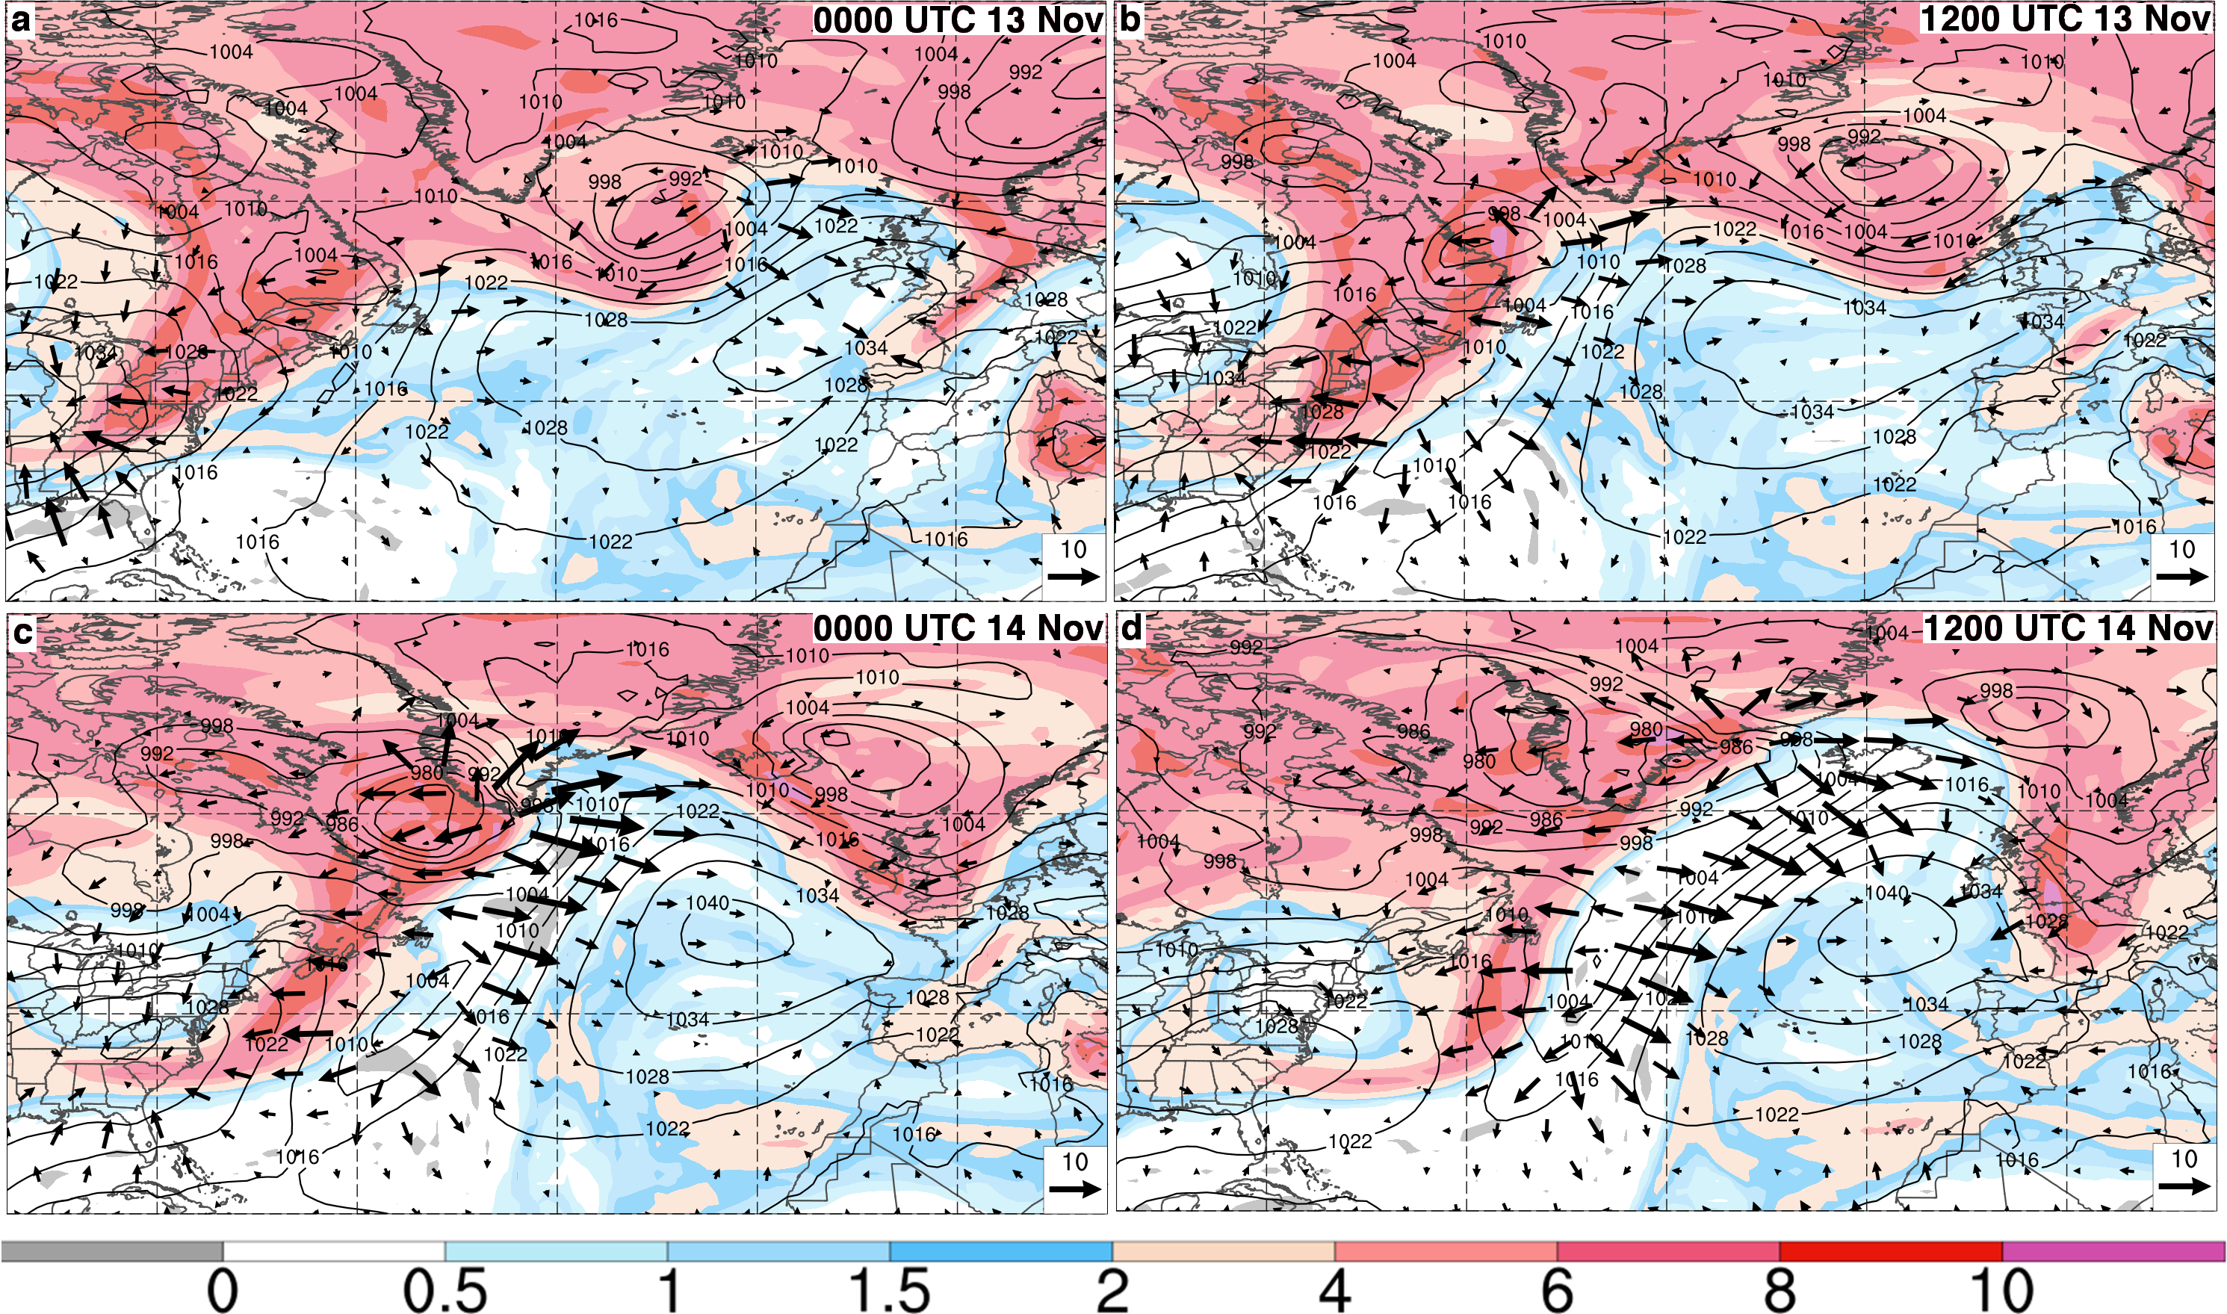
Case Overview
ECMWF deterministic analyses of MSLP (contours, hPa), 200—300-hPa irrotational winds (vector winds m s⁻¹) 200—300-hPa PV (shading, PVU)
Ridge
Ridge
0000 UTC 13 Nov
1200 UTC 13 Nov
L
L
Ridge
Ridge
L
L
0000 UTC 14 Nov
1200 UTC 14 Nov
Divergent flow
Divergent flow

Slide 8
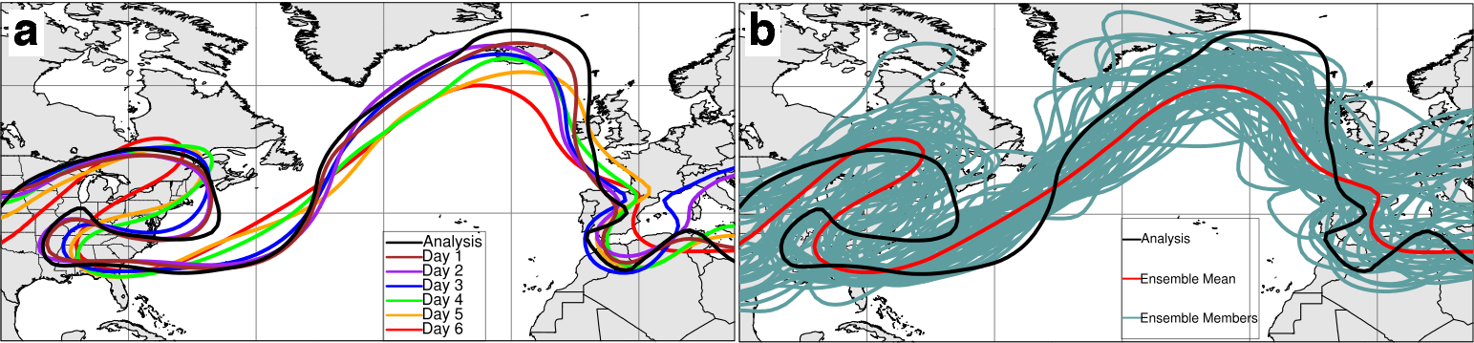
Waveguide Variability
200—300-hPa averaged 2 PVU contour for:
(a) ensemble-mean PV field as a function of lead time
Variability in amplitude and position of synoptic features
(b) 6-day forecast as a function of ensemble member
Notes:
Set up the position and amplitude variability! Make it clear, and explain one way to distinguish them is through EOFs (then click next slide)
Fig. 4: Contours of 550 dam geopotential height contour on the 500 hPa isobaric surface valid at 1200 UTC on 14 November 2013 in the ECMWF ensemble prediction system showing (a) ensemble-mean for forecasts with different lead times and (b) analysis (black), ensemble-mean (red) and ensemble members (blue) for the Day 6 forecast. The black box outlines the metric box for computing ridge strength.

Slide 9
Methods
Goal: Test the sensitivity of ridge to upstream WCB → Use Ensemble Sensitivity Analysis
Linear regression between ensemble model grid point (x_{i}) and forecast metric (J)
Ancell and Hakim (2007); Hakim and Torn (2008)
Here J represents ridge amplitude and x represents a model state variable (e.g., MSLP, 850-hPa winds)
Need to define metric J for ridge amplitude
Notes:
Mention that unlike the adjoint model, there is “no implicit assumption of linearity” in sensitivity analysis. ESA uses non-linear forecast trajectories.
The equation represents linear regression where the independent variable is an analysis grid point and the dependent variable is the forecast metric.
Equation taken from Torn and Hakim (2008), but says that this equation (1) is derived in Ancell and Hakim (2007)
Here x and J are 1 x M ensemble estimates of the state variable and forecast metric, respectively, with the ensemble mean removed; cov denotes the covariance between the two arguments; and var is the variance.

Slide 10
Ridge Amplitude Metric
  What’s an appropriate metric?
500 hPa
Box?
Φ
Notes:
26% -- first EOF (500 hPa heights)
21% -- second EOF (500 hPa heights)
Mention: “you could use a metric box just over the area, but it will conflate position and amplitude variability. So this motivates using EOFs instead.”

Slide 11
Ridge Amplitude Metric
  What’s an appropriate metric?
Amplitude Variability
500 hPa
Φ
Notes:
26% -- first EOF (500 hPa heights)
21% -- second EOF (500 hPa heights)
Mention: “you could use a metric box just over the area, but it will conflate position and amplitude variability. So this motivates using EOFs instead.”

Slide 12
Ridge Amplitude Metric
  What’s an appropriate metric?
Position Variability
500 hPa
Φ
Notes:
26% -- first EOF (500 hPa heights)
21% -- second EOF (500 hPa heights)
Mention: “you could use a metric box just over the area, but it will conflate position and amplitude variability. So this motivates using EOFs instead.”

Slide 13
Ridge Amplitude Metric
  What’s an appropriate metric?
Amplitude and Position Variability
500 hPa
Φ
Conflate Amplitude and Position Errors
Notes:
26% -- first EOF (500 hPa heights)
21% -- second EOF (500 hPa heights)
Mention: “you could use a metric box just over the area, but it will conflate position and amplitude variability. So this motivates using EOFs instead.”

Slide 14
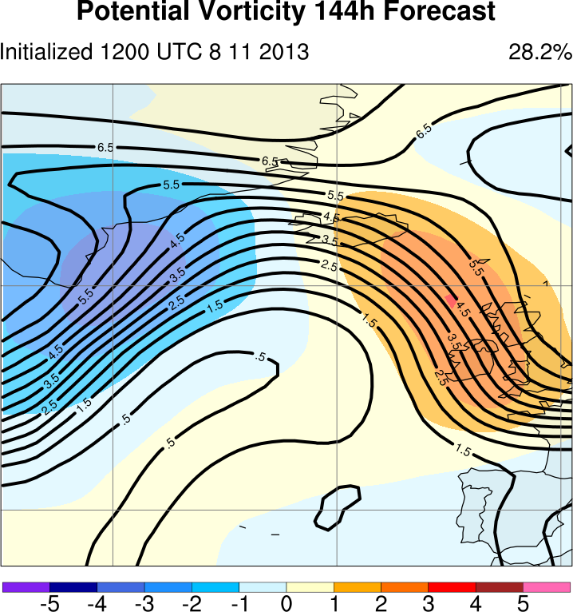
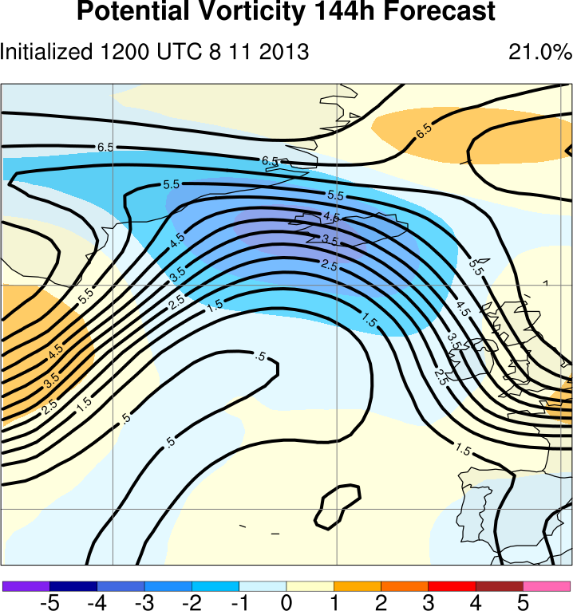
EOF Analysis: 144 h PV
  Apply EOF analysis to 144 h PV over Ridge
EOF 1
EOF 2
Units: PVU
144 h
144 h
Position Variability
Amplitude Variability
Notes:
Mention: We want to use the PC2 (EOF2) pattern as a proxy for the amplitude of the ridge.

Slide 15
EOF Analysis: 144 h PV
  Apply EOF analysis to 144 h PV over Ridge
  Use PC of EOF 2 (PC2) to rank members: J
EOF 2
  Members with high (low) PC2 will have large (small) ridge amplitudes
144 h
Amplitude Variability
Notes:
Mention: We want to use the PC2 (EOF2) pattern as a proxy for the amplitude of the ridge.

Slide 16
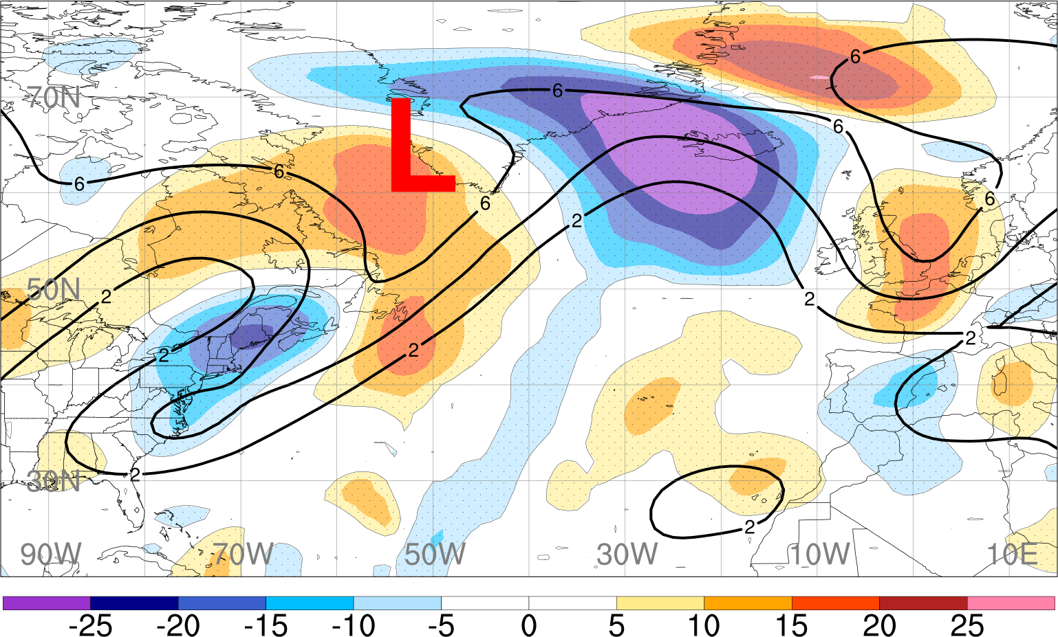
Sensitivity to 250 hPa PV
144 h
Stronger ridge

Slide 17
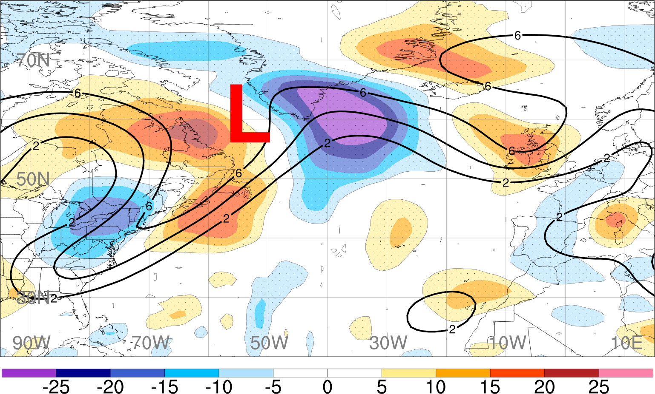
Sensitivity to 250 hPa PV
132 h
Dipole: indicates trough shifted eastward

Slide 18
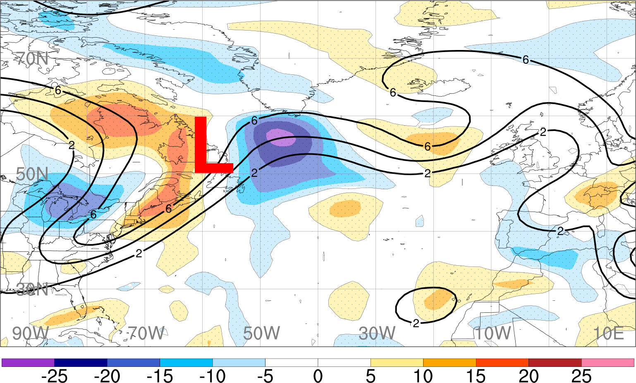
Sensitivity to 250 hPa PV
120 h

Slide 19
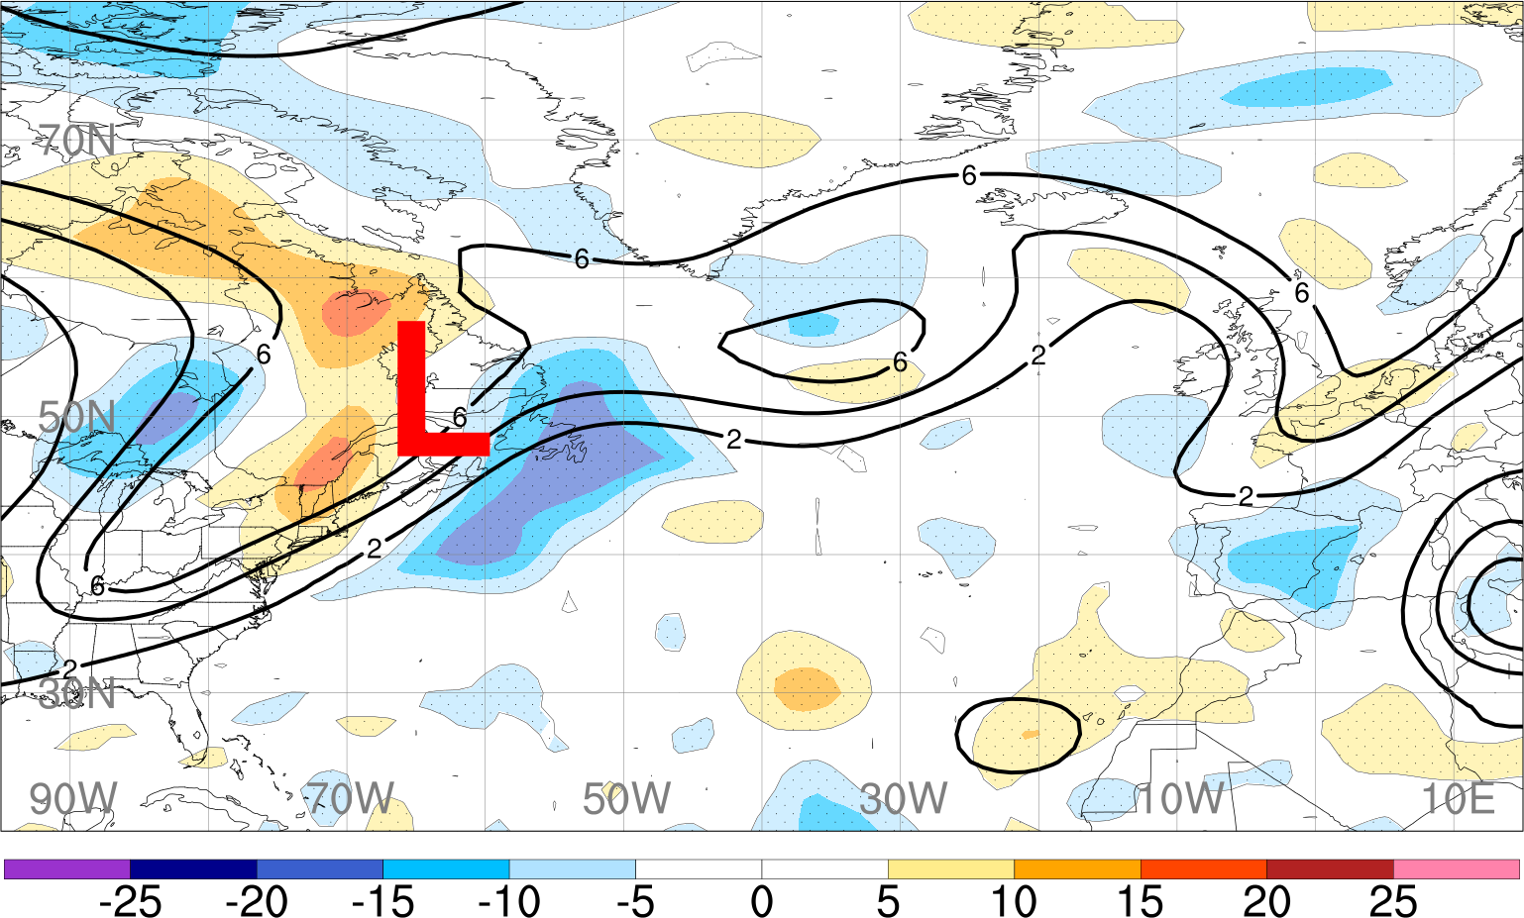
Sensitivity to 250 hPa PV
108 h
More amplified trough-ridge near cyclone
Trough shifted eastward

Slide 20
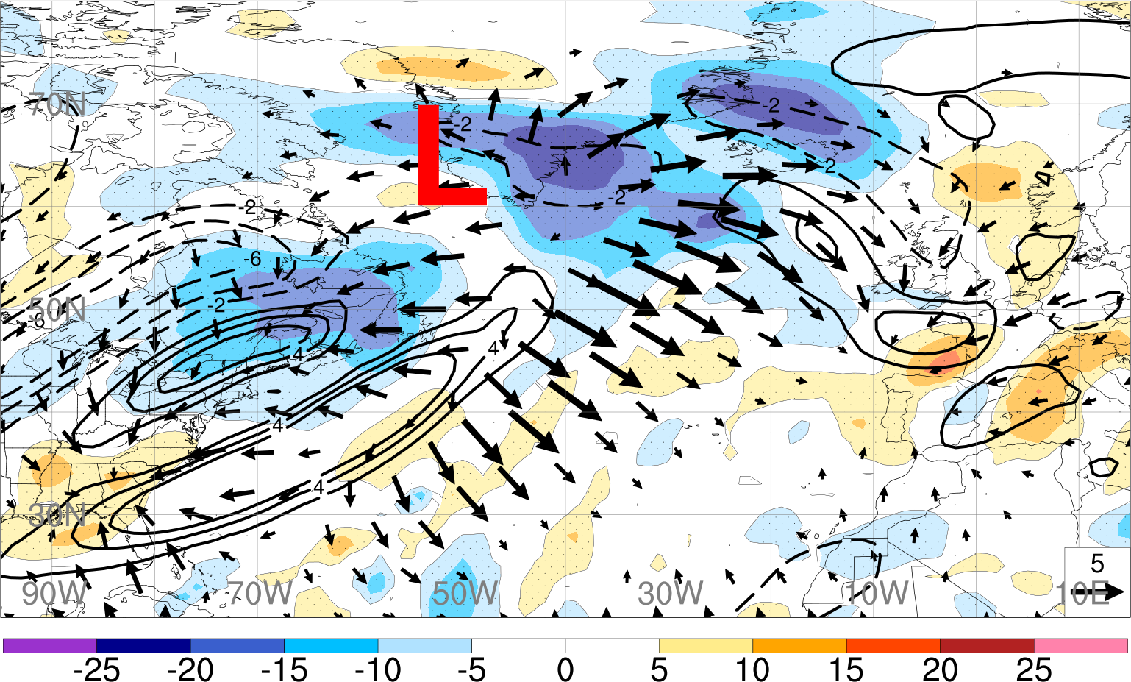
Sensitivity to PV Advection by Irrotational Wind
144 h
Stronger negative PV advection by the irrotational wind
Notes:
Mention “2 days prior to forecast metric (144 h)”

Slide 21
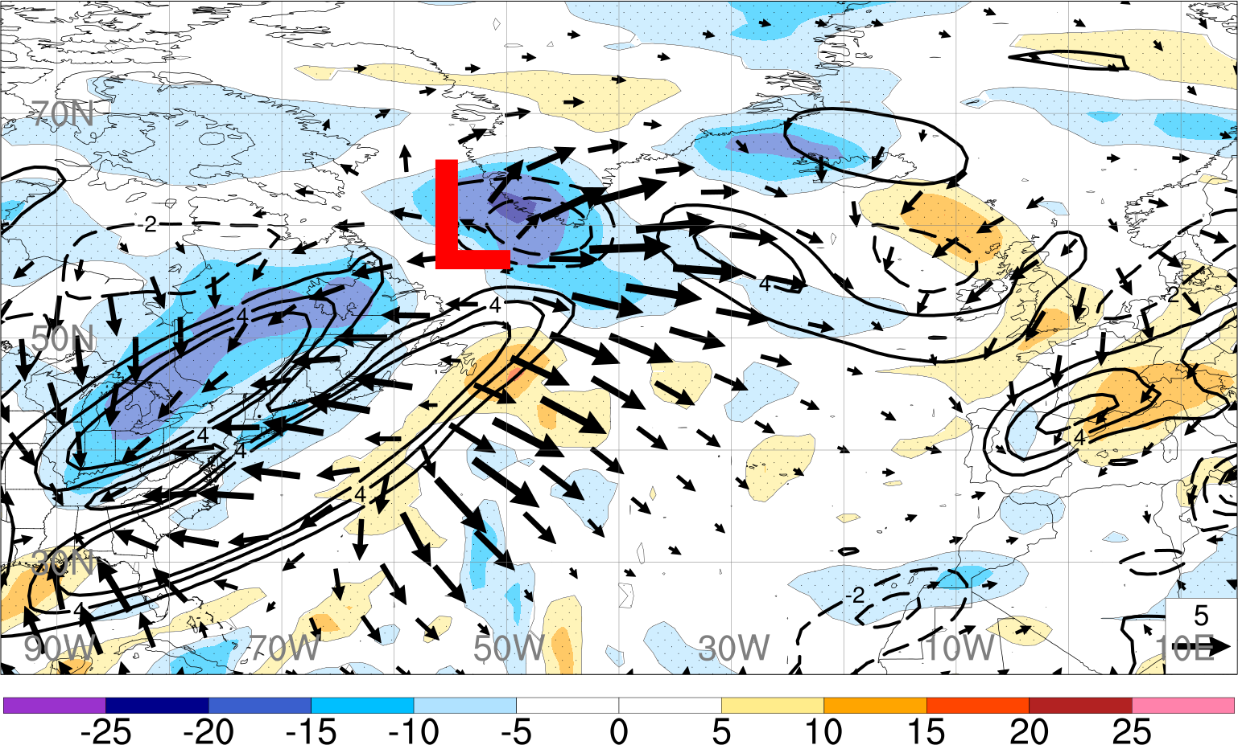
Sensitivity to PV Advection by Irrotational Wind
132 h
Notes:
Mention “2 days prior to forecast metric (144 h)”

Slide 22
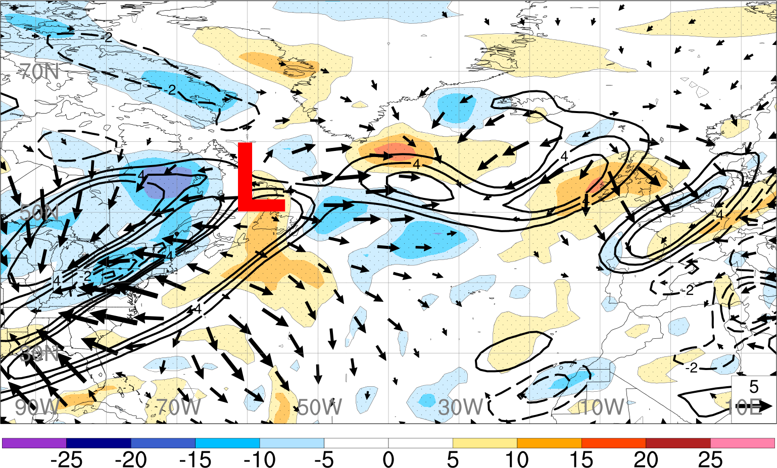
Sensitivity to PV Advection by Irrotational Wind
120 h
Little sensitivity prior to 120 h
Question:
What precedes uncertainty in PV advection by irrotational wind?
Notes:
Mention “2 days prior to forecast metric (144 h)”

Slide 23
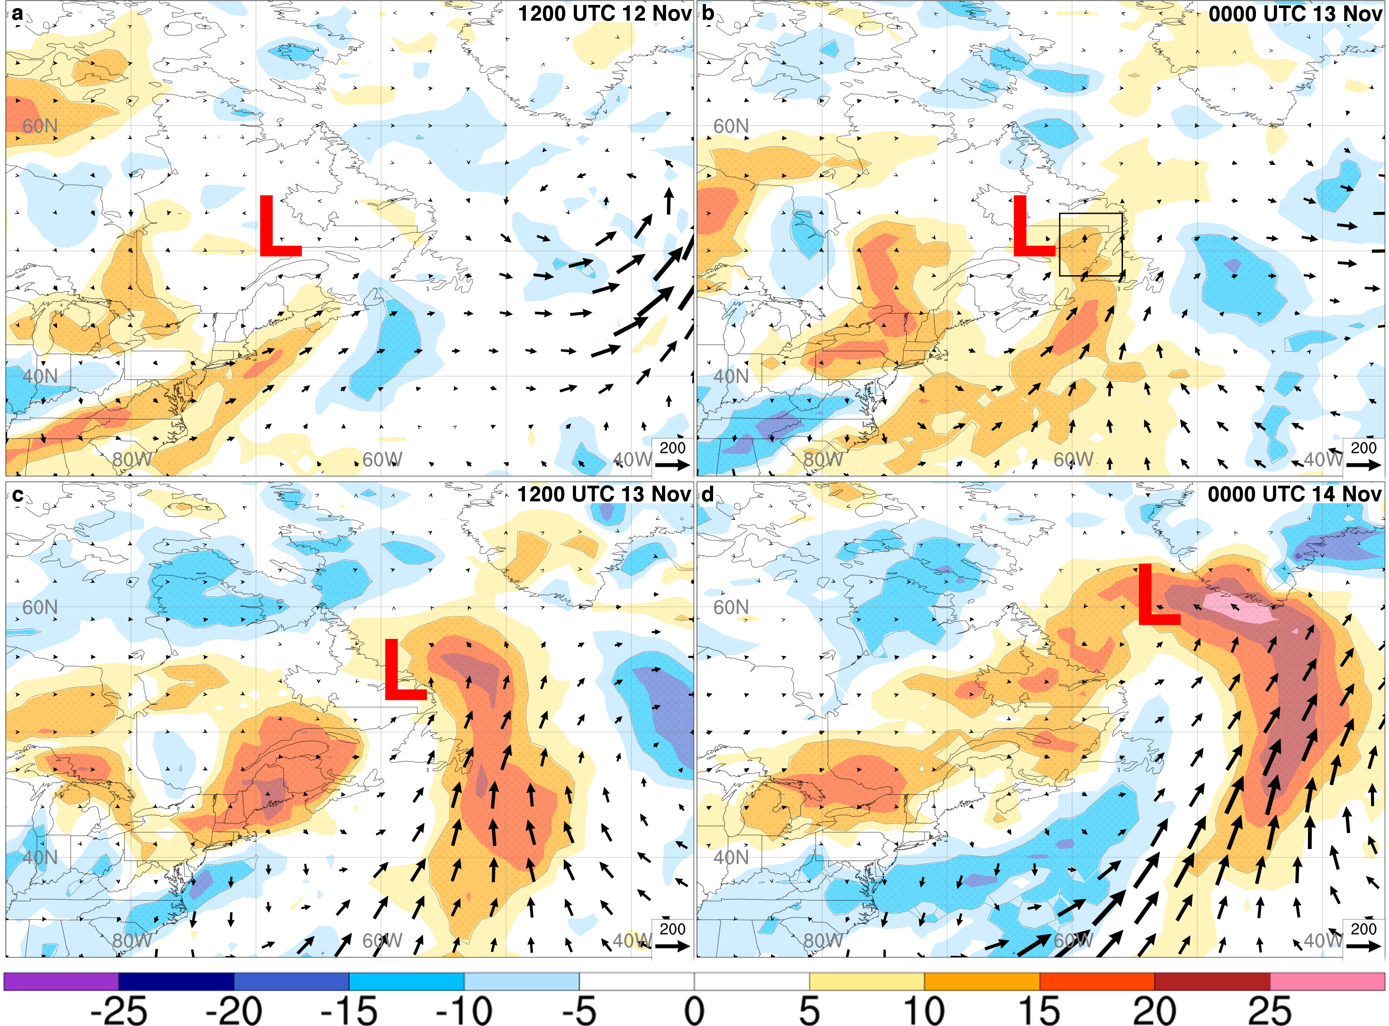
Sensitivity to 850—1000 hPa Integrated Vapor Transport
84 h
96 h
Stronger southerly transport of moisture
108 h
120 h
*Stronger WCB*
Notes:
Mention “2 days prior to forecast metric (144 h)”

Slide 24
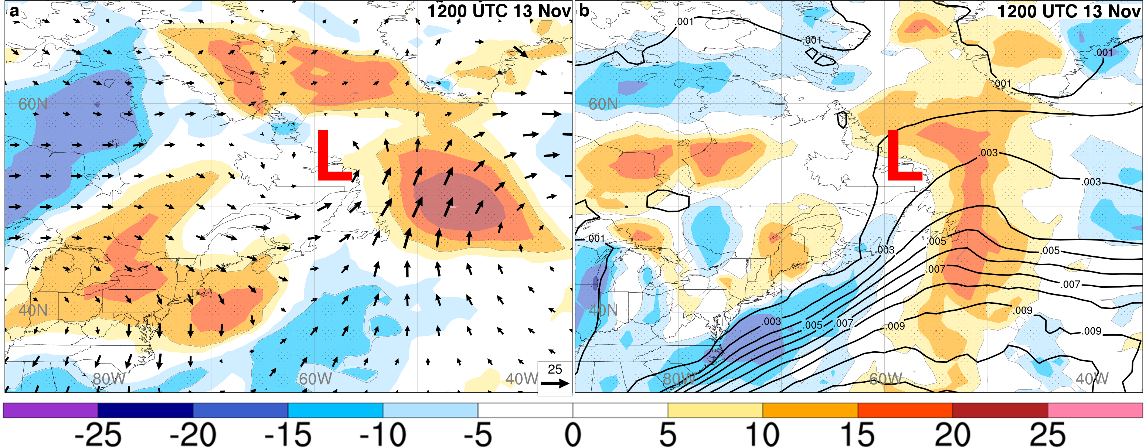
Sensitivity to lower-level fields
850—1000 hPa Meridional Wind
850—1000 hPa
Specific Humidity
120 h
120 h
Both stronger southerly flow and moisture east of cyclone
Notes:
Mention “2 days prior to forecast metric (144 h)”

Slide 25
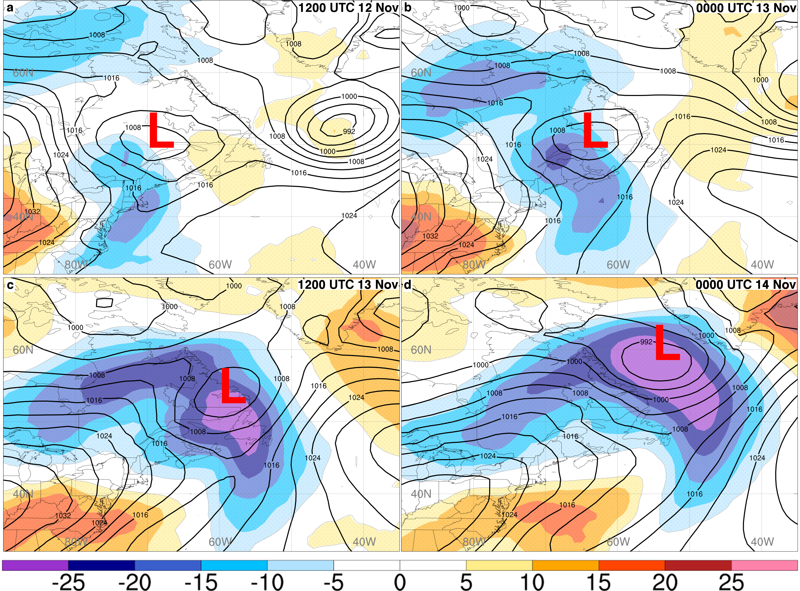
Sensitivity to MSLP
84 h
96 h
Traced to pressure trough along cold front
108 h
120 h
Proposed mechanism:
stronger pressure trough ->
stronger southerly moist transport ->
deeper cyclone
Deeper cyclone at 120 h = greater ridge amplitude

Slide 26
Summary and Conclusions
Forecast variability in the upper-level ridge
Isolate amplitude variability using EOF analysis
144 h Ridge amplitude uncertainty traced to 108 h
Nonlinear growth in ridge amplitude uncertainty; uncertainty in position of upstream trough
  Ridge amplitude sensitive to the PV advection by irrotational wind downstream of cyclone (up to 24 h prior)
What is the source of uncertainty prior to 120 h?
Ridge sensitive to strength of WCB (southerly moist flow)
Stronger southerly moist flow east of cyclone associated with greater ridge amplitude
Greater moisture allows for greater moisture convergence and latent heat release → stronger PV advection by irrotational wind
Stronger southerly flow not just stronger cyclone; preceded by stronger pressure trough to it’s south
Ridge errors not solely advective; they amplify in concert with WCB errors. Better assimilation of observations in upstream WCB could lead to improved forecasts downstream
Notes:
Say: westward shift in cyclone associated with not only a westward shift in the WCB, but also stronger WCB
Take Home message: Amplitude errors are not just advective; they are due to WCB processes!
We’ve seen sensitivity to pressure trough in ECMWF case study (include in extra slides?)

Slide 27
End
Notes:
490 mm = 19.2 inches.
Over $5 billion dollars in damages
18 people dead. Thousands homeless.
Winds up to 75 mph; some areas saw 17 inches of rain in 1.5 h

Slide 28
Extra Slides
Notes:
490 mm = 19.2 inches.
Over $5 billion dollars in damages
18 people dead. Thousands homeless.
Winds up to 75 mph; some areas saw 17 inches of rain in 1.5 h

Slide 29
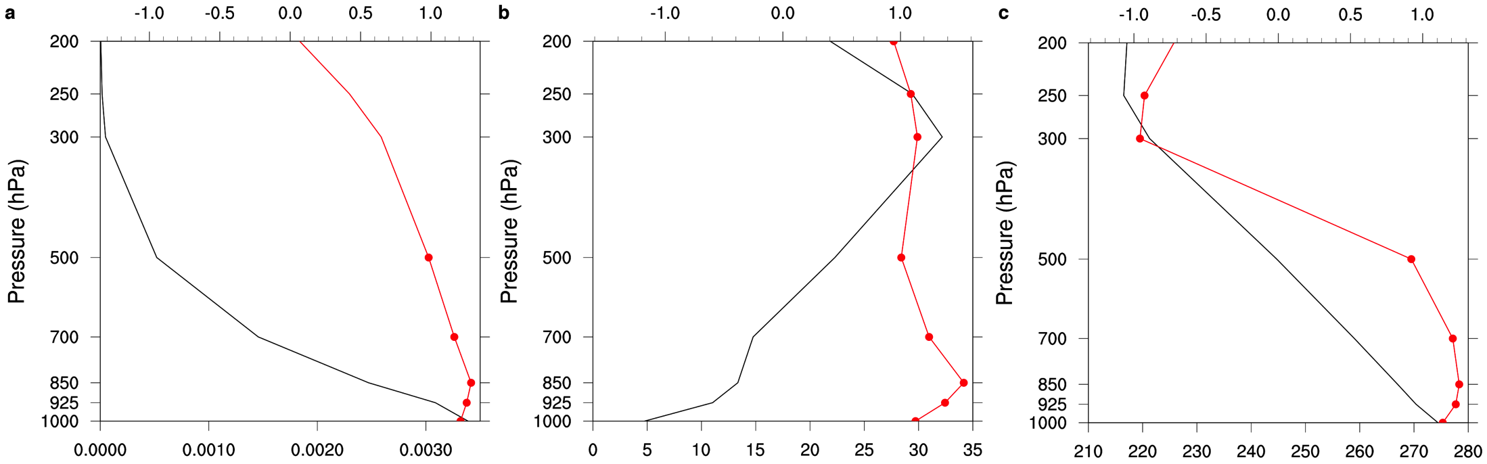
Composite Difference: WCB Profile valid 0000 UTC 13 Nov 2013
Normalized composite difference (red line; top x-axis) and ensemble-mean (black line, bottom x-axis)
Water Vapor
Meridional Wind
Temperature
t_{max} – 36 h
Higher: water vapor mixing ratio (a), meridional wind (b), and temperature (c)
=
Stronger WCB
Notes:
Convergence of IVT is proportional to latent heat release. This is related to the meridional transport of moisture associated with the WCB.
*Note: zoom in more on the IVT composite difference plots*

Slide 30
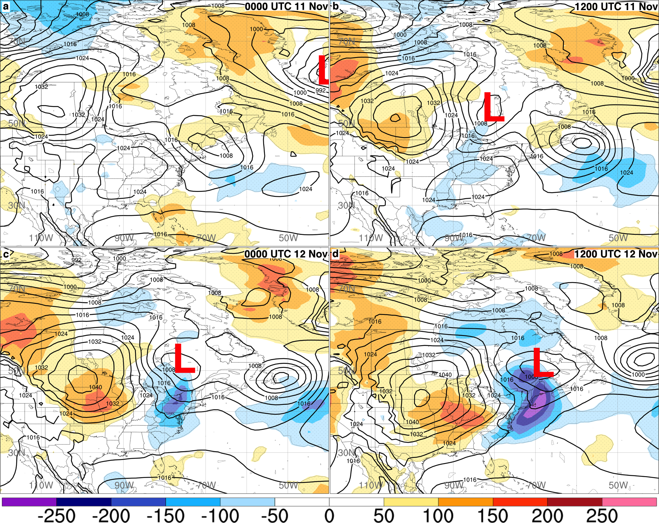
Sensitivity of MSLP Metric to MSLP
60 h
72 h
84 h
96 h

Slide 31
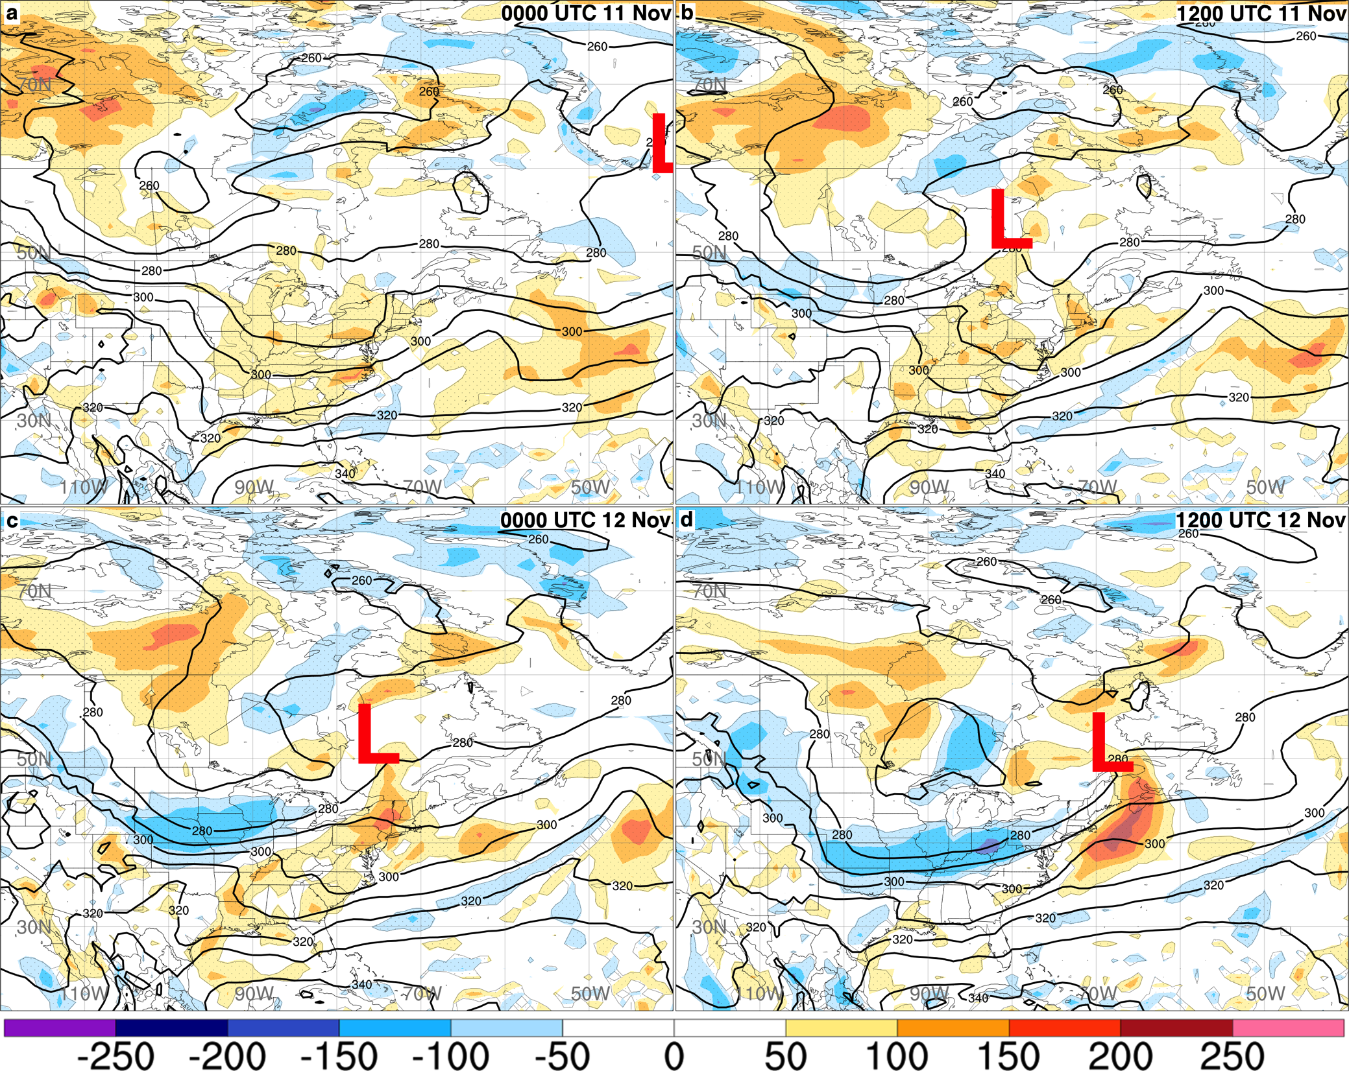
Sensitivity of MSLP Metric to 850—1000 hPa θ_{e}
60 h
72 h
84 h
96 h

Slide 32
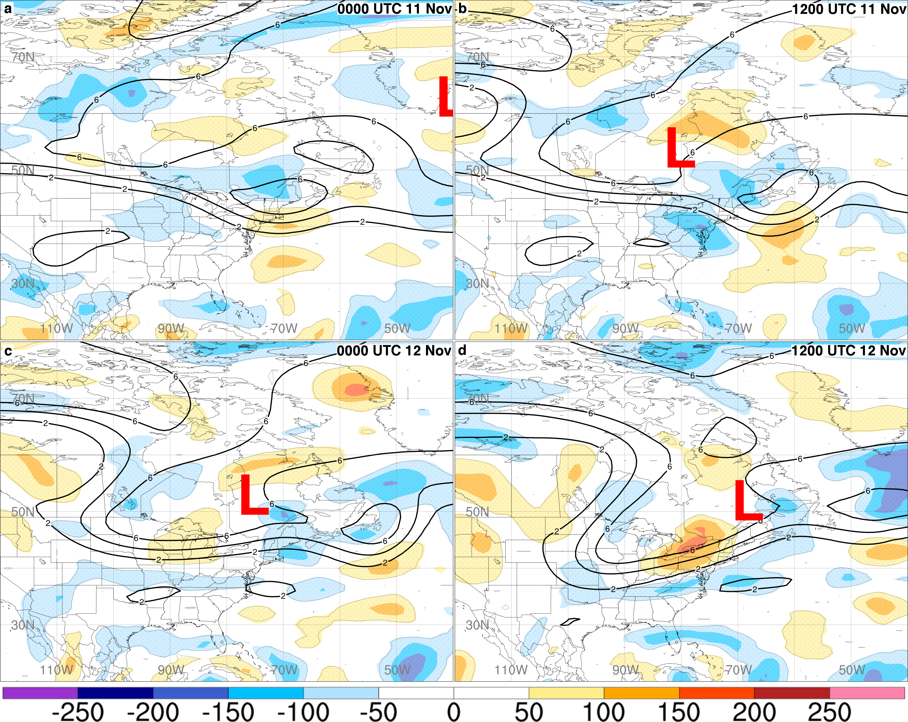
Sensitivity of MSLP Metric to PV
60 h
72 h
84 h
96 h

